Slide 1

Stock Price Prediction
Made by : Reema Gupta

Slide 2
TABLE OF CONTENTS
01
02
03
INTRODUCTION
ABOUT EXPEDIA
PROBLEM STATEMENT
04
05
06
PROCESS FLOW
RNN MODELS
CONCLUSION

Slide 3
INTRODUCTION
A stock market is a public market where you can buy and sell shares for publicly listed companies. The stock exchange is the mediator that allows the buying and selling of shares.
Stock Price Prediction using machine learning helps you discover the future value of company stock.
Notes:
The entire idea of predicting stock prices is to gain significant profits.

Slide 4
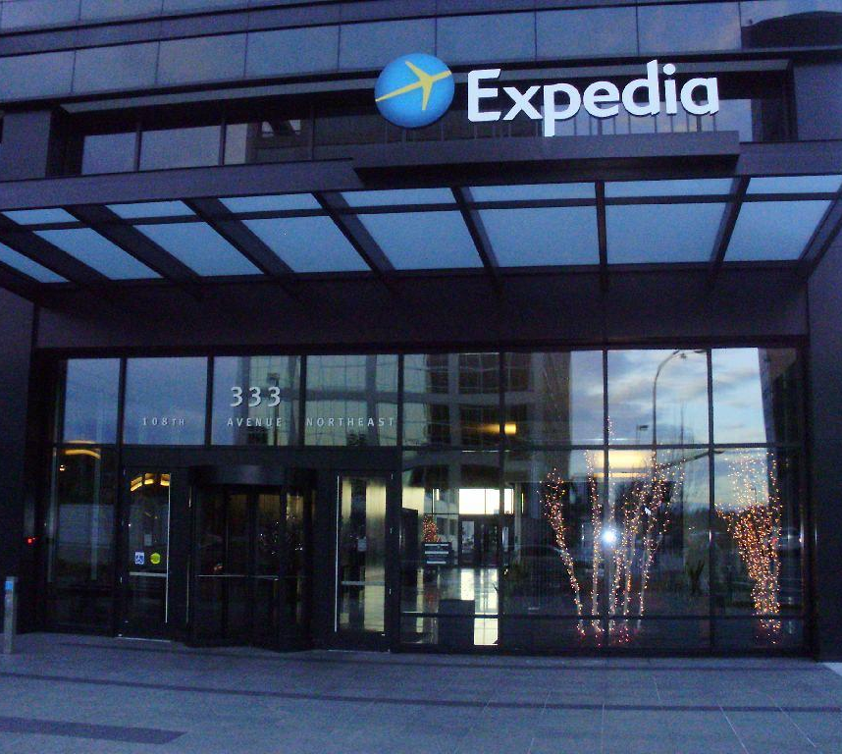
ABOUT
EXPEDIA

Slide 5
Launched in 1996, Expedia is world’s leading online travel booking system, and by far the largest travel agency in the US.
On November 10, 1999 Expedia announced the Initial public offering of its common stock on the Nasdaq National Market under the trading symbol EXPE.
Before COVID-19, travel and tourism industry had become one of the most important sectors in the world economy, but in the wake of pandemic, very few industries have
fallen as far and as fast as tourism.
The pandemic hit the travel giant Expedia hard as it saw its First Revenue Decline in Eight Years, where in revenue dropped by 57%. The company posted a loss in each quarter of 2020 after three consecutive profitable quarters in 2019.
Net loss attributable to the company was $412 million, or $2.89 per share, in the quarter ended Dec. 31, compared with a profit of $76 million, or 52 cents per share, a year earlier.

Slide 6
PROBLEM STATEMENT
To minimise the difference between the predicted and true value of stocks
To accurately predict the future High price of Expedia stock for a given period of the time by using use Deep learning models.

Slide 7
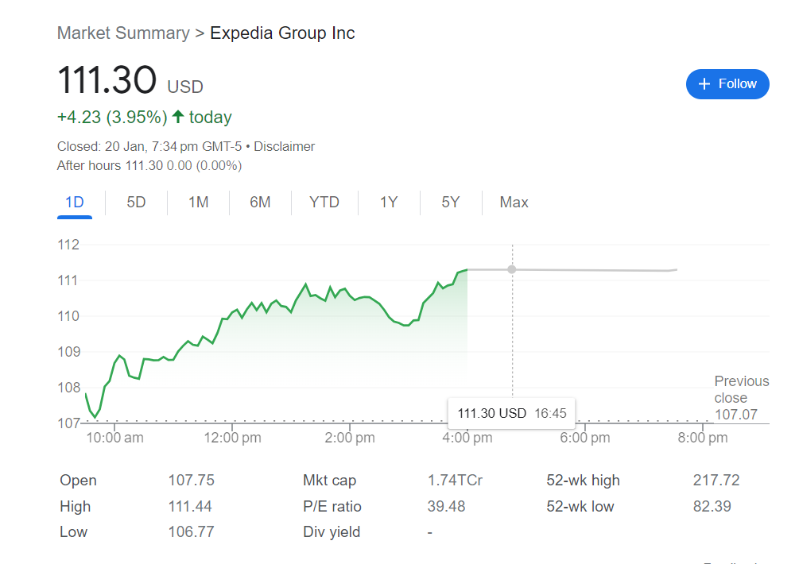
Dataset
The data used in this project consists of the historical stock prices of EXPD obtained via Yahoo Finance.
Dataset contains the following variables; Open, High, Low, Close, Adjusted Close and Volume.
Dataset contains 4402 rows and 6 columns.
Date range is from July 2005 to January 2023.
There are no null values in the data.

Slide 8
FEATURES
Open
High
Close
Low
Volume
Adj
close
Opening price of stock at that date
Highest price of stock at that date
Closing price of stock on the day
Lowest price of stock on the day
Volume of traded stocks
Refers to the closing price after paying off the dividends

Slide 9
Process
Flow

Slide 10
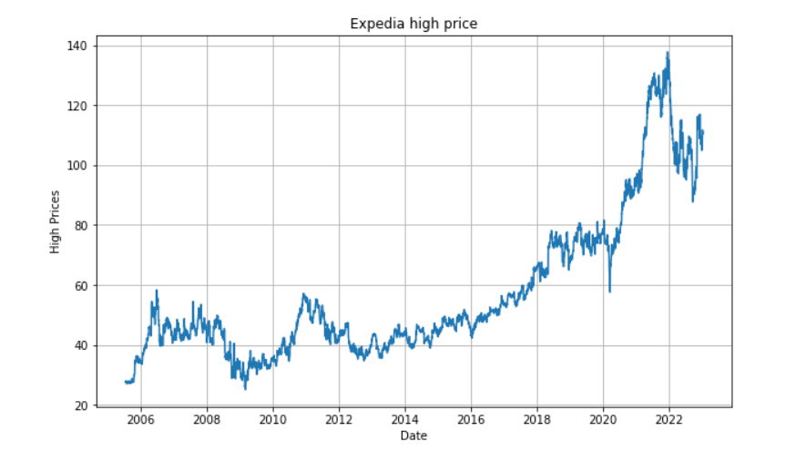
After loading the dataset we visualize our stock’s daily high price.
Sudden fall in stock after 2019 justifies the effect of COVID 19.

Slide 11
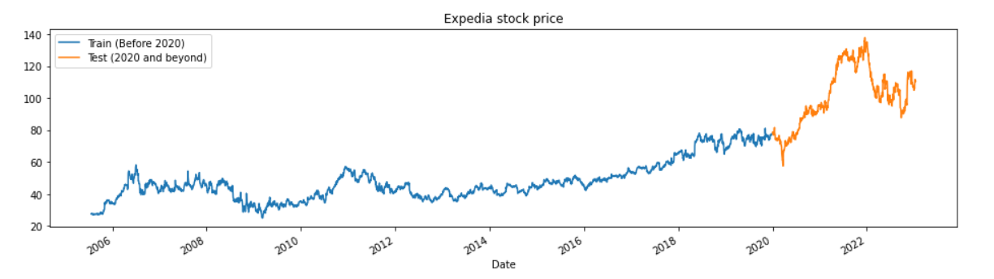
Train Test Split
Train Set : Date Range (2005-2020)
Test Set : Date Range (2020-2023)

Slide 12
Scaling and Creating Train Data Structures
The next step was scaling for normalizing the dataset, min max scalar was used for that.
Then a function was created for splitting the sequence of the input.
Number of steps=30
So, it will consider 30 data points as input and predict the consequent data points as output . The process continues for the entire sequence.
The split sequence function is used to divide the historical stock price data into smaller chunks, which are fed into the RNN model one at a time. This helps the model learn and identify patterns in the data that may be relevant for making predictions.
The Data was then reshaped in order to use it for model application.
Notes:
Scales the data between 0 and 1, the pattern and trends in data become more visible and easier to interpret(may not always have normal distribution)(data is conentray=ted around mean in normal distribution
The split sequence function is used to divide the historical stock price data into smaller chunks, which are fed into the RNN model one at a time. This helps the model learn and identify patterns in the data that may be relevant for making predictions.

Slide 13
RNN Model Application
Bidirectional LSTM
LSTM
GRU
Long Short Term Memory Network (LSTM)
Bidirectional Long Short Term Memory Network
Gated recurrent units

Slide 14
LSTM MODEL
LSTM is a type of recurrent neural network (RNN) architecture used for sequence prediction tasks.
It uses memory cells and gating mechanisms to selectively remember or forget information from previous timesteps.
The LSTM architecture includes input, forget, and output gates, which control the flow of information in and out of the memory cell.

Slide 15
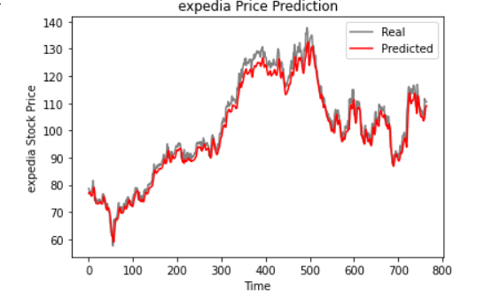
The Sequential() function in Keras is used to create a sequential model, to which LSTM layers can be added using the LSTM() function.
The return_sequences=True argument is used to specify that the LSTM layer should output a sequence rather than a single value.
The final output is generated using a dense layer with a single unit and linear activation function.
The model is compiled using the compile() function, with the Adam optimizer and mean squared error (MSE) loss function.
The model is trained using the fit() function.
The predicted values can be obtained using the predict() function.
The model is evaluated using the using RMSE
As you can see above, the model can predict the trend of the actual stock prices very closely.

Slide 16
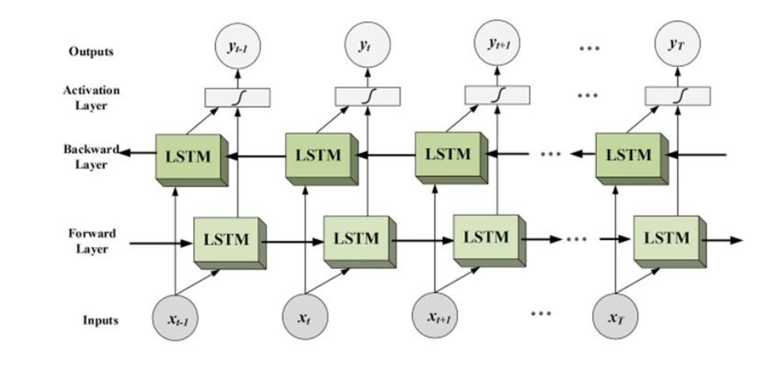
BIDIRECTIONAL
LSTM
With the regular LSTM, we can make input flow in one direction, either backwards or forward. However, in bi-directional, we can make the sequence information flow in both directions to preserve the future and the past information.

Slide 17
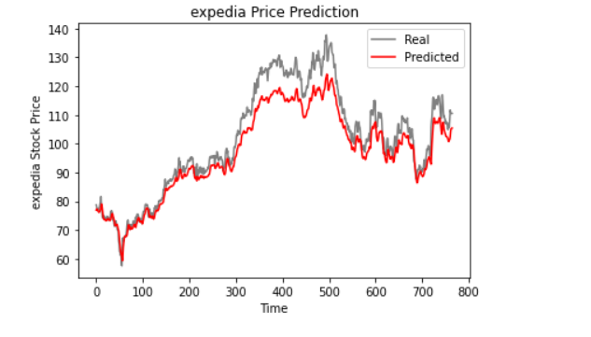
The Bidirectional() function in Keras is used to create a bidirectional layer, to which LSTM layers can be added using the LSTM() function.
The outputs of the forward and backward LSTM layers are concatenated and fed into a dense layer for final prediction.
The model is compiled and trained in the same way as the standard LSTM model.
We got a higher RMSE then LSTM model.

Slide 18
GRU Model
GRU is a type of RNN architecture that is similar to LSTM, but with fewer gates.
It uses memory cells to remember previous information, and includes reset and update gates that control how much of the previous memory cell should be forgotten and how much of the new input should be used to update the memory cell.
Notes:
This is really powerful because the model can decide to copy all the information from the past and eliminate the risk of vanishing gradient.
in short, it decides whether the previous cell state is important or not.

Slide 19
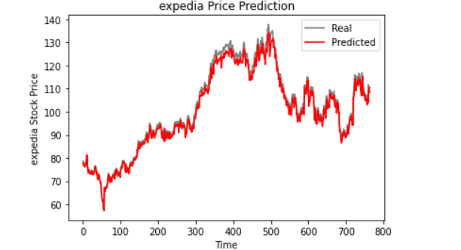
The GRU architecture can be built using the GRU() function in Keras, similar to the LSTM architecture.
The final output is generated using a dense layer with a single unit and linear activation function.
The model is compiled using the Adam optimizer and MSE loss function, and can be trained and evaluated in the same way as the LSTM model.
On evaluation, the rmse obtained was lower than the other two models.
The difference between the predicted and true value of stocks is also low, as seen from the graph.

Slide 20

CONCLUSION
Based on the analysis conducted on the stock price dataset, it was found that the GRU model achieved the lowest mean squared error among the models that were evaluated. It was relatively fast in terms of training/fitting, time and complexity.

