Slide 1
Stock Price Return and Volatility Analysis
 | Reema Gupta

Slide 2

Problem Statement & Project Overview
A Beginner investor wants to analyze Indian IT stocks using SQL and Python.
Goals:
Identify risk (volatility)
Measure growth (returns)
Recommend best stock – performing stock
Approach:
SQL → Data extraction
Python → Cleaning + Analysis
Visualization → Insights

Slide 3

Data Pipeline & Preprocessing
Data Source:
SQL → Python (Jupyter)
Preprocessing Steps:
Data Definition
Merge datasets
Convert Date → datetime
Handle missing values
Handle Datatype mismatch
Remove duplicates
Sorting
Multi-index (Company, Date)

Slide 4

Analytical Framework
Time-Based Analysis:
Short-term: Monthly / Quarterly
Long-term: 1–5 years
Metrics:
Daily Return → momentum
Volume → liquidity
Close Price 🡪 Adjusted Price
Key Concept:
252 trading days/year

Slide 5
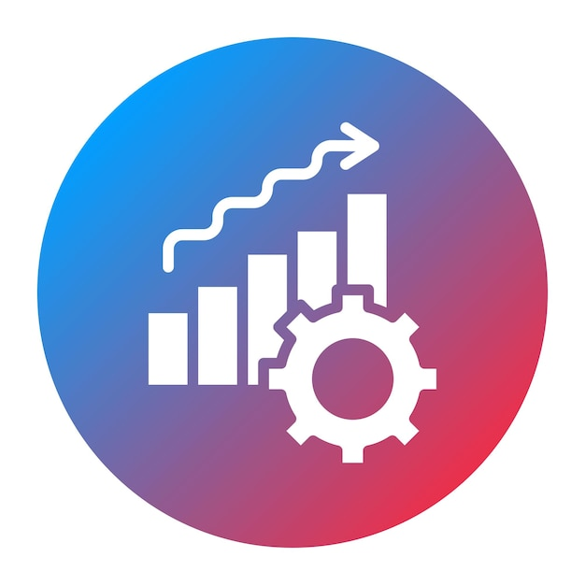
Risk and Performance Metrics
Metrics:
Annual Return
Volatility (Risk)
Concept:
Volatility = std * √252
Moving Average:
Smooths noise
Shows trend
Interpretation:
Higher volatility indicates higher risk

Slide 6

Company-wise Analysis
Insights:
Low risk (stable)
Balanced growth/Moderate
High risk
Factors:
Price Trend
Returns
Consistency
Time-based behavior

Slide 7

Comparative Analysis
Factors:
Return comparison
Stability comparison
Growth comparison
Relative performance
Observations:
Sector recovery trend
Short-term correlation high
Long-term variation
Concept:
Risk vs Return trade-off

Slide 8

Visualization
Return and Volatility Analysis
Daily
Weekly
Monthly
Annualy
Cummulative
Charts/Plots used:
Line Chart
Bar Chart
Candle Light
Histogram
Scattered Plot

Slide 9
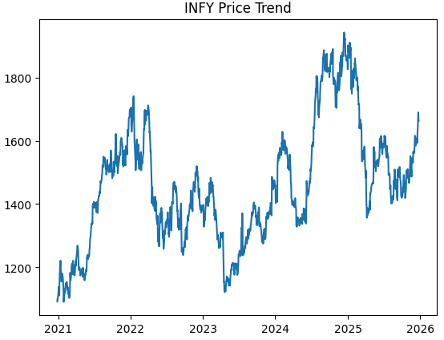
Return Analysis

Slide 10
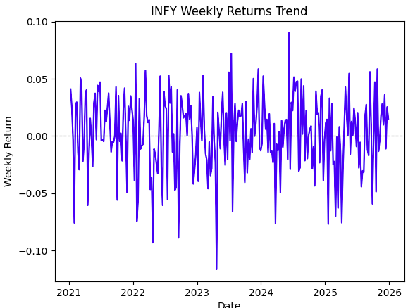
Return Analysis

Slide 11
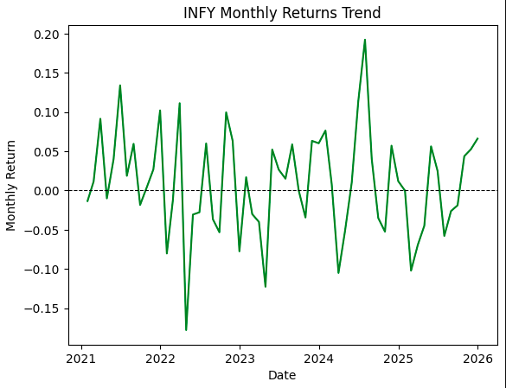
Return Analysis

Slide 12
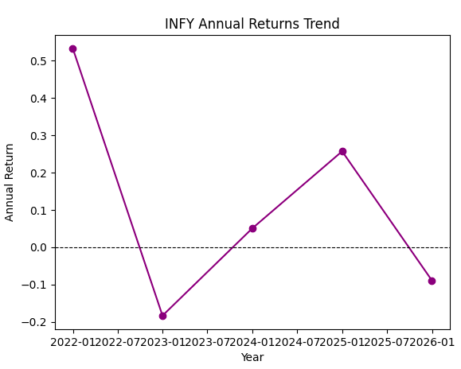
Return Analysis

Slide 13
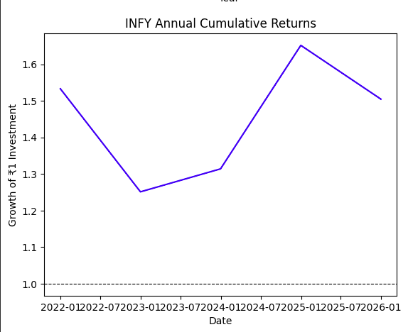
Return Analysis

Slide 14
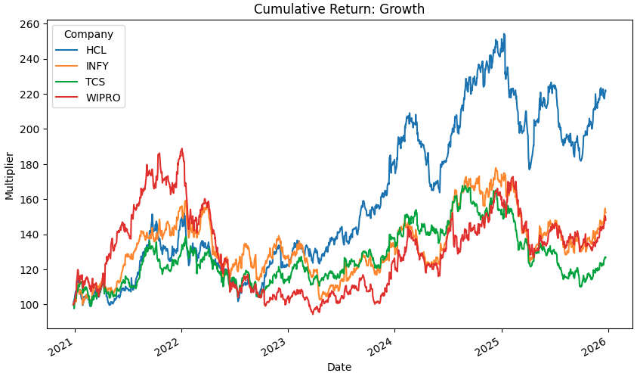
Return Analysis

Slide 15
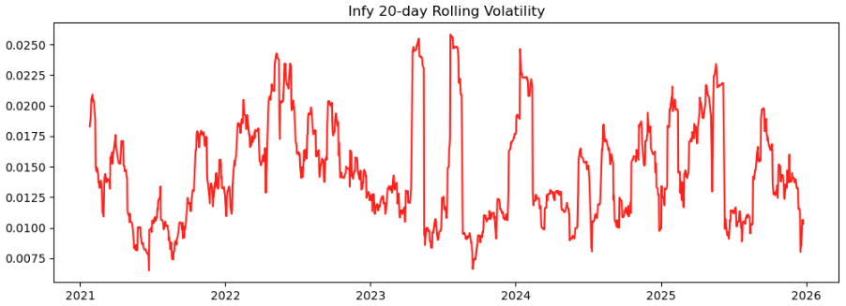
Volatility And Risk Analysis

Slide 16
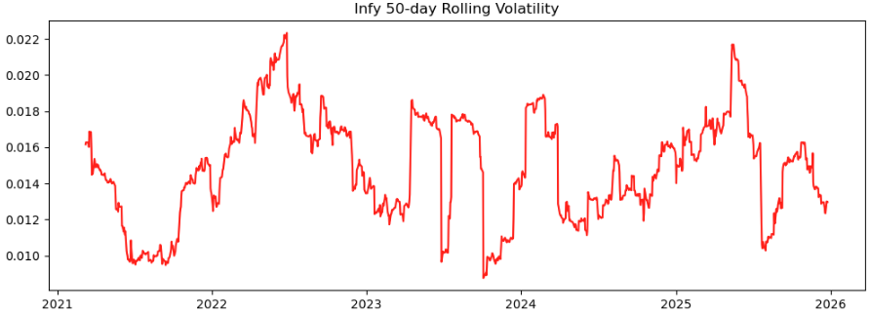
Volatility And Risk Analysis

Slide 17
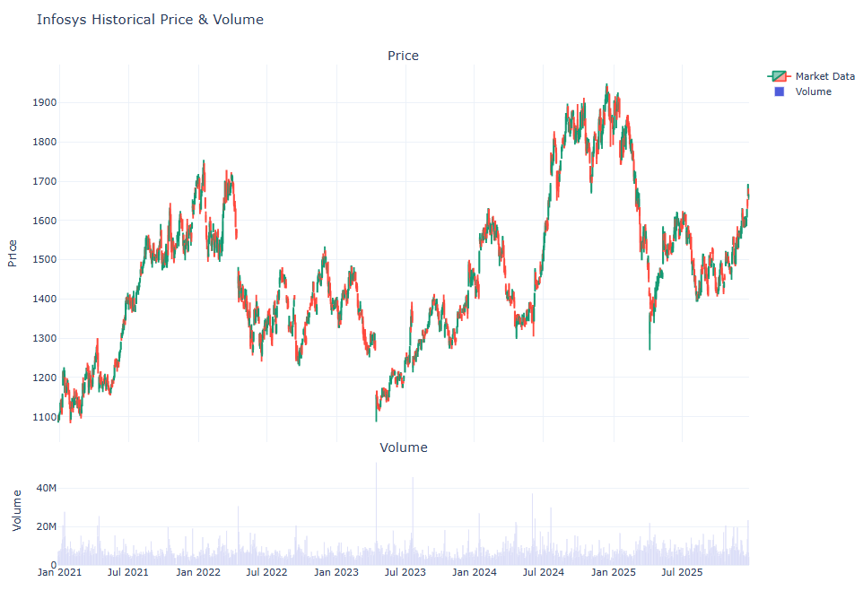
Volatility And Risk Analysis

Slide 18
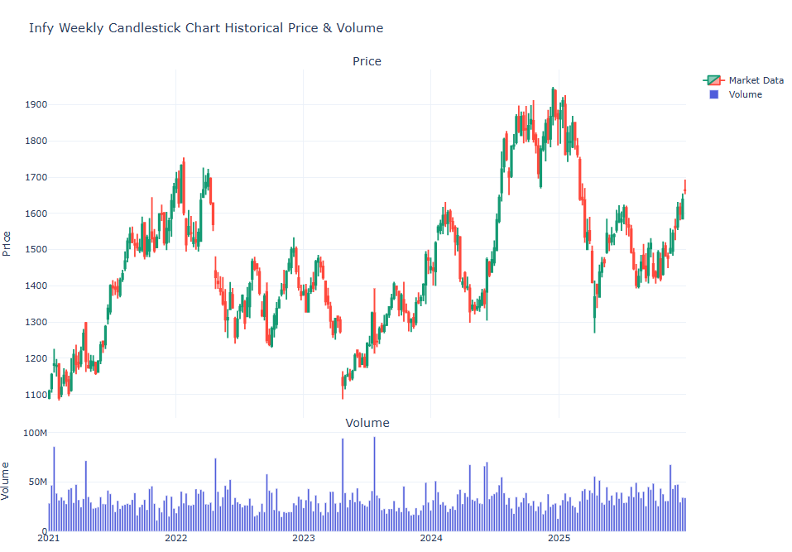
Volatility And Risk Analysis

Slide 19
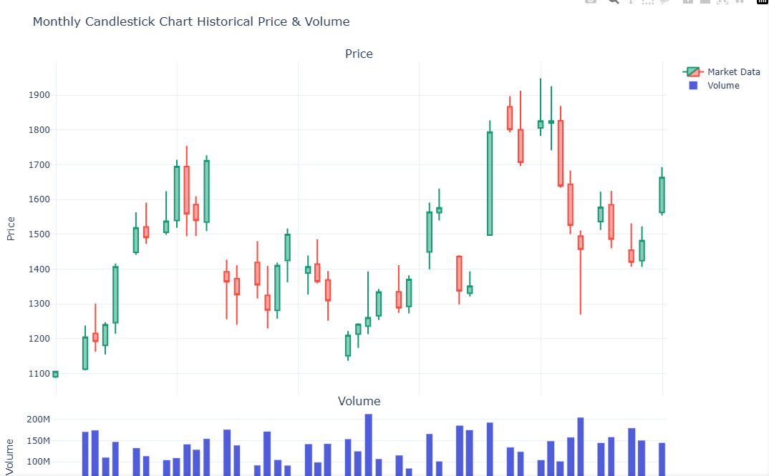
Volatility And Risk Analysis

Slide 20
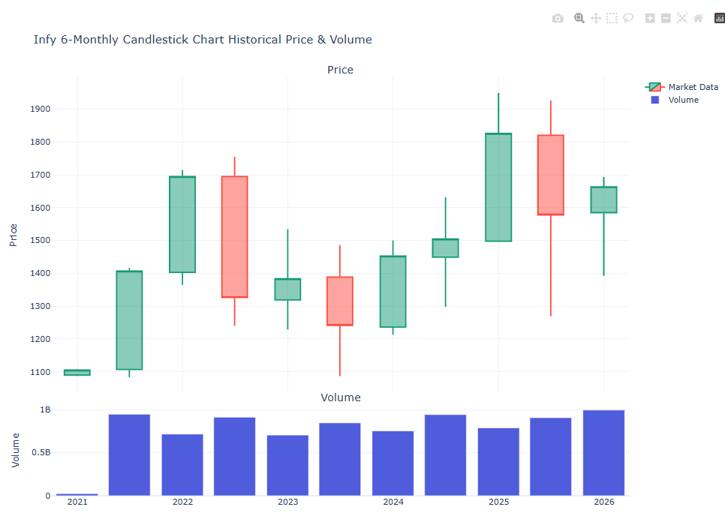
Volatility And Risk Analysis

Slide 21
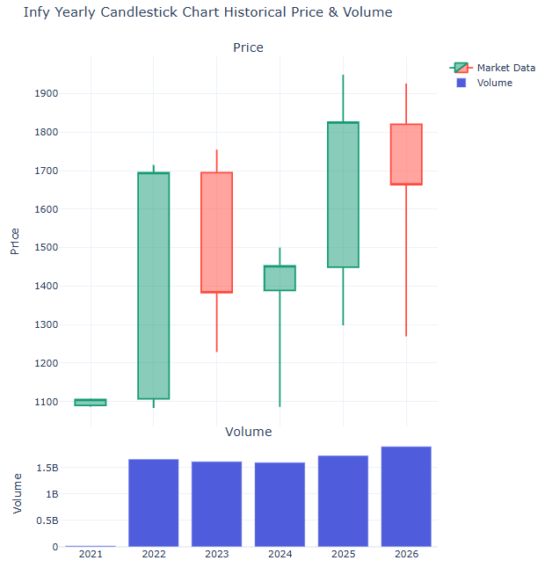
Volatility And Risk Analysis

Slide 22
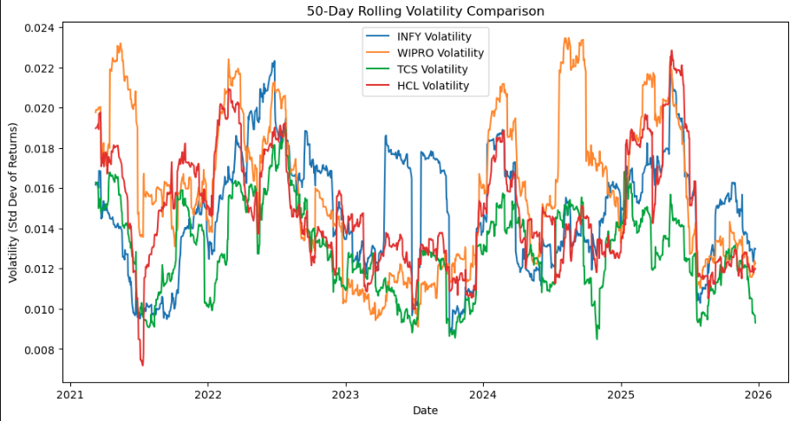
Volatility And Risk Comparison

Slide 23
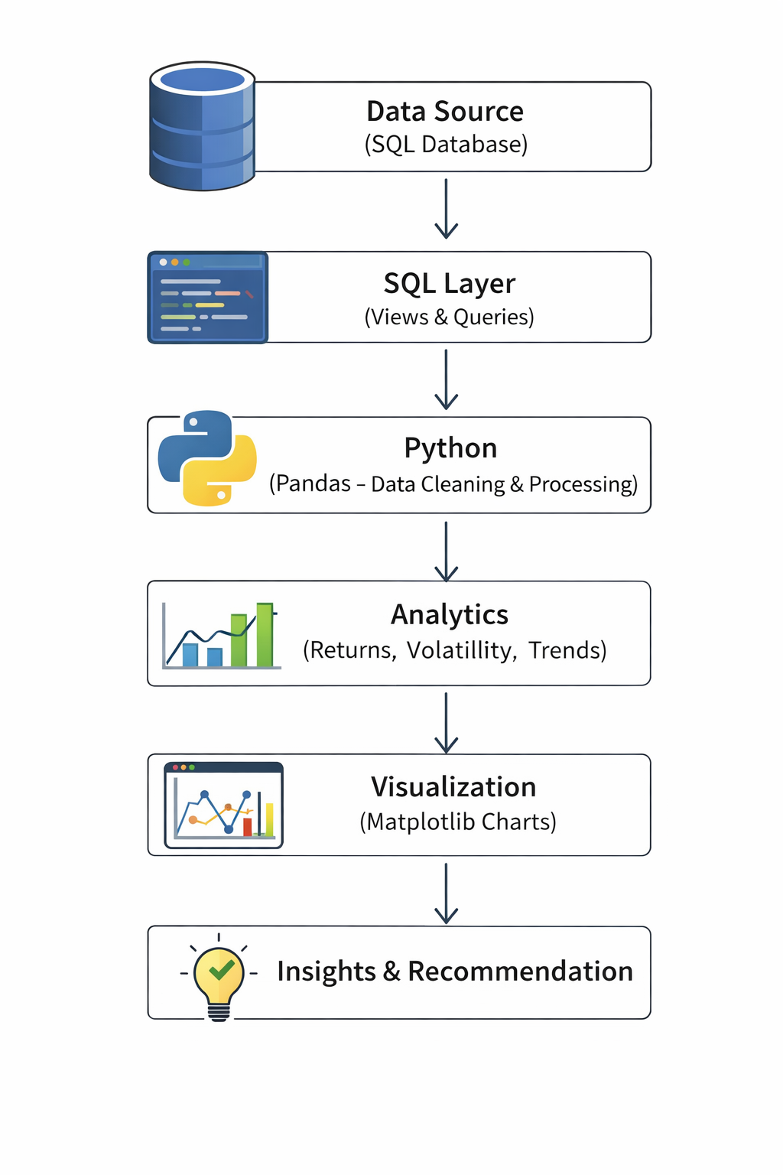

Data to Insights - Pipeline

Slide 24

Conclusion
Data-driven stock analysis improves decision-making Python + SQL enable efficient data processing and insights
TCS: Stable & low risk
Infosys: Balanced growth
Wipro: Higher risk, higher fluctuation
HCL: Highest risk-adjusted return
Our Visualizations simplify complex financial insights.

Slide 25
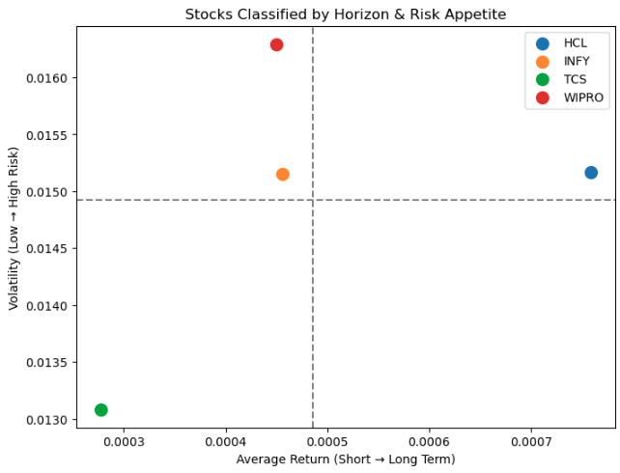
Conclusion

Slide 26
Credits
Mr. Manvindar Singh
Mr. Vinay

