Slide 1
HEALTHY FOOD CART
REEM ALHARBI 202022306
FUNDAMENTALS OF WEB DESIGN

Slide 2
About My Website
TABLE OF CONTENTS
HTML
03
Html files for my website
CSS
01
What is my website and why did I choose this topic
04
Css files for my website
Page Layout
Java
02
The page layout of my website
05
Java files for my website

Slide 3
Healthy Food Cart
01
Easy to use Website that motivates users to eat more healthy by helping them calculate the average calorie intake of the most popular foods and snacks.

Slide 4
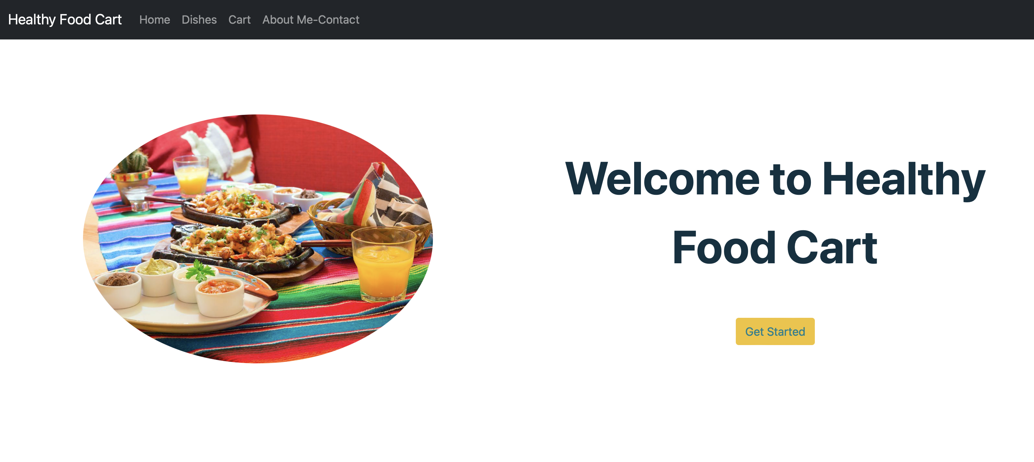
PAGE LAYOUT
Home Page

Slide 5
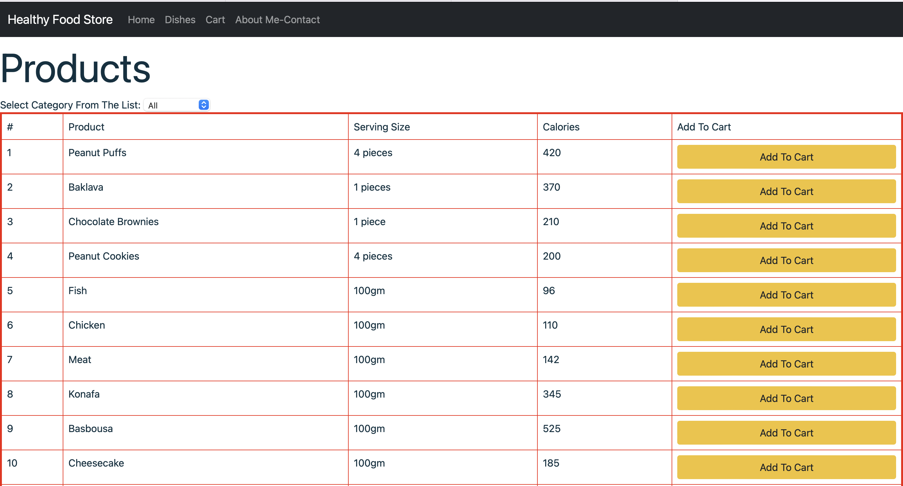
PAGE LAYOUT
Dishes page

Slide 6
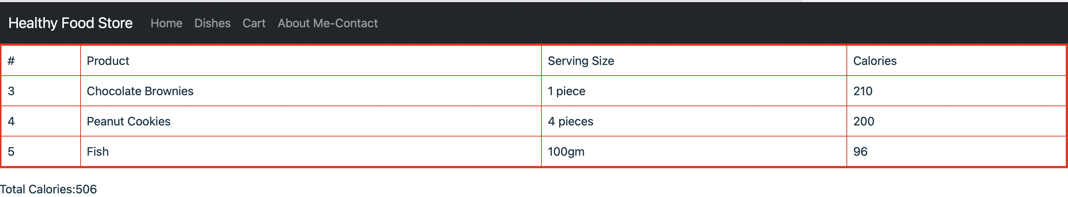
PAGE LAYOUT
Cart page

Slide 7
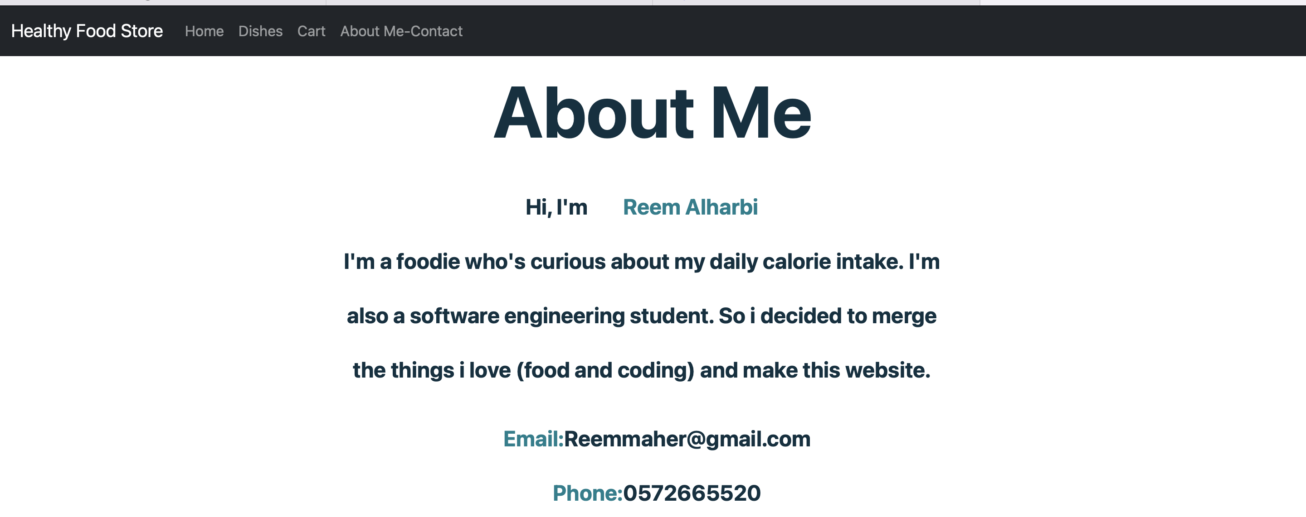
PAGE LAYOUT
About Me-Contact Page

Slide 8
HTML
HOME PAGE
DISHES PAGE
“WELCOME TO MY HEALTHY CART”
TABLE THAT CALLS JAVASCRIPT
CART PAGE
ALL PAGES
CALL TABLE FROM JAVA
Navigation bar

Slide 9
CSS
Width
Margin
Used in: index.page
Used in: Index.page
Boarder Radius
Color
Used in: index.page
Used in: index.page,About-me
A
Font-Size
Font-weight
Used in: index.page,About-me
Used in: index.page,About-me

Slide 10
Java
Var Categories
Var Products
Includes: Id, Cat (Category)
Includes: Id, Prod, Serving, Calories, Cat_Id
Loop
Menu
To view added dishes in cart
Separate Dishes by Categories
Function addToCart(event){
Loop
Adds dish to cart
To calculate the total calorie

Slide 11
Website Process
Desired Dishes The User Chose
Peanut Cookies | 4 pieces | 200 Calories | Added to Cart
Fish | 100gm | 96 Calories | Added to Cart
Get Started Button
Total Calories Calculated
User Adds Desired Dishes
Dishes Page
Cart Page
Index-Page

