Slide 1


NATURAL
LANGUAGE
PROCESSING
IN
HEALTH CARE
By: Reema Ratnani

Slide 2
Context
Natural Language Processing or NLP is a field of Artificial Intelligence that gives the machines the ability to read, understand and derive meaning from human languages.
In this Project NPL is utilized to develop a text-based classification algorithm that can use a knowledge base to learn and classify the genetic mutations automatically.
An attempt was made to answer questions through exploratory data analysis and explore cancer gene mutation dataset with an interactive dashboard.

Slide 3
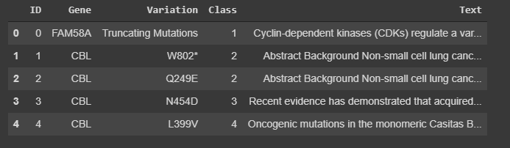
Dataset

Slide 4
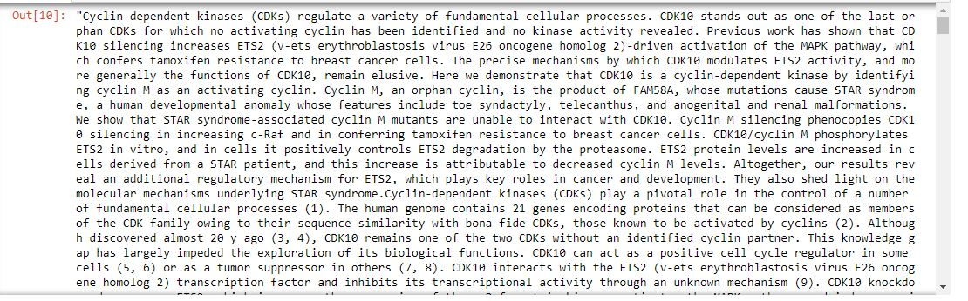
Text Sample

Slide 5
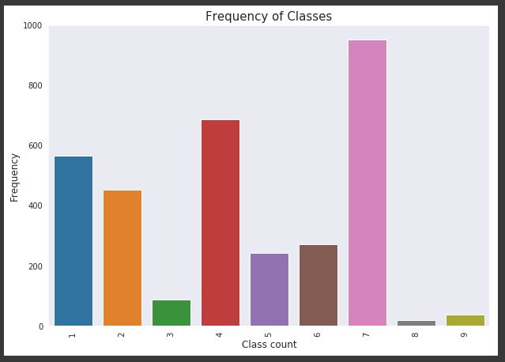
Data Analysis
Identify the unique target classes and their proportion in the train data

Slide 6
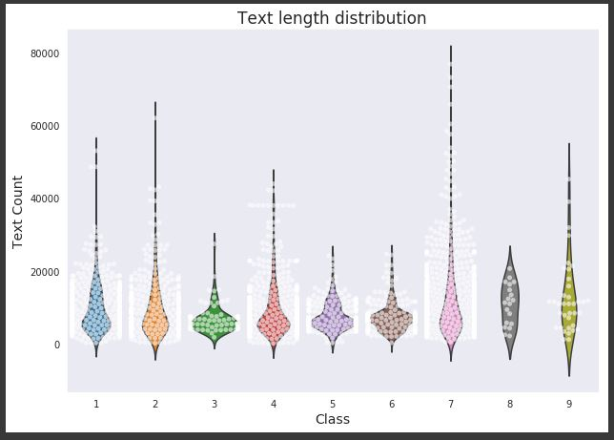
Data Analysis
All classes have most counts in between 0 to 20K.
Length could be useful to discriminate some of the classes 3, 6 from others.

Slide 7
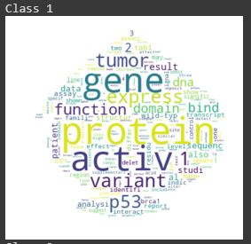
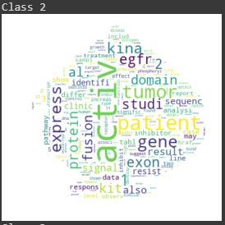
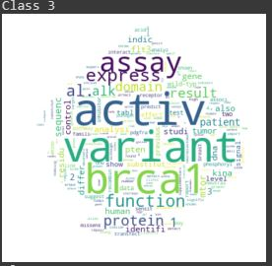
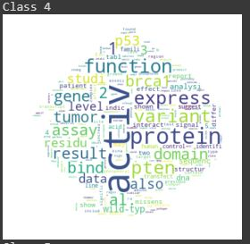
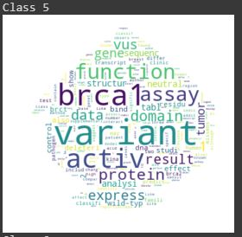
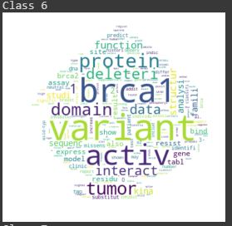
Data Analysis

Slide 8
Data Processing
Tokenization
Stemming : Bringing word back to its original form
Lemmatization: Grouping the different forms of a word into a single token
Stop word removal
Count Vector : Bag of words
Term Frequency – Inverse Document Frequency(tfidf): Reduces the importance of commonly occurring word

Slide 9
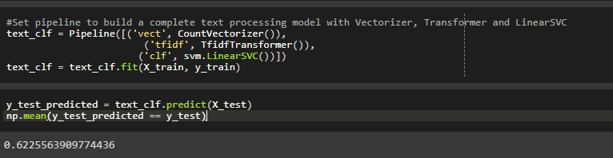
Classifier

Slide 10
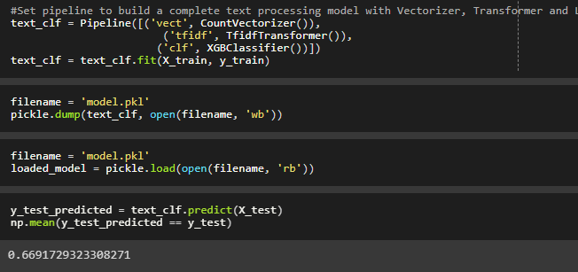
Classifier

Slide 11
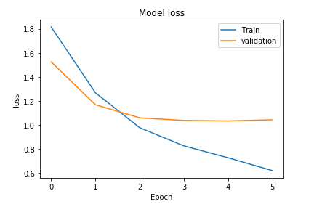
Keras-LSTM Model

Slide 12
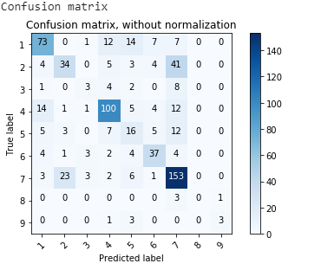
Keras-LSTM Model

Slide 13
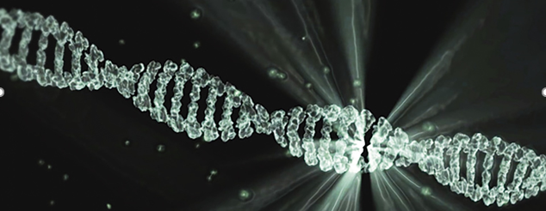
Project Link

Slide 14

Discussion
This Photo by Unknown Author is licensed under CC BY-SA

