Slide 1
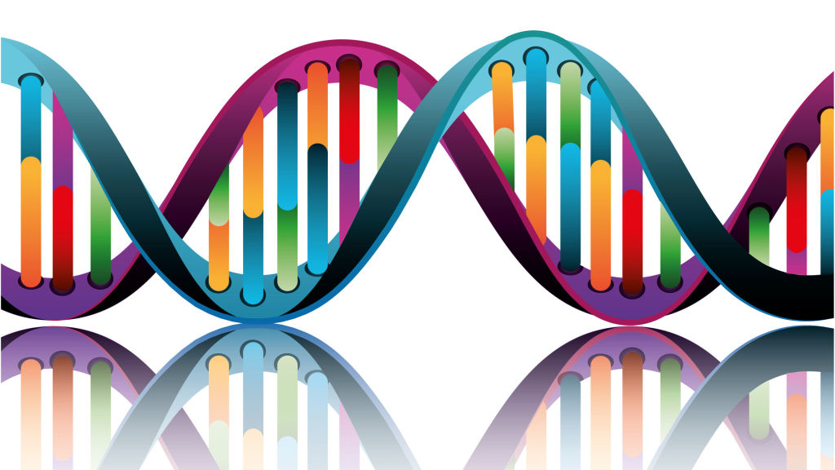

PRECISION MEDICATION
By: Reema Ratnani

Slide 2
Background
Cancer is complex, for example ovarian cancer itself is not one single disease. Thus, one treatment can not be use for all patients.
Every tumor is different due to the DNA changes(mutations) in that tumor.
Tailoring medical treatment to the individual characteristics of each patient’s tumor (i.e. Cancer )

Slide 3
Challenges
Identifying and understanding the “drivers” of cancer growth.
Distinguishing the mutations that contribute to tumor growth(drivers) from the neutral mutations(passengers).
Very time consuming, manually review and classify every single genetic mutation based on evidence from text-based clinical literature.

Slide 4
Project Goal
To train machine using knowledge base as a baseline, automatically classifies genetic variations.
To develop python flask powered API to retrieve cancer gene data.
Develop an interactive dashboard using javascript, html, bootstrap and css to visualize dataset.

Slide 5
ETL
Data extracted form Kaggle and COSMIC (Catalogue of Somatic mutations in cancer) website.
Data transformation was done using Pandas library.
Clean data was loaded on MongoDB database.

Slide 6
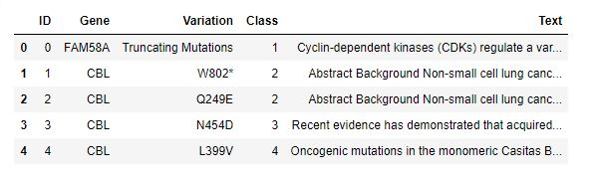
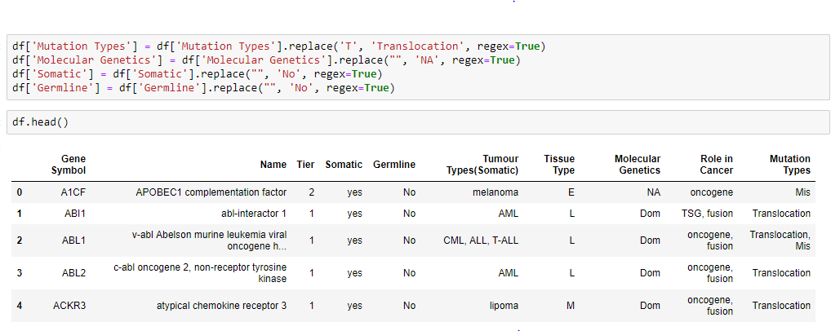
Dataset

Slide 7
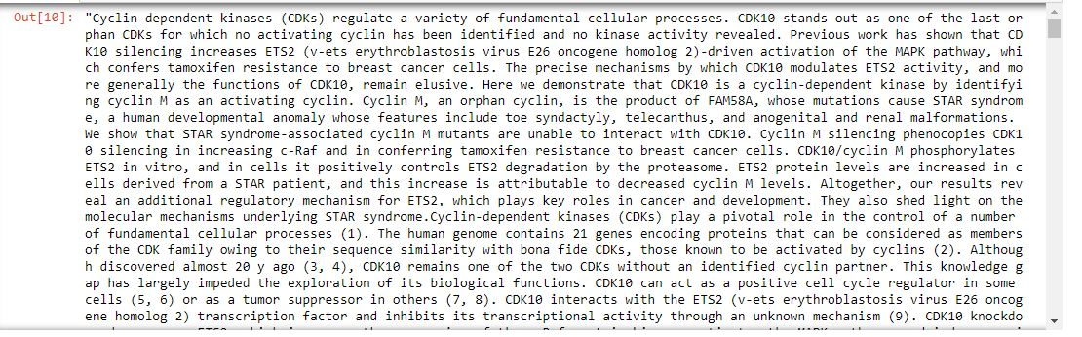
Text Sample

Slide 8
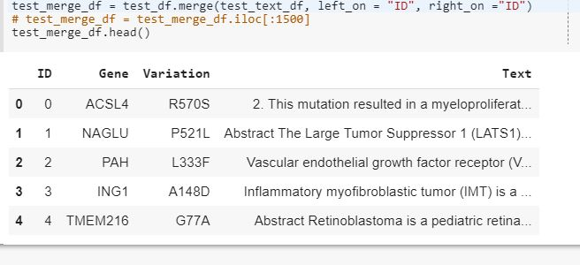
Text Classifier
Text classification using Support Vector Machine.

Slide 9
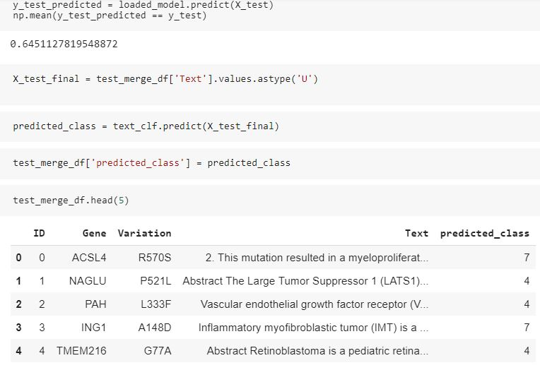
Text Classifier

Slide 10

Dashboard

Slide 11

THANKS
This Photo by Unknown Author is licensed under CC BY-SA

