Slide 1

Capstone Project (SUPERVISED ML – REGRESSION)
Seoul Bike Sharing Demand Prediction
TEAM
IQBAL BABWANE
SAMEER ANSARI
LUKMAN HAIDER KHAN
~ UNDER THE GUIDANCE OF TEAM ALMABETTER

Slide 2

CONTENT
PROBLEM STATEMENT
METHODOLOGY
INTRODUCTION OF PROJECT
DATA DESCRIPTION
EDA
FEATURE SELECTION
FITTING VARIOUS MODEL
MODEL PERFORMANCE COMPARISION
MODEL VALIDATION
MODEL EXPLAINABILITY
CONCLUSION

Slide 3

PROBLEM STATEMENT
Currently Rental bikes are introduced in many urban cities for the enhancement of mobility comfort. It is important to make the rental bike available and accessible to the public at the right time as it lessens the waiting time. Eventually, providing the city with a stable supply of rental bikes becomes a major concern. The crucial part is the prediction of bike count required at each hour for the stable supply of rental bikes.

Slide 4
METHODOLOGY
Data distribution of features
Deal with multicollinearity
Separate dependent and independent features
EDA
Model building
Data transformation
Fitting
Prediction
Evaluation matrices
Model validation
Model selection
Feature importance
Conclusion

Slide 5
INTRODUCTION
The basic idea of this capstone project is to use the Supervised Machine Learning - Regression to predict the bikes going for rent per hour. We have several seasons, whether conditions, day-wise data for every hours in a day.
Based on these features we will be predicting our target variable i.e. rented bikes per hour. By using concepts like model validation, we will came to know which features are important and how much they contribute to our target variable.

Slide 6

DATA DESCRIPTION
The dataset contains weather information (Temperature, Humidity, Windspeed, Visibility, Dewpoint, Solar radiation, Snowfall, Rainfall), the number of bikes rented per hour and date information.
Attribute Information:
Date : year-month-day
Rented Bike count - Count of bikes rented at each hour
Hour - Hour of he day
Temperature-Temperature in Celsius
Humidity - %
Windspeed - m/s
Visibility - 10m
Dew point temperature - Celsius
Solar radiation - MJ/m2
Rainfall - mm
Snowfall - cm
Seasons - Winter, Spring, Summer, Autumn
Holiday - Holiday/No holiday
Functional Day – NoFunc (Non Functional Hours), Fun(Functional hours)

Slide 7
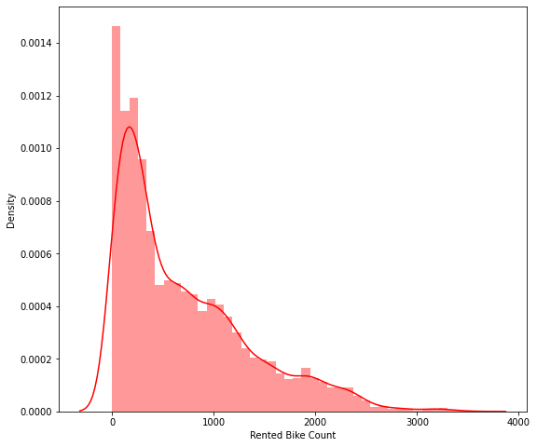
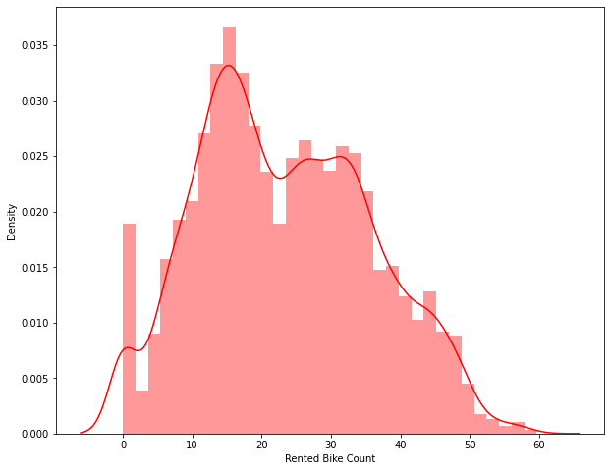
EDA
Data distribution of target variable
Before transformation
After using sqrt transformation

Slide 8
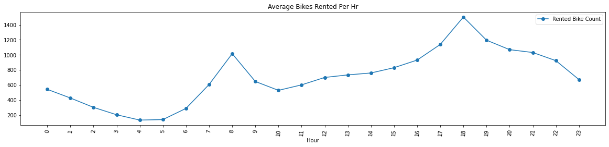
EDA
High demand on morning 8 AM and Evening 6 PM
Quite good counts in afternoon and evening as well

Slide 9
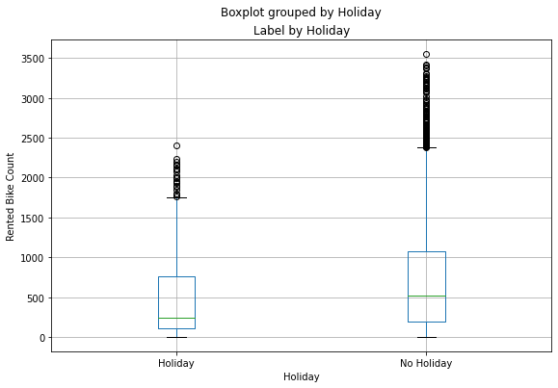
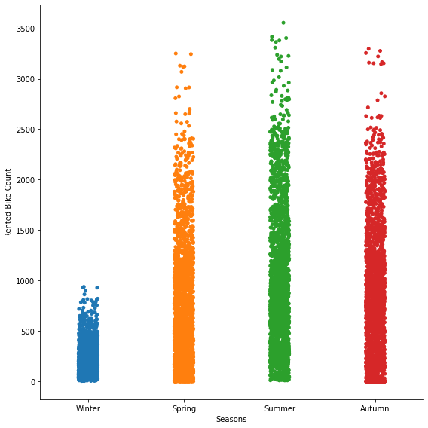
EDA
Less bikes are being rented in winter season
Bikes are mostly rented on working days i.e when there is no holiday

Slide 10
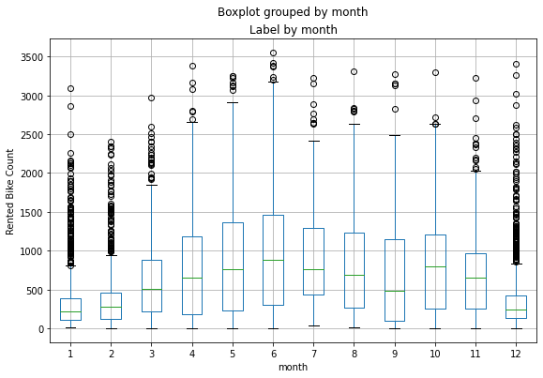
EDA
Demand is high in April, May, June i.e. Summer Seasons

Slide 11
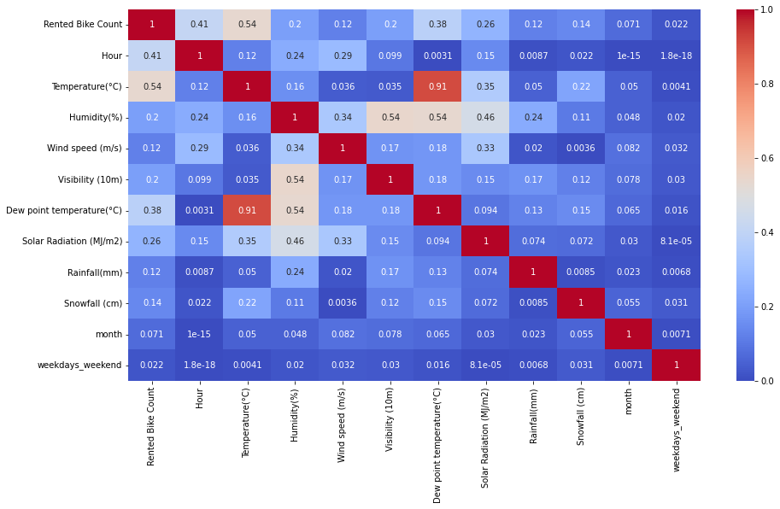
EDA
Multicollinearity
There is 91% of collinearity between Temperature and Dew point temperature feature
Temperature is correlated with target variable with 54%

Slide 12
FEATURE SELECTION
After doing Exploratory Data Analysis, some Feature Engineering, finding correlation and multicollinearity , we filtered out the features that should be taken for model execution.
Final features :-
Humidity(%), Wind speed (m/s), Visibility (10m), Solar Radiation (MJ/m2), Rainfall(mm), Snowfall (cm), temperature, Hour, Holiday, Functioning Day, month, weekdays_weekend, seasond_Autumn, season_Spring', season_Summer', season_Winter

Slide 13

FITTING VARIOUS MODEL
Linear Regression
Lasso Regression
Ridge Regression
Elastic net Regression
Decision trees
Bagging Regressor
Random Forest
Gradient Boosting
Extreme Gradient Boosting
Light Gradient Boosting Machine

Slide 14
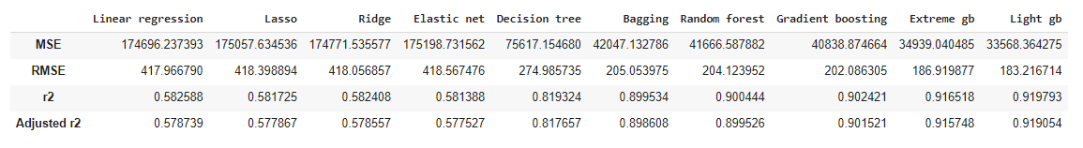

MODEL PERFORMANCE COMPARISION
Evaluation matrices for all the models

Slide 15
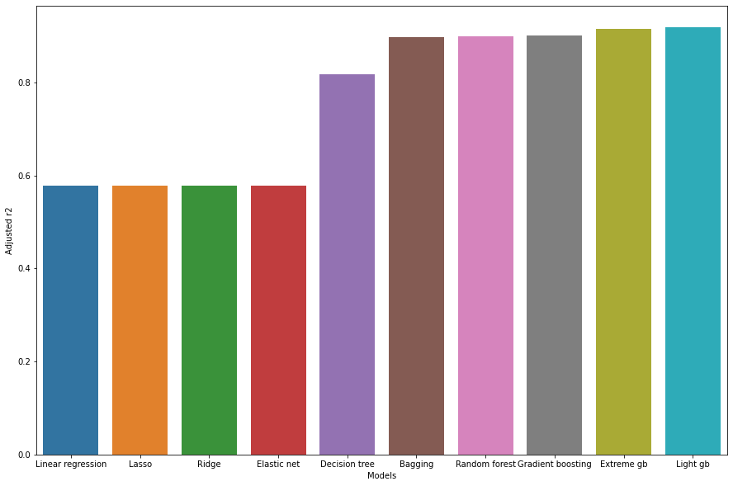
Adjusted R2 Matrix score for all the corresponding models

Slide 16

MODEL VALIDATION
By observing Evaluation matrices for all the models-
Linear Regression, Lasso and Ridge are not at its best
Decision Trees, Bagging, Random Forest are quite good with linear models, but they are not giving optimum prediction
Gradient boosting type models are giving better results, while Light GBM is performing well among all having 91% Adjusted R2 score, so we can use Light GBM as our final model for prediction

Slide 17
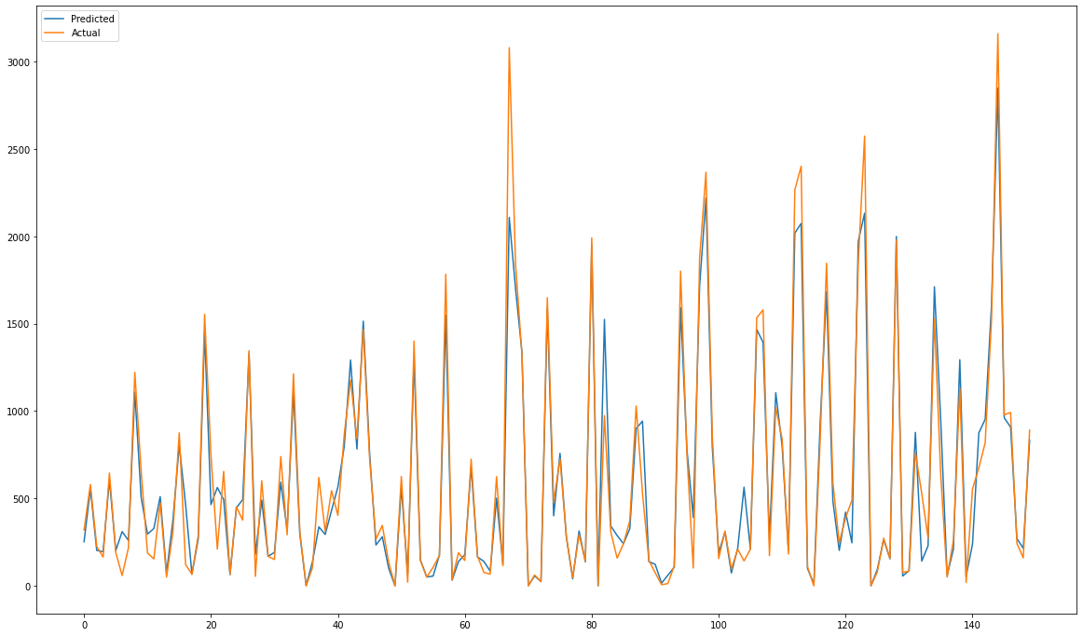
Light GBM Actual and Predicted Behaviour

Slide 18
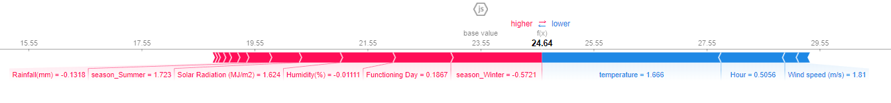
MODEL EXPLAINABILITY
For a data point in Light GBM, we got-
Base value = 23.55
Output value = 24.64

Slide 19
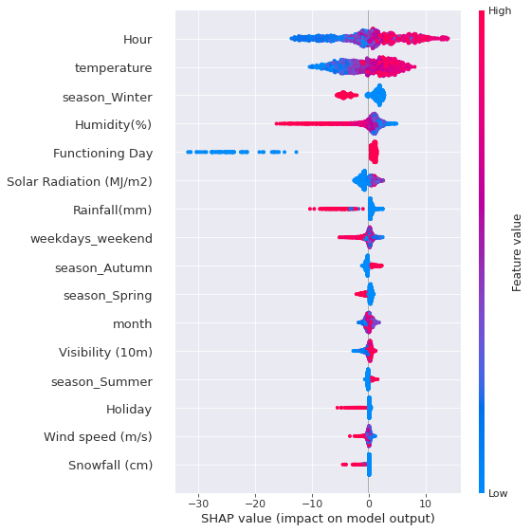
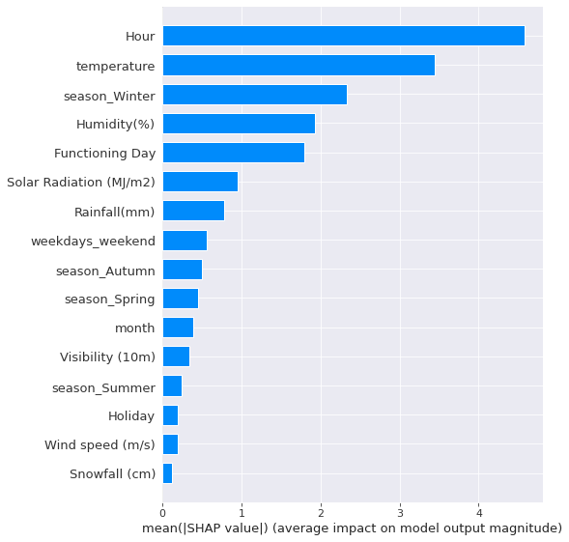
Top features which helping to make our prediction

Slide 20

CONCLUSION
From the previous slides we got some evident that Light GBM will perform better among all the models for the Bike Sharing Demand Prediction, since the evaluation matrices was best for this model.
Hours and temperatures, both the features contributes heavily to predict our target variable.

Slide 21


