Slide 1

Capstone Project (SUPERVISED ML – CLASSIFICATION)
Credit Card Default Prediction
TEAM
IQBAL BABWANE
SAMEER ANSARI
LUKMAN HAIDER KHAN
~ UNDER THE GUIDANCE OF TEAM ALMABETTER

Slide 2

CONTENT
PROBLEM STATEMENT
METHODOLOGY
INTRODUCTION OF PROJECT
DATA DESCRIPTION
EDA
FITTING VARIOUS MODEL
MODEL PERFORMANCE COMPARISION
MODEL VALIDATION
MODEL EXPLAINABILITY
CONCLUSION

Slide 3

PROBLEM STATEMENT
This project is aimed at predicting the case of customers default payments in Taiwan. From the perspective of risk management, the result of predictive accuracy of the estimated probability of default will be more valuable than the binary result of classification - credible or not credible clients.

Slide 4
METHODOLOGY
Data distribution of features
Check with multicollinearity
Feature Engineering
EDA
Model building
Using SMOTE Technique
Fitting & Prediction
Evaluation matrices
Model validation
Model selection
Feature importance
Conclusion
Data transformation

Slide 5
INTRODUCTION
The basic idea of this capstone project is to use the Supervised Machine Learning - Classification to predict customers default payments in Taiwan. Here we have previous 6 month transaction bills and statements as our major information to classify defaulter.
Based on these features we will be predicting our target variable i.e. credit card defaulters. By using concepts like model validation, we will came to know which features are important and how much they contribute to our target variable.

Slide 6
DATA DESCRIPTION
ID: ID of each client
LIMIT_BAL: Amount of given credit in NT dollars (includes individual and family/supplementary credit)
SEX: Gender (1 = male, 2 = female)
EDUCATION: (1 = graduate school, 2 = university, 3 = high school, 0,4,5,6 = others)
MARRIAGE: Marital status (1 = married, 2 = single, 3 = others)
AGE: Age in years
Scale for PAY_0 to PAY_6 :
(-2 = No consumption, -1 = paid in full, 0 = use of revolving credit (paid minimum only),
1 = payment delay for one month, 2 = payment delay for two months,
... 8 = payment delay for eight months, 9 = payment delay for nine months and above)
PAY_0 to PAY_6: Repayment status in (September, 2005), (August, 2005)…..(April, 2005)
BILL_AMT1 to BILL_AMT6: Amount of bill statement in (September, 2005), (August, 2005)…..(April, 2005)
PAY_AMT1 to PAY_AMT6: Amount of previous payment in (September, 2005), (August, 2005)…..(April, 2005)
Default payment next month: Default payment (1=yes, 0=no)

Slide 7
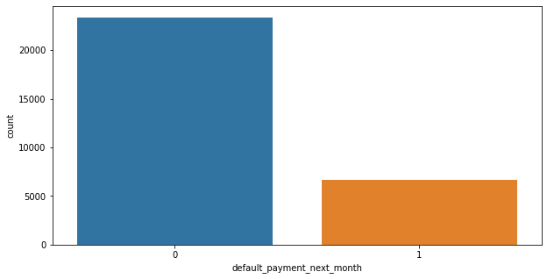
EDA
Data distribution of target variable
Non-Defaulter(0) -0.7788
Defaulter(1) - 0.2212
22% of customers has default payment next month

Slide 8
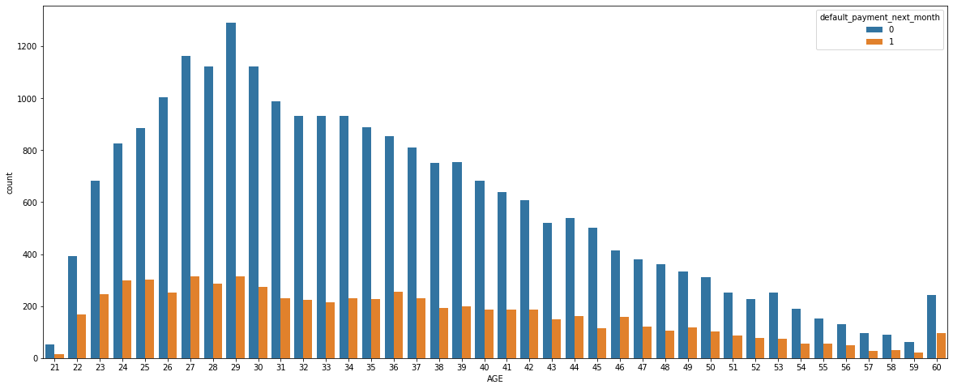
EDA
Analysis on AGE feature
20 to 40 years customer are on average for defaulters
Age above 60 years are almost defaulters

Slide 9
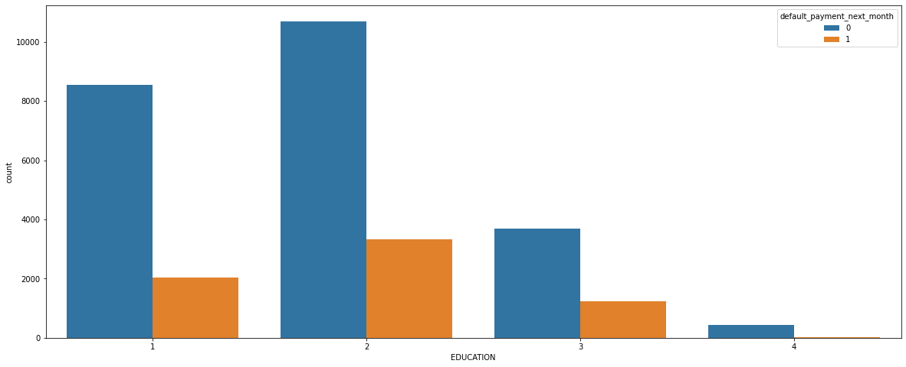
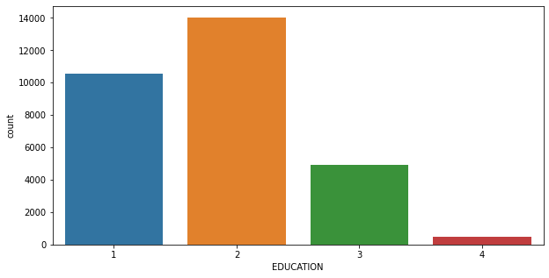
EDA
Analysis on Education feature
EDUCATION
Graduate School
University
Highschool
Others
Customer which had education at University level has more user as well as defaulters

Slide 10
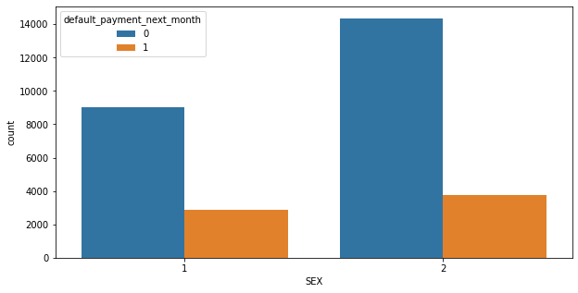
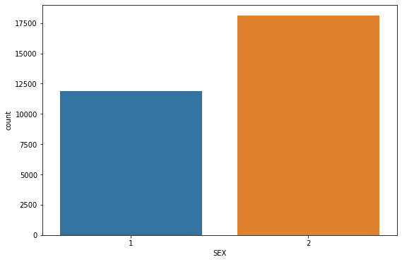
EDA
Analysis on SEX feature
SEX
Male
Female
Female customer count are more as compared to male
From above graph it is clear that female customers are more defaulters

Slide 11
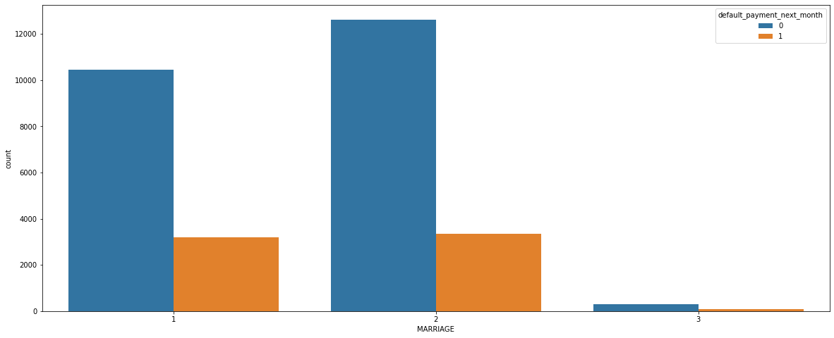
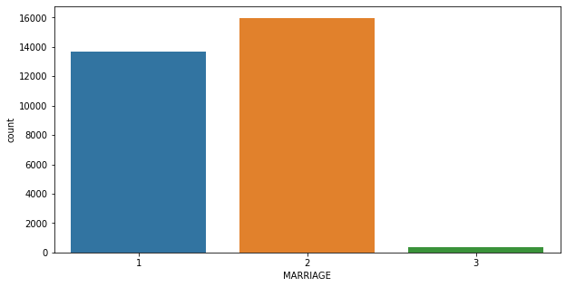
EDA
Analysis on MARRIAGE feature
MARRIAGE
Married
Single
Others
Married customer count is greater of all
Married and single defaulter customers does not have much difference but, married customers takes lead for defaulters

Slide 12
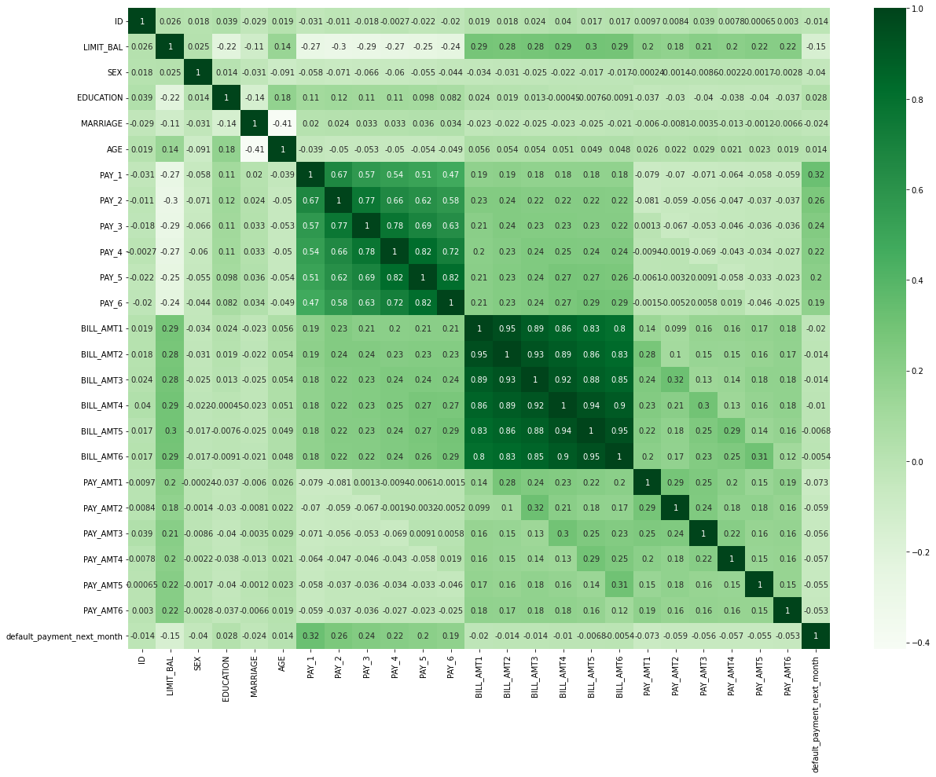
Here most of the categories have correlated with each other, because all those are previous transaction of customer
Multicollinearity

Slide 13
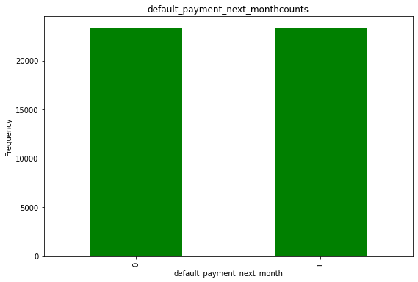
SMOTE - Synthetic Minority Oversampling Technique
Target Variable before SMOTE
Target Variable after SMOTE

Slide 14

FITTING VARIOUS MODEL
Logistic Regression
Decision Tree Classifier
K-Nearest Neighbors Classifier
Random forest Classifier
Support Vector Classifier
Gradient Boosting Classifier

Slide 15
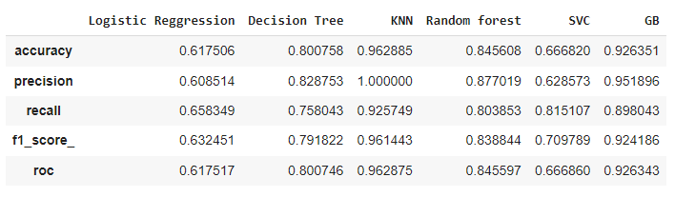
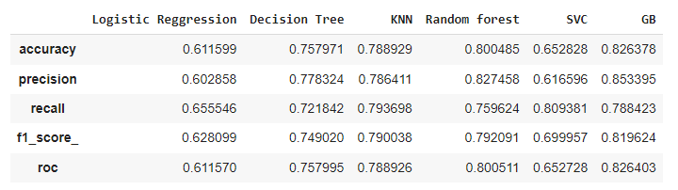
MODEL PERFORMANCE COMPARISION
Evaluation matrices for all the models
Training Scores
Testing Scores

Slide 16
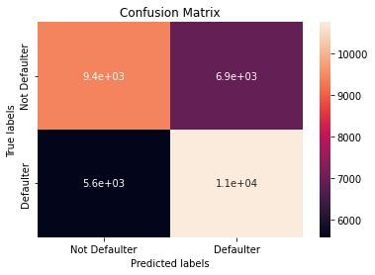
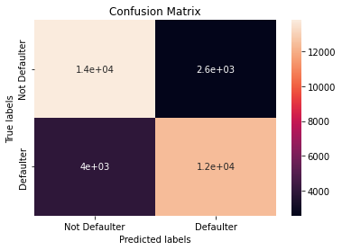
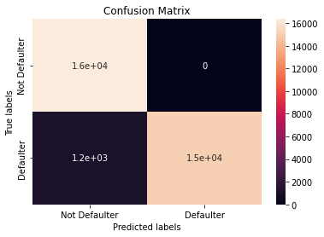

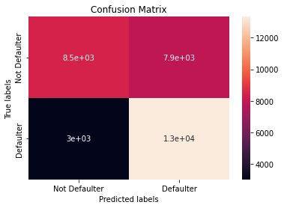
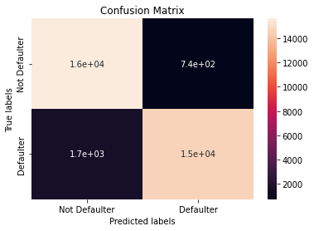
Confusion matrices of all training model
LR
DT
KNN
RF
SVC
GB

Slide 17
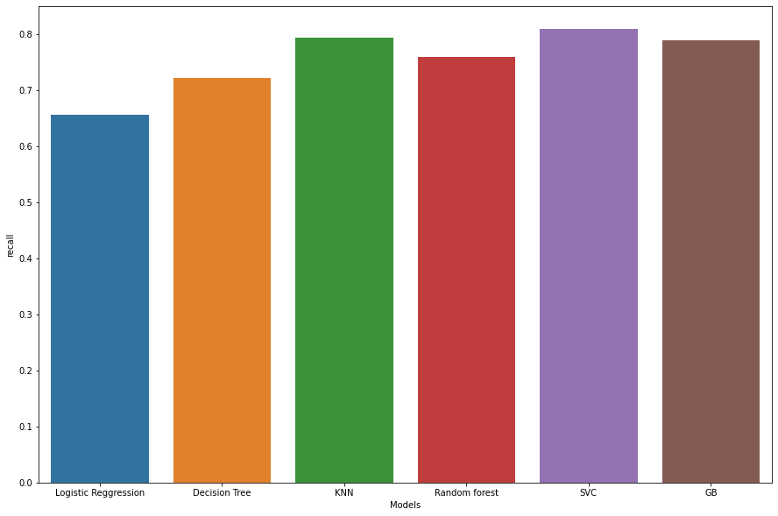
Recall score for all the corresponding models
In this classification problem there is a high cost for the bank when a default credit card is predicted as non-default, since no actions can be taken. Thus, we will give recall more importance .
Here we find SVC Model as best performer in our case

Slide 18

MODEL VALIDATION
By observing Evaluation matrices for all the models-
Logistic Regression model scores very bad as compared to others
Decision Trees, KNN, Random Forest and Gradient boosting are quite good with linear models and gives better accuracy, but looking at the scores this models are over fitting and we can’t conclude w.r.t. accuracy.
SVC Model are not so good with accuracy, but they are best with its recall score and that is what we wanted, so we will go with it.

Slide 19
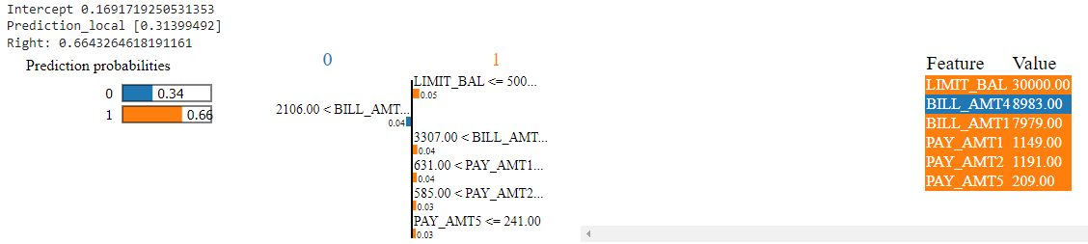
MODEL EXPLAINABILITY
1. Using LIME
For a data point in SVC, we got-
Non -Defaulter probability – 0.34
Defaulter probability – 0.66

Slide 20
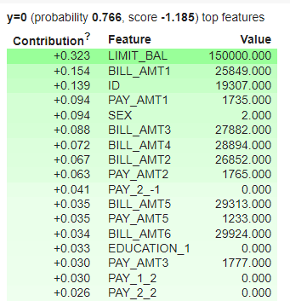
2. Using ELI5
By using ELI5, for a particular data point, we got some of the best feature with its corresponding values

Slide 21
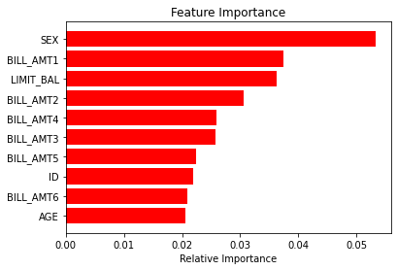
Top features which helping to make our prediction
Apart from Gender of Customer, transaction of last months and limit balance are the top features for prediction

Slide 22

CONCLUSION
From the previous slides we got some evident that SVC will perform better among all the models for the Credit Card Default Prediction, since the recall score was best for this model.
Limit balance and previous last months bills are the features contributes heavily to predict our target variable.

Slide 23


