Slide 1
ML TOOLS FOR GAME STOREFRONTS
REEM CHAABAN
EECE 503N - Final Project

Slide 2
ML TOOLS
01
02
GAME RECOMMENDER
PLAYER COUNT PREDICTOR
DYNAMIC SERVER SCALING
=
REDUCED INFRASTRUCTURE COSTS & SERVER STABILITY
PERSONALIZED RECOMMENDATIONS
=
INCREASED SALES & HIGHER ENGAGEMENT

Slide 3
PLAYER COUNT PREDICTION MODEL
Model: LSTM
Input: future date (e.g., June 21, 2026)
Output: predicted number of players on given date
Accounts for weekends & holidays

Slide 4
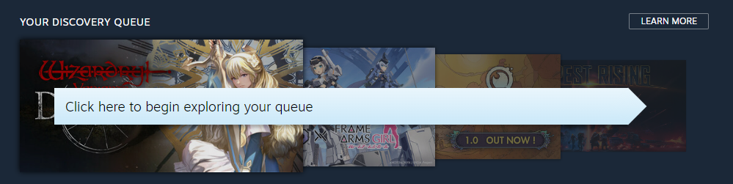
GAME RECOMMENDATION MODEL
Model: LightFM
Input: player’s game library (game-playtime list)
Output: 5 recommended games

Slide 5





DATA COLLECTION
PLAYER COUNT PREDICTION
Collected daily online player counts using SteamDB API
Calculated daily sum of players across all games
01
02
03
04
Created synthetic players with focus genres
Synthesized game libraries for 50,000 players
Retrieved top 200 games & game metadata from SteamSpy API
Merged data to create our game library
GAME RECOMMENDATION

Slide 6
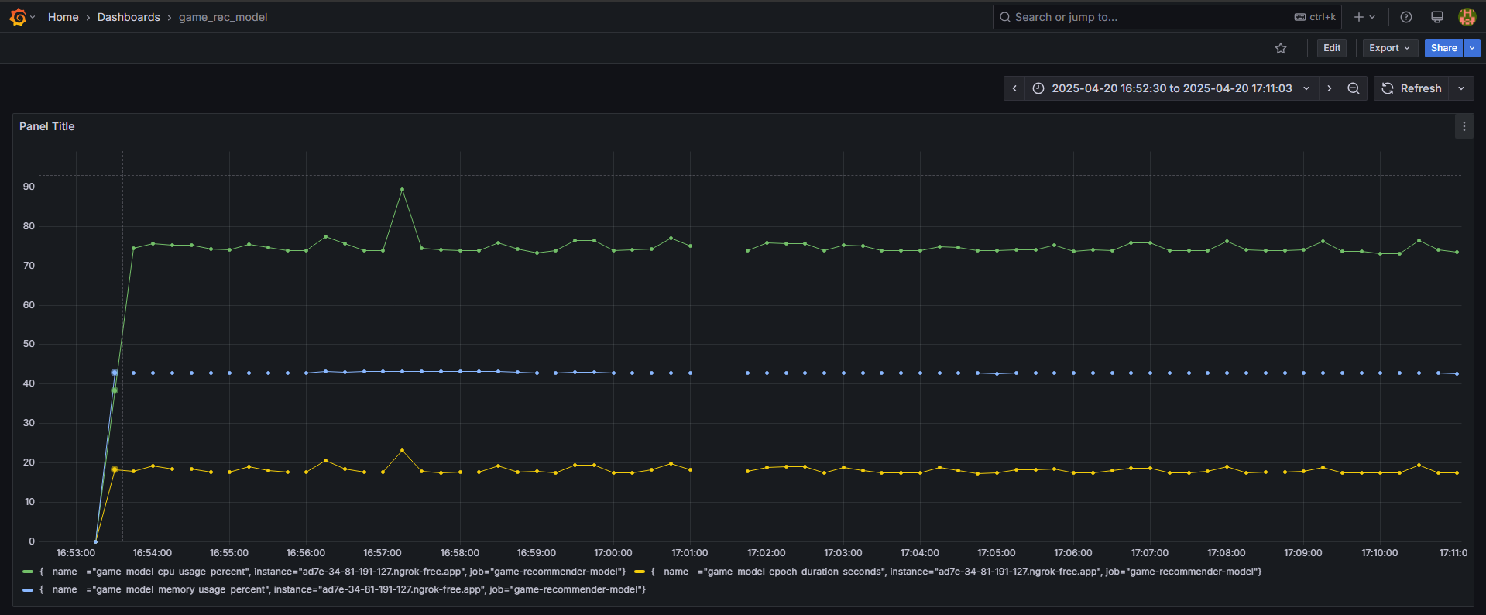
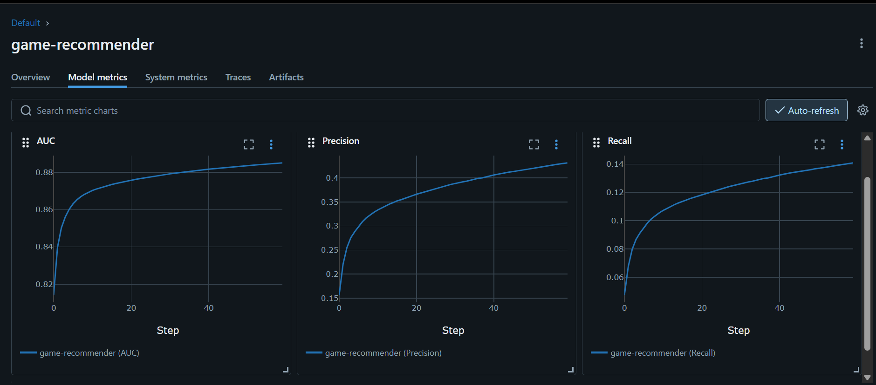
TRAINING
MLflow
Model training metrics
Prometheus & Grafana System-level metrics
Player Count Predictor: regression model → MAE, MSE
Game Recommender: hybrid filtering model → Precision, recall
CPU usage (%)
Memory usage (%)
Epoch duration (s)

Slide 7

FRONTEND
Streamlit: open-source Python framework for developing ML web apps
Built-in frontend components
Calendar, dropdown menu, etc.
Simple Python scripts
Seamless backend integration
Continuous deployment (CD)
Pushing to repo → automatic redeployment on Railway

Slide 8
EEP
Streamlit web interface + Flask API
Validates data inputted by user
Queries models through IEP endpoints
Containerized using Docker → image deployed to Railway

Slide 9
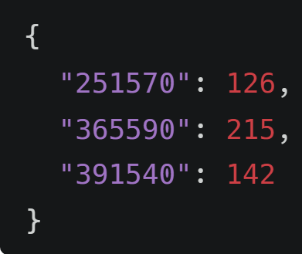
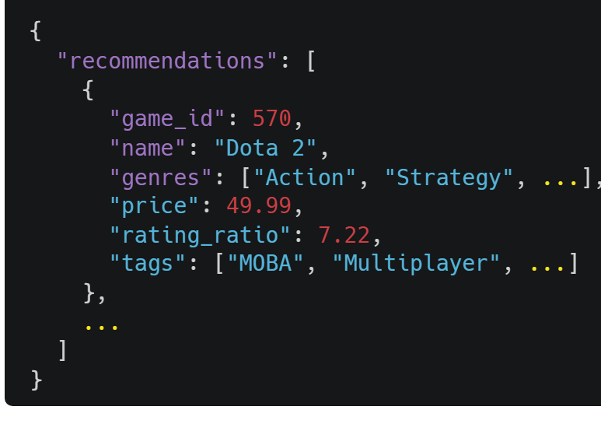
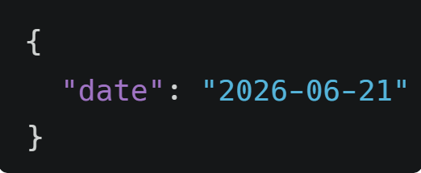
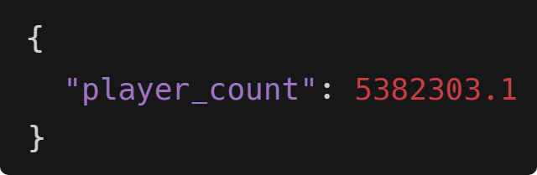
IEPs
Each model exposed through a Flask API
/get-player-count
Query model utility functions
Containerized using Docker → images deployed to Railway
/get-recommendations
→
→

Slide 10







ARCHITECTURE
CD
Front-end
‣ User-friendly UI
User Input
Model Output
EEP
‣ User facing API
‣ Data validation
‣ Status codes
Future Date
Player Game Library
Predicted Player Count
5 Game
Recs
IEP #1
IEP #2
Player count predictor
Video game recommender
LSTM
LightFM

Slide 11





MLOPS PIPELINE
REBUILD DOCKER IMAGE
UPDATE DATA
RETRAIN MODEL
GITHUB WORKFLOW
PUSH TO DOCKER HUB

Slide 12
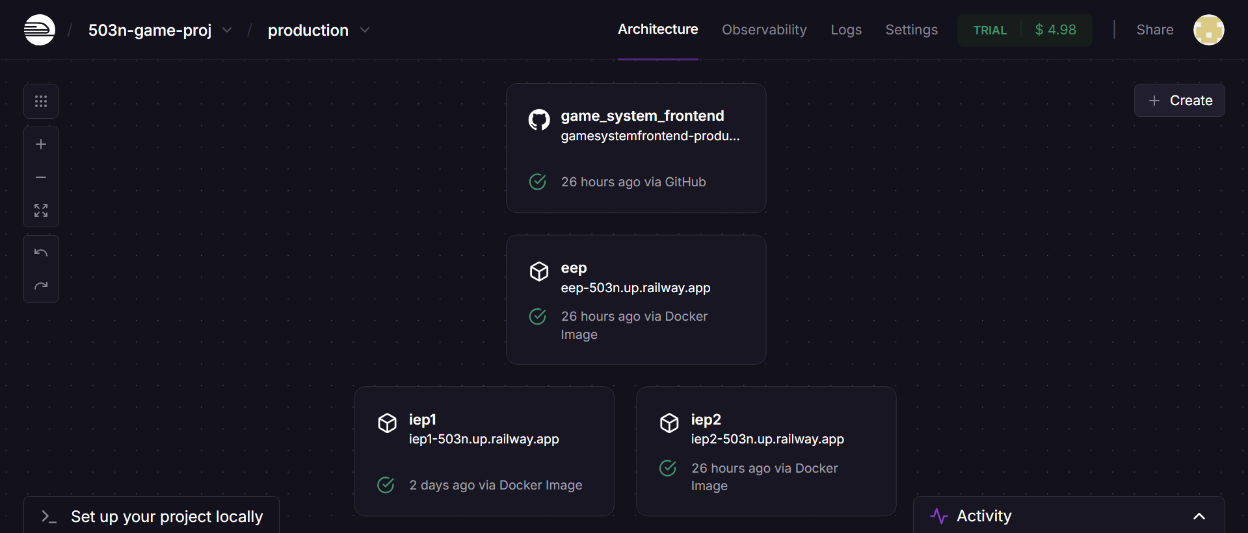
RAILWAY DEPLOYMENT

Slide 13
THANK
YOU!

