Slide 1

College of Computer & Cyber Sciences
Department of Computer Science
Program of SW Engineering
SE 431 - SW Evolution & Maintenance
Chapter 4: Reengineering
Dr. Ftoon Kedwan

Slide 2

4 General Idea
4.2 Reengineering Concepts
4.3 A General Model for SW Engineering
4.3.1 Types of Changes
4.3.2 SW Reengineering Strategies
4.3.3 Reengineering Variations
4.4 Reengineering Process
4.4.1 Reengineering Approaches
4.4.2 Source Code Reengineering Reference Model
4.4.3 Phase Reengineering Model
4.5 Code Reverse Engineering
4.6 Techniques used for Reverse Engineering
4.6.1 lexical Analysis
4.6.2 Syntactic Analysis
4.6.3 Control Flow Analysis
4.6.4 Data Flow Analysis
4.6.5 Program Slicing
4.6.6 Visualization
4.6.7 Program Metrics
4.7 Decompilation versus Reverse Engineering
4.8 Data Reverse Engineering
4.8.1 Data Structure Extraction
4.8.2 Data Structure Conceptualization
4.9 Reverse Engineering Tools
Outline

Slide 3











4.1 General Idea
Reengineering is the examination, analysis, & restructuring of an existing SW system to reconstitute it in a new form, & the subsequent implementation of the new form. e.g.,
Code Decompilation, a Reverse Engineering for code recovery & understanding (binary file to python).
Data recovery using Reverse Engineering.
The goal of reengineering is to:
Understand the existing SW system artifacts, namely, specification, design, implementation, & documentation.
Improve the functionality & quality attributes of the system.
SW systems reengineering objectives:
Improving maintainability.
Migrating to a new technology.
Improving quality.
Preparing for functional enhancement.

Slide 4











4.2 Reengineering Concepts
WHAT are they, exp, which side is that task
Abstraction & Refinement are key concepts used in SW development.
Both concepts are equally useful in reengineering.
It may be recalled that abstraction enables SW maintenance personnel to reduce the complexity of understanding a system by:
Focusing on the more significant information about the system.
Hiding the irrelevant details at the moment.
Refinement is the reverse of abstraction.
Principle of abstraction:
The abstraction level of a system’s representation can be gradually increased by successively replacing the details with abstract information.
By means of abstraction, 1 can produce a view that focuses on selected system characteristics by hiding information about other characteristics.
Principle of refinement:
The abstraction level of a system’s representation is gradually decreased by successively replacing some aspects of the system with more details.

Slide 5
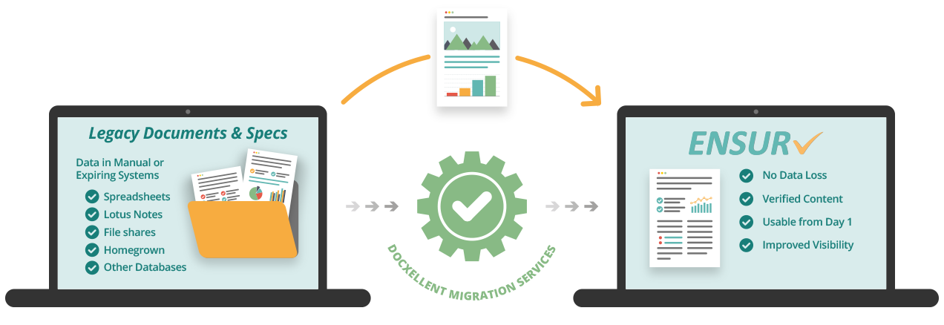







4.2 Reengineering Concepts
Forward engineering is when a new SW is created by going downward from the top, highest level of abstraction to the bottom, lowest level, following a sequence of activities:
Formulating concepts about the system.
Identifying requirements.
Designing the system.
Implementing the design.
Reverse engineering is the upward movement through the abstraction layers, comprising the following steps:
Analyze the SW to determine its components & the relationships among the components.
Represent the system at a higher level of abstraction or in another form.
E.g., Decompilation is a Reverse Engineering example where object code is translated into a high-level program.
Creating product
Data recovery

Slide 6
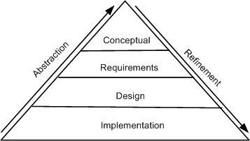
4.2 Reengineering Concepts
The concepts of abstraction & refinement are used to create models of SW development as sequences of phases, where the phases map to specific levels of abstraction or refinement (Fig. 4.1).
The 4 levels are:
Conceptual
Requirements
Design
Implementation
Fig. 4.1 levels of abstraction & refinement © IEEE, 1992

Slide 7

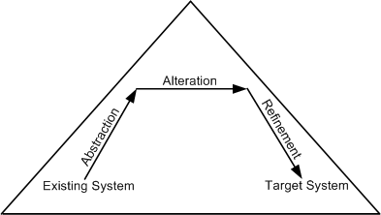












4.2 Reengineering Concepts
An optional principle called alteration underlies many reengineering methods.
Principle of alteration: The making of some changes to a system representation, but:
Doesn't change the degree of abstraction.
Doesn't modify, delete, or add any information.
Fig. 4.2 Conceptual basis for the reengineering process © IEEE, 1992
Notes:
The arrows depicting refinement & abstraction are slanted, thereby indicating the increase & decrease, respectively, of system information.
It may be noted that alteration is non-essential for reengineering.
Reengineering principles are represented by means of arrows.
Abstraction is represented by an up-arrow.
Alteration is represented by a horizontal arrow.
Refinement by a down-arrow.

Slide 8


IS IT INCLUDED OR NOT??????
4.3 A General Model For SW Reengineering
The reengineering process accepts as input the existing code of a system & produces the code of the renovated system.
The reengineering process may be as straightforward as translating with a tool the source code from the given language to source code in another language.
e.g., a program written in C++ can be translated into a new program in Python.
The reengineering process may be very complex as explained below:
Recreate a design from the existing source code.
Find the requirements of the system being reengineered.
Compare the existing requirements with the new ones.
Remove the requirements that aren't needed in the renovated system.
Make a new design of the desired system.
Code the new system.

Slide 9
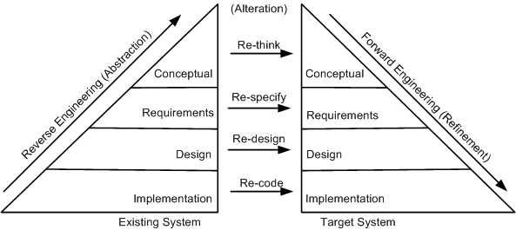
4.3 A General Model For SW Reengineering
This model suggests that reengineering is a sequence of 3 activities:
Reverse engineering
Re-design
Forward engineering
Fig. 4.3 General model of SW reengineering © IEEE, 1992
Notes:
proposed by Eric J. Byrne

Slide 10
4.3 A General Model For SW Reengineering
3 Definitions of Reengineering:
• The definition by Chikofsky & Cross II: SW reengineering is the analysis & alteration of an operational system to represent it in a new form & to obtain a new implementation from the new form.
Here, a new form means a representation at a higher level of abstraction.
• The definition by Byrne: Reengineering of a SW system is a process for creating a new SW from an existing SW so that the new system is better than the original system in some ways.
• The definition by Arnold: Reengineering of a SW system is an activity that:
Improves the comprehension of the SW system, or
Raises the quality levels of the SW, namely, performance, reusability, & maintainability.

Slide 11




4.3 A General Model For SW Reengineering
In summary, Reengineering entails:
The creation of a more abstract view of the system by means of some reverse engineering activities.
The restructuring of the abstract view.
Implementation of the system in a new form by means of forward engineering activities.
This process is formally captured by the following expression:
Reengineering = Reverse engineering + Δ + Forward engineering
The element “Δ” captures alterations made to the original system.
2 major dimensions of alteration are:
Change in functionality (comes from a change in business rules).
Change in implementation technique.
An end-user of a system never knows if the system is implemented in an object-oriented language or a procedural language.

Slide 12
4.3 A General Model For SW Reengineering
Another common term used by practitioners of reengineering is rehosting.
Rehosting means reengineering of source code without addition or reduction of features in the transformed targeted source code.
Rehosting is most effective when the user is satisfied with the system’s functionality, but looks for better qualities of the system.
Examples of better qualities are improved efficiency of execution & reduced maintenance costs.

Slide 13
Based on the type of changes required, system characteristics are divided into groups:
Recode:
Source code implementation characteristics are changed by re-coding it.
Source-code level changes are performed by means of:
Program Rephrasing
e.g., normalization, optimization, refactoring, & renovation.
Program Translation into a different language.
e.g., compilation, decompilation, & migration.
Redesign:
The design characteristics of the SW are altered by re-designing the system.
Common changes to the SW design include:
Restructuring the architecture.
Modifying the data model of the system.
Replacing a procedure or an algorithm with a more efficient one.
Respecify:
This means changing the system requirement characteristics in 2 ways:
Change the form of the requirements.
Change the scope of the requirements.
Rethink:
Re-thinking a system means manipulating the concepts embodied in an existing system to create a system that operates in a different problem domain.
It involves changing the conceptual characteristics of the system.
It can lead to the system being changed in a fundamental way.
e.g., Moving from developing an ordinary cellular phone to developing smartphone systems.
4.3.1 Types of Change
Notes:
rephrasing keeps the program in the same language.
Rethink, Respecify, Redesign, & Re-code.

Slide 14
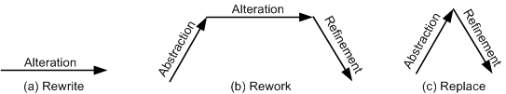
4.3.2 SW Reengineering Strategies
3 strategies that specify the basic steps of reengineering:
Rewrite strategy:
This strategy reflects the principle of alteration.
By means of alteration, an operational system is transformed into a new system, while preserving the abstraction level of the original system.
e.g., the Python code of a system can be rewritten in the Java language.
Rework strategy:
The rework strategy applies all the 3 principles.
Let the goal of a reengineering project is to replace the unstructured control flow constructs, namely GOTOs, with more commonly used structured constructs, say, a “for” loop.
A classical, rework strategy based approach is as follows:
Application of abstraction: By parsing the code, generate a control-flow graph (CFG) for the given system.
Application of alteration: Apply a restructuring algorithm to the CFG to produce a structured CFG.
Application of refinement: Translate a new structured CFG back into the original programming language.
Replace strategy:
The replace strategy applies 2 principles, namely, abstraction & refinement.
To change a certain characteristic of a system:
The system is reconstructed at a higher level of abstraction by hiding the details of the characteristic.
A target system representation is generated at a lower level of abstraction by applying refinement.
e.g., Reconsidering the GOTO example:
By means of abstraction, a program is represented at a higher level without using control flow concepts.
Next, by means of refinement, the system is represented at a lower level of abstraction with a new structured control flow.
Fig. 4.5 Conceptual basis for reengineering strategies © IEEE, 1992

Slide 15
4.4 Reengineering Process
An ordered set of activities designed to perform a specific task is called a process.
For ease of understanding & communication, processes are described by means of process models.
e.g., in the SW development domain, the Waterfall process model is widely used in developing well-understood SW systems.
Process models are used to comprehend, evaluate, reason about, & improve processes.
Intuitively, process models are described by means of important relationships among data objects, human roles, activities, & tools.
We will discuss 5 process models for SW reengineering.
The 5 approaches are different in 2 aspects:
The extent of reengineering performed.
The rate of substitution of the operational system with the new one.

Slide 16





4.4.1 Reengineering Approaches
Big Bang Approach
Replaces the whole system at once.
Once a reengineering effort is initiated, it is continued until all the objectives of the project are achieved & the target system is constructed.
This approach is generally used if reengineering can't be done in parts.
e.g., if there is a need to move to a different system architecture, then all components affected by such a move must be changed at once.
Advantages:
The system is brought into its new environment all at once.
Disadvantages:
The reengineering project becomes a monolithic task, which isn’t desirable in all situations.
Consumes too much resources at once for large systems.
Takes a long time before the new system is visible.
Everything's happens at once

Slide 17




4.4.1 Reengineering Approaches
One step at time, but we have multi- versions. In the alteration no versions, because we take it component by component
Incremental Approach
A system is reengineered graduallyتدريجياً, 1 step closer to the target system at a time.
For a large system, several new interim versions are produced & released.
Successive interim versions satisfy increasingly more project goals than their preceding versions.
Advantages:
Locating errors becomes easier, because 1 can clearly identify the newly added components.
It becomes easy for the customer to notice progress, because interim versions are released.
Disadvantages:
With multiple interim versions & their careful version controls, the incremental approach takes much longer to complete.
Even if there is a need, the entire architecture of the system can't be changed.

Slide 18




4.4.1 Reengineering Approaches
Partial Approach
Only part of the system is reengineered & then it is integrated with the non-engineered portion of the system.
You must decide whether to use a “Big Bang” or an “Incremental” approach for the portion to be reengineered.
The partial approach follows 3 steps:
The existing system is partitioned into 2 parts:
1 part is identified to be reengineered.
The remaining part to be not reengineered.
Reengineering work is performed using either:
The “Big Bang” approach.
The “Incremental” approach.
The 2 parts are integrated to make up the new system.
The advantages:
Reduces the scope of reengineering that consumes less time & costs less.
The disadvantages:
Modifications aren't performed to the interface between the portion modified & the portion not modified.

Slide 19






4.4.1 Reengineering Approaches
Iterative Approach
The reengineering process is applied on the source code of a few procedures at a time, with each reengineering operation lasting for a short time.
This process is repeatedly executed on different components in different stages.
During the execution of the process, ensure that the 4 types of components can coexist:
Old components not reengineered.
Components currently being reengineered.
Components already reengineered.
New components added to the system.
The advantages:
It guarantees the continued operation of the system during the execution of the reengineering process.
The maintainers’ & the users’ familiarities with the system are preserved.
The disadvantages:
The need to keep track of the 4 types of components during the reengineering process.
Both, the old & the newly reengineered components, need to be maintained.
Takes short time, have 4 component not versions

Slide 20




Organize component per functionality, so that lead to a cohesive software
4.4.1 Reengineering Approaches
Evolutionary Approach
Components of the original system are substituted with re-engineered components.
The existing components are grouped by functions & reengineered into new components.
SW engineers focus their reengineering efforts on identifying functional objects irrespective of the locations of those components within the current system.
As a result, the new system is built with functionally cohesive components as needed.
The advantages:
The resulting design is more cohesive.
The scope of individual components is reduced.
The disadvantages:
All the functions with much similarities must be 1st identified throughout the operational system.
Next, those functions are refined as 1 unit in the new system.

Slide 21
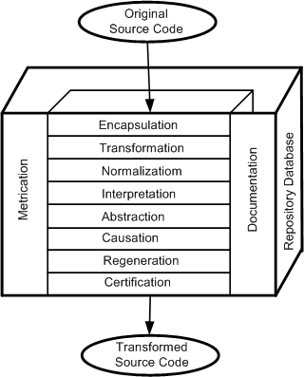
4.4.2 Source Code Reengineering Reference Model
The SCORE/RM model framework consists of 4 kinds of elements (Fig.4.6):
Function
Documentation
Repository database
Metrication
The function element is divided into 8 layers, namely:
Encapsulation
Transformation
Normalization
Interpretation
Abstraction
Causation
Regeneration
Certification
Fig. 4.6 Source code reengineering reference model © IEEE, 1990
Notes:
The SCORE/RM model was proposed by Colbrook, Smythe & Darlison.

Slide 22
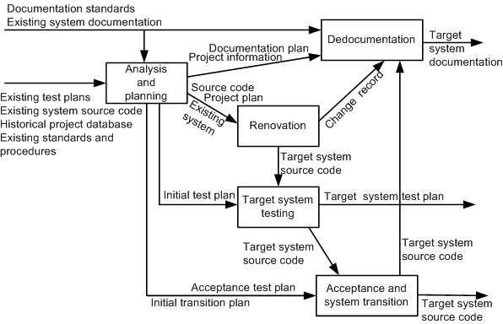
4.4.3 Phase Reengineering Model
The model comprises 5 phases (Fig. 4.8):
Analysis & planning
Renovation
Target system testing
Redocumentation
Acceptance testing & system transition
The labels on the arcs denote the possible information flows.
A major process activity is represented by each phase.
Tasks represent a phase’s activities.
Tasks can be further decomposed to reveal the detailed methodologies.
Fig. 4.8 SW reengineering process phases © IEEE, 1992
Notes:
The labels on the arcs denote the possible information that flows from the tail entities of the arcs to the head entities.

Slide 23
4.5 Code Reverse Engineering
Reverse engineering was 1st applied in electrical engineering to produce schematics from an electrical circuit.
It was defined as the process of developing a set of specifications for a complex hardware system by an orderly examination of specimens of that system.
In the context of SW engineering, Chikofsky & Cross II defined reverse engineering as a process to:
Identify the components of an operational SW.
Identify the relationships among those components.
Represent the system at a higher level of abstraction or in another form.
Reverse engineering is performed to achieve 2 key objectives:
Redocumentation of artifacts
It aims at revising the current description of components or generating alternative views at the same abstraction level.
Examples of redocumentation are pretty printing & drawing CFGs.
Design recovery
It creates design abstractions from code, expert knowledge, & existing documentation.

Slide 24
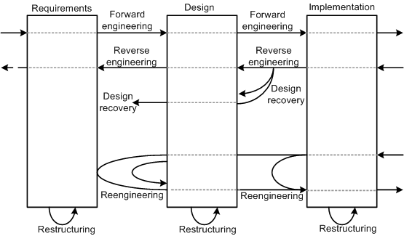
4.5 Code Reverse Engineering
The relationship between forward engineering, reengineering, & reverse engineering is shown in Fig. 4.10
Fig. 4.10 Relationship between reengineering & reverse engineering ©IEEE, 1990

Slide 25


4.6 Techniques Used for Reverse Engineering
The well-known analysis techniques that facilitate reverse engineering are:
Lexical analysis
Syntactic analysis
Control flow analysis
Data flow analysis
Program slicing
Visualization
Program metrics

Slide 26

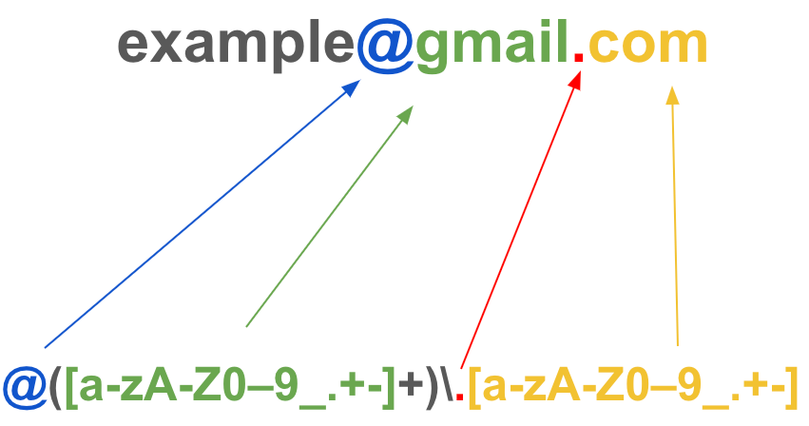

4.6.1 Lexical Analysis
Lexical analysis is the process of decomposing the sequence of characters in the source code into its constituent lexical units.
A program performing lexical analysis is called a lexical analyzer, & it is a part of a programming language compiler.
It uses rules describing lexical program structures that are expressed in a mathematical notation called regular expressions.
Modern lexical analyzers are automatically built using tools called lexical analyzer generators, namely, lex & flex (fast lexical analyzer).
Regular Expression Example

Slide 27

4.6.2 Syntax Analysis
Syntactic analysis is performed by a parser. محلل
Similar to syntactic analyzers, parsers can be automatically constructed from a description of the programatical properties of a programming language.
e.g., YACC is 1 of the most commonly used parsing tools.
2 types of representations are used to hold the results of syntactic analysis:
Parse tree
Abstract Syntax Tree (AST)
A parse tree contains details unrelated to actual program meaning (i.e., the punctuation) whose role is to direct the parsing process.
Grouping parentheses are implicit in the tree structure, which can be pruned from the parse tree.
Removal of those extraneous details produces a structure called an AST.
An AST contains just those details that relate to the actual meaning of a program.
Many tools have been based on the AST concept.
To understand a program, an analyst makes a query in terms of the node types.
The query is interpreted by a tree walker to deliver the requested information.

Slide 28


4.6.3 Control Flow Analysis
After determining the structure of a program, Control Flow Analysis (CFA) can be performed on it.
2 kinds of CFAs:
Intraprocedural Analysis: داخل الاجزاء
It shows the order in which statements are executed within a subprogram.
A basic block is a maximal sequence of program statements such that execution enters at the top of the block & leaves only at the bottom via a conditional or an unconditional branch statement.
The idea of basic blocks is central to constructing a Control Flow Graph (CFG).
A basic block is represented with 1 node in the CFG, & an arc indicates possible flow of control from 1 node to another.
A CFG can directly be constructed from an AST by walking the tree to determine basic blocks & then connecting the blocks with control flow arcs.
Interprocedural Analysis:بين الاجزاء
It shows the calling relationship among program units.
It is performed by constructing a call graph.
Calling relationships between subroutines in a program are represented as a call graph which is a directed graph.
A procedure in the source code is represented by a node in the graph, & the edge from node f to g indicates that procedure f calls procedure g.
Call graphs can be static or dynamic.
A dynamic call graph is an execution trace of the program, thus, it is exact, but it only describes 1 run of the program.
A static call graph represents every possible run of the program.
What is ?
The flow of control between a functional and another functional in the same class
Between class, component

Slide 29



4.6.4 Data Flow Analysis
Data flow analysis (DFA) concerns how values of defined variables flow through & are used in a program.
CFA can detect the possibility of loops, whereas DFA can determine data flow anomalies. e.g.,:
An undefined variable is referenced.
A variable is successively defined without being referenced in between.
DFA enables:
The identification of code that can never execute.
Variables not defined before they are used.
Statements that might have to be altered when a bug is fixed.
CFA can't answer the question: Which program statements are likely to be impacted by the execution of a given assignment statement?
To answer this, an understanding of definitions (def) of variables & references (uses) of variables is required.
If a variable appears on the left-hand side of an assignment statement, then the variable is said to be defined.
If a variable appears on the right-hand side of an assignment statement, then it is said to be referenced in that statement.

Slide 30




4.6.5 Program Slicing
A program slice is a portion of a program with an execution behavior identical to the initial program with respect to a given criterion but may have a reduced size.
A slicing criterion of a program P is S <p;v>
where p is a program point, &
v is a subset of variables in P.
A Backward Slice, with respect to a variable v & a given point p, comprises all instructions & predicates which affect the value of v at point p.
Used to answer the question “What program components might effect a selected computation?”
A Forward Slicing, with respect to a variable v & a point p in a program, comprises all instructions & predicates which may depend on the value of v at p.
Used to answer the question “What program components might be effected by a selected computation?”
Notes:
Originally introduced by Mark Weiser, program slicing has served as the basis of numerous tools.
In Weiser’s definition, a slicing criterion of a program P is S < p; v > where p is a program point & v is a subset of variables in P.

Slide 31
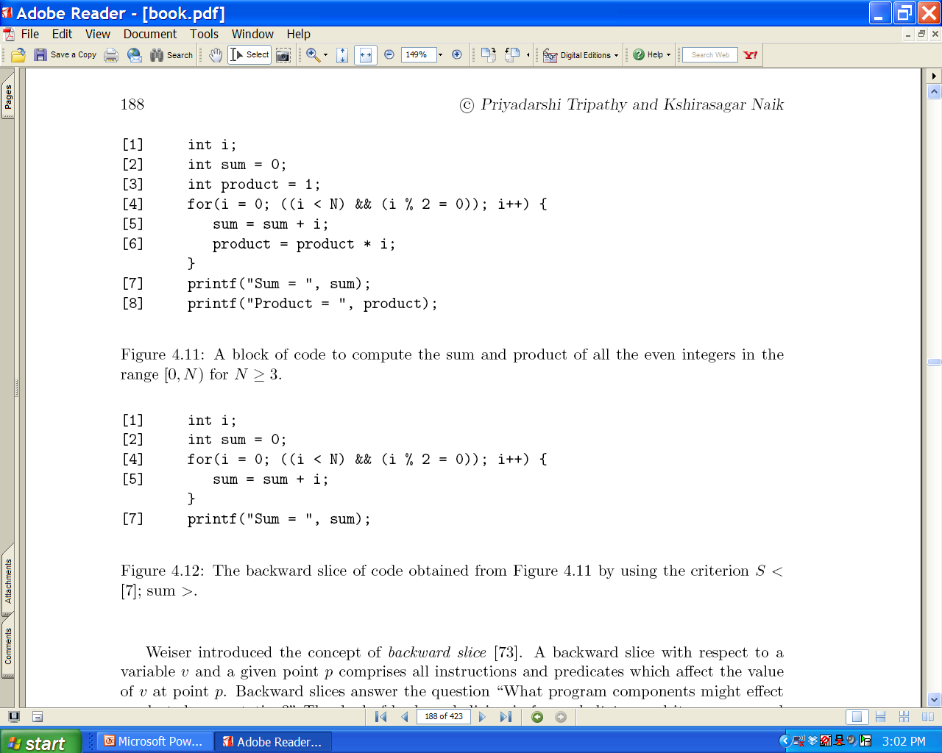
4.6.5 Program Slicing: Example of Backward Slice

Slide 32
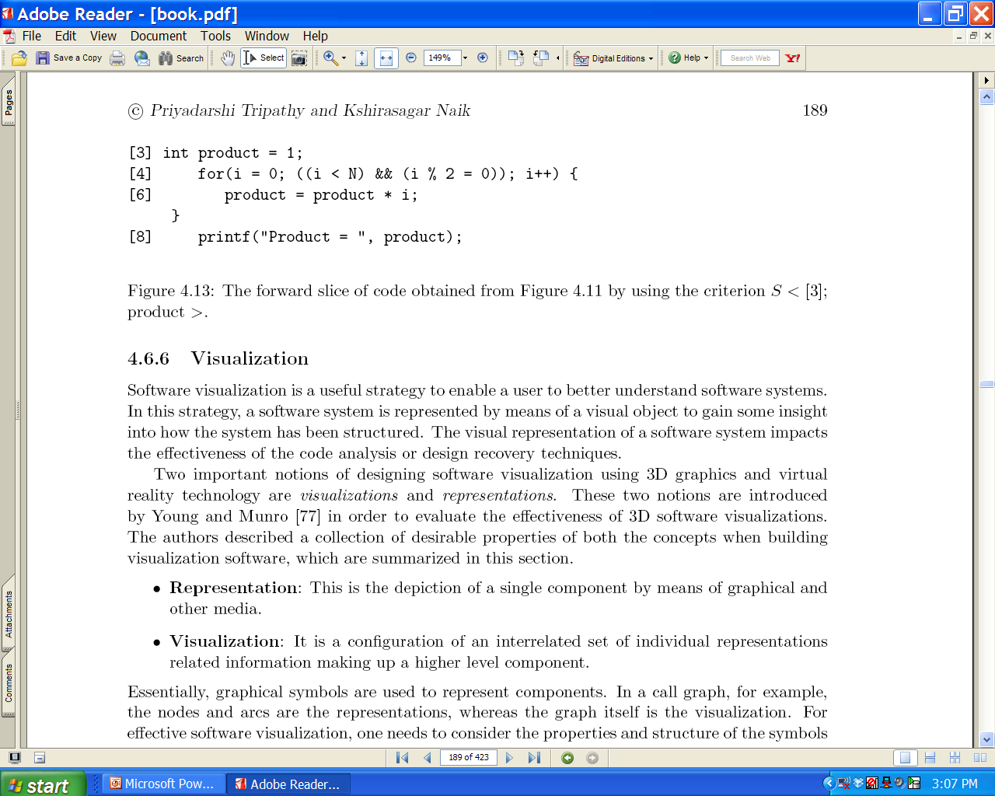
4.6.5 Program Slicing: Example of Forward Slice

Slide 33





4.6.6 Visualization
SW visualization is a useful strategy to enable a user to better understand SW systems.
SW system is represented by means of a visual object to gain some insight into how the system has been structured.
The visual representation of a SW system impacts the effectiveness of the code analysis or design recovery techniques.
2 important notions of designing SW visualization using 3D graphics & virtual reality technology are:
Representation: an illustration of a single component by means of graphical & other media.
Visualization: a configuration of an interrelated set of individual representations related information making up a higher-level component.
For effective SW visualization, you need to consider the properties & structure of the symbols used in SW representation & visualization.

Slide 34
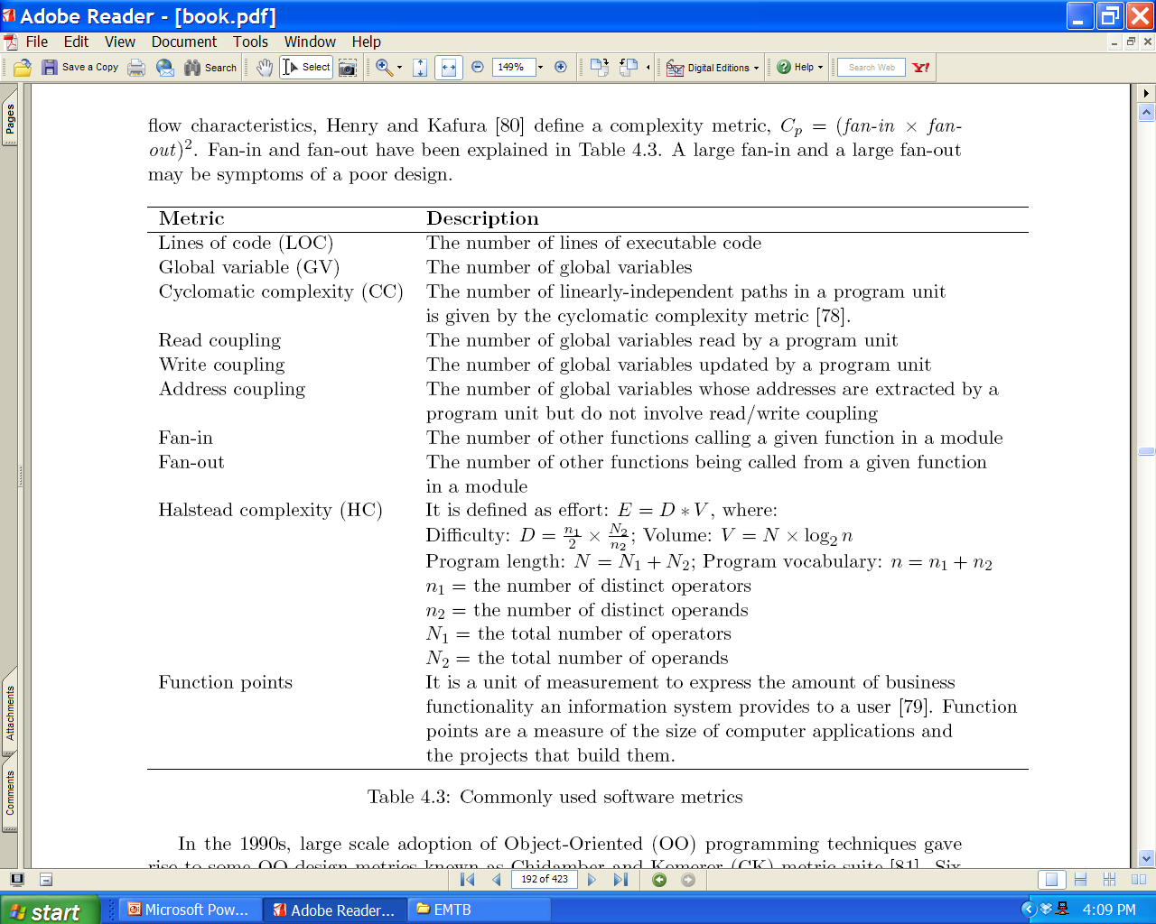
4.6.7 Program Metrics
To understand & control the overall SW engineering process, program metrics are applied.
Table 4.3: Commonly used SW Metrics
Notes:
Table 4.3 summarizes the commonly used program metrics.

Slide 35
Program Metrics
Based on a module’s fan-in & fan-out information flow characteristics, a complexity metric is defined:
Cp = (fan-in × fan-out)
A large fan-in & a large fan-out may be symptoms of a poor design.
6 performance metrics are found:
Weighted Methods per Class (WMC): the number of methods implemented within a given class.
Response for a Class (RFC): number of methods executed in response to a message received by an object of a given class.
Lack of Cohesion in Methods (LCOM): For each attribute in a given class, calculate the percentage of the methods in the class using that attributes. Next, compute the average of all those percentages, & subtract the average from 100%.
Coupling between Object Class (CBO): number of distinct non-inheritance related classes on which a given class is coupled.
Depth of Inheritance Tree (DIT): the length of the longest path from a given class to the root in the inheritance hierarchy.
Number of Children (NOC): the number of classes that directly inherit from a given class.
Clones’ detection techniques in programs using 5 kinds of metrics:
Fan-out.
The ratio of the total count of input & output variables to the fan-out.
Cyclomatic complexity.
Function points metric.
Henry & kafura information-flow metric.
Notes:
Henry & Kafura define a complexity metric, Cp = (fan-in × fan- out).
6 performance metrics are found in the Chidamber-Kemerer CK metric suite:

Slide 36
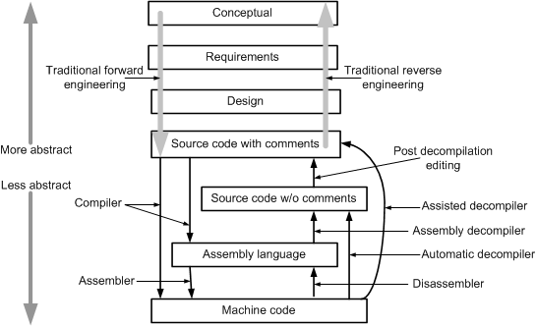
4.7 Decompilation Versus Reverse Engineering
Fig. 4.14 Relationship between decompilation & traditional reengineering ©2007

Slide 37
4.7 Decompilation Versus Reverse Engineering
A decompiler takes an executable binary file & produces readable high-level language source code from it.
The output will not be the same as the original source code, & may not even be in the same language.
The decompiler doesn't provide the original programmers’ annotations that provide vital instructions as to the functioning of the SW.
Disassemblers are programs that take a program’s executable binary as input & generate text files that contain the assembly language code for the entire program or parts of it.
Decompilation, or disassembly, is a reverse engineering process, since it creates representations of the system at a higher level of abstraction
However, traditional reverse engineering from source code entails the recognition of “goals”, or “plans”, which must be known in advance.
However, compilation isn't considered part of the forward engineering, since it is an automatic step.

Slide 38
4.7 Decompilation Versus Reverse Engineering
Decompilers aided program migration from 1 machine to another.
As decompilation capabilities have increased, a wide range of potential applications emerged.
Examples of new applications are:
Recovery of lost source code.
Error correction.
Security testing.
Learning algorithms.
Interoperability with other programs.
Recovery of someone else’s source code.
Not all uses of decompilers are legal uses.
Most of the applications must be examined from the patent &/or copyright infringement point of view.
It is recommended to seek legal counsel before starting any low-level reverse engineering project.

Slide 39
4.8 Data Reverse Engineering
Data Reverse Engineering (DRE) is defined as “the use of structured techniques to reconstitute the data assets of an existing system” .
By means of structured techniques, existing situations are analyzed & models are constructed prior to developing the new system.
The 2 vital aspects of a DRE process are:
Recover data assets that are valuable.
Reconstitute the recovered data assets to make them more useful.
The purpose of DRE is as follows:
Knowledge acquisition
Tentative requirements
Documentation
Integration
Data administration
Data conversion
SW assessment
Quality assessment
Component reuse

Slide 40
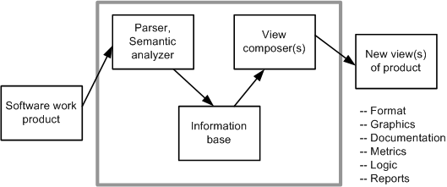
4.9 Reverse Engineering Tools
SW reverse engineering is a complex process that tools can only support, not completely automate.
There is a need of human intervention with any reverse engineering project.
The tools can provide a new view of the product, as shown in Fig. 4.16.
The basic structure of reverse engineering tools is as follows:
The SW system to be reverse engineered is analyzed.
The results of the analysis are stored in an information base.
View composers use the information base to produce alternative views of the system.
Fig. 4.16 Basic structure of reverse engineering tools ©IEEE 1990

Slide 41
4.9 Reverse Engineering Tools
Ada SDA (System Dependency Analyzer) is a tool that supports analysis & migration of Ada programs.
CodeCrawler is a language independent reverse engineering tool which combines metrics & SW visualization.
DMS (Design Maintenance System) toolkit developed by Semantic Design, Inc is composed of a set of tools for carrying out re-engineering of medium or large scale SW systems.
FermaT is the generic name for a set of tools designed by SW Migration Ltd., specifically to support assembler code comprehension, maintenance, & migration.
GXL (Graph eXchange Language) is an XML-based format for sharing data between tools. GXL represents typed, attributed, directed, ordered graphs which are extended to represent hyper-graphs & hierarchical graphs.
IDA Pro Disassembler & Debugger by Hex-Rays is a powerful disassembler that supports more than fifty different processor architectures, including IA-32, IA-64 (Itanium), & AMD64.
Hex-Rays Decompiler is a commercial decompiler plug-in for IDA Pro.
Imagix 4D is useful in understanding legacy C, C++, & Java SW.
IRAP (Input-Output Reengineering & Program Crafting) is a data reengineering tool developed by Spectra Research that provides a semi-automated approach to re-craft legacy SW into an Intranet/Internet enabled application without compromising program computational integrity.
JAD (JAva Decompiler) is a Java decompiler written in C++.
ManSART is a tool to recover the architecture of a given SW system.
McCabe IQ is capable of predicting some key issues in maintaining large & complex business SW applications:
(i) locate error-prone sections of code. (ii) identify the risk of system failure.
PBS (Portable Bookshelf) is an implementation of the web based concept called SW Bookshelf for the presentation navigation of information representing large SW systems.
RE-Analyzer is an automated, reverse engineering system providing a high level of integration with a computer-aided SW engineering (CASE) tool developed at IBM.
Reengineering Assistant (RA) aims to provide an interactive environment where SW maintainers can reverse engineer source code into a higher abstraction level of representation.
Rigi is a SW tool for comprehending large SW systems. SW comprehension is achieved by performing reverse engineering on the given system.
SEELA is a reverse engineering tool developed by Tuval SW Industries to support the documentation & maintenance of structured source code.

Slide 42

Assignment 4
What are the differences among reengineering, reverse engineering, and forward engineering?
Discuss the purpose of reverse engineering.
Explain why decompilation is a reverse engineering process, whereas compilation is not a forward engineering process?

