Slide 1
Fetch
A method for communication between the server and client

Slide 2




Fetch (data)
fetch
fetch
fetch

Slide 3
Fetch (data)
data
data
data
app.get(‘/’, req, res =>{ res.send({data:data})
}

Slide 4
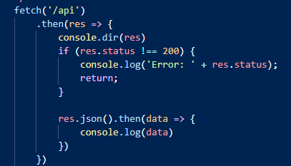

Fetch
Client (index.html)
Server (Node)

Slide 5
Status
A status is a code.
A null body status is a status that is 101, 204, 205, or 304.
An ok status is any status in the range 200 to 299, inclusive.
A redirect status is a status that is 301, 302, 303, 307, or 308.
From fetch spec: https://fetch.spec.whatwg.org/#concept-status

Slide 6
More info
https://developer.mozilla.org/en-US/docs/Web/API/Fetch_API/Using_Fetch

