Slide 1

Angular
Google’s framework for SPA

Slide 2
What we will cover?
Init project
Architecture
Creating new component
Data model (in ts)
Single
Array
Events
Select
Input (with two way binding)

Slide 3
init
npm install -g @angular/cli
ng new <nameOfApp>
cd <nameOfApp>
ng serve --open

Slide 4
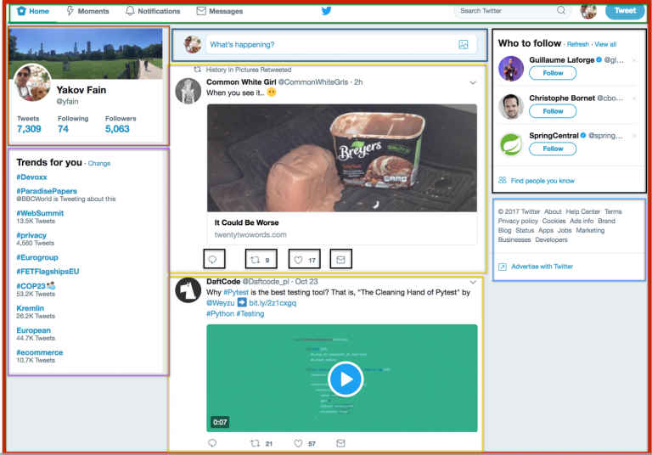
Architecture
Module
Component
Component
Component

Slide 5
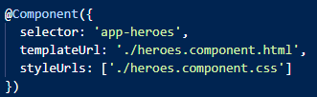
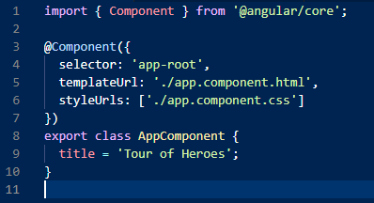
Architecture
Module
Component
.ts (control)
Component
Component

Slide 6
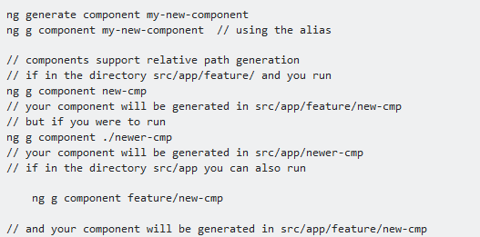
Generate new component

Slide 7
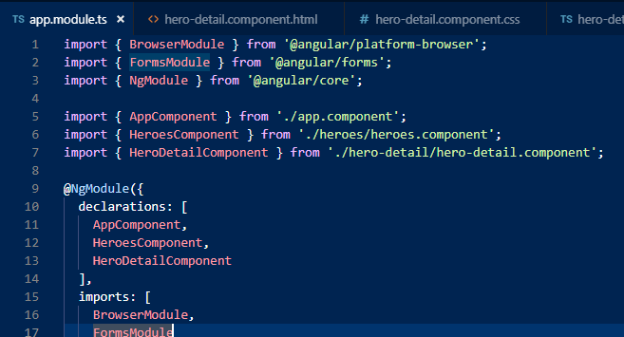
Generate new component

Slide 8
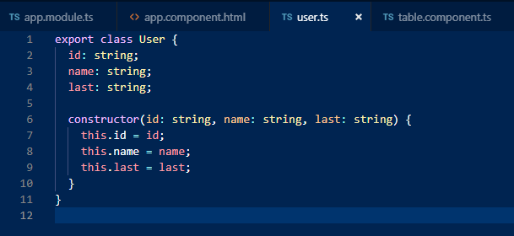
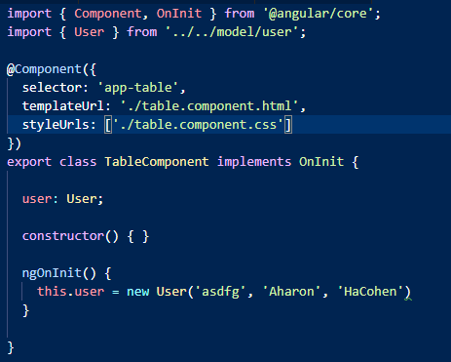
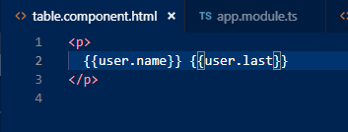
Data model
Declare class of variable
Declare variable in control
Call it in view

Slide 9
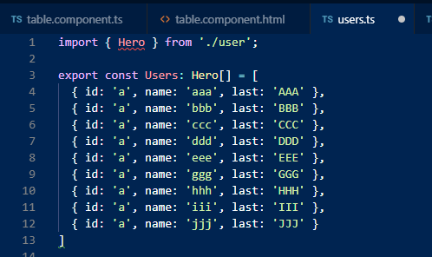
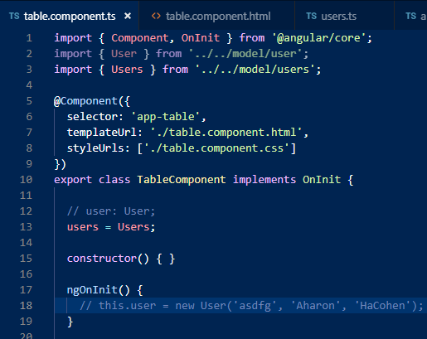
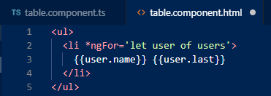
Data model

Slide 10
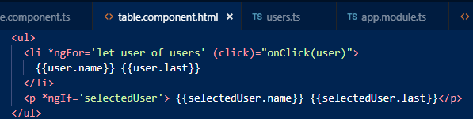
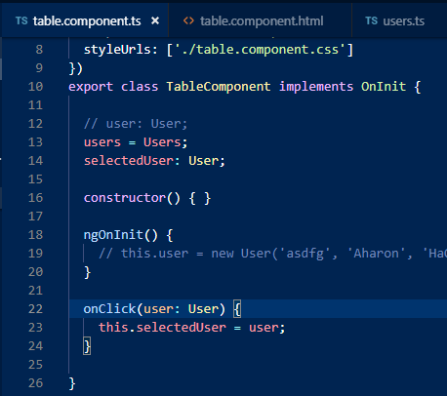
Select (on select)

Slide 11
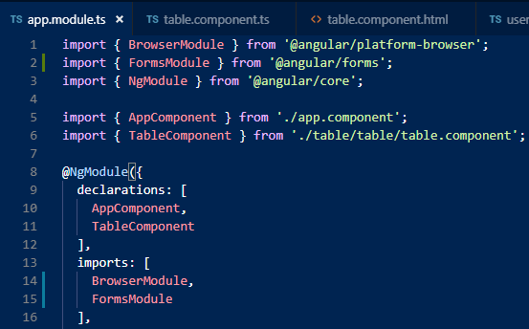
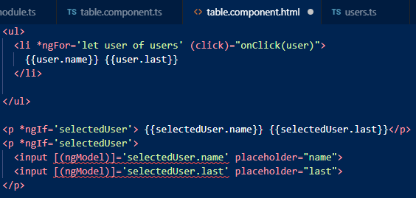
Input (two-ways binding)

