Slide 1

Angular
Google’s framework for SPA

Slide 2
init
npm install -g @angular/cli
ng new <nameOfApp>
cd <nameOfApp>
ng serve --open

Slide 3
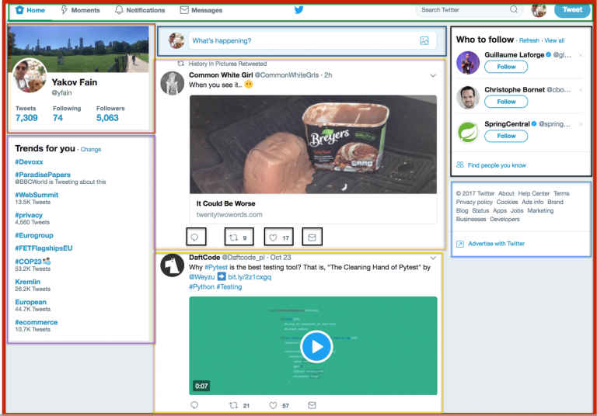
Architecture
Module
Component
Component
Component

Slide 4
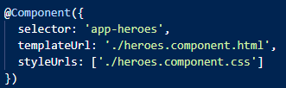
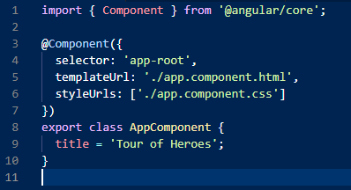
Architecture
Module
Component
.ts (control)
Component
Component

