Slide 1
Socket.io
Real-time connection

Slide 2
Old server-client communication
Server
HTTP request
Client

Slide 3
Old server-client communication
Server
Client
HTTP response

Slide 4
Old server-client communication
The client only initiate communication
Server
HTTP request
Client
HTTP response

Slide 5
Old server-client communication
How can a server send real-time updates?
How can a chat be handled?
Server
HTTP request
Client
HTTP response

Slide 6
Socket.io communication
Check for constant connection
Server
Client
TCP/IP ping

Slide 7

Socket.io communication
Server
Client
TCP/IP ping
Emit
on(‘namespace’, callback)
on(‘namespace’, callback)
Emit

Slide 8
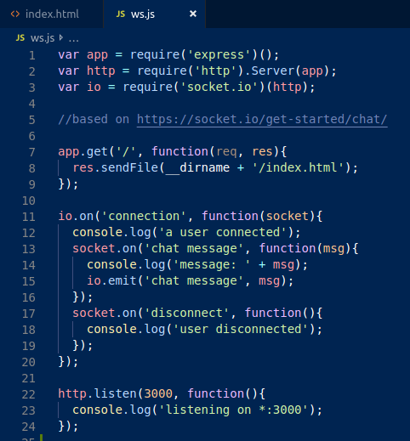
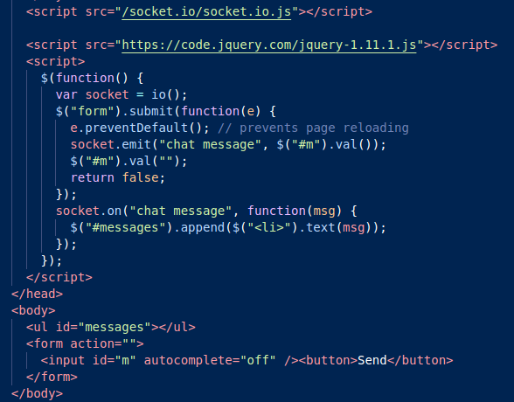
Client

Slide 9
Socket.io communication
Server
Client
TCP/IP ping
Emit
on(‘namespace’, callback)
on(‘namespace’, callback)
Emit

Slide 10
Structure
Socket.emit:all
Socket.emit(name-space):name-space
Socket.in(room).emit(name-space):Room
https://socket.io/docs/emit-cheatsheet/

