Slide 1
Angular
https://youtu.be/5wtnKulcquA?t=1232

Slide 2
Install
npm i -g @angular/cli
Install instance:
ng new <name of folder>
Run:
cd <name of folder>
ng serve -o

Slide 3
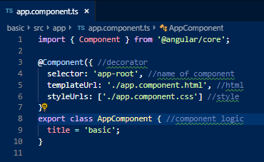
Components
Every component is built out of three files:
Logic (ts)
template(HTML)
Style

Slide 4
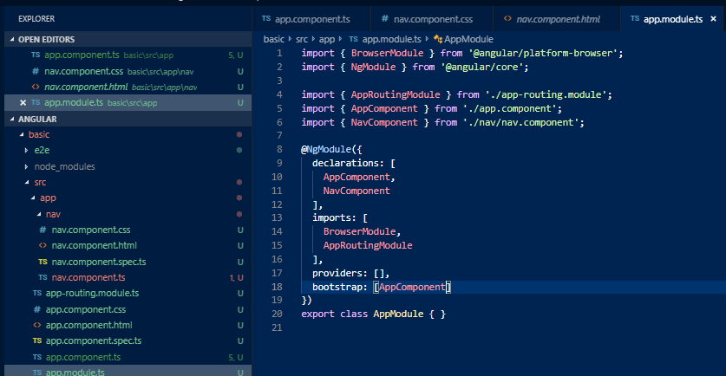
Create component
ng generate component <component name>

Slide 5
Create component
ng g c <component name>

Slide 6
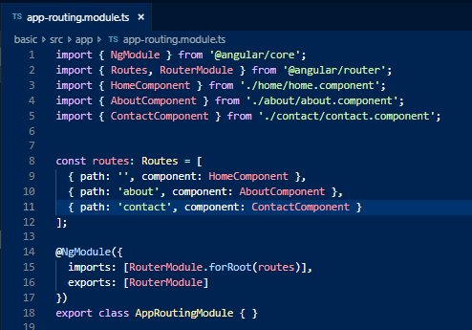
Router

Slide 7
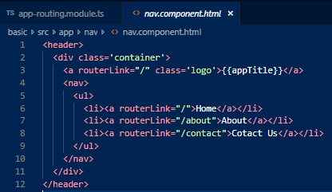
Router

Slide 8
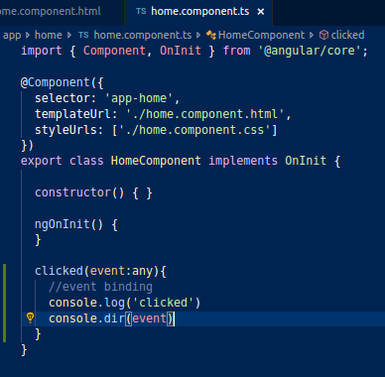

Event binding

Slide 9
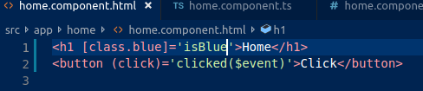
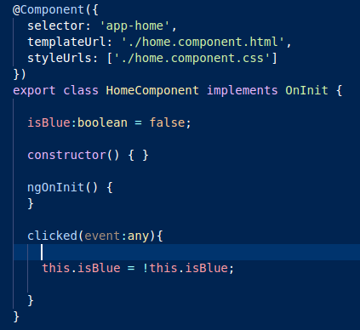
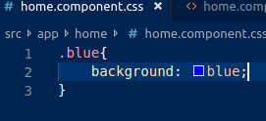
Class binding

Slide 10
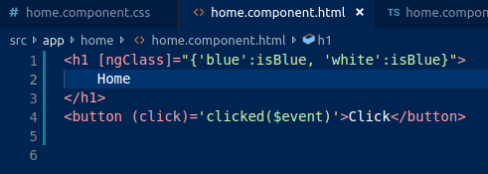
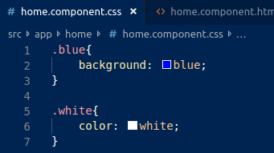
Class binding:many (ngClass)

Slide 11
Class binding: inline

Slide 12
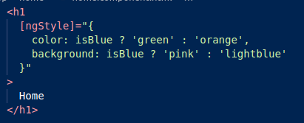
Class binding: inline-multi

Slide 13
Services
Code that is accessible to many components
ng g s <name_of_service>

Slide 14
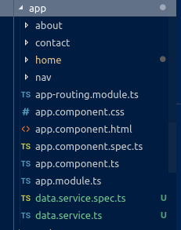
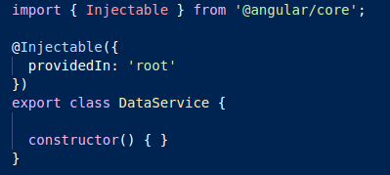
Service

Slide 15
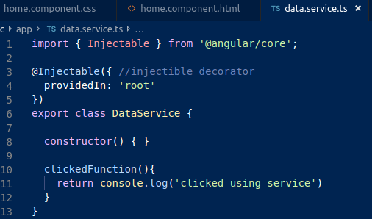
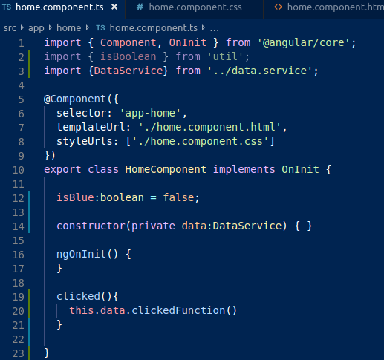
Service

Slide 16
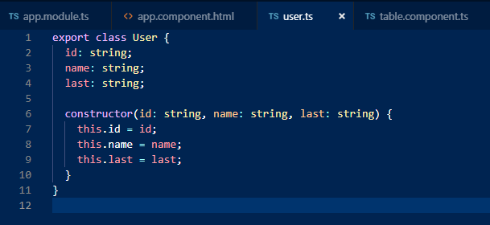
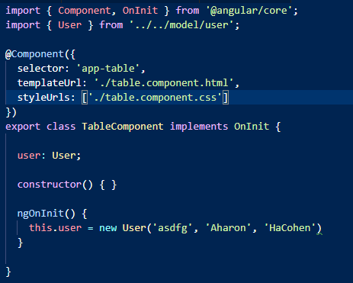
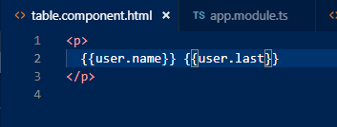
Data model
Declare class of variable
Declare variable in control
Call it in view

Slide 17
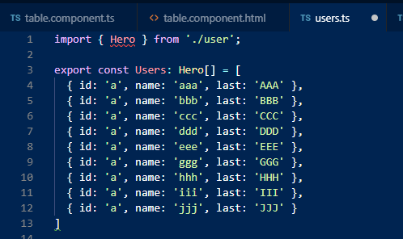
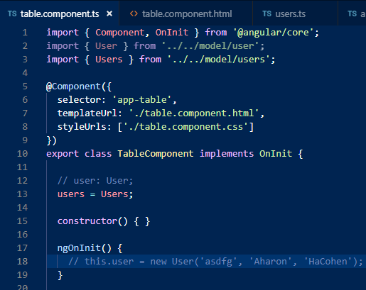
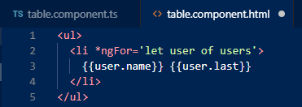
Data model

Slide 18
This work is licensed under a Creative Commons Attribution-ShareAlike 3.0 Unported License. It makes use of the works of Mateus Machado Luna.

