Slide 1
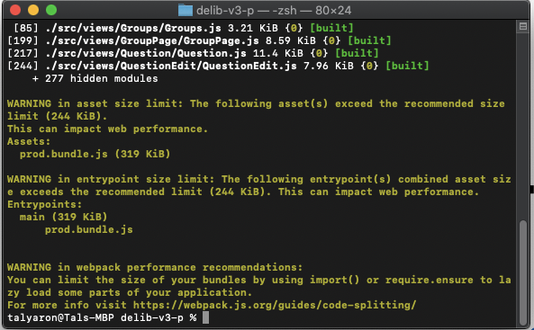


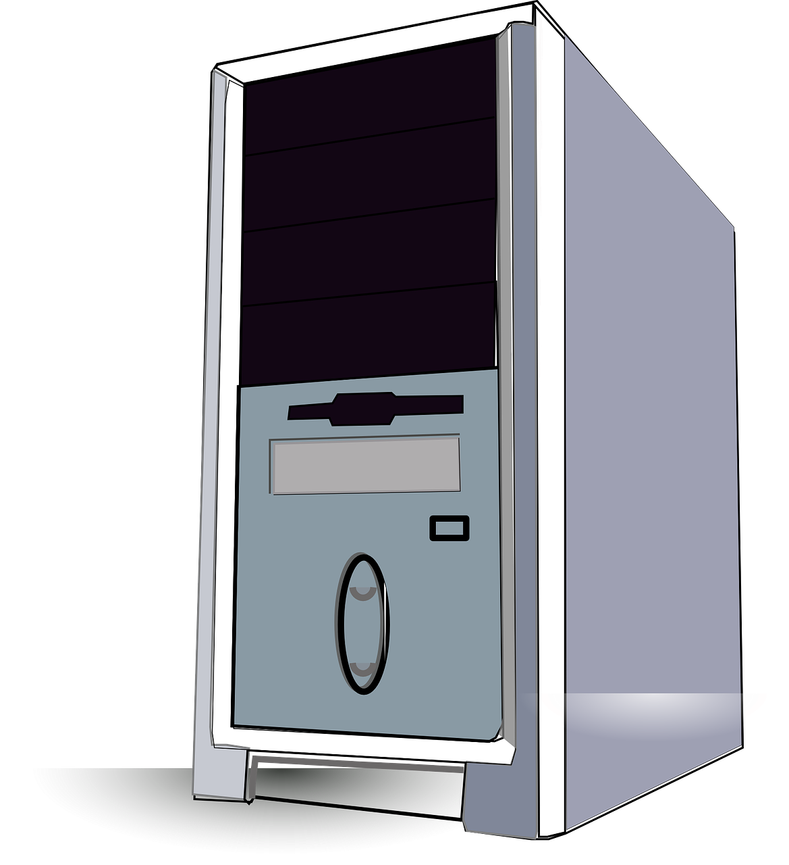

terminal
DNS
Javascript
Client
Javascript – node / deno
python
Ip address (172.45.23.124)
java
Ip address (127.0.0.1)
.net
Javascript
Server
(under a host)
Client

