Slide 1
By value and by reference

Slide 2

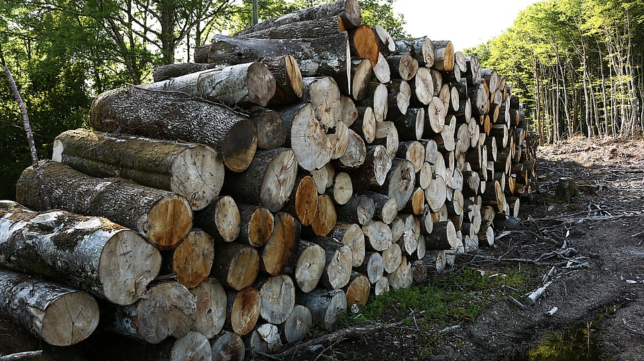
stack
heap
data
data
data
data
data

Slide 3
stack
heap
data
data
data
data
data

Slide 4
stack
heap
data
data
data
data

Slide 5
stack
heap
data
data
data
data
data
data

Slide 6
stack
heap
data
data
pointers
data
data
data
data

Slide 7
By Value
By Reference
Primitives
stack
Objects
heap
String
Number
Boolean
Null
Undefined
Symbol
Object
Functions
Date
Array
Maps
Sets
data
data
pointers
data
data
data
data

Slide 8
