Slide 1
Angular
https://youtu.be/5wtnKulcquA?t=1232

Slide 2
Install
npm i -g @angular/cli
Install instance:
ng new <name of folder>
Run:
cd <name of folder>
ng serve -o

Slide 3
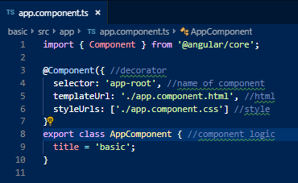
Components
Every component is built out of three files:
Logic (ts)
template(HTML)
Style

Slide 4
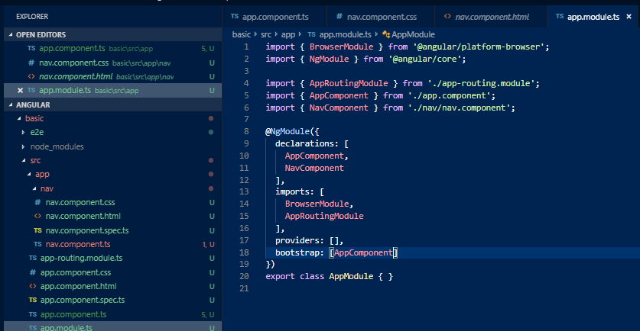
Create component
ng generate component <component name>

Slide 5
Create component
ng g c <component name>

Slide 6
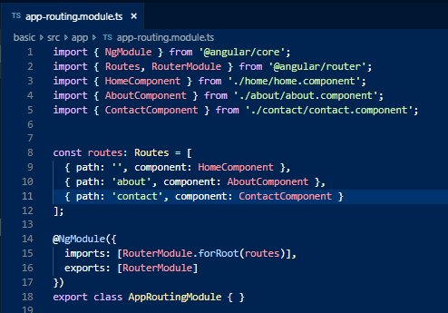
Router

Slide 7
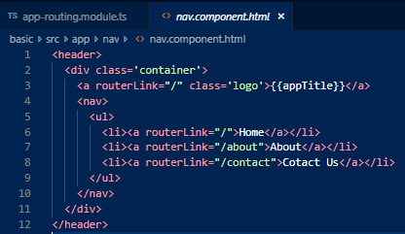
Router

Slide 8
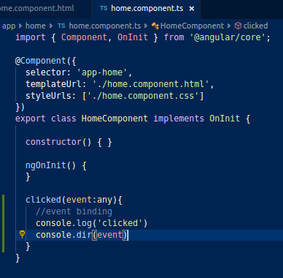

Event binding

Slide 9
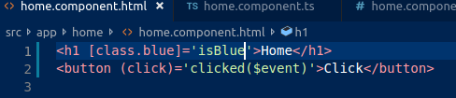
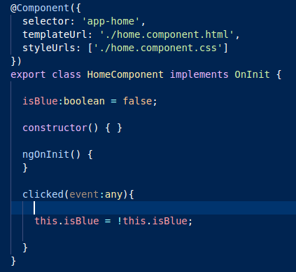
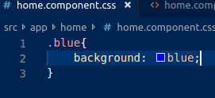
Class binding

Slide 10
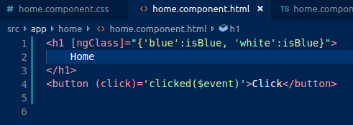
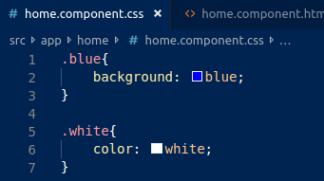
Class binding:many (ngClass)

Slide 11
Class binding: inline

Slide 12
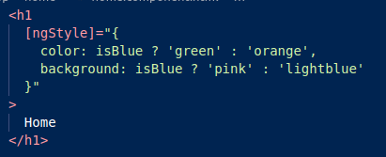
Class binding: inline-multi

Slide 13
Services
Code that is accessible to many components
ng g s <name_of_service>

Slide 14
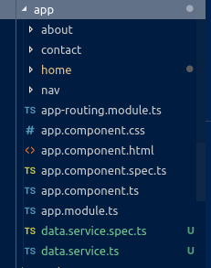
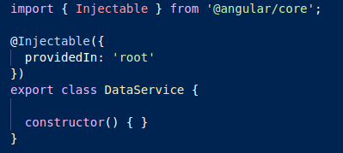
Service

Slide 15
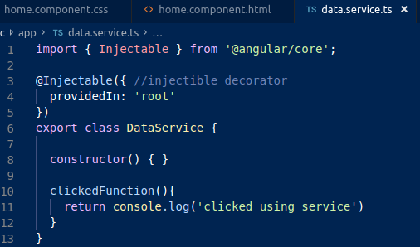
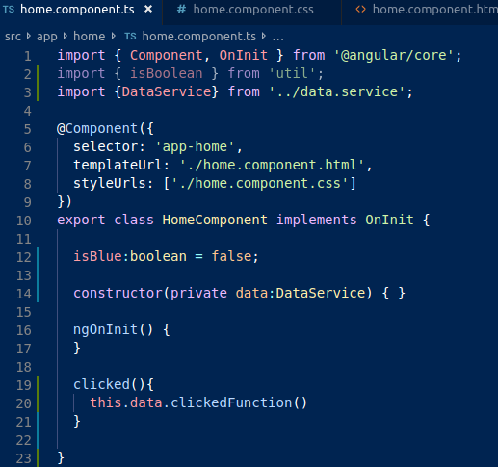
Service

Slide 16
This work is licensed under a Creative Commons Attribution-ShareAlike 3.0 Unported License. It makes use of the works of Mateus Machado Luna.

