Slide 1
Personal information
Name: Alaa Ayman Mohamed
Group: YAT-Web-038L-8Nov-EhabH
Dr: Ehab Habib

Slide 2
Tools used :
Html
css
bootstrap
JavaScript
jQuery
PhP
MySQL
Ajax

Slide 3
Objective :
-The site is For freelancer
-The client searches about
the best freelancer easily

Slide 4
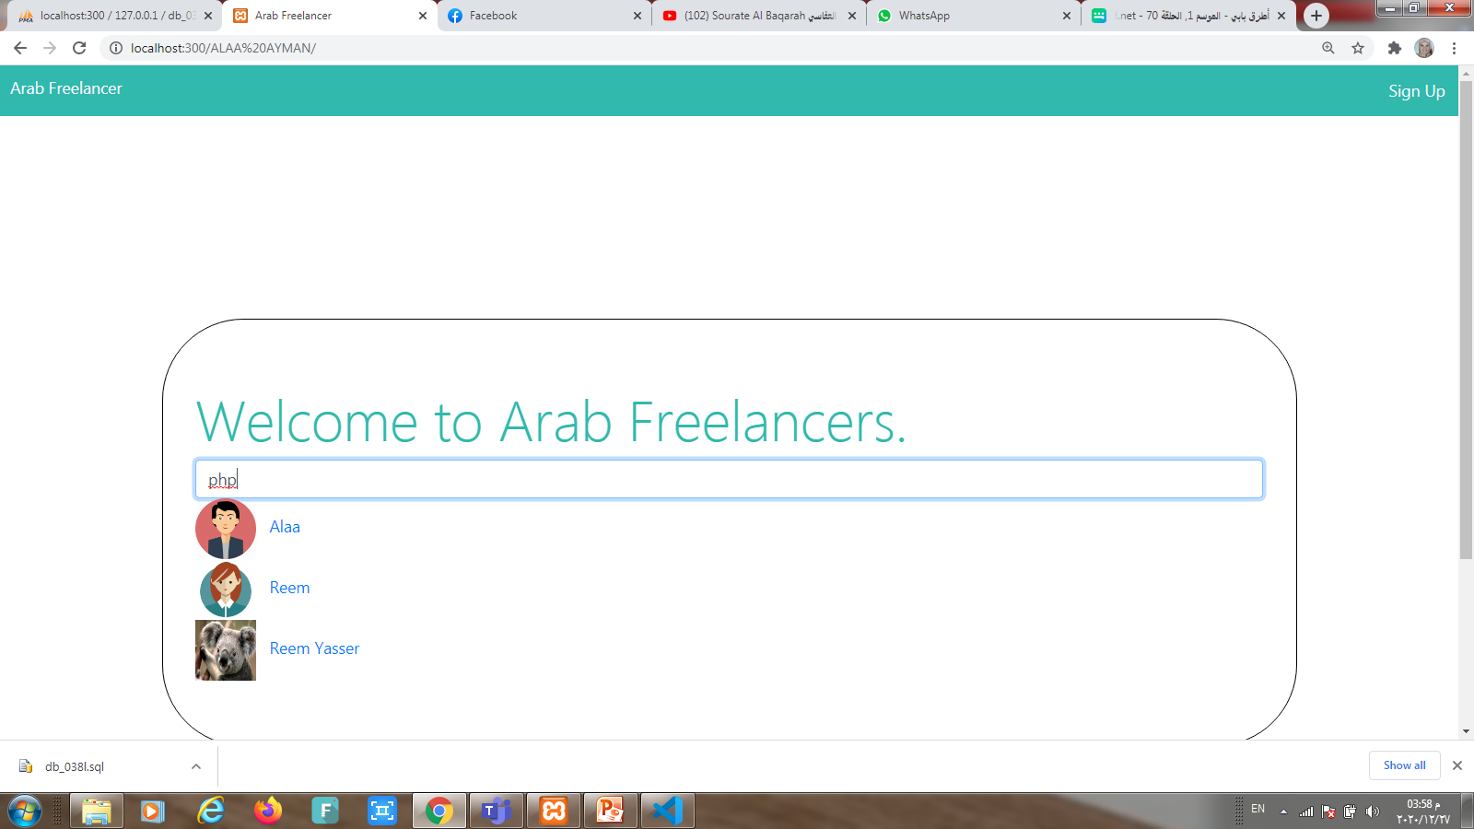
Arab Freelancer site

Slide 5
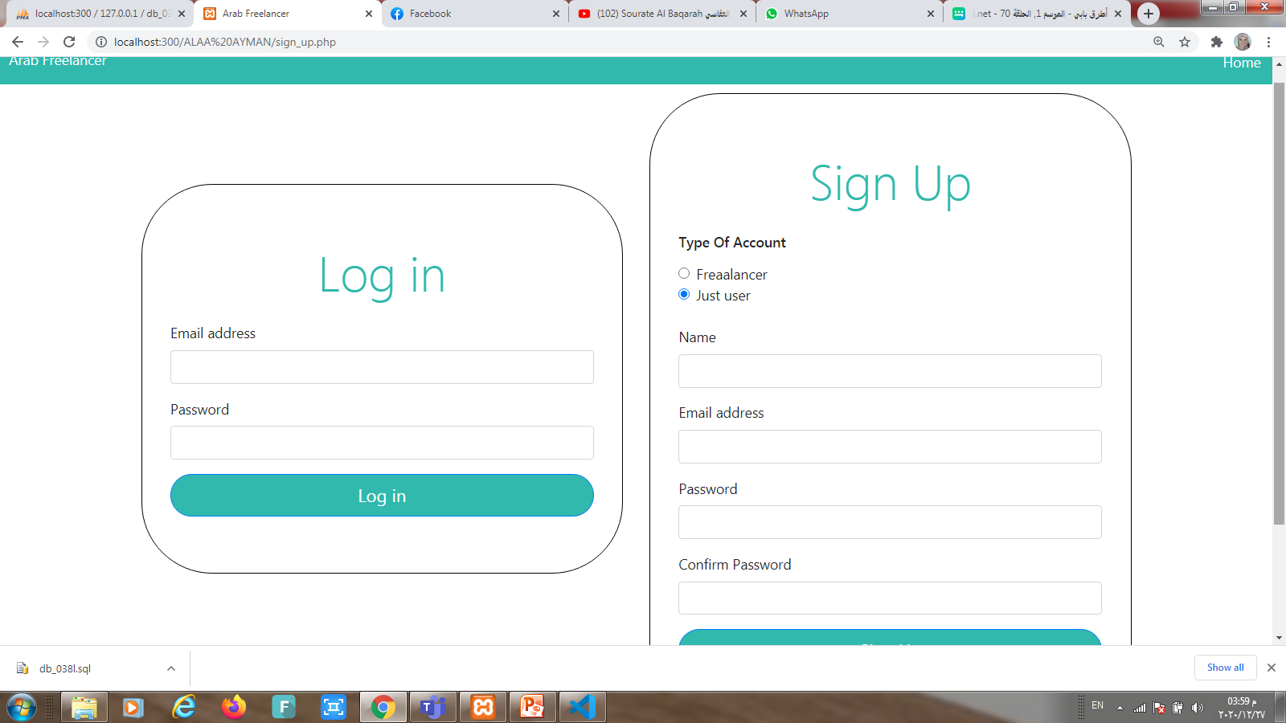
:this is login and signup for user or freelancer

Slide 6
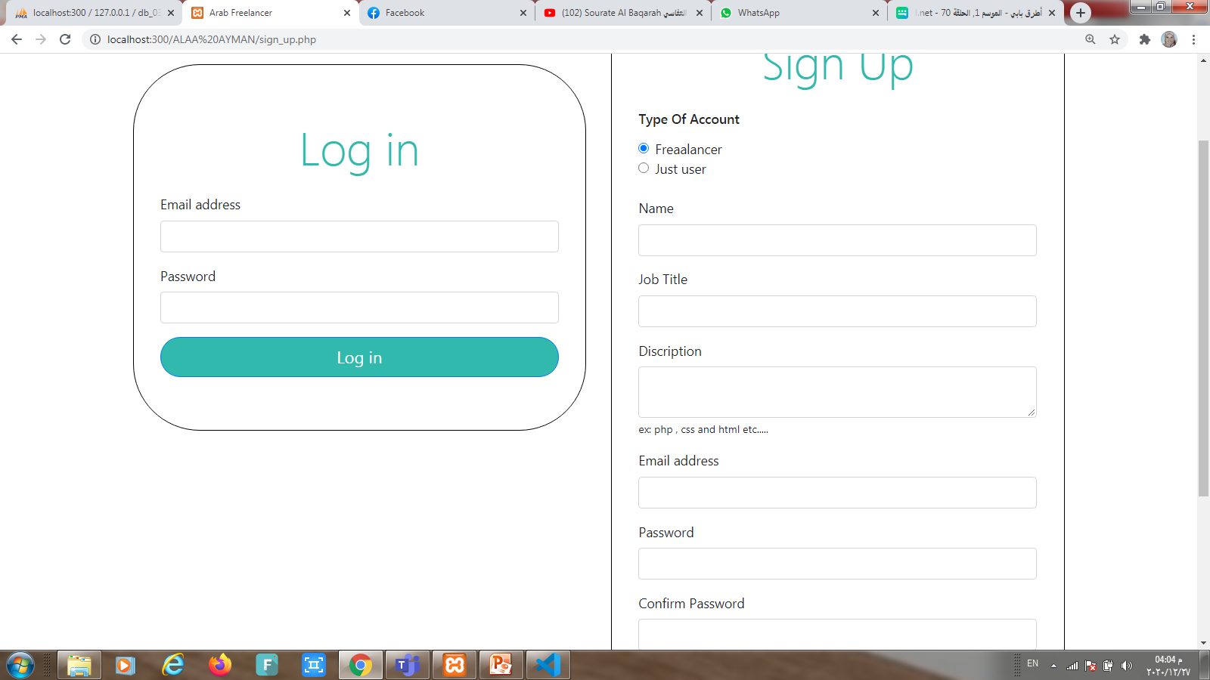
This is the same signup page but for freelancer

Slide 7
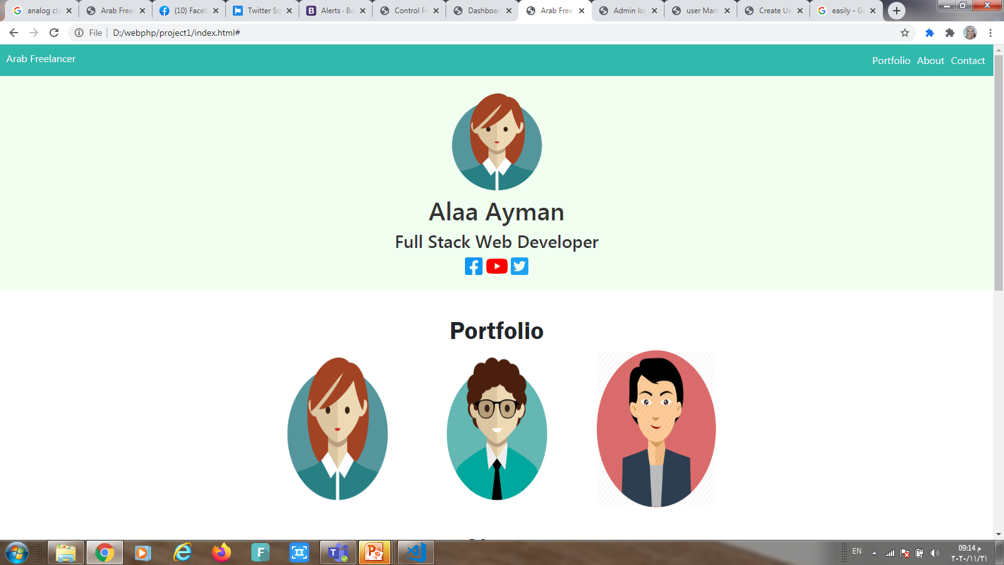
This is freelancer profile :

Slide 8
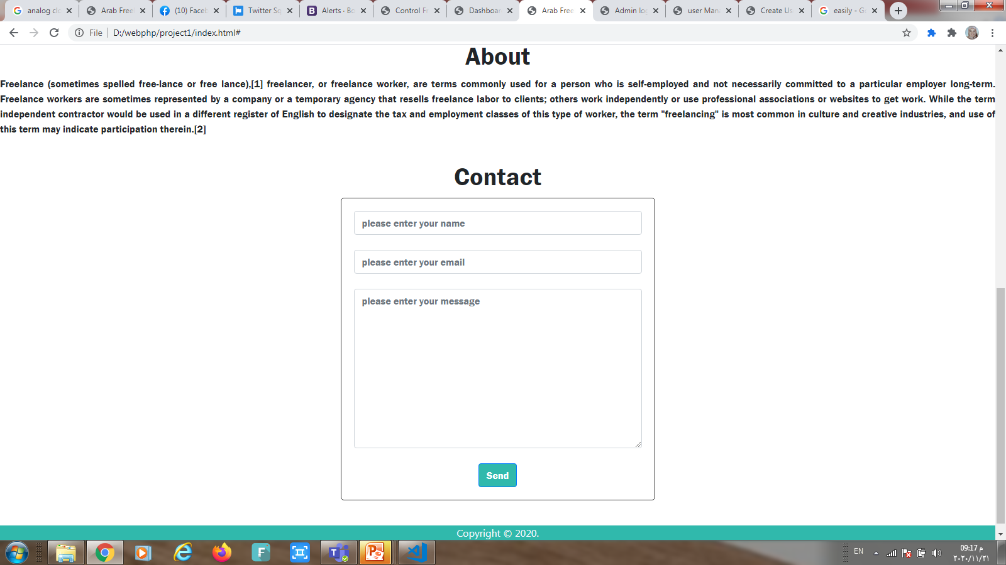
freelancer About and contact

Slide 9
This is admin’s part

Slide 10
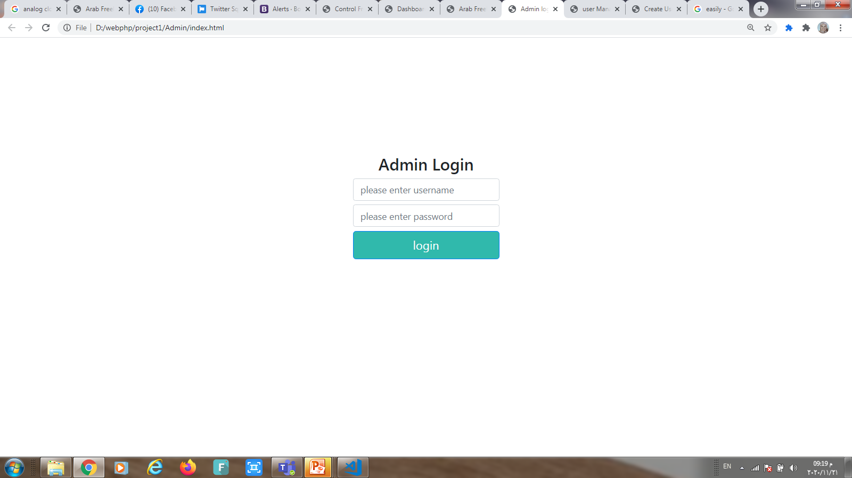
Admin login the website

Slide 11
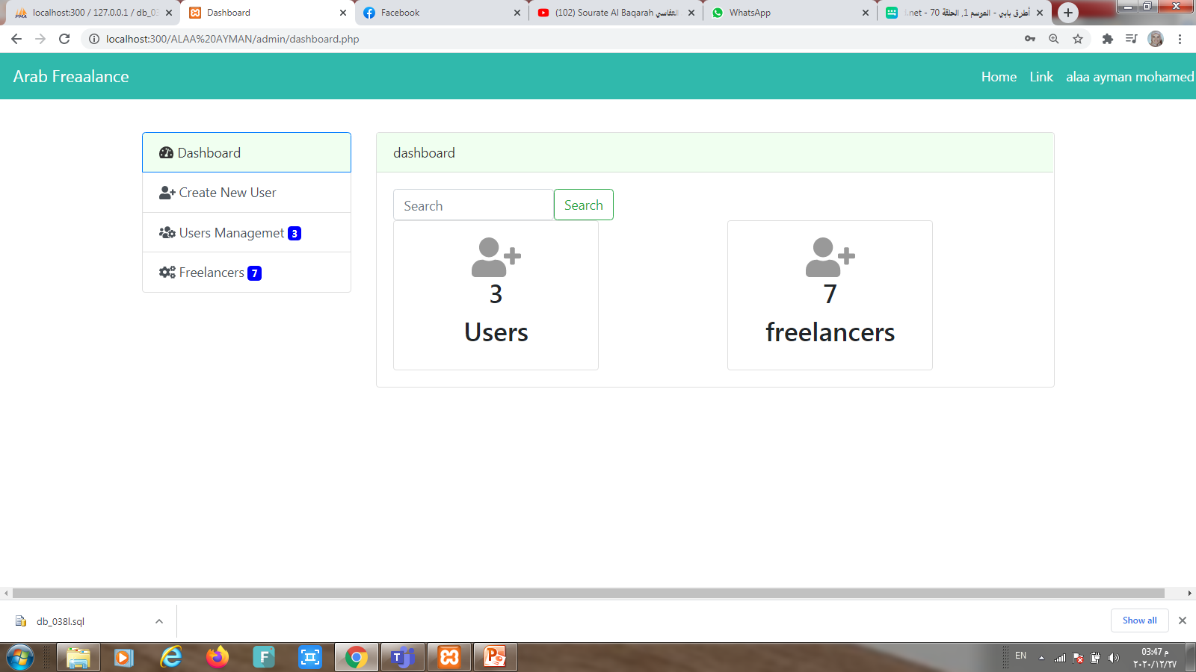
Admin Dashboard the website

Slide 12
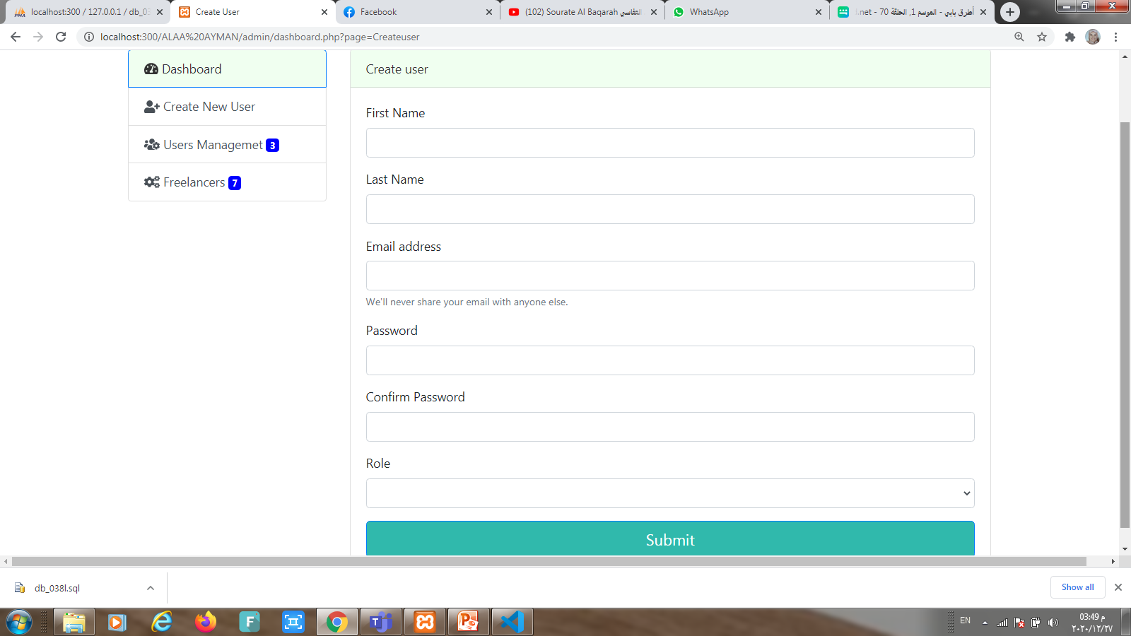
Admin create user

Slide 13
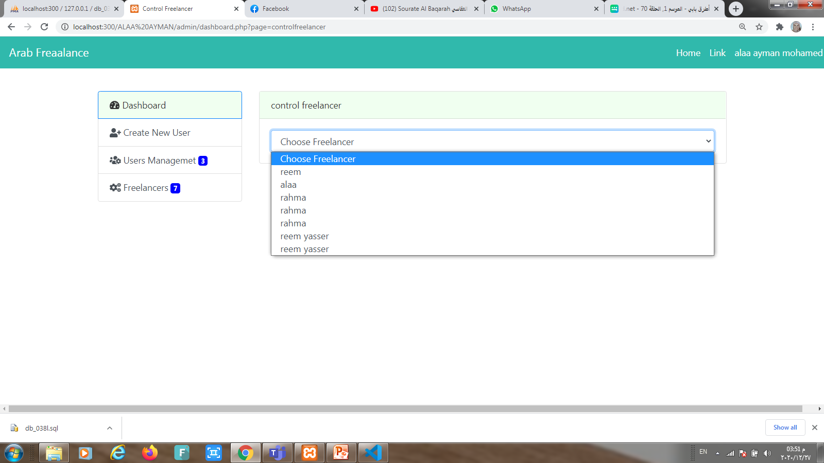
Admin control freelancer

Slide 14
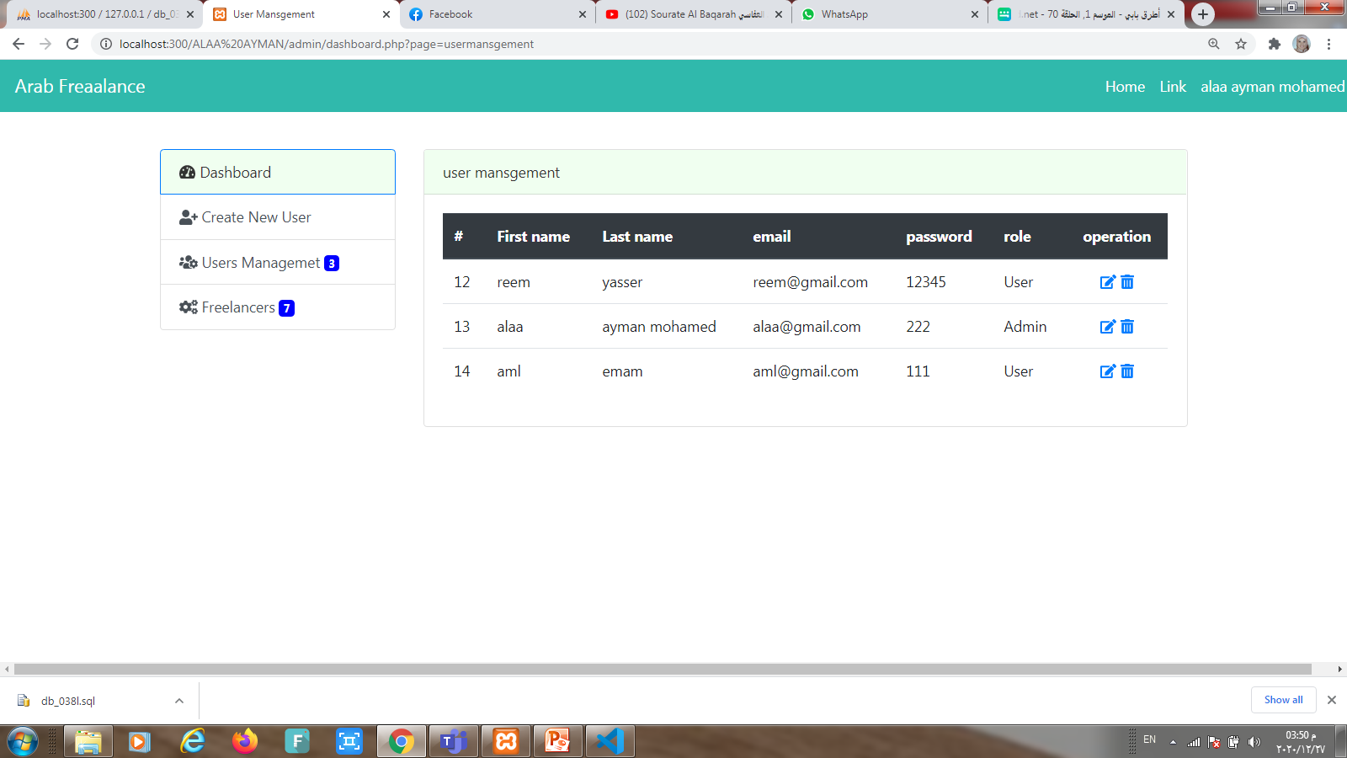
Admin Users management

Slide 15
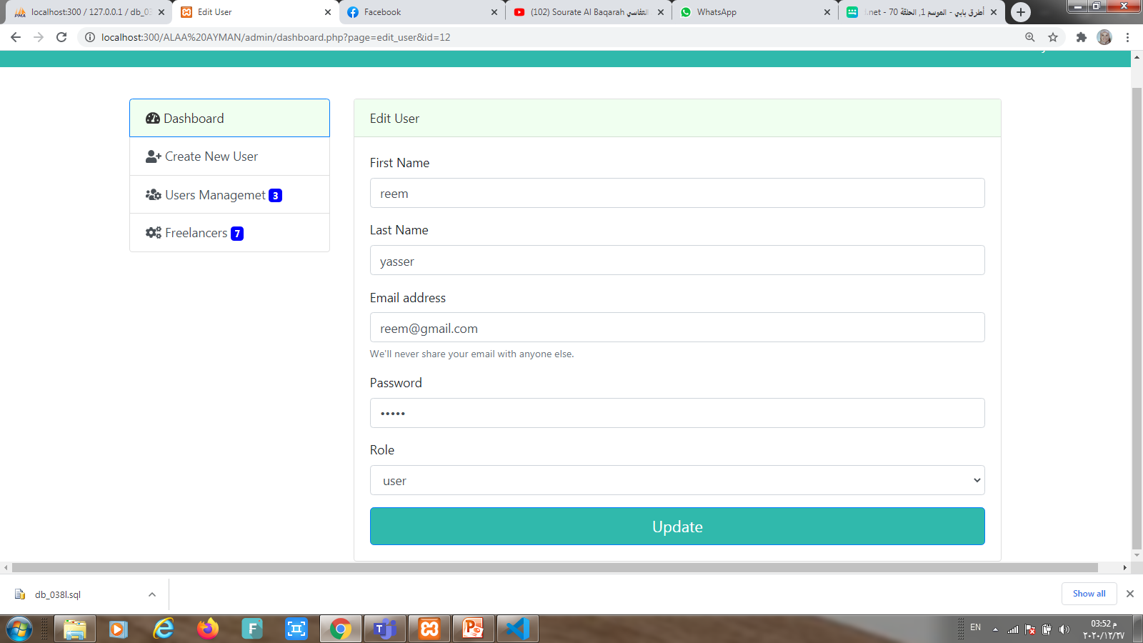
Edit user Information :

Slide 16
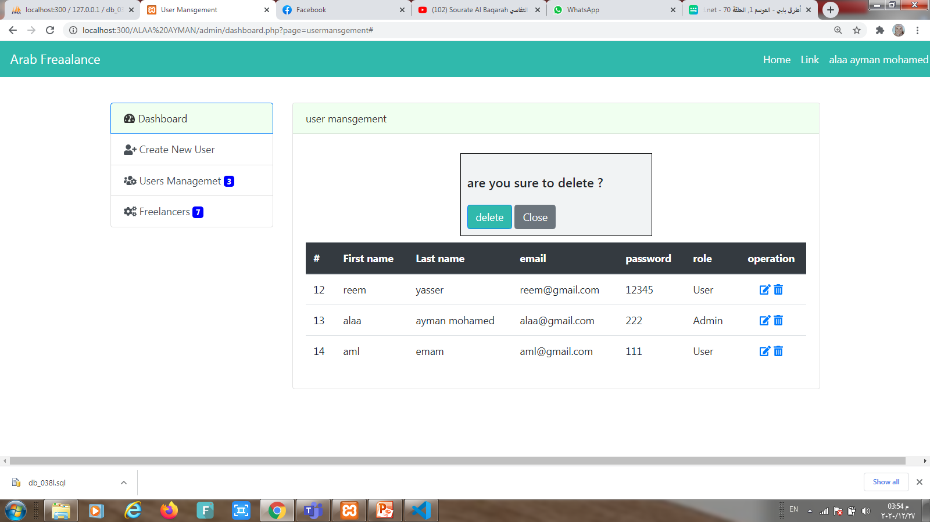
Delete user :

