Slide 1

Interpretable Medical
Diagnosis
Glass-Box Models vs Black-Box Models
Accuracy vs Interpretability
Done by: Reem AL-ZOUHBY
Mariam MARHABA

Slide 2




Project Overview & Goal
Medical Context
The Core Challenge
Breast cancer diagnosis requires both accuracy AND explanations — clinicians must understand WHY a model predicts malignancy to trust it in clinical decisions.
Traditional ML (Random Forest, Neural Nets) achieves high accuracy but is a black-box. Can we match that accuracy while keeping the model fully transparent?
Project Goal
Key Question
Compare EBM (Glass-Box) vs Random Forest (Black-Box) on the Breast Cancer Wisconsin dataset — measuring both predictive performance and interpretability quality.
Do we really sacrifice accuracy for interpretability, or can EBMs give us the best of both worlds?

Slide 3


Glass-Box vs Post-Hoc Explainability
POST-HOC EXPLANATIONS
(Black-Box + Explainer Added After)
GLASS-BOX MODELS
(Interpretable by Design — No Extras Needed)
Model
Random Forest, Neural Net, XGBoost
Model
EBM, Decision Tree, Linear Regression
Process
Train model → then add explanation tool
Process
The model IS the explanation — built in
Examples
SHAP, LIME, Permutation Importance
Examples
EBM, GAM, Logistic Regression
Explanation
APPROXIMATE — an approximation of
the model's true behavior
Explanation
EXACT — the explanation IS the model's
actual decision logic
Fidelity
Can be wrong or misleading in edge cases
Fidelity
100% faithful to the model's computation
Trust Issue
The explanation ≠ the actual model logic
Trust Issue
None — what you see is what the model does

Slide 4
What is EBM? (Explainable Boosting Machine)
P(malignant | x) = σ( β₀ + f₁(x₁) + f₂(x₂) + … + fₙ(xₙ) + fᵢⱼ(xᵢ, xⱼ) )
Shape Functions fₖ(xₖ)
Pairwise Interactions fᵢⱼ
Trained by Boosting
Each feature has its OWN learned curve showing exactly how it contributes to the cancer prediction. These curves are the explanation — no approximation needed.
EBM can also capture how TWO features interact (e.g., high radius + high concavity), making it more powerful than plain GAMs while remaining interpretable.
EBM trains one feature at a time in rounds (like gradient boosting), allowing it to learn complex non-linear shapes while keeping each feature's contribution separable and explainable.

Slide 5
Partial Dependence Plots (PDPs) — Explained
What is a PDP?
PDP: RF vs EBM
A Partial Dependence Plot shows the MARGINAL effect of one (or two) features on the predicted outcome, averaging over all other features.
How it works:
1. Pick feature X (e.g., 'worst radius')
2. For each value of X across its range…
3. Replace every sample's X with that value
4. Get prediction for all modified samples
5. Average the predictions → plot the curve
PDP for RF: POST-HOC — computed AFTER training, only an approximation of the true model behavior.
EBM Shape Functions: INTRINSIC — the shape function IS the PDP, exact by construction.
Property
RF PDP
EBM Shape
Type
Post-hoc
Intrinsic
Fidelity
Approximate
Exact
Speed
Slow (recompute)
Instant
Corr. features
Can mislead
Robust
Trust level
Medium
High

Slide 6
Dataset & Methodology
569
30
357
212
Samples
Features
Benign
Malignant
PIPELINE
Load Data
Train/Test Split
(80/20 stratified)
Scale (RF only)
Train RF
200 trees
Train EBM
(3 interactions)
Evaluate
Acc + AUC
Visualize
PDP + Shapes
→
→
→
→
→
→
Evaluation Metrics Used
✦ Test Accuracy — % of correct classifications on unseen data
✦ AUC-ROC — Area under ROC curve; measures discrimination power
✦ 5-Fold Cross-Validation — Checks generalization, reduces overfitting risk
✦ Precision / Recall / F1 — Critical in medical context (false negatives are costly)

Slide 7
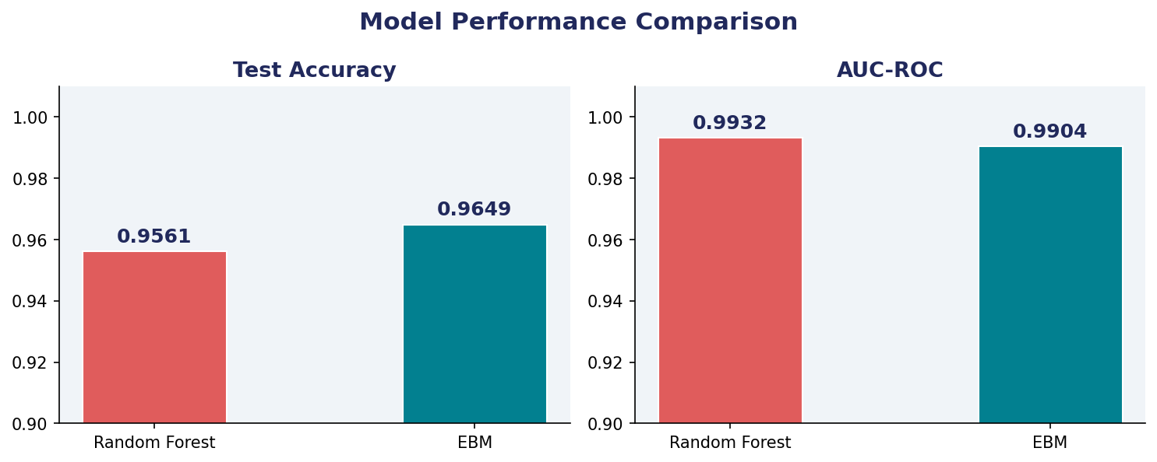
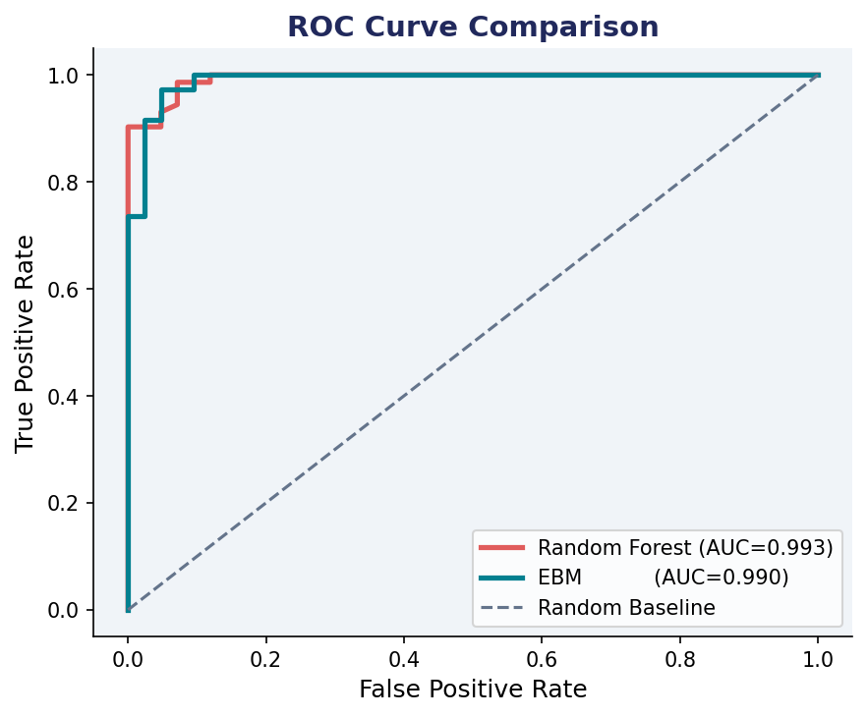
Results: Performance Comparison
Metric
Random Forest
EBM
Winner
Test Accuracy
95.61%
96.49%
EBM ✦
AUC-ROC
99.32%
99.04%
RF ✦
CV Accuracy
96.26% ± 1.8%
96.92% ± 1.3%
EBM ✦
Interpretable
❌ No
✅ Yes
EBM ✦

Slide 8
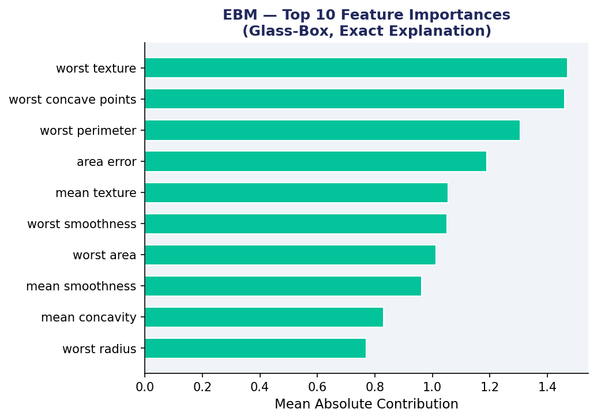
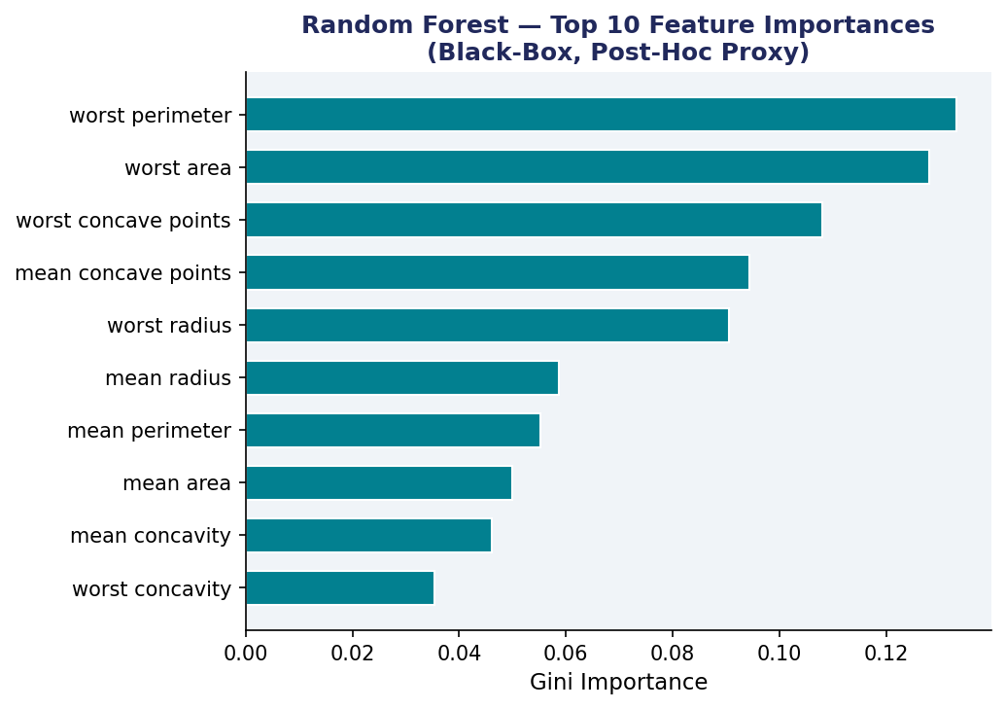
EBM Global Explanation — Feature Importance
RF post-hoc feature importance (Gini)

Slide 9
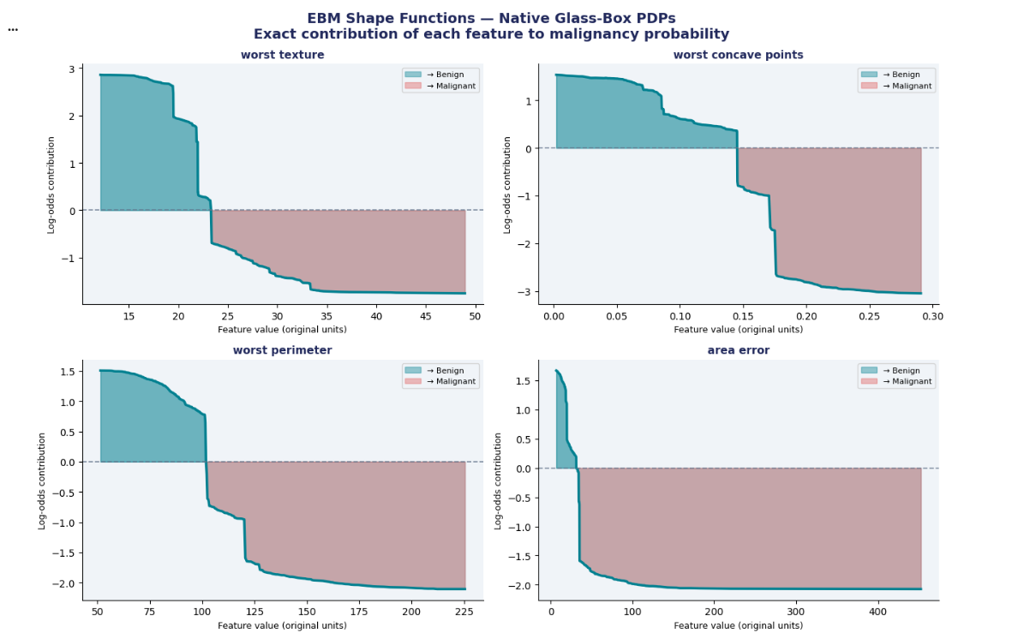
EBM Shape Functions — Native PDPs (Glass-Box)

Slide 10
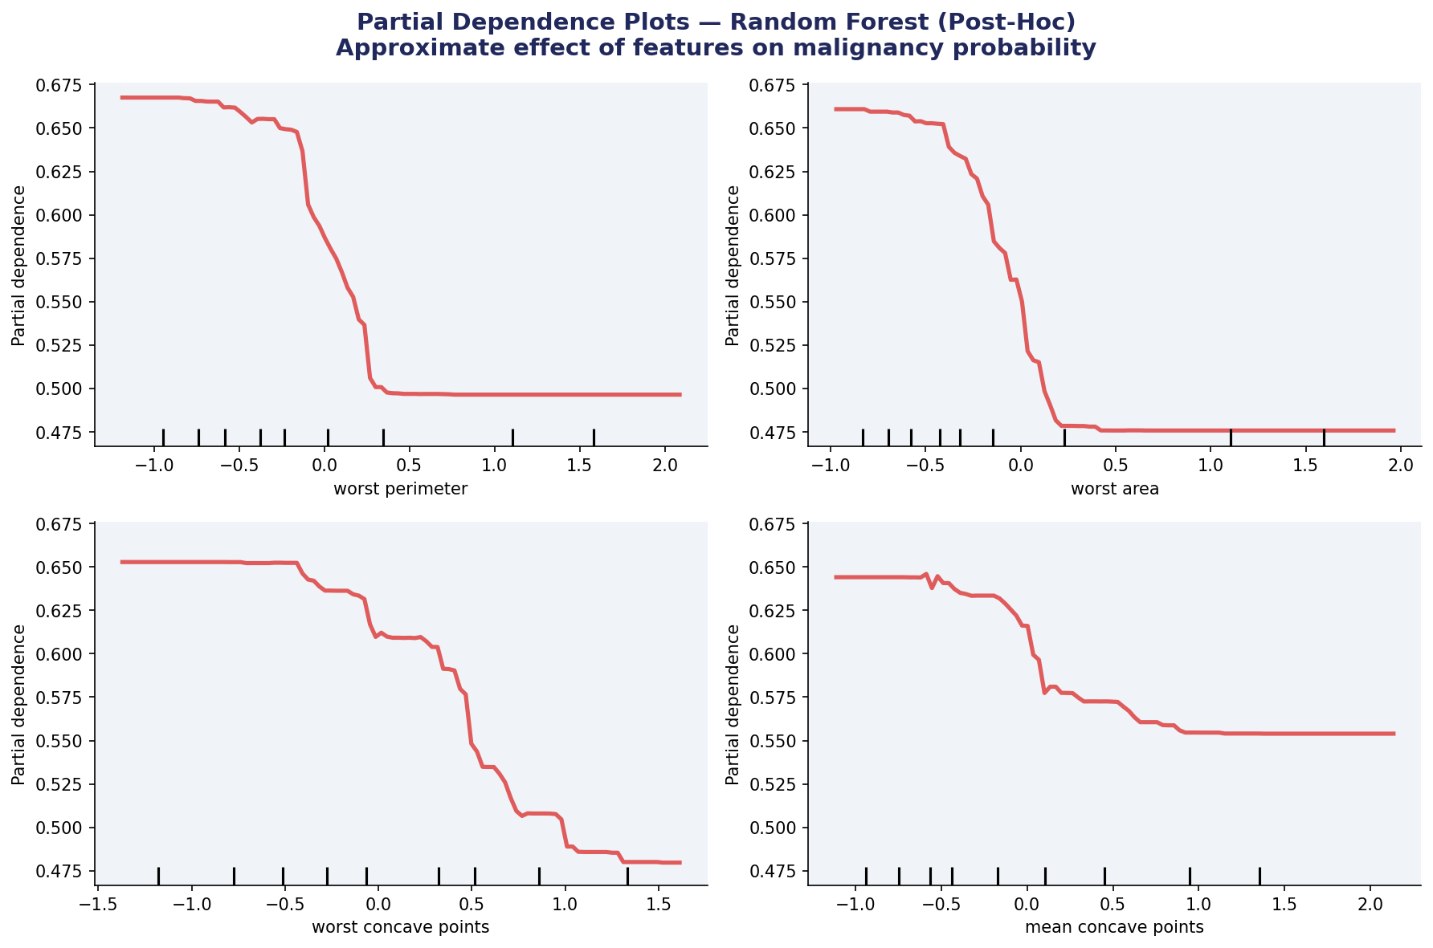
Random Forest — PDPs (Post-Hoc Approximation)

Slide 11
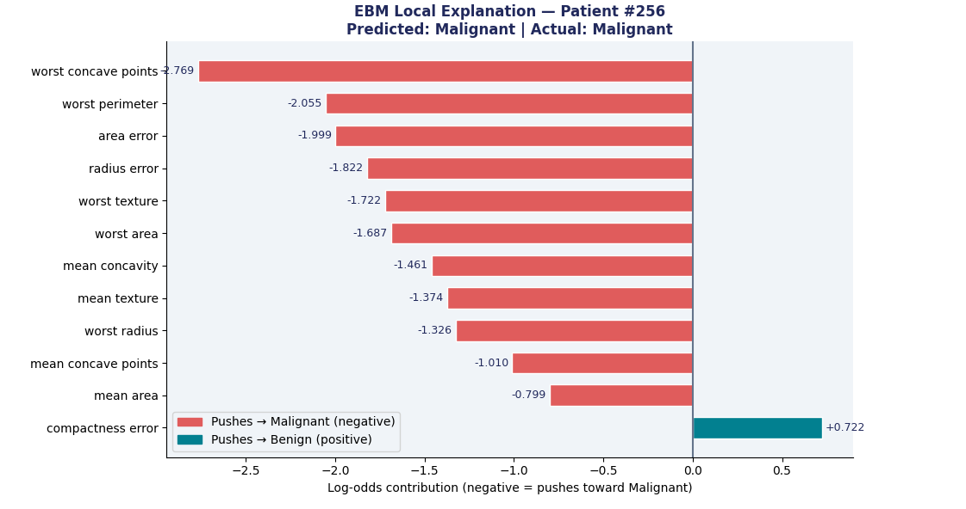
EBM Local Explanation — Single Patient Prediction

Slide 12
Discussion: The Accuracy–Interpretability Tradeoff
← More Interpretable
More Accurate →
Linear
Regression
Decision
Tree
GAM
EBM ★
Random
Forest
Neural
Net
The Myth
When RF Wins
It was long assumed that interpretable models are less accurate. Our results challenge this: EBM (96.49%) outperformed Random Forest (95.61%) on this dataset.
RF achieved slightly higher AUC (99.32% vs 99.04%). In complex tabular data with many high-order interactions, black-boxes may still have an edge.
When EBM Wins
Medical AI Principle
EBM wins on interpretability, regulatory compliance, clinical trust, debugging, and in many real-world datasets with reasonable feature complexity.
In high-stakes decisions, a model that is 99% accurate but unexplainable may be less useful than a 97% accurate model with clear, auditable explanations.

Slide 13
Conclusions
01
EBM ≈ RF Accuracy
Explainable Boosting Machines achieved 96.49% accuracy vs RF's 95.61% — demonstrating that interpretability does not require sacrificing predictive power.
02
Interpretability Is Real
EBM shape functions provide exact, faithful explanations. Unlike SHAP/LIME applied to RF, no approximation is involved — what you see IS the model.
03
PDPs: Native vs Post-Hoc
EBM's shape functions are intrinsically PDPs — instant, exact, and reliable. RF PDPs are approximate, slow, and can mislead when features are correlated.
04
Medical AI Recommendation
For clinical decision support, EBMs should be the default choice. They satisfy regulatory requirements and clinical trust without compromising accuracy.

Slide 14
Thank you for your attention ;)

