Slide 1
TD
RISK DATA PLATFORM
Technology & Data:
Where We Are, Where We're Going
The Risk technology and data landscape — the applications and layers in play today, the constraints we operate within, and the path to a governed analytics environment alongside the enterprise model.
Internal

Slide 2

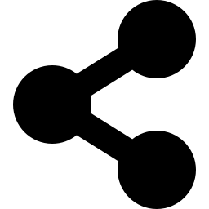
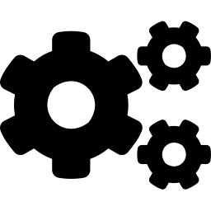
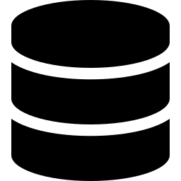
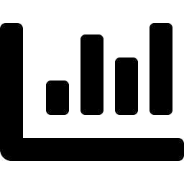
WHERE WE ARE · THE LANDSCAPE
Risk Applications & How Data Flows Today
RISK PRODUCT GROUPS
Credit Risk
Market Risk
Liquidity
Finance
XVALA · CMOS · CRS · REGDS · TCC
RCAPS · RCS · RAMS · SRLM · Infinity
ALFA
TRW
Produces: XVA, collateral, counterparty exposure, limits
Produces: Valuations, VaR, sensitivities
Produces: Liquidity & funding metrics
Produces: P&L consolidation, attribution
How data flows today — from sources, through enterprise-managed layers, to Risk applications and consumers
ENTERPRISE-MANAGED
RISK-OWNED
Source systems
›
Enterprise distribution
›
Risk processing
›
Stored in many systems
›
Consumption
OMS / TMS — Calypso · Murex · Sophis · Matrix; market & reference data
Veritas services · InfoP · Dremio · CDS · streaming (Kafka)
Calc engines — vendor or in-house
Postgres · HBase · Cassandra · SQL Server · Druid · files
Service APIs + CSV → Excel ·
Strategy / BI · custom UIs
InfoP / CDM run on the enterprise platform (Cloudera) — separate from TDVIP. Dremio is the query engine for InfoP.
Risk data is produced and distributed. But nothing tells each consumer what the data means — so consumers have to work it out for themselves.
The shift ahead — Risk data modernization: from silo’d data copies, where every team re-derives its meaning, to sharing one governed set — one catalog, one set of meanings. It starts with the move onto TDVIP and declaring schemas and definitions in unity catalog (databricks)
TD Securities · Risk Data Platform
Internal
1
Notes:
Current landscape, one slide. Top: the four product groups and what they produce (Liquidity = ALFA only; Finance = TRW only; SRLM and Infinity sit under Market Risk). Below: the layered flow, colour-coded to separate enterprise-managed central layers (Veritas, InfoP, Dremio, CDS, streaming — on Cloudera) from Risk-owned tech (calc engines, polyglot persistence). Calc is vendor / Monte-Carlo / in-house; distribution is service APIs + CSV. Close on the neutral message: it works, but no shared meaning travels.

Slide 3


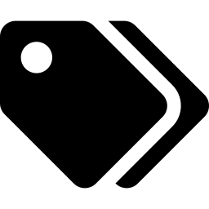


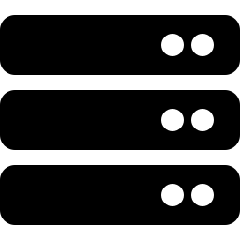
WHERE WE ARE · THE PLATFORM
TDVIP Platform, Tooling & Operating Constraints
TDVIP — the new Databricks risk analytics platform – medallion architecture
Tooling in the stack
Account One TDS Databricks account, managed by TD
Dremio
Queries InfoP (enterprise CDM); Currently does not integrate with Unity Catalog .
Workspace provisioned by the platform team ( expected:dedicated, actual: shared)
Strategy (MicroStrategy)
Catalog = product group creditrisk · marketrisk · liquidity · finance
Own semantic model (Databricks lacks today); enterprise direction still to be settled
Power BI
Schema = app / project One or more per risk app, apps build conformity and contracts.
Approved BI tool for dashboards and self-service .
riskwh enables business analytics — consuming app-published data products and joining across products.
Platform-owned: workspace · catalog · schema & properties · compute. Risk-owned: objects within a schema.
What's slowing us down today
The normal guardrails — compute from an approved list, central provisioning — are fine. These five actually slow us down:
Setting up takes a ticket
We get a room, not the building
AI & self-service are switched off
The same data, described twice
We share a workspace, not our own
A new data area must be created by the platform team and named using app deployment codes — not the business name. We wait on it.
We can work inside a space, but can't create or change the space, its labels (tags) or settings ourselves.
Serverless is off, so the AI assistant, the business-friendly metric layer and self-service aren't available to us yet.
Dremio doesn't connect to Databricks’ catalog, so data gets defined in two places — and the two can drift apart.
Because of IP limits, Risk shares a workspace rather than having a dedicated one — less isolation, and harder to manage as we grow.
Expectation: domain teams set up their own areas within guardrails.
Expectation: domain teams own their own space.
Expectation: these run as standard.
Expectation: one catalog (Unity Catalog), not two.
Expectation: each domain or business unit gets its own workspace.
TD Securities · Risk Data Platform
Internal
2
Notes:
Platform + tooling + constraints on one slide. Left: the TDVIP/Databricks operating model. Right: the other tools (Dremio enterprise-managed; Strategy and Power BI approved BI), plus a colour-coded ownership line. Constraints, sharpened: schema names tied to malcode; control inside a schema but nothing above it (no create/alter schema, tags or properties); compute set by policy and serverless off (which gates AI and the semantic layer); slow/IP-limited workspace provisioning (shared not dedicated); and the engagement point — the platform should facilitate, not gate. Detailed ownership matrix is Appendix A2.

Slide 4

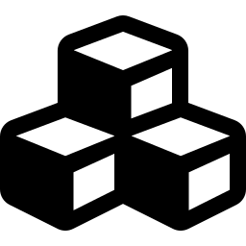
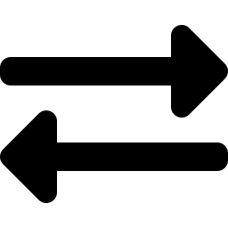

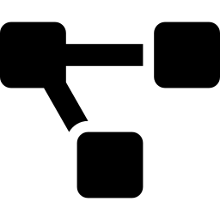

WHERE WE'RE GOING · STEP ONE, INSIDE RISK
Domain-First Conformance & Risk Data Products
Step one of the shift, inside Risk: conform the data once in Risk, so every team reads the same thing — then align to the enterprise. Built once, read in place.
RISK DOMAIN
Then the enterprise
Business Analytics & Reporting
Governed dashboards and self-service via the Strategy semantic model
Conformed Risk entities align to — and contribute back to — the enterprise CDM where Risk owns expertise CDM does not yet cover (netting set, CSA terms, regulatory regime).
Risk Data Products
Exposure · PFE · Limits — schema and metadata travel as a contract
Populate forward, consume back
conform
& elevate
Risk Conformed Entities
One agreed definition across the Risk domain
Apps feed the conformed model and read it back. One model — conformance is no longer rebuilt downstream.
Product-Group Conformance
Reconcile entities across applications within a product group
What unlocks it
Application data & app-entity conformance
Risk-generated data lands in app schemas; elevate existing datasets into a data model
Serverless brings native AI, the semantic metric layer and self-service.
TD Securities · Risk Data Platform
Internal
3
Notes:
The target conformance model, domain-first. Inside the Risk Domain boundary, data is conformed in an upward progression: app data → product-group conformance → Risk conformed entities → Risk data products (exposure, PFE, limits) → business analytics (Strategy). The single upward arrow fixes the earlier odd arrows. Right rail: then align to the enterprise CDM (domain-first, then enterprise); populate-forward/consume-back so conformance isn't rebuilt; and serverless as the unlock. PoC validates the model (no application named).

Slide 5

WHERE WE'RE GOING · STEP TWO, WITH THE ENTERPRISE
Same Answer, Whichever Way You Ask
Step two of the shift, upstream of Risk: today the enterprise sends the same information two ways, and each app lines them up itself. There is a simpler way.
TODAY — TWO main ENTERPRISE PATHS, IN PARALLEL
Veritas real-time service
Risk apps
The risk: the two paths can carry the same number differently, so a figure read live may not match the one reported at end-of-day.
Different Semantics.
Reconciliation between two data models left to the Apps.
Its own data model · not governed
consume both paths
CDM end-of-day batch
each app lines them up itself
Conformed, governed model · new
THE OPPORTUNITY — ONE GOVERNED MODEL, SERVED TWO WAYS
›
›
›
Live feed in
One governed model
Served two ways
Same answer for every app
Real-time data flows in as the input — not as a second model
Agreed meaning, lineage and a data contract — defined once
A live view and an official end-of-day snapshot — from the same model
No one re-does the mapping; the numbers line up
Live and end-of-day won't match every second — but they mean the same thing and line up at end-of-day. Governing the live feed (lineage + contract) is the price of entry.
TD Securities · Risk Data Platform
Internal
4
Notes:
Reframed to the enterprise opportunity in plain language. Both Veritas (real-time) and CDM (batch) are ENTERPRISE paths for the same data; the Risk Data Model is a separate Risk-domain concern (Slide 3). Today the two paths can disagree and each app reconciles them. The opportunity: one governed model (agreed meaning + lineage + data contract), fed by the live feed as input, served two ways (live view + official end-of-day snapshot) so every app gets the same answer. Real-time and batch won't be identical every instant, but they share meaning and reconcile at end-of-day. Governing the live feed is the precondition. Avoid implying Veritas becomes the source of truth — the governed model owns the meaning.

Slide 6
APPENDIX · A1
TDS Data Domains — the Enterprise View
The domains the enterprise CDM models. Risk's generated outputs sit primarily in Derived Data & Metrics; everything else is shared enterprise data Risk consumes.
Pre-Trade
Post-Trade
Position
Payments
Cash · OTC Derivs · Listed Derivs
Cash · OTC Derivs · Listed Derivs
Position · Cash Balances
Payments
Derived Data & Metrics
Transactions
GL
Reference & Master
RISK
VaR · xVA · Valuations · Collateral · PnL · Cash Flows
Margin · Deals · Fees · Loans · Deposits
NOSTRO / VOSTRO
Party · Account · Facilities · Trading Agreements
Product / Instrument
3rd Party Market Data
Internal Pricing Data
Research
Product · Instruments · Basket Comp.
Pricing · Corporate Actions · Other
Pricing · Other Internal Data
Research
Risk
Reference
Market
Finance / GL
Transactional
TD Securities · Risk Data Platform
Internal
A1
Notes:
Orientation appendix: the enterprise data-domain taxonomy the CDM models. Risk-generated metrics sit in Derived Data & Metrics (highlighted); the other domains are shared enterprise data Risk consumes. Useful for the new CDO to place Risk within the bank-wide model.

Slide 7
APPENDIX · A2
Databricks Governance Control — Who Owns What
Control sits largely with the platform team (amber). Risk's control begins inside the schema (green). This is the detail behind the constraints.
Control area | Cloud Ops | TDVIP (Workspace) | Catalog Owner | Schema Owner (App / Risk)
Workspace / Network / Storage | Provisions | Requests | — | —
Unity Catalog binding | — | Configures | — | —
SQL Warehouse | — | Provisions | — | Uses
Catalog creation | — | Creates | — | —
Schema creation | — | Creates | — | Provides names
Schema properties / tags | — | Owns | — | Requests
Cluster policy | — | Creates | — | Must follow
Cluster · Jobs · Tables · Views | — | — | — | Creates
Data permissions | — | — | Cross-schema | Own schema
Cross-catalog sharing | — | — | Approves | Requests
Platform-owned
Risk-owned (within a schema)
Industry practice: domain teams are granted schema creation and ownership within central guardrails, so the green boundary sits higher. Granting CREATE SCHEMA / ownership in Unity Catalog moves it there — domain self-service without a product change.
TD Securities · Risk Data Platform
Internal
A2
Notes:
Detail behind Slide 2's constraints, colour-coded. Amber = platform-owned, green = Risk-owned. The pattern is clear: everything at and above the schema is platform-owned; Risk's control starts with objects inside a schema. The note is the constructive unlock — granting CREATE SCHEMA / ownership within guardrails moves that boundary up, enabling domain self-service without a product change.

