Slide 1


Diabetes prediction based on TEDDY Reenal Boddul
mainly.ai
™®

Slide 2
Outline
™®
About Me
Artificial Intelligence
TEDDY Study and Type 1 Diabetes
Problem Statement(s)
AI Tools Used
Tested Models
Selection of Model
Q & A
Notes:
Problem: to exchange insights from AI and ML models in a privacy-preserving fashion. We’ll address this in a couple of slides

Slide 3

About Me
™®
My name is Reenal Boddul
Data Scientist @ MainlyAI
~6 + years of experience in Software Development and Project Implementation and 2+ years’ experience as Data Scientist Machine Learning and Deep Learning Developer
Publish my success story in WINDS Pune (https://wimldspune.wordpress.com/2022/04/02/reenal-boddul/)
(https://halloffame.ineuron.ai/achiever/Reenal-Zampal-(Boddul)-AtQRPU)
Open-Source Contributor
Mentor, and Speaker
Playing Cricket, Reading, Traveling , Cooking
Notes:
Problem: to exchange insights from AI and ML models in a privacy-preserving fashion. We’ll address this in a couple of slides

Slide 4
MainlyAI
™®
Store, track and manage your knowledge objects* in one place
Group and user management for knowledge object access and sharing
Execute models in MIRANDA
Pull models into the platform from outside
Multi-tenancy model
Privacy-preserving sharing of insights
Share insights across the units and geographies
Stockholm and Palo Alto based startup company
Personalization and optimization using AI
Health and Sustainability
MIRANDA / AIStore
Store, track, manage, execute, trade knowledge objects
Privacy preserved multi-tenant
PaaS
*knowledge object is a collection of all data streams and machine-readable insights including ML models, related to a certain KPI of interest that we are monitoring, predicting and actuating
Notes:
Uppfatta
Data
Moving frontier definition
Growing set of technologies

Slide 5
Artificial Intelligence
™®
An ensemble of technologies that makes it possible for machines to learn from experience, adjust to new data, take actions that maximize the chances of reaching a goal, and perform human-like tasks.
Term coined by John McCarthy to describe science and engineering of making intelligent machines (1955).
Notes:
Uppfatta
Data
Moving frontier definition
Growing set of technologies

Slide 6
Artificial Intelligence
™®
Artificial intelligence (AI) makes it possible for machines to learn from experience, adjust to new inputs, and perform human-like tasks
Popular branch of computer science with aims to build intelligent machines capable of performing intelligent tasks
Activities that would necessitate human intelligence
Notes:
Problem: to exchange insights from AI and ML models in a privacy-preserving fashion. We’ll address this in a couple of slides

Slide 7
AI Progression
™®
Deep learning algorithms started to become mainstream in the early 2010’s.
Deep learning algorithms represent AI techniques that have neural networks capable of unsupervised learning from data that are unstructured.
Notes:
Problem: to exchange insights from AI and ML models in a privacy-preserving fashion. We’ll address this in a couple of slides

Slide 8
AI Fields
™®
AI
z
Content Extraction
Machine Translation
Natural Language Processing and Speech
Reasoning
Deductive, Inductive, Analogical, Abductive, Cause-and-effect, Critical thinking, Decompositional reasoning.
Speech Recogition
Speech Synthesis
Machine Learning
Deep Learning
Computer Vision
Automated Planning and Scheduling
Classical, Temporal,
Probabilistic, Contingent, Planning, Conformant, Preference-Based Planning
Image Recognition
Machine Vision
Notes:
This slide illustrates the fields of AI
No clear distinctions between them - sometimes technologies developed in one field can be useful in another.
Overlaps
Machine learning algorithms, are of wide use by all fields of AI. Such algorithms improve automatically through experience and by use of data.
Deep learning algorithms in particular, inspired by biological systems such as the human brain, are of widespread use.
Natural language processing algorithms process and analyse natural language data, with an end-goal for machines to understand the meaning of the language. Speech recognition algorithms convert spoken language to machine readable text, that can later be processed by NLP. Speech synthesis algorithms convert text into human-interpretable speech.
Reasoning infers facts from existing data using logic. It mimics human’s process to think rationally and find valid conclusions. For example, in deductive reasoning facts can be deduced from logically related known information.
If all humans eat vegetables and Dennis is human, then Dennis eats vegetables.
In inductive reasoning uses generalization, not always guaranteeing the truth of a conclusion. For example, if it is cloudy and rainy, then it will rain on all cloudy days. The usefulness of inductive reasoning lies in establishing probability, i.e. the probability that it could be that it could rain on a cloudy day with some probability.
Computer vision derives information from images that are meaningful to humans. For example, image recognitions might recognise objects in an image, while visual object detection also reveal their position.
Planning and scheduling identifies a strategy to be executed. It is of particular use in robotics, which interpret these strategies as a series of action and observation sequences. In known environments, planning can be done offline/hardcoded, but in new and/or dynamic environments, such strategies need to be learned.

Slide 9
Machine Learning
™®
Algorithms that automatically learn using training data and improve from experience, without explicit programming
Supervised Learning – when training data is available and pre-categorized (labeled)
build models using training data, that are able to predict labels of new data. Models perform predictions.
Example: disease predition using biomarkers
Unsupervised Learning – when training data is available but not labeled
Do not predict, but identify patterns in data (clustering, dimensionality reduction)
Reinforcement Learning – when no training data is available
An intelligent agent, interacts with the environment and is rewarded for its interactions.
Through trial and error, it learns an optimal policy, i.e., the action for every state of the environment that yields highest reward.
Example: dynamic treatment regimes tailored for individual patients with longer-term conditions.
Deep learning – artificial neural networks for any learning tehniques
Advantages: can handle large number of input data and labels, is transferable to similar problems, software/hardware support.
Notes:
Problem: to exchange insights from AI and ML models in a privacy-preserving fashion. We’ll address this in a couple of slides

Slide 10
TEDDY Study
™®
NIDDK funded study called The Environmental Determinants of Diabetes in the Young (TEDDY) study that investigates:
Genetic and genetic-environmental interactions, including gestational infection or other gestational events.
Childhood infections or other environmental factors after birth in relation to the development of prediabetes autoimmunity and T1D.
The long-term goal of the TEDDY study is the identification of factors which trigger T1D in genetically susceptible individuals or which protect against the disease.
Identification of such factors will lead to a better understanding of disease pathogenesis and result in new strategies to prevent, delay or reverse T1D.
The TEDDY participants are followed for 15 years for the appearance of various beta-cell autoantibodies and diabetes.
The participants are no longer followed once they reach a study endpoint.
Notes:
Problem: to exchange insights from AI and ML models in a privacy-preserving fashion. We’ll address this in a couple of slides

Slide 11
Type 1 Diabetes
™®
Type 1 diabetes (T1D) is a complex autoimmune disease resulting in the destruction of β-cells leading to deficient insulin production overtime.
Diabetes is a worldwide epidemic, prevalence figures estimate 382 million people living with diabetes in 2013. By 2035 this number is projected to rise to 592 million.
The prevalence of T1D in individuals younger than 20 years of age has increased by 23%, from 2001 to 2009.
The CDC’s 2020 National Diabetes Statistics report shows the prevalence of T1D in the U.S. increased nearly 30% from 2017 to 2020.
Notes:
Problem: to exchange insights from AI and ML models in a privacy-preserving fashion. We’ll address this in a couple of slides

Slide 12
T1D Triggers and Risk Factors
™®
TEDDY researchers believe that T1D may be triggered by environmental and genetic factors
Main genes associated with T1D are human leukocyte antigen (HLA): DR3, DR3-DQ2, DR4, and DR4-DR8.
At least five autoantibody-reactivities are predictive of T1D: ICA, IAA, GADA, IA-2A, and ZnT8A.
Notes:
At least five autoantibody-reactivities are predictive of T1D: ICA, IAA, GADA, IA-2A, and ZnT8A. What about ICA?

Slide 13
Current Problem Statement
™®
Based on the TEDDY database, Survival Analysis is used to estimate the lifespan of a particular population under study. It is also called ‘Time to Event’ Analysis as the goal is to estimate the time for an individual or a group of individuals to experience an event of interest.
Based on the TEDDY database, the objective is to give a probability of whether or not, and if likely when, a person will develop diabetes, based on a subset of the dataset
Notes:
Problem: to exchange insights from AI and ML models in a privacy-preserving fashion. We’ll address this in a couple of slides

Slide 14
AI Tools
™®
Programmed in Python version 3.9 using Scikit-learn – a free software machine learning library
lifelines is a complete survival analysis library
scikit-survival is a Python module for survival analysis built on top of scikit-learn
For AI modeling, TensorFlow version 2.5.0 and Keras version 2.3 will be used in later phase of development
GitHub is used for version control and source code management.
Visual Studio Community: a fully-featured, extensible, free IDE as well as Jupyter Notebook used for machine learning programming
Notes:
Problem: to exchange insights from AI and ML models in a privacy-preserving fashion. We’ll address this in a couple of slides

Slide 15
AI/ML Workflow For KM
™®
Acquire Data
Data Preprocessing
1. Drop
2. Derived Feature
3. Encoding
Data Imputation
1. Static: Mean, Median, Mode
2.Temporal: Interpolate
AI Model Training
1. Fit
Model Interpretation
1)Visualization (plot)
2)Median survival time
3)Confidence interval
Notes:
Problem: to exchange insights from AI and ML models in a privacy-preserving fashion. We’ll address this in a couple of slides

Slide 16
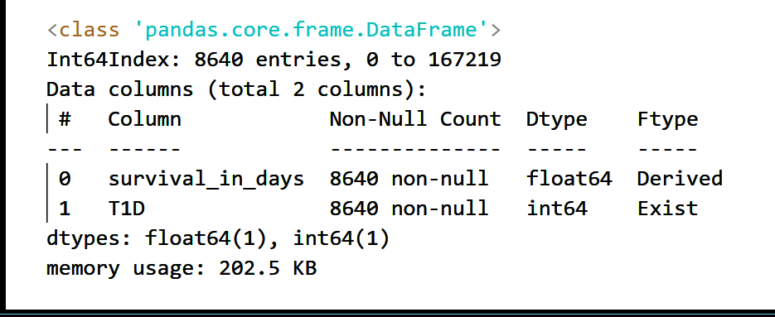
Data Overview KM
TEDDY consists of 53 data files in total
We use three files: three_month_interview, teddy_update_form, test_results, and diabetes_diagnosis
Imputation: mean, median or mode
Derived variables: Survival in days
Table of 2 features with
8640 data points (rows) in total (unique persons)
333 develop T1D, 8307 do not
Notes:
Problem: to exchange insights from AI and ML models in a privacy-preserving fashion. We’ll address this in a couple of slides

Slide 17
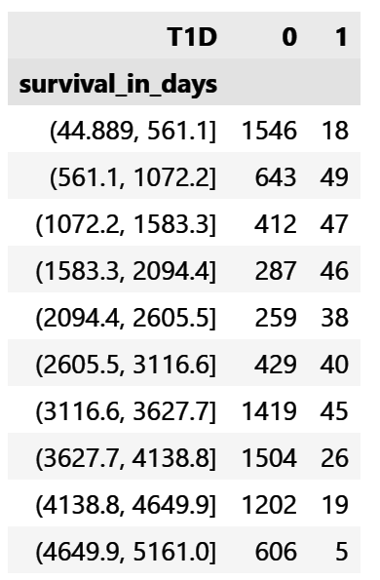
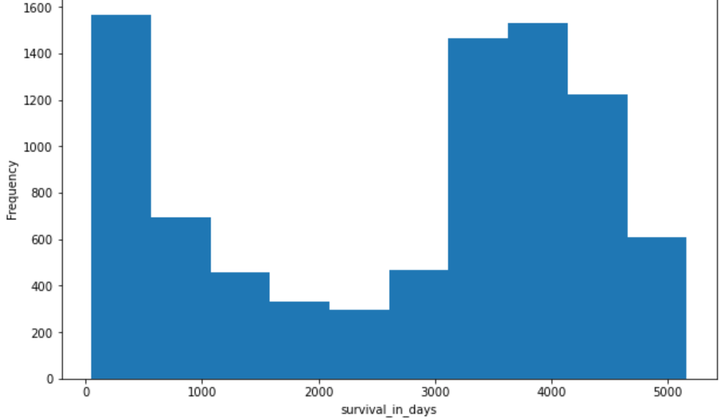
Experiment KM
™®
Survival In Days Survival In Days Distribution
Notes:
Lower left = falce negatives
Upper right = false positives

Slide 18
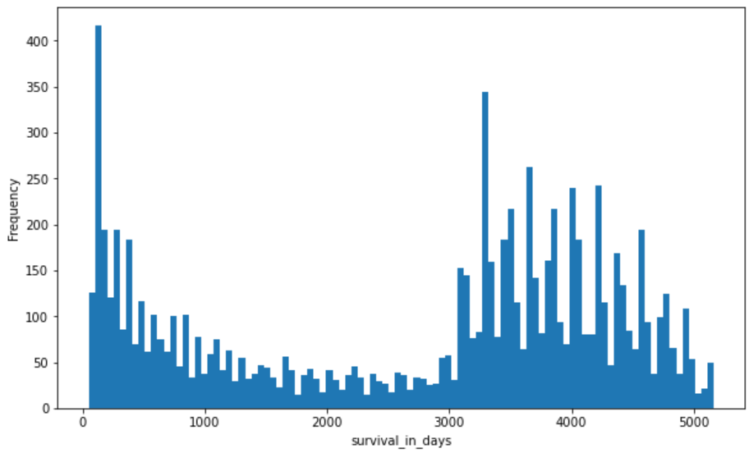
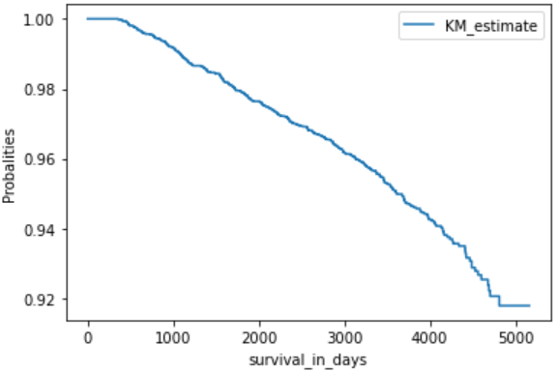
Experiment KM
™®
Survival In Days Distribution KM Graph
Median Survival Time = 5161
Notes:
Lower left = falce negatives
Upper right = false positives

Slide 19
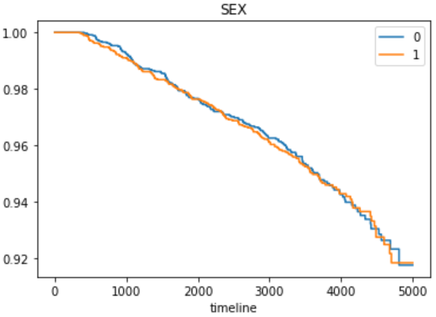
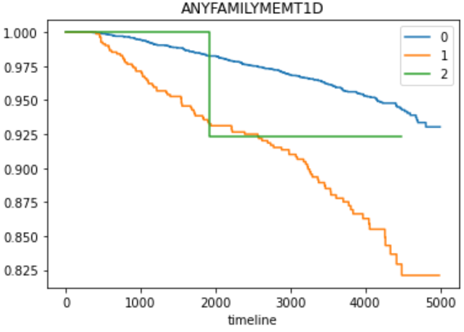
Group Wise KM
™®
KM For Gender KM For Any Family Member With T1D
(0:Female,1: Male)
(0: Famialy Not T1D,1: Famialy T1D,2: No Data )
Notes:
Lower left = falce negatives
Upper right = false positives

Slide 20
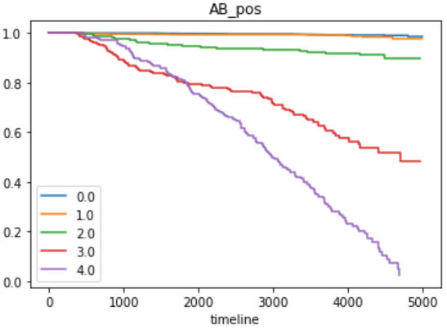
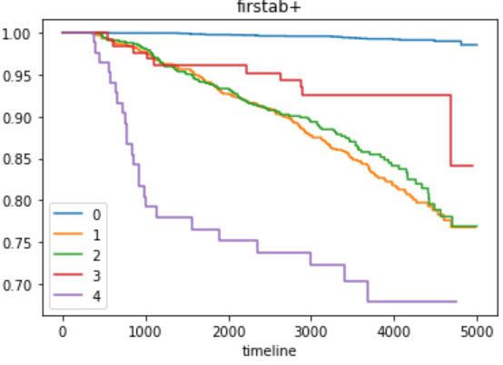
Group Wise KM
™®
KM For Number Of AB+ KM For First AB+
(0: no ab +, 1:GAD, 2:IAA ,3:IA2A,4:Zn )
Notes:
Lower left = falce negatives
Upper right = false positives

Slide 21
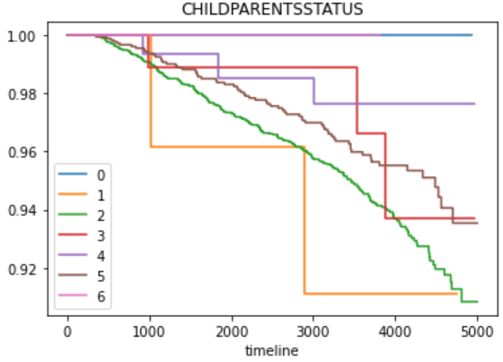
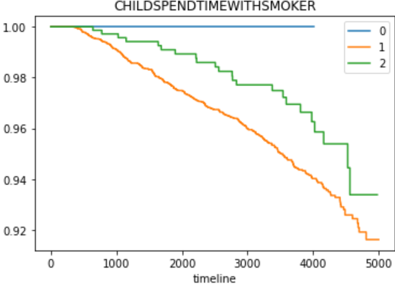
Group Wise KM
™®
KM For Child Parents Status KM For Child Spend Time With Smoker
(0:No Info ,1: Divorced ,2:Married ,3:Separated, (0:No Info , 1: No, 2:Yes )
4:Unmarried and living apart,
5:Unmarried but living together, 6:Widowed )
Notes:
Lower left = falce negatives
Upper right = false positives

Slide 22
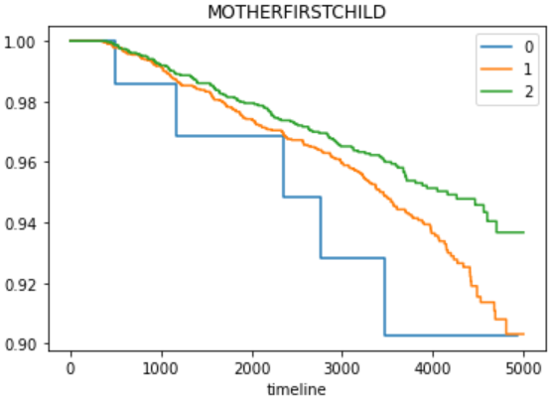
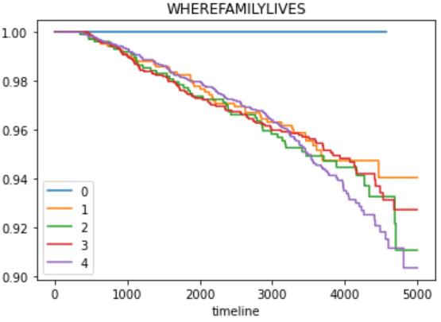
Group Wise KM
™®
KM For Mother First Child KM For Where Family Lives
(0:No Info ,1: No ,2: Yes) (0:No Info ,1:Big city ,2:Rural area, 3:Small city/village, 4:Suburb)
Notes:
Lower left = falce negatives
Upper right = false positives

Slide 23
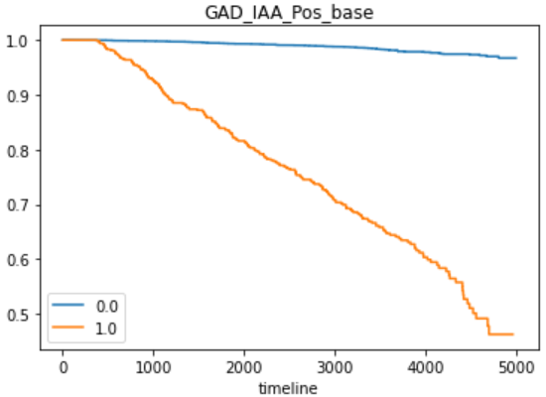
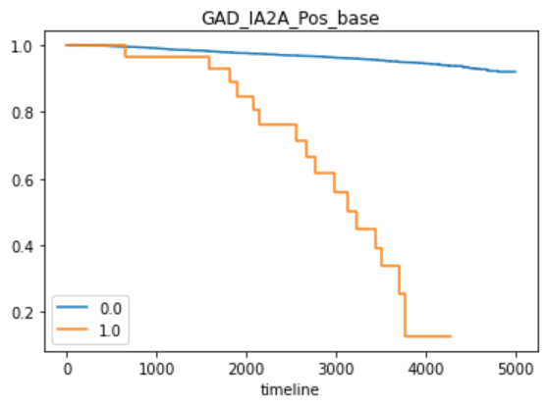
Group Wise KM
™®
KM For GAD IAA First Positive KM For GAD IA2A First Positive
Notes:
Lower left = falce negatives
Upper right = false positives

Slide 24
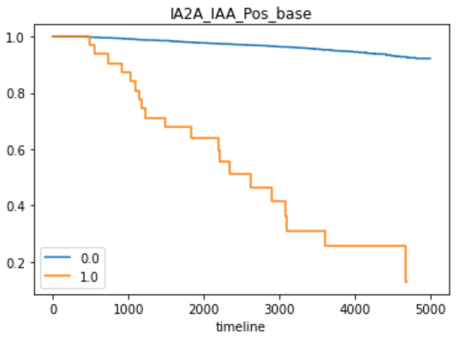
Group Wise KM
™®
KM For IA2A IAA First Positive
Notes:
Lower left = falce negatives
Upper right = false positives

Slide 25
Cox Proportional Hazards
Cox-PH model is a semi-parametric model which solves the problem of incorporating covariates
Cox proportional hazard model is basically a regression model it is used to find out the relationship between the survival time of a subject and one or more predictor variables. In short, we want to find out how different parameters like age, sex, weight, height affects the length of survival for a subject.
Notes:
Problem: to exchange insights from AI and ML models in a privacy-preserving fashion. We’ll address this in a couple of slides

Slide 26
AI/ML Workflow/Pipeline CPH
™®
Acquire Data
Data Preprocessing
1. Drop
2. Derived Feature
3. Encoding
Data Imputation
1. Static: Mean, Median, Mode
2.Temporal: Interpolate
Feature Selection
1. Pearson corr
2. Chi-2
3. LogisticRegression
4. Random Forest
5. LightGBM
AI Model Interpretation
Visualization
1. Feature Importance
2. P value
3. Hazard Ratio
Model Evaluation
Concordance
AIC
3. AUC/ROC
4. Predictions
AI Model Training
1. Fit
2. Predict
Notes:
Problem: to exchange insights from AI and ML models in a privacy-preserving fashion. We’ll address this in a couple of slides

Slide 27
AI/ML Workflow/Pipeline CPH
™®
Acquire Data
Data Preprocessing
1. Drop
2. Derived Feature
3. Encoding
Data Imputation
1. Static: Mean, Median, Mode
2.Temporal: Interpolate
Feature Selection
1. Pearson corr
2. Chi-2
3. LogisticRegression
4. Random Forest
5. LightGBM
AI Model Interpretation
Visualization
1. Feature Importance
2. P value
3. Hazard Ratio
Model Evaluation
Concordance
AIC
3. AUC/ROC
4. Predictions
AI Model Training
1. Fit
2. Predict
Notes:
Problem: to exchange insights from AI and ML models in a privacy-preserving fashion. We’ll address this in a couple of slides

Slide 28
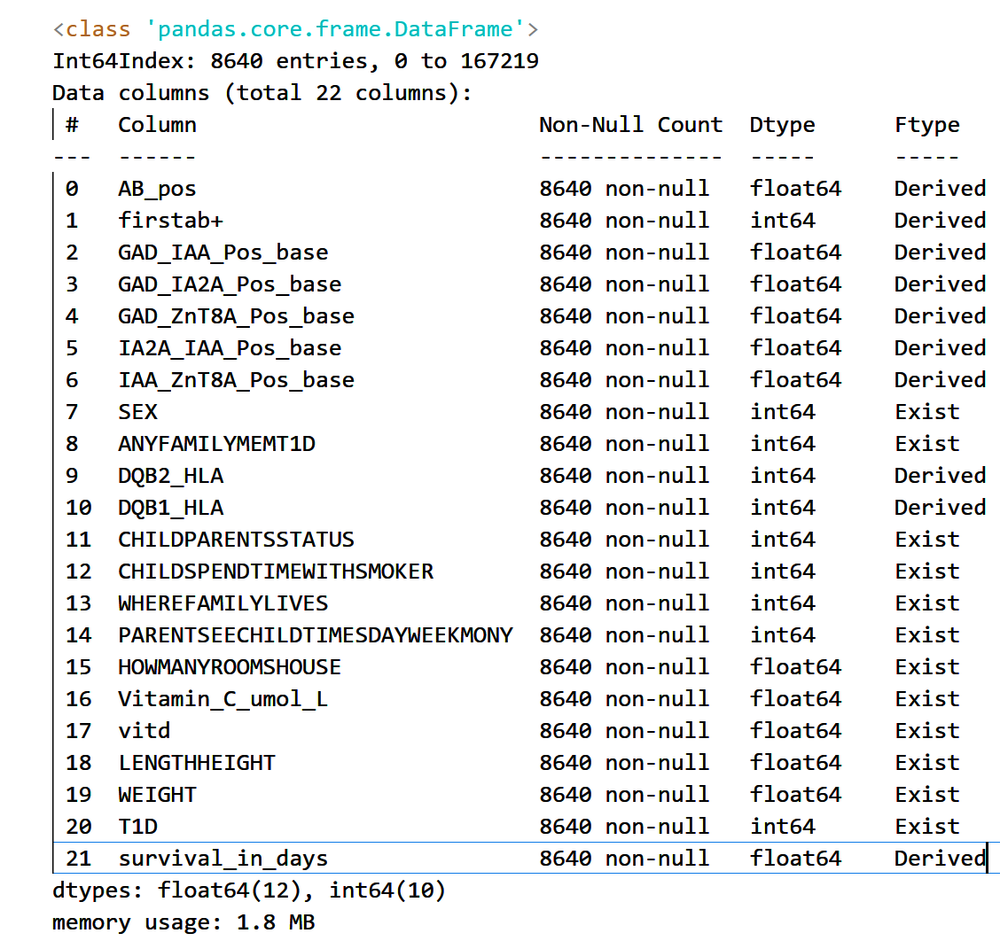
Data Overview CPH
TEDDY consists of 53 data files in total
We use these files: three_month_interview, teddy_update_form, test_results, physical_exam, vitd_niddk,and diabetes_diagnosis, ascorbic_acid_niddk, nine_month_parent_questionnaire, screening_form
Imputation: mean, median or mode
Table of 22 features with
8640 data points (rows) in total (unique persons)
333 develop T1D, 8307 do not
Notes:
Problem: to exchange insights from AI and ML models in a privacy-preserving fashion. We’ll address this in a couple of slides

Slide 29
Feature Overview CPH
1) AB_pos = Number of antibody positive
2) firstab+ = Out of 4 (GAD, IAA ,IA2A, Zn) which one got first positive
3) GAD_IAA_Pos_base = GAD and IAA this antibody pair got positive first or not
4) GAD_IA2A_Pos_base = GAD and IA2A this antibody pair got positive first or not
5) GAD_ZnT8A_Pos_base = GAD and ZnT8A this antibody pair got positive first or not
6) IA2A_IAA_Pos_base = IA2A and IAA this antibody pair got positive first or not
7) IAA_ZnT8A_Pos_base = IAA and ZnT8A this antibody pair got positive first or not
8) SEX = Gender
9) ANYFAMILYMEMT1D = Any of family member is with T1D positive
10) DQB2_HLA = DQB2 HLA category child belong
11) DQB1_HLA = DQB1 HLA category child belong
12) CHILDPARENTSSTATUS = Child parent status
13) CHILDSPENDTIMEWITHSMOKER = Child spend time with smoker
14) WHEREFAMILYLIVES = Where does child family lives
15) PARENTSEECHILDTIMESDAYWEEKMONY = If child parent separated how many times parent see their child in weekly
16) HOWMANYROOMSHOUSE = Child live in house , it contains how many rooms
17) Vitamin_C_umol_L = Vitamin C level of child
18) vitd = Vitamin D level of child
19) LENGTHHEIGHT = Height of child
20) WEIGHT = Weight of child
21) T1D = Child id positive with T1D or not
22) survival_in_days = Child how long it has survival (from not getting T1D) in days / Child follow for T1D in days
Notes:
Problem: to exchange insights from AI and ML models in a privacy-preserving fashion. We’ll address this in a couple of slides

Slide 30
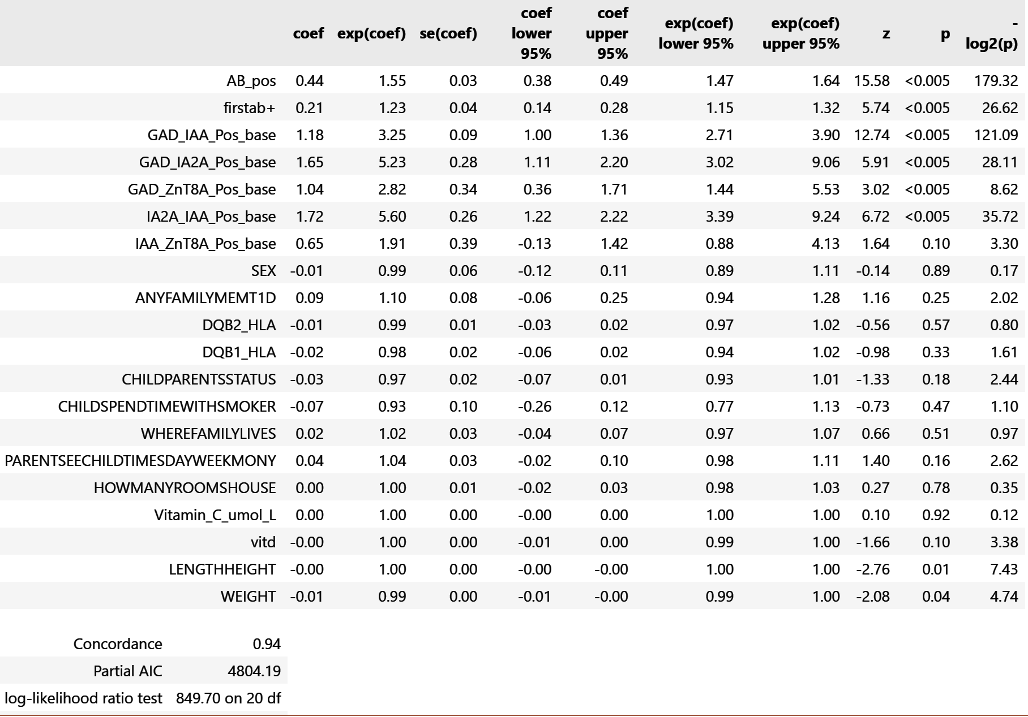
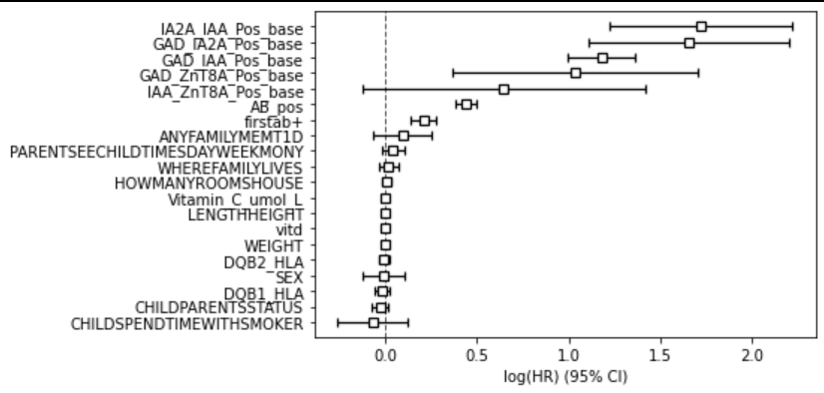
Experiment CPH
Hazard: Hazard is essentially the inverse of survival, or the probability of failure (death event). It basically represents the slope of the survival curve — a measure of how rapidly subjects are dying.
Hazard ratio: The hazard ratio is the ratio of the hazard rates corresponding to the conditions described by two levels of an explanatory variable. For example, in a drug study, the treated population may die at twice the rate per unit time of the control population. The hazard ratio would be 2, indicating higher hazard of death from the treatment.
Notes:
Problem: to exchange insights from AI and ML models in a privacy-preserving fashion. We’ll address this in a couple of slides

Slide 31
Experiment CPH
P-value from summary tell us that AB_pos, fristab+, GAD_IAA_Pos_base, GAD_IA2A_Pos_base,GAD_ZnT8A_Pos_base,IA2A_IAA_Pos_base are highly significant. Their p-value is less than 0.005 These features are highly correlated to the T1D event.
Interpretation of the Coefficients :
1)AB_pos Its coefficient 0.44 is interpreted as 1.55 is the Hazard Ratio associated with AB_pos . So, if the patient has AB_pos the instantaneous hazard of T1D at any given time t, increases by: (1.55 – 1) * 100 = 55%.
2)fristab+ Its coefficient 0.21 is interpreted as 1.23 is the Hazard Ratio associated with fristab+ . So, if the patient has fristab+ the instantaneous hazard of T1D at any given time t, increases by: (1.23 – 1) * 100 = 23%.
Hazard Ratio (HR)
The value exp(coef) is called the hazard ratio which indicates how much the baseline hazard changes due to one-unit change in the corresponding factor. A higher hazard means more at risk of the event occurring.
The hazard ratio is the multiplicative effect of the covariate.
HR = 1 indicates no effect.
HR > 1 indicates an increase in the hazard as the covariate value rises.
HR < 1 indicates a decrease in the hazard as the covariate value rises.
Notes:
Problem: to exchange insights from AI and ML models in a privacy-preserving fashion. We’ll address this in a couple of slides

Slide 32
Experiment CPH
Partial Log-Likelihood : The partial log-likelihood of the model is -2382.10. This is useful to compare the model’s goodness-of-fit with a different version of the same model, stratified in the same manner, but with fewer or greater number of variables. The model with the larger Partial Log-Likelihood will have a better goodness-of-fit. The actual log-likelihood value for a given model is mostly meaningless, but it’s only useful for comparing two or more similar models.
Concordance : The C-statistic gives the probability a randomly selected patient who experienced an event (e.g. a disease or condition) had a higher risk score than a patient who had not experienced the event. Concordance index is a measure of how discriminant the model is. For survival analysis, say you have a covariate 𝑋 and a survival time 𝑇. Assume that higher values of 𝑋 imply shorter value for 𝑇 (thus 𝑋 has a deleterious effect on 𝑇). Discrimination means that you are able to say, with high reliability, that between two patients which one will have a shorter survival time.
It is equal to the area under the ROC curve and ranges from [0.5 - 1].
-A value below 0.5 indicates a very poor model. Such model is no better than predicting an outcome than random chance.
-Values over 0.7 indicate a good model.Values over 0.8 indicate a strong model.
-A value of 1 means that the model perfectly predicts those group members who will experience a certain outcome and those who will not.
The Concordance statistics for current fit is 0.94 indicates of the good model.
Notes:
Problem: to exchange insights from AI and ML models in a privacy-preserving fashion. We’ll address this in a couple of slides

Slide 33
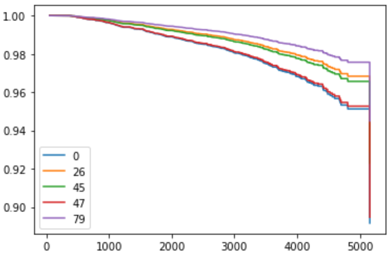
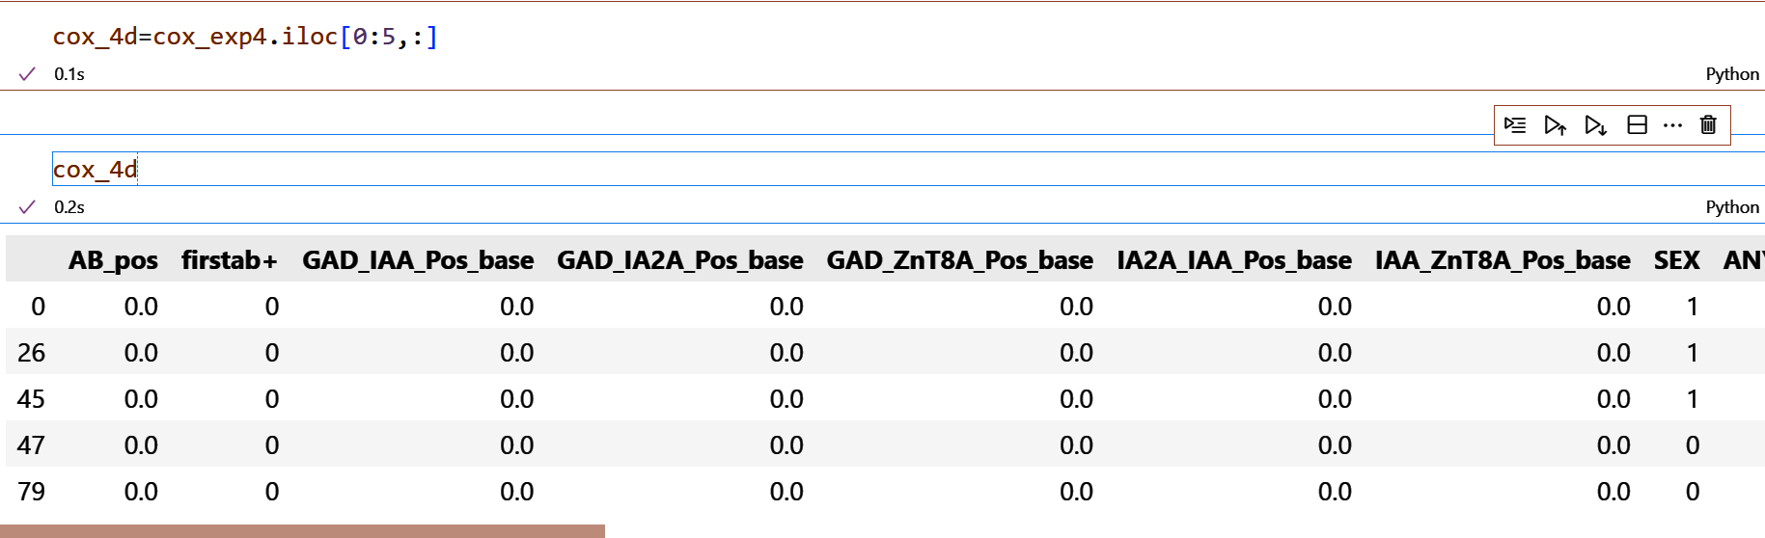
Experiment CPH
We tested with 5 data points
Notes:
Problem: to exchange insights from AI and ML models in a privacy-preserving fashion. We’ll address this in a couple of slides

Slide 34
Thank You

Slide 35
mainly.ai contact@mainly.ai @mainly_ai

