Slide 1
Reenal Boddul
Data Scientist

Slide 2
Agenda
About Me
Asset
Alistair
Melanoma Skin Cancer

Slide 3
About Me
Data Scientist @ MainlyAI
~6 + years of experience in Software Development and Project Implementation
3 years’ experience as Data Scientist Machine Learning and Deep Learning Developer
Publish my success story in WINDS Pune, India (https://wimldspune.wordpress.com/2022/04/02/reenal-boddul/)
(https://halloffame.ineuron.ai/achiever/Reenal-Zampal-(Boddul)-AtQRPU)
Open-Source Contributor
Mentor, and Speaker ,GenAI Content Creator
Playing Cricket, Reading, Traveling , Cooking
Notes:
Problem: to exchange insights from AI and ML models in a privacy-preserving fashion. We’ll address this in a couple of slides

Slide 4
Project: Asset
Type 1 Diabetes : Type 1 diabetes (T1D) is a complex autoimmune disease resulting in the destruction of β-cells leading to deficient insulin production overtime.
Dataset: (Teddy) : NIDDK funded study called The Environmental Determinants of Diabetes in the Young (TEDDY) study that investigates:
Genetic and genetic-environmental interactions, including gestational infection or other gestational events. Childhood infections or other environmental factors after birth in relation to the development of prediabetes autoimmunity and T1D.
The long-term goal of the TEDDY study is the identification of factors which trigger T1D in genetically susceptible individuals or which protect against the disease.
Aim: Objective is to find probability whether child will develop Type 1 diabetes in given time range .
Method : Temporal predictive approach Inspired by “Incorporating temporal EHR data in predictive models for risk stratification of renal function deterioration

Slide 5
Project: Asset
Description: To leverage our longitudinal data, we have used temporal predictive approach. Temporal predictive approach address some of the challenges faced in using EHR data these challenges include irregularly sampled data and varying lengths of patient history. Data points unevenly distributed over 0-15 years, sub-intervals computed based on evaluation metrics sensitivity threshold of 70% results in 6 sub-intervals (0-2,2-4,4-6,6-8,8-11,11-15).
In multitask temporal approach we consider the task of predicting the T1D in each subinterval while creating data for subinterval features are aggregated within time window. We used this subinterval model result to create a meta-Training dataset on this meta-Training dataset we create a Meta-Model to learn weights for each task simultaneously (Multi-Task learning). For subinterval model M1 to M6 we have tried different ML model, but we come up with Logistic Regression performing good as well as for final MTTM Model ( x )= w1M1( x ) + … + w6M6( x ) .

Slide 6
Project: Asset
Result:
MTTM has given weight as follow:
M1 (0-2 years: 2.76)
M2 (2-4 years: -1.96)
M3 (4-6 years: 1.55)
M4 (6-8 years: 1.44)
M5 (8-11 years: 1.99)
M6 (11-15 years: 1.41)
so MTTM gives Model 0-2 has highest weight and Model 2-4 negative weight.
MTTM results (0-15): sensitivity = 0.789, specificity = 0.949 and AUROC = 0.920.
Conclusion:
Predictive ability of environmental, health, biomarker, and AB-related features is tested and reported.
May become useful for screening program of T1D.
E-poster At (ATTD) Conference Advanced Technologies & Treatments for Diabetes (ATTD)

Slide 7
Project : Asset
My Contribution To This Project
Requirement gathering and convert business requirement to use case
Understand various data file and convert unstructured data to structured data which can used for model building i.e., Data Wrangling.
Sparse, complex, and large data handling and data analysis (EDA) to identify data trends, patterns, and insights. develop crisp visualizations.
Solution designing, Model Design and Development Multitask temporal approach (MTTM).
Evaluating model performance using metrics like, precision, recall, and F1-score, Optimizing model.
Building docker image and containerized hole application.
Check various SOTA Paper feasible for our solution and implement.
To routinely communicate metrics, progresses and other key indicators and explain complex technical concepts to both technical and non-technical stakeholders

Slide 8
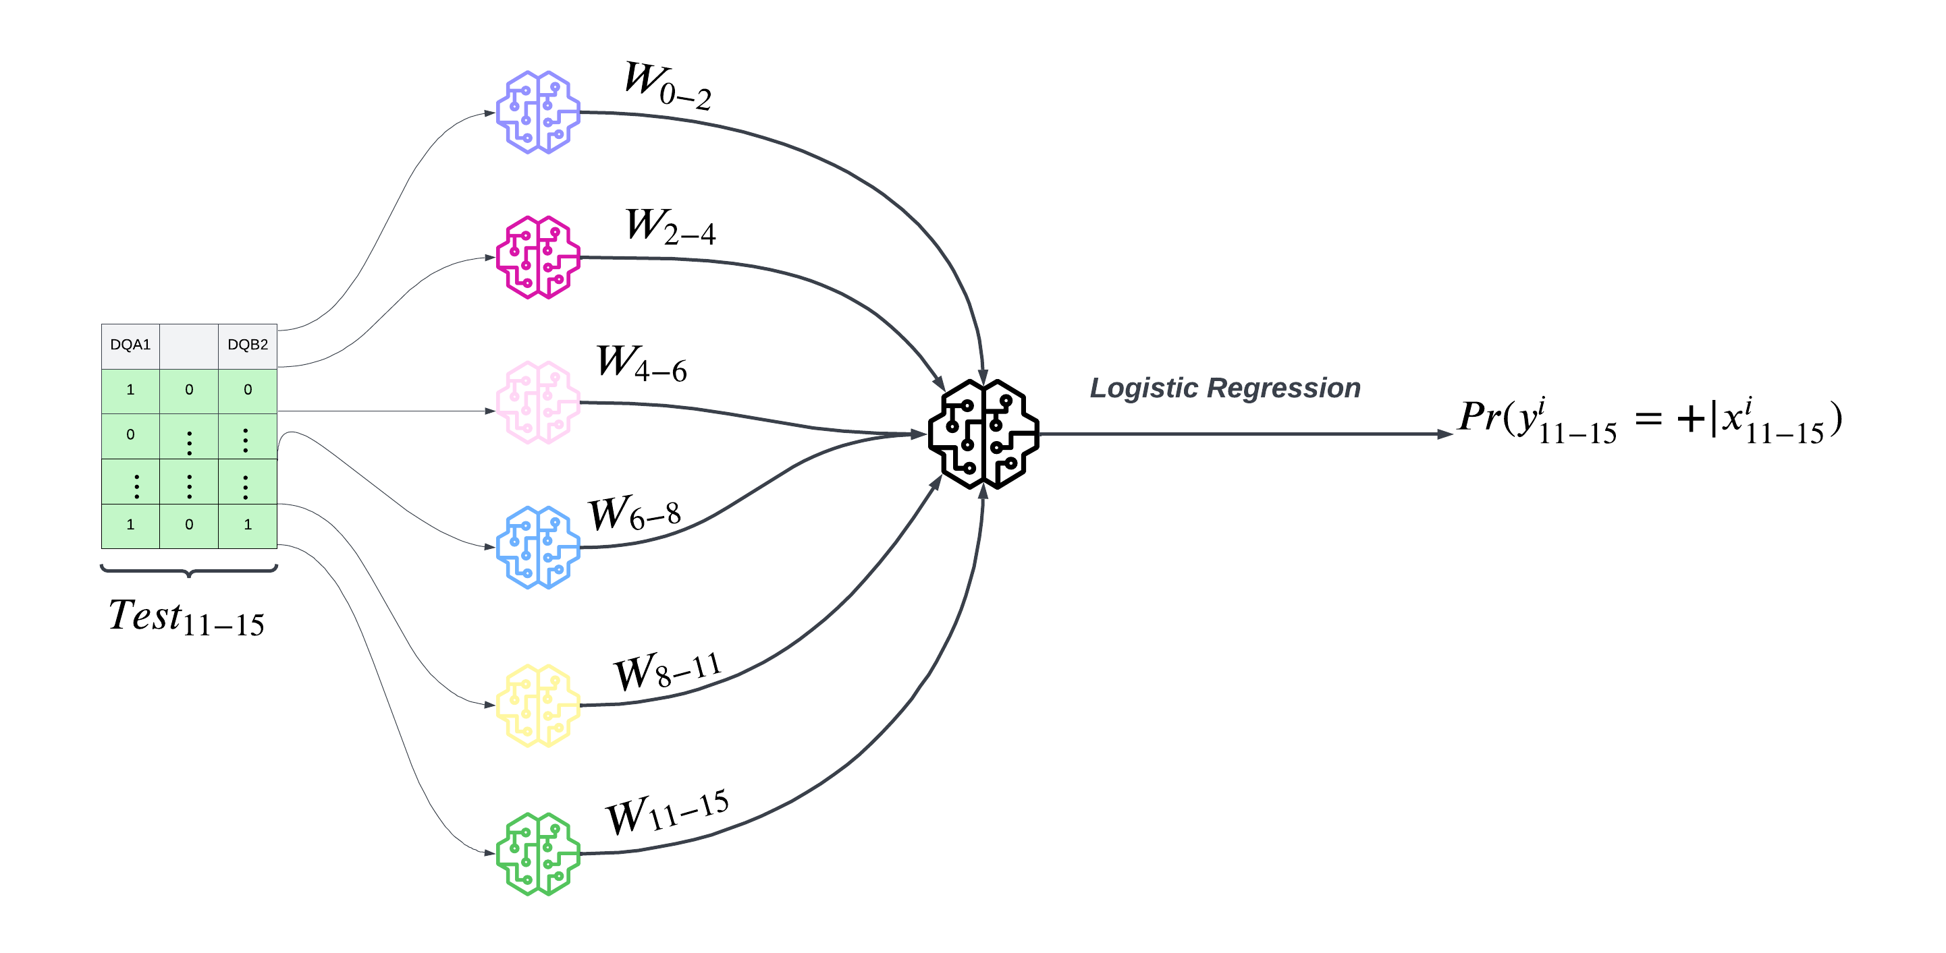
Inference Phase

Slide 9
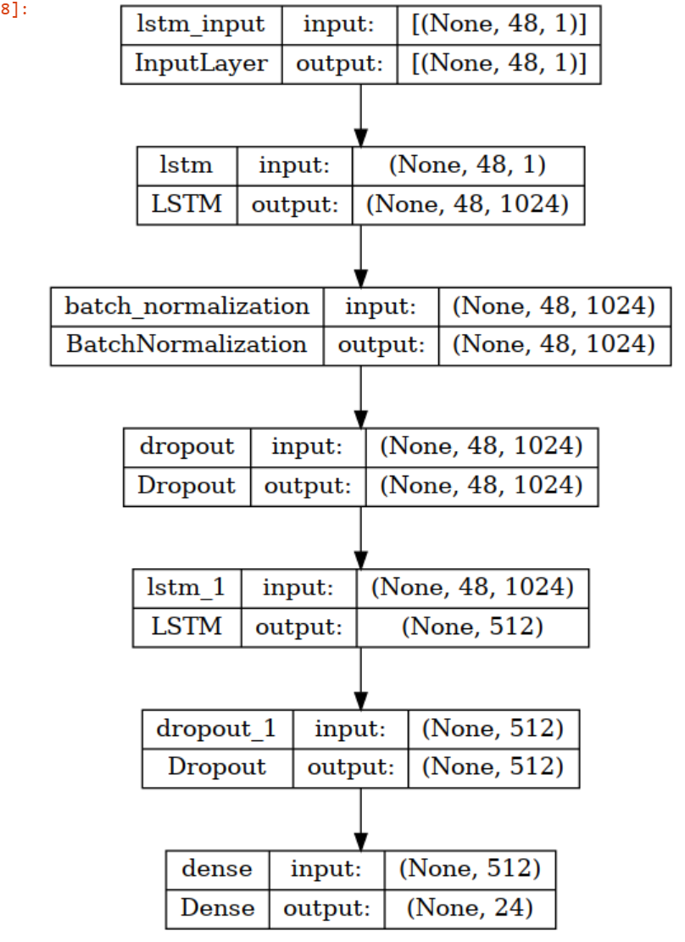
Project: Alistair
Aim: Predict Future Humidity (Indoor Climate Prediction which help in vaccine production)
Dataset: Data collected from temperature and humidity sensor (Govee)
There are 6 different rooms , and one sensor place for each room .
Which we collect data of humidity , temperature at each 15 min .

Slide 10
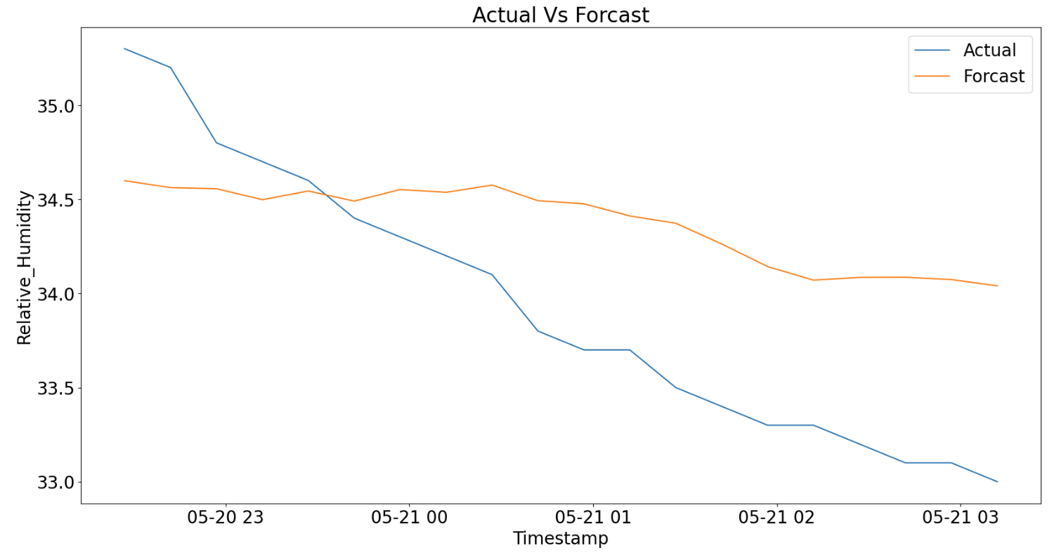

Project : Alistair
Result::

Slide 11
My Contribution To This Project:
Data Preparation and Exploration:
Cleaned and preprocessed large-scale time series datasets, ensuring data integrity and consistency.
Conducted exploratory data analysis to identify relevant patterns and features crucial for forecasting.
Model Development and Architecture:
Designed and implemented a robust sequence-to-sequence LSTM model for time series forecasting.
Optimized model architecture by experimenting with different LSTM layer configurations, activation functions, and sequence lengths.
Data Sequencing and Normalization:
Engineered input-output sequences for the LSTM model, incorporating historical data to capture temporal dependencies effectively.
Applied normalization techniques to scale input features, enhancing model convergence and performance.
Training and Validation:
Executed model training on historical data, fine-tuning hyperparameters for optimal performance.
Implemented a rigorous validation process to ensure the model's generalization capability and prevent overfitting.
Performance Evaluation:
Utilized standard performance metrics such as Root Mean Squared Error (RMSE) to assess model accuracy.
Demonstrated consistent improvement in forecasting accuracy through continuous refinement and experimentation.
Hyperparameter Tuning:
Conducted systematic hyperparameter tuning, optimizing learning rates, batch sizes, and other parameters for enhanced model performance.
Employed a data-driven approach to iterate on model configurations, leading to improved forecasting accuracy.
Documentation and Communication:
Documented the entire modeling process, including architecture, hyperparameters, and data preprocessing steps for knowledge sharing and reproducibility.
Effectively communicated technical findings and forecasting results to both technical and non-technical stakeholders.
Building Docker Image and containerized hole application

Slide 12
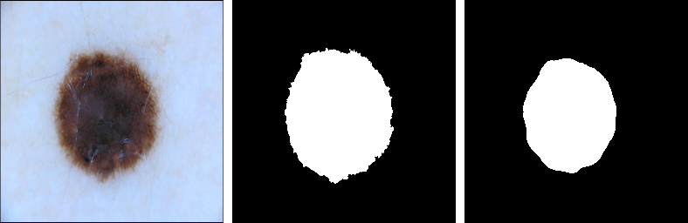
Project Melanoma Skin Cancer(POC)
Aim:. Robust Melanoma Skin Cancer detection system
Dataset: https://www.kaggle.com/datasets/hasnainjaved/melanoma-skin-cancer-dataset-of-10000-images.
Method : Utilizing the UNet architecture, a convolutional neural network (CNN)
Result:
Test image Ground truth Model prediction

Slide 13
Melanoma Skin Cancer(POC)
My Contribution To This Project
Unboding data, and creating training pipeline
Algorithm Development:
Designed and implemented a U-Net based deep learning model for melanoma skin cancer image segmentation.
Developed and fine-tuned hyperparameters to optimize the model's performance in accurately detecting melanoma regions.
Data Preprocessing and Augmentation:
Conducted comprehensive data preprocessing, including normalization, resizing, and augmentation, to enhance model generalization and robustness.
Implemented strategies to address class imbalance in the dataset, improving the model's ability to handle varying melanoma lesion characteristics.
Model Training and Validation:
Orchestrated the training process of the U-Net model using an extensive dataset, achieving state-of-the-art segmentation results.
Performance Evaluation:
Conducted thorough quantitative and qualitative evaluations of the model's performance, utilizing metrics such as sensitivity, specificity ,accuracy
Application
Build end to end application using flask
Building Docker Image and containerized hole application.

Slide 14
Thank you Any queries welcome

