Slide 1
"Boosting Performance with Ensemble Methods: Combining the Strengths of Multiple Models".
- by K Vikas ( Staff Data Scientist at Avlino)

Slide 2
Table of Contents
Table of contents
Introduction to Ensemble Techniques
Agenda:
Types of Ensemble Methods
Averaging Methods
Boosting Methods
Implementation and Interpretation
Conclusion
Advantages & Disadvantages
Common Applications
Q & A

Slide 3

Brief about me..
My name is K Vikas
Staff Data Scientist @ Avlino
~5 years of work experience
Areas of expertise
Classical ML / DL
CV / NLP
I like to travel, play fifa and binging

Slide 4
Prerequisites
BASIC ML
Understanding supervised ranking
Python
Little bit of enthu!!!

Slide 5
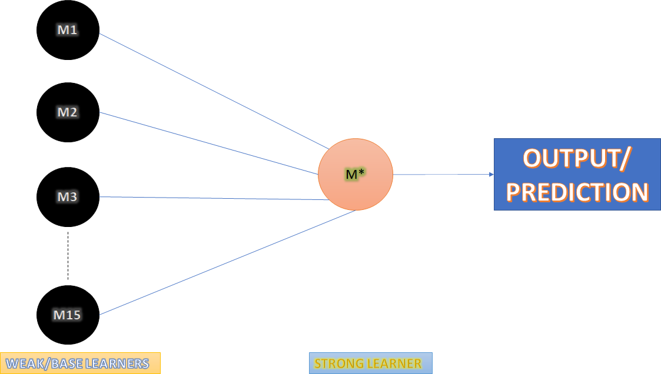
Introduction to Ensemble Techniques
Brief about me..
Ensemble methods are a type of machine learning technique that combines multiple models to improve the overall accuracy and performance of a predictive model. Ensemble methods can be applied to various types of models, including decision trees, neural networks, and regression models.
Certain models do well in one aspect
of data while others do well in other
aspect.
Multiple models - base learners
Combine the several models to produce
The final output
Combined model - strong learner
Combined model offestes individual
Models biases and variances
Notes:
Before we start. I assume the audience here have prior knowledge of statistics, basic ml and python

Slide 6
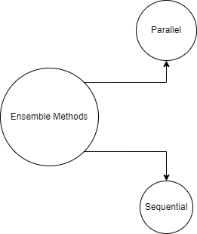
Ensemble Methods: Working
Parallel Learning
Base learners are generated parallely
Use dependency of each base learner
Example: random Forest
Sequential learning
Base learners are generated consecutively
Use dependency between the base learners
Example: Adaboost

Slide 7
Ensemble methods: Significance
Improved Accuracy
Reduced Overfitting
Robustness
Flexibility
Notes:
Improved Accuracy: Ensemble methods can significantly improve the accuracy of machine learning models by combining multiple models. Each model may have its own biases, strengths, and weaknesses, and the ensemble can compensate for these differences and produce more accurate predictions.
Reduced Overfitting: Overfitting occurs when a model is too complex and fits the training data too closely, resulting in poor performance on new, unseen data. Ensemble methods can reduce overfitting by combining multiple models with different parameters, reducing the risk of a single model overfitting the data.
Robustness: Ensemble methods can make machine learning models more robust to outliers and noisy data. By combining multiple models, the ensemble can identify and discard outliers or noise in the data, leading to more reliable and accurate predictions.
Flexibility: Ensemble methods can be applied to a wide range of machine learning models, including decision trees, neural networks, and regression models. This flexibility makes ensemble methods a versatile tool in the machine learning toolkit.
Real-World Applications: Ensemble methods have been successfully applied in a variety of real-world applications, such as image and speech recognition, fraud detection, and recommendation systems. These applications require high accuracy and robustness, and ensemble methods can help achieve these goals.

Slide 8
Ensemble Methods: types and details

Slide 9
Averaging
Simple Averaging
Regression
P = (p1 + p2 + p3) / n_models
Classification
Mode of the class predicted
Probability: argmax of the summed probability of each class
Limitation: each model have equal contribution
Weighted Averaging
Weighted by the model performance
Weights:
w1 + w2 +w3 =1

Slide 10
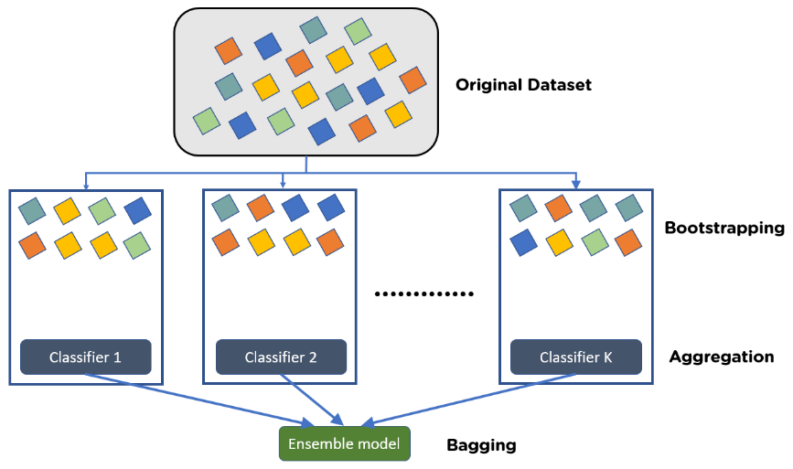
Bagging
Bagging or Bootstrap aggregation is a technique that involves training multiple instances of the same model on different subsets of the training data.
Reduces Variance
Steps involved:
Generated random sample ( boostraping)
Training multiple model on different samples of data
Combine the result of different models

Slide 11
Random Forest
Random Forest is a popular bagging algorithm that uses decision trees as the base model.
Each decision tree is trained on a randomly selected subset of the training data and a random subset of features.
De-corelated trees
The final prediction is made by averaging the predictions of all the decision trees in the forest.
Overcomes overfitting

Slide 12
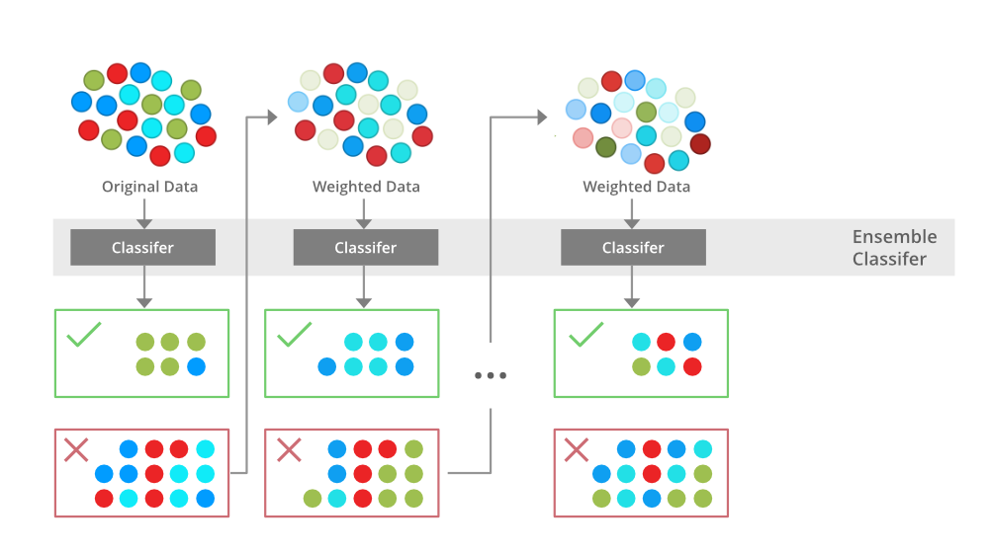
Boosting
Boosting is a technique that involves sequentially training multiple weak models on the same dataset.
Step involved
Train a classifier C1 that best classifies data with respect to accuracy
Identify the regions where C1 produces error add weights to them and train C2 classifier
Repeat the above two steps

Slide 13
Adaboost
Combines multiple weak learners (classifiers that are slightly better than random guessing) to create a strong learner (classifier that is much better than random guessing).
Only classification problems are supported
Works by adjusting the weights of training examples based on their classification accuracy, so that subsequent weak learners will focus more on misclassified examples.
Misclassification error rate:
ε = Pr_i~Dt [h_t(xi) not equal to y_i

Slide 14
AdaBoost : Algorithm
Initialize each data point by weights:
W_i = 1/n, n= sample size
Train a model which gives best accuracy
Calculate the weighted error of the weak learner, where the weights are updated based on the accuracy of the weak learner on the training data.
ε = Pr_i~Dt [h_t(xi) not equal to y_i
Weight of the weak classifier
α_t = 1/2 * ln(1-ε / ε)
Update the weights of each training example, where the weights of correctly classified examples are decreased and the weights of misclassified examples are increased.
D_{t+1(i)} = D_{t(i)}exp(-α_{t} * y_i * h_t(x_i) / Z_{t}
Where Z_{t} is the normalizing factor
6. Repeat steps 2-5 for certain number of iterations to achieve the accuracy of strong learner

Slide 15
Gradient Boosting Mechanism ( GBM )
GBM iteratively combines multiple weak learners to create a strong learner.
The difference between GBM and other boosting algorithms like AdaBoost is that GBM builds the weak learners sequentially, where each subsequent learner tries to correct the residual errors of the previous learner.
Three elements required for GBM:
Loss function
Weak learner
Additive model

Slide 16
GBM : algorithm
Steps involved:
Initialize the predicted values of each training example to a constant value (for regression problems, this could be the mean of the target variable; for classification problems, this could be the log-odds of the class probabilities).
Train a weak learner (such as a decision tree or a linear regression model) on the training data, where the target variable is the residual error of the predicted values from step 1.
Calculate the prediction of the weak learner, and add it to the predicted values from step 1.
Repeat steps 2-3 for a specified number of iterations, or until the accuracy of the model reaches a desired level.
Combine the weak learners into a strong learner, where the prediction of each weak learner is weighted by its contribution to the final prediction.

Slide 17
XGBOOST
XGBoost (short for Extreme Gradient Boosting) is a powerful open-source software library that provides an efficient implementation of the gradient boosting algorithm.
XGBoost is particularly well-suited for working with structured data, such as tabular data in databases or spreadsheets
Some of the key features of XGBoost include:
Fast and efficient: XGBoost is designed to be highly optimized and can handle very large datasets with relative ease.
Regularization: XGBoost includes built-in regularization techniques to prevent overfitting, such as L1 and L2 regularization.
Tree pruning: XGBoost uses a technique called tree pruning to remove unnecessary nodes from decision trees, which helps to prevent overfitting and reduce model complexity.
Handling missing values: XGBoost has built-in support for handling missing values, which is a common problem in real-world datasets.
Cross-validation: XGBoost includes built-in cross-validation support to help optimize model hyperparameters and prevent overfitting.

Slide 18
Practicals !!

Slide 19
Conclusion

Slide 20
Advantages and disadvantages
Advantages:
Improved Accuracy: Ensemble methods can improve the accuracy of predictions by combining the strengths of different models. When the individual models have different strengths and weaknesses, the ensemble can leverage their collective power to achieve better accuracy.
Robustness: Ensemble methods can be more robust than individual models because they are less sensitive to changes in the training data. By combining multiple models, the ensemble can better handle noise and outliers in the data.
Reduced Overfitting: Ensemble methods can reduce overfitting, which occurs when a model is too complex and performs well on the training data but poorly on new data. By combining multiple models, the ensemble can reduce the risk of overfitting.
Versatility: Ensemble methods can be used with any type of model, including decision trees, support vector machines, and neural networks.

Slide 21
Continued…
Disadvantages:
Increased Complexity: Ensemble methods can be more complex than individual models, which can make them harder to interpret and understand. The increased complexity can also lead to longer training times and higher computational costs.
Data Requirements: Ensemble methods require a larger amount of data to train multiple models, which can be a challenge if the data is scarce or expensive to collect.
Limited Improvement: Ensemble methods may not always improve performance, particularly if the individual models are similar in nature. In some cases, the ensemble may even perform worse than the individual models.
Difficulty Tuning: Ensemble methods require careful tuning of the individual models and the combination method, which can be a challenging task that requires a lot of trial and error.

Slide 22
DataHour : Q&A

Slide 23
Thank you!

