Slide 1
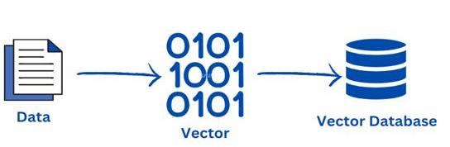
Vector Databases

Slide 2
What we will learn?
What is Vector Database?
Why we need Vector DB?
How Vector DB work?
Use cases of Vector DB
Some widely used Vector DB
Practical demo using Python & Langchain

Slide 3
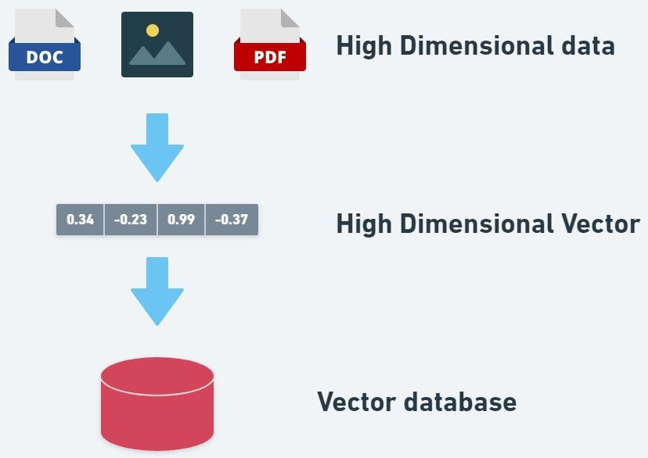
What is Vector Database?
A vector database is a database used for storing high-dimensional vectors such as word embeddings or image embeddings.

Slide 4




Why we need Vector DB?
Over 80 - 85% data out there is unstructured data

Slide 5

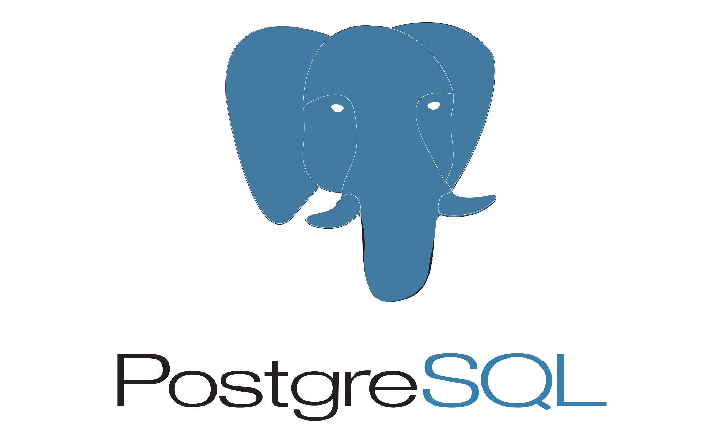

We can’t easily store them into a Relational/Traditional database !!

Slide 6


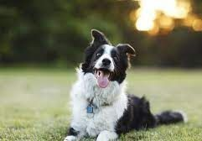


Slide 7


Slide 9
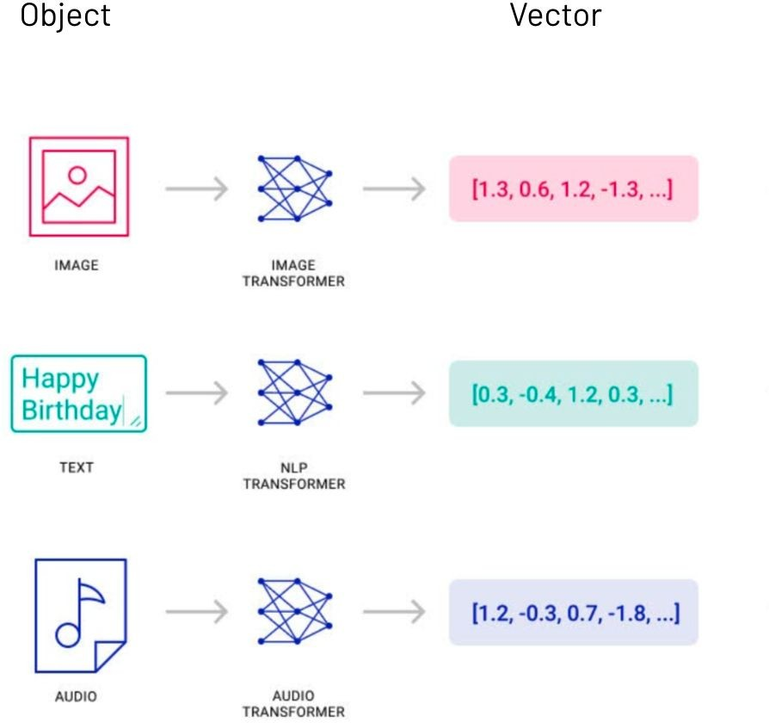
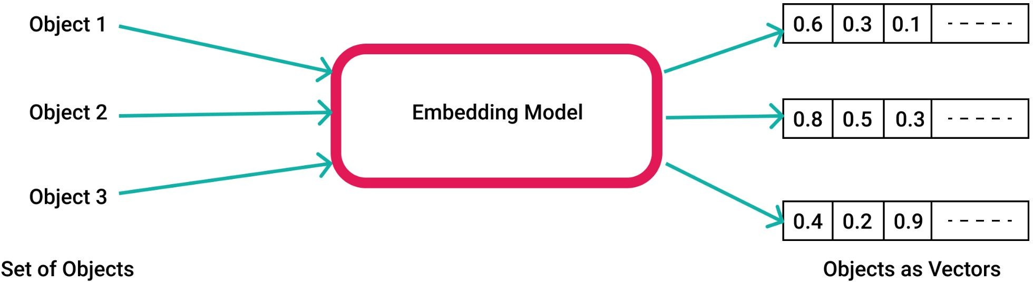
Vector Embeddings

Slide 10
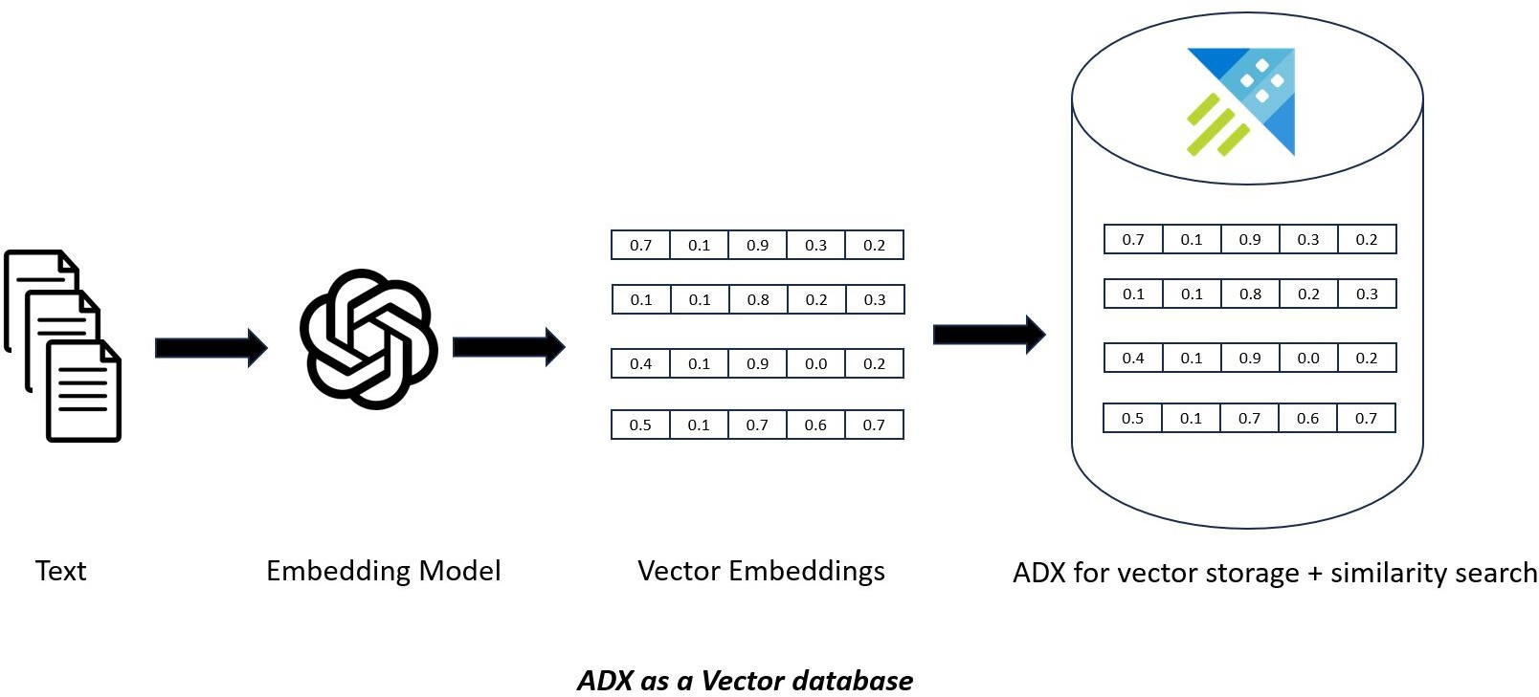

Slide 11
Embeddings Example
Lets go to whiteboard & understand :)

Slide 12
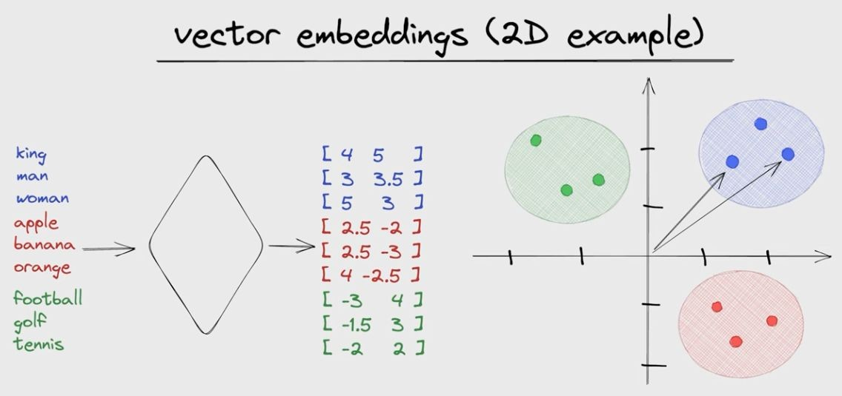

Slide 13
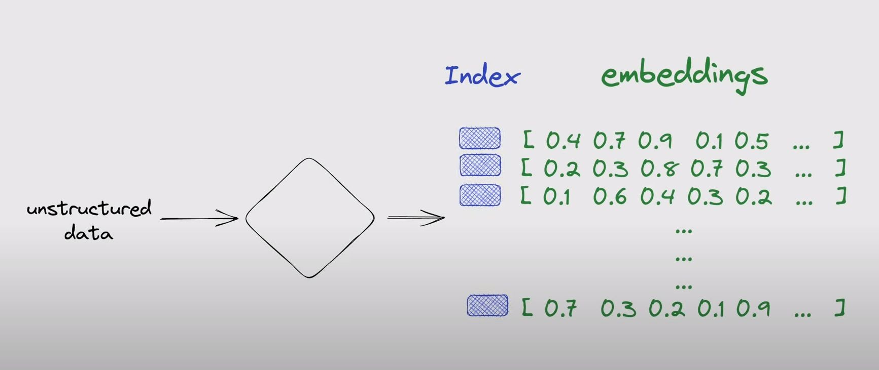
Vector Indexes

Slide 14
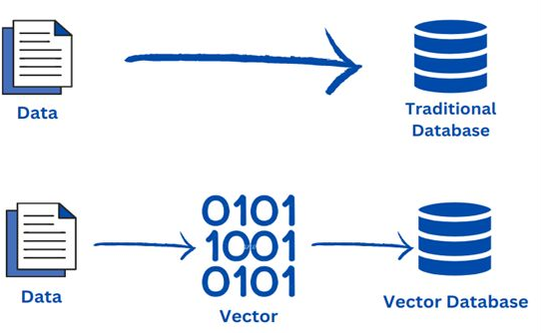
A vector database indexes and store vector embeddings for faster retrieval and similarity search.

Slide 15
Use cases of Vector DB
Long-Term memory for LLMs
Semantic Search: Search based on the meaning of context
Similarity Search: Text, Images, Videos, Audios
Recommendation engine as well

Slide 16





Some widely used Vector DB

Slide 17

Practical demo

