Slide 1
Thanks a Plot!
2018

Slide 2
Today’s Class

Slide 3
Objectives
In today’s class we’ll be covering:
Introduction to Plotly.js, charting, and customizing charts
Understand Charting, Interactivity, and Figure Hierarchy
Build Basic Chart types including Scatter, Line, Bar, and Pie
Customize Chart layouts
More JavaScript practice!

Slide 4
Journey to JavaScript

Slide 5
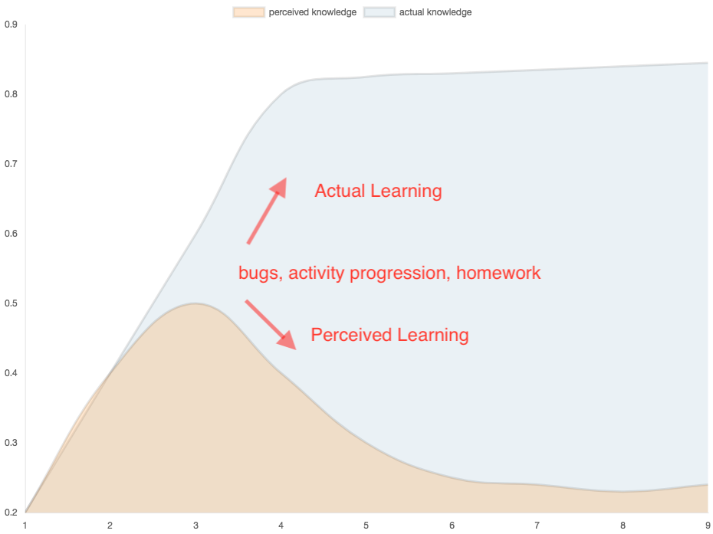
The Journey to JavaScript...

