Slide 1
Customer Retention
Submitted by: Reena

Slide 2
AGENDA
What is Customer Retention?
Importance and Benefits of Customer Retention
Objective
Data analysis steps done
EDA Steps
Visualizations
Assumptions
Conclusion

Slide 3
Customer retension
Customer retention is the ability to keep customers coming back to your store or website to create repeat business and investment.
Keep your Customer engaged and Build Trust.
It is the process of engaging existing customers to continue buying products or services from your business.

Slide 4
the benefits of CR
Retained customer tend to buy other services from the same company
Retained customer are known to be less price/cost effective
Positive publicity - Free Marketing 24 x7
The probability of selling to an existing customer is 60 – 70%
While the probability of selling to a new customer is 5-20%
Decline Migration rate

Slide 5
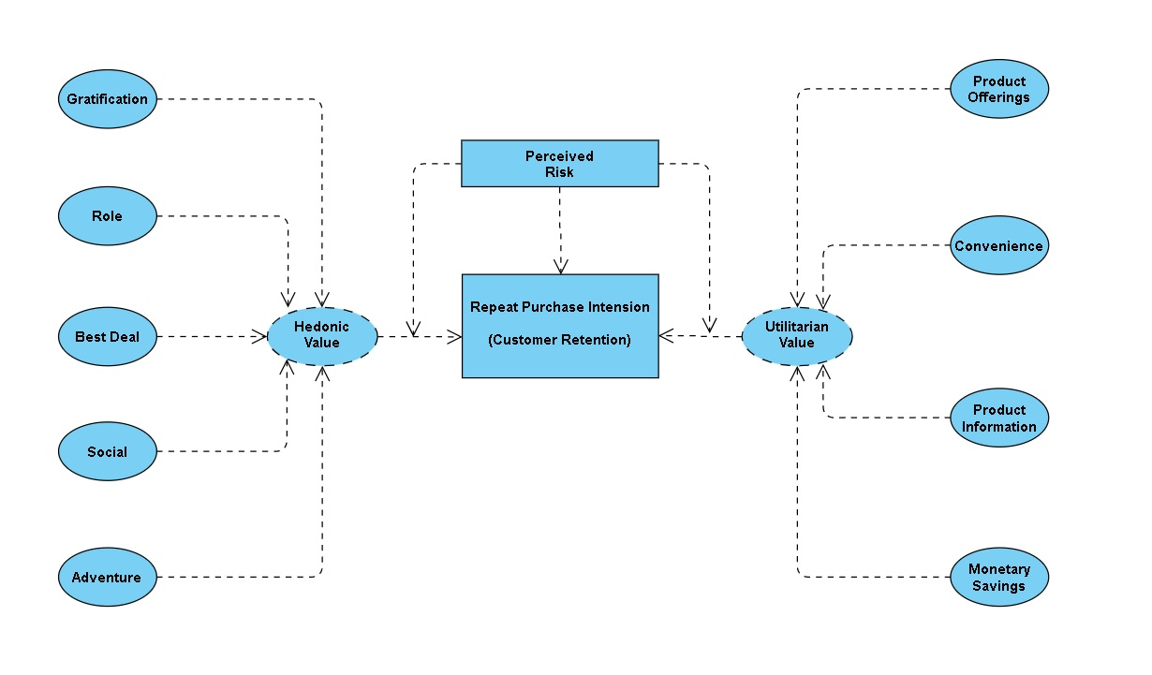
The problem statement can be represented in the form of below use case diagram as well.

Slide 6
Data Analysis Steps Done:
Import Libraries
Import Dataset
Data Preprocessing
Label Encoding & Checked for Correlation
Visualization
(EDA)
Finding null values

Slide 7
Objective
The problem statement examined how customers form expectations on technology based self-service quality and suggested five main attributes of ecommerce store quality, that are service quality, system quality, information quality, trust and net benefit.
Many businesses focus on customer loyalty programs to remain competitive in today's marketplaces and explore innovative ways to keep their existing customers engaged. Customer retention is a simple concept. Yet, it often requires effort from every department to improve the customer experience and build lasting trust. So, what is customer retention and why it is so important. Let’s know about it by analysing the problem

Slide 8
Exploratory Data Analysis (EDA) Steps:
I have imported the dataset which was in excel format.
Performed some of the statistical analysis like dimension of the dataset, data types, info, number of unique values, value counts etc.

Slide 10
VISUALIZATION
Since all the columns contains categorical data, so we will visualize the data using both pie plots and count plots.

Slide 11
OBSERVATIONS FROM pie plots
The number of gender of respondent for Female customers have high counts compared to Male customers. That is around 67% of female customers shopped online and only 32% of male customers shopped online.
The count is high for customers whose age is between 31-40 years and they shopped more from the online stores followed by the customers' age between 21-30 years and 41-50 years.
70% of the customers access Mobile Internet to for online purchase and 28% of the customers used WiFi to shop online and only 1% of the customers used Dial-up method to shop online.
About 45% of the customers' operating system is Windows/windows Mobile and the count is also high for the same followed by the customers having Android OS.
Around 85.50% of the customers used Search Engine channel to arrive at their favorite online store for the first time.
Most of the customers prefer to pay the bill using Credit/Debit cards and some of the customers prefer cash on delivery and very few of customers use E-wallets payment methods.

Slide 12
About 70% of the customers agreed that the online shopping gives monetary benifits and discounts.
53.90% of the customers agreed that they enjoys online shoppings and only 18% of the customers disagreed.
S 97% of the customers agreed that they are satisfied while shopping on a good quality website and 3% of the customers disagreed with it.
About 81% of the customers agreed that the net benefit derived from shopping online can lead to users satisfaction.
71% of the customers agreed that the Convenience of patronizing the online retailer.
57% of the customers agreed that shopping on the website gives the sense of adventure. The adventures in the shopping websites gives positive activity to experience an amplified enjoyment to the customers while shopping on websites.
Around 39.78% customers agreed that shopping on preferred e-tailer enhances the social status of the customers.
47.58% of the customers agreed that they felt gratified while shopping on their favourite e-tailer.

Slide 13
OBSERVATIONS FROM VISUALIZATION
Most of the customers from the city Delhi, Greater Noida, Noida and Bangalore are used to shop onine and the shopping count is high in these cities.
Most of the customers found shopping online for more than 4 years and the count is high for the same followed by the customers shopping for 2-3 years.
In last 1 year, most of the customers were purchased online less than 10 times and only few of the customers purchased online 21-30 times.
Most of the customers used Smartphone device to access the online shopping and only few customers used Tablet to access the online shopping.
Most of the customers used Search Engine and Via application to reach the online retail store after their first visit and also some customers used Detect URL to reach the online store. Which means these customers have downloaded their most favourite application to reach the online stores easily.
Many customers took more than 15 mins before making the purchase decision and some of the customers explored 6-10 mins.
Most of the customers abandoned their shopping cart sometimes and some of the customers abandoned their shopping cart frequently.
Around 133 customers abandoned their bag due to some better alternative offer and 54 customers abandoned due to promo code not applicable.
Around 90% of the customers agreed that the content on the website is easy to read and understand.

Slide 14
The count is high for amazon followed by amazon and flipkart which means most of the customers liked the reliability of website or application in amazon and flipkart.
Most of the customers likes Amazon's quickness to complete the purchase followed by Flipart's and only few of the customers likes Myntra website.
In Amazon and flipkart websites there are several payment options available compared to the other shopping websites.
Most of the customers believed that Amazon has perceived trustworthiness comapared to others. Apart from this customers believed that flipkart and Myntra also have perceived trustworthiness.
Most of the customers like Amazon inerms of presence of online assistance through multi-channel followed by flipkart,Myntra and snapdeal.
Most of the customers agreed that Amazon takes longer time to get logged them in.
Customers believes that Amazon and flipkart takes longer time in display the graphics and photos in sales period.
Customers says that Myntra and paytm have late declaration of price in promotion/sales period compared to others.
Also Myntra and paytm takes longer page loading time.
Most of the customers disliked frequent disruption when moving from one page to another on amazon, Myntra and snapdeal.
Most of the customers believes that Amazon and flipkart website is as efficient as before.

Slide 15
The count is high for amazon followed by amazon and flipkart which means most of the customers liked the reliability of website or application in amazon and flipkart.
Most of the customers likes Amazon's quickness to complete the purchase followed by Flipart's and only few of the customers likes Myntra website.
In Amazon and flipkart websites there are several payment options available compared to the other shopping websites.
Most of the customers liked Amazon's delivery speed followed by flipkart and snapdeal.
Most of the customers trusts amazon followed by flipkart in terms of keeping the privacy of their data information.
The count is high for the customers who belives that amazon website keeps their finanacial information secrete also the customers trusts flipkart, Myntra, Snapdeal and paytm in terms of keeping thier finanacial information secured.
Most of the customers believed that Amazon has perceived trustworthiness comapared to others. Apart from this customers believed that flipkart and Myntra also have perceived trustworthiness.
Most of the customers like Amazon inerms of presence of online assistance through multi-channel followed by flipkart,Myntra and snapdeal.
Most of the customers agreed that Amazon takes longer time to get logged them in.
Customers believes that Amazon and flipkart takes longer time in display the graphics and photos in sales period.
Customers says that Myntra and paytm have late declaration of price in promotion/sales period compared to others.
Also Myntra and paytm takes longer page loading time.
Snapdeal.com has limited mode of payment on most products followed by Amazon.in.

Slide 16
ASSUMPTIONS
Transaction security and consumers data safety are principal concerns of online customers purchasing products or services online.
Retailers should be careful about the annoying factors of online shopping such as being unable to access the website, long delays in completing online orders, inconsistencies in the items available online, mistakes in filling orders, and the hassle of returning goods
Online sellers can be more concerned about delivery times, delivery charge and product return policies.
Getting feedbacks from the customers is also on of the important thing to improve the sales of the company

Slide 17
CONCLUSION
According to consumers' opinions, "time saving" is the most important motivating factor for online shopping
After visualizing the data, I found Amazon is the best online store where the customers trust on buying products and it has positive impact on the customers.
amazon and flip kart have increased customers’ expectations. So, they are the best online retailer who makes the loyal customers and satisfies the customers.
Customer satisfaction and customer trust appeared as the outcomes of overall e-retail factor.

Slide 18


