Slide 1
Fatalities
Airline vs. Motor Vehicles
Reenie Christudass

Slide 2
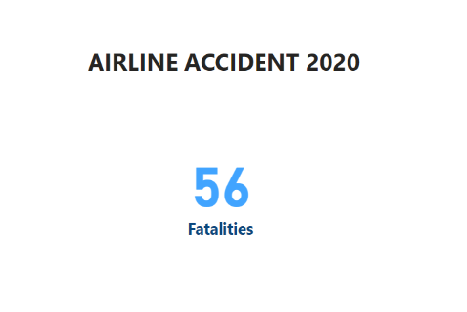
AIRLINE ACCIDENT USA
Aviation Safety Network (ASN) provides up-to-date, reliable authoritative information on airliner accidents
Gathered data from ASN wiki based on airline accidents for the year 2020 for the USA
For the year 2020, 56 fatalities were recorded

Slide 3
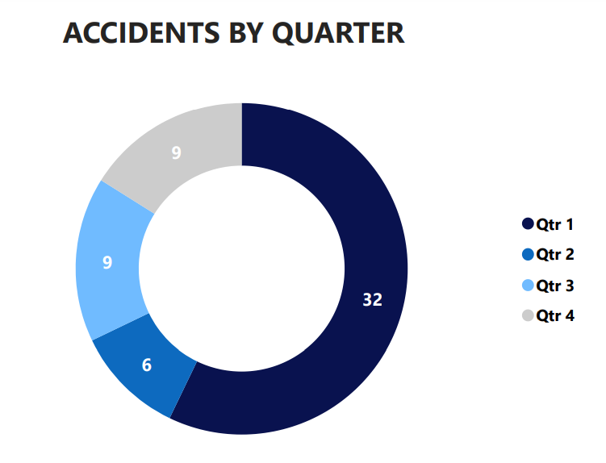
AIRLINE ACCIDENT USA
Donut graph represents the quarter in which most fatalities occurred
Q1 had more accidents compared to Q2, Q3 and Q4

Slide 4
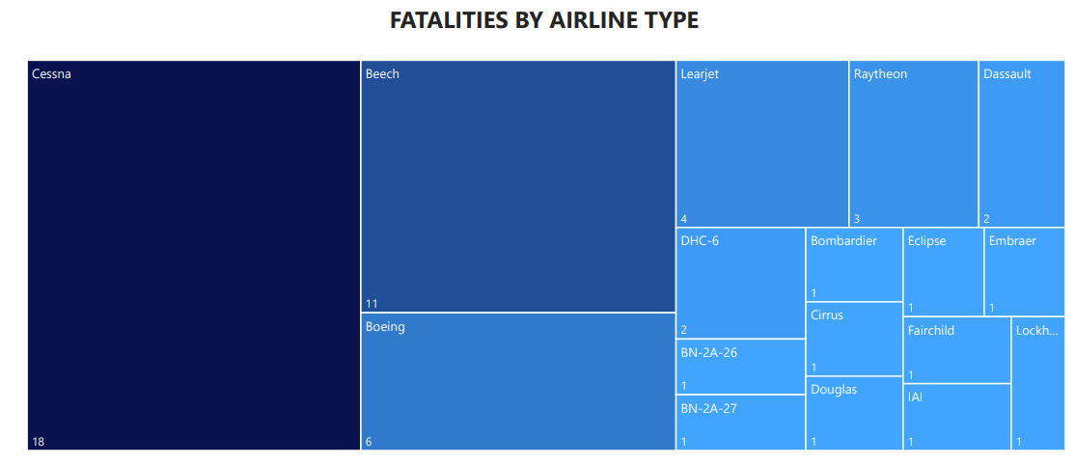
AIRLINE ACCIDENT USA
Cessna, Beech, and Boeing are the airline types involved in more accidents compared to other plane types
Airlines involved in fatalities were small planes

Slide 5
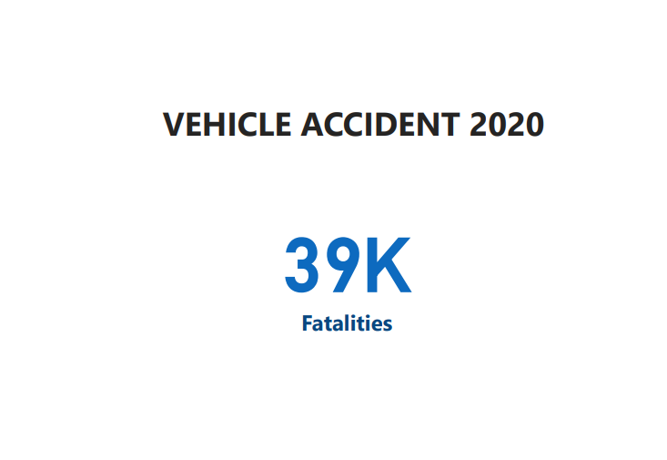
VEHICLE ACCIDENT USA
Fatality Analysis Reporting System (FARS) is a nationwide census providing National Highway Traffic Safety Administration (NHTSA) regarding fatal injuries suffered in motor vehicle traffic crashes
For the Year 2020, 39K fatalities were recorded

Slide 6
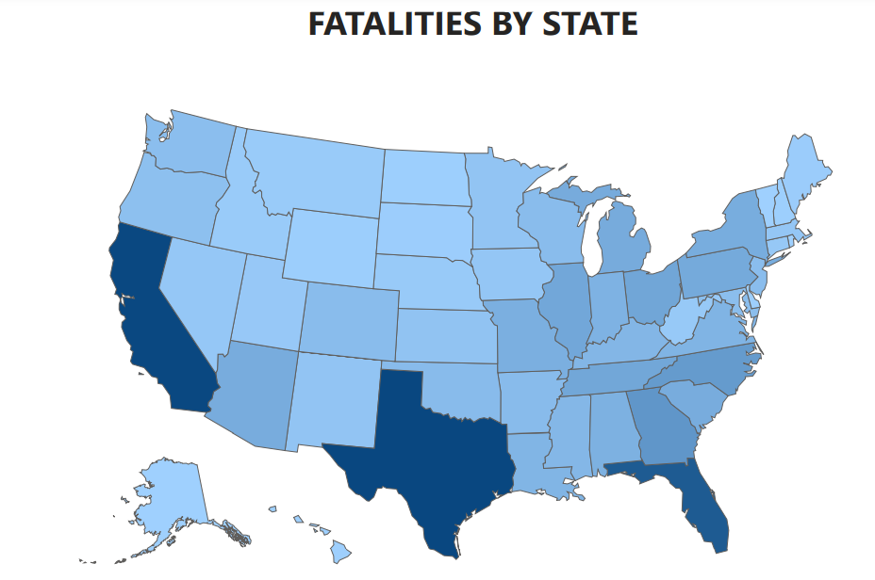
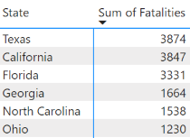
VEHICLE ACCIDENT USA
Shape map shows the state which has more fatalities.
California, Texas, and Florida have recorded more fatalities
These three states are the most populated and highlighted in dark blue

Slide 7
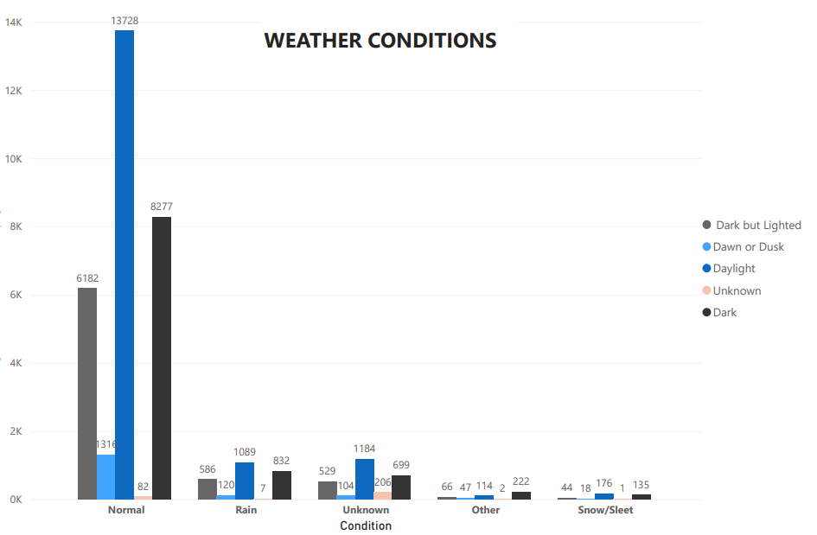
VEHICLE ACCIDENT USA DUE TO WEATHER
More fatalities were seen during normal daylight condition
Weather has minimal impact on the fatalities or accidents
Fewer fatalities were observed during extreme weather conditions, snow/sleet

Slide 8
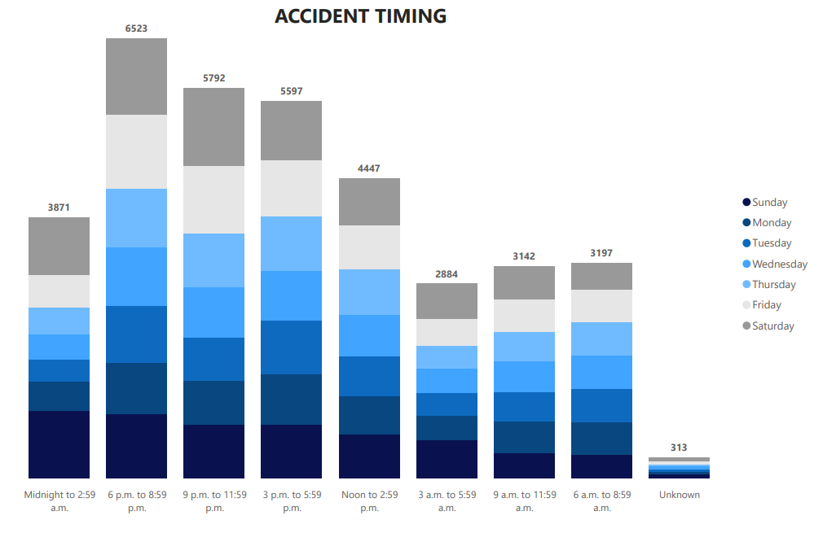
VEHICLE ACCIDENT USA - TIME
More accidents happened from 6 PM to 9 PM
There are no patterns during which day most of the accidents happened

