Slide 1

“SPEED CONTROL OF DC MOTOR USING LINEAR QUDRATIC REGULATOR TECHNIQUE”
SUBMITTED BY
PRASANT KUMAR
M.TECH
(INSTRUMENTATION & CONTROL ENGINEERING)

Slide 2
OUTLINE
1. INTRODUCTION OF DISSERTATION WORK
2. DC MOTOR
3 .INTRODUCTION OF DIFFERENT TECHNIQUE OF SPEED CONTROL DC MOTOR
4. PROPOSED TECHNIQUE (LINEAR QUADRATIC REGULATOR)
5. MYTHOLOGY OF SPEED CONTROL OF DC MOTOR
6. RESULT
7. CONCLUSION
8. FUTURE SCOPE
9. REFERENCES
10.LIST OF PUBLICATIONS

Slide 3
INTRODUCTION
DC MOTOR
Electric machines are a means of energy converting device. Motors take electrical energy and produce mechanical energy. A DC motor in simple words is a device that coverts electrical energy (Direct current system) into mechanical energy.
DC shunt motor because of their self regulating capabilities, ideal for application where precise speed control is required. It used due to their simplicity, ease of application, reliability and favorable cost have long been a backbone of industrial application.
The DC shunt motors are used in various applications such as defense, industries,RoboticslikesLathemachines,centrifugalpumps,fans,blowers,conveyors,spinning machines etc.

Slide 4
Linear quadratic regulator
Linear quadratic regulator is the most effective controller because it regulates the error to zero and minimum settling time and it doesn’t have percentage of overshoot.LQR is an optimal control regulator that better tracks a reference trajectory compared against traditional controllers such as PID.
So it can stabilize the system quicker than any other controller. The introduction of Artificial Intelligence based LQR tuning methods are becoming popular these days because higher performance and faster speed. Their performance is analyzed on basis of their tuning results for DC motor model and better one is concluded.
Advantages of LQR technique
Fast adaptation
Smooth operation
Reduce the effect of Non-linearity
Learning ability
Simulation of MATLAB results using Linear-Quadratic Regulator (LQR) for such as Effect of different tuning parameter for Motor and comparisons of different technique such as FUZZY controller , it is found that the LQR controller is the best controller among the other controllers.

Slide 5
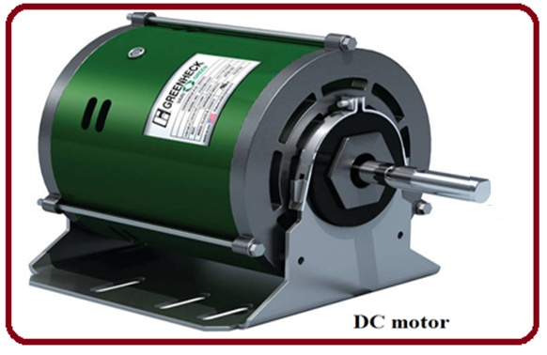
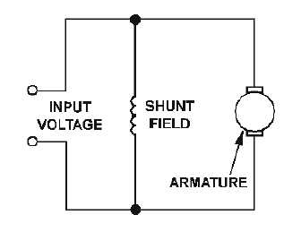
DC MOTOR
Direct current (DC) motors convert electrical energy into mechanical energy through the interaction of two magnetic fields. One field is produced by a magnet of poles assembly, the other field is produced by an electrical current flowing in the motor windings. These two fields result in a torque which tends to rotate the rotor
DC Shunt Motor

Slide 6

SPEED CONTROL OF DC MOTOR
Speed control means intentional change of the drive speed to a value required for performing the specific work process.
It is obvious that speed can be control by varying
Change Terminal voltage
Change of armature resistance
Change of flux

Slide 7
OTHER DIFFERENT TECHNIQUE FOR SPEED CONTROL OF DC MOTOR
PID controller
FUZZY LOGIC CONTROLLER
ZN TUNING CONTROLLER
NEURAL NETWORK CONTROLLER
GA

Slide 8
PROPOSED TECHNIQUE (LINEAR QUADRATIC REGULATOR)
Linear quadratic regulator design technique is well known in modern optimal control theory and has been widely used in many applications. Under the assumption that all state variables are available for feedback, the LQR controller design method starts with a defined set of states which are to be controlled. In general, the system model can be written in state space equation as follows

Slide 9

Continue…
The minimization of it is just the means to the end of achieving acceptable performance of the system. For the design of a linear quadratic regulator controller, the performance index (J) is given by
Where Q is symmetric positive semi definite ( ≥0 ) state weighting matrix of order nXn, and R is symmetric positive definite ( > 0 ) control weighting matrix of order mXm. The choice of the element Q and R allows the relative weighting of individual state variables and individual control inputs as well as relative weighting state vector and control vector against each other.

Slide 10
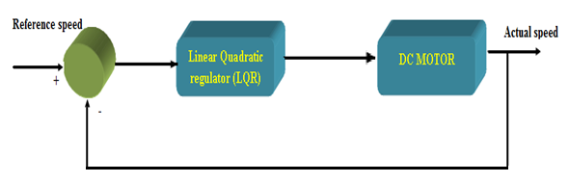
SPEED CONTROL OF DC MOTOR USING LINEAR QUADRATIC REGULATOR
The flow chart in Figure shows. The mathematical modeling is doing to find the mathematical model for the DC motor where we will get the state-space model.
Fig. Block diagram DC motor control system used by LQR Controller.
This followed by getting the LQR controller from the state-space model. The simulink result by using LQR controller Show the fig , the Flow chart of Linear-Quadratic Regulator (LQR) with speed analysis of DC motor .

Slide 11
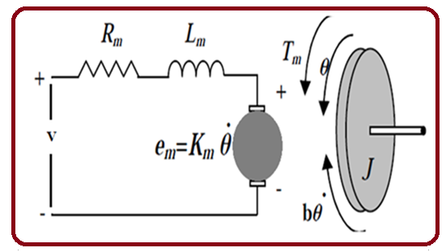




MODELLING OF DC MOTOR

Slide 12

TRANSFER FUNCTIONS OF DC MOTOR USING DATA IN APPENDIX SECTION
…

Slide 13
DESIGN OF LINEAR QUADRATIC REGULATOR FOR SPEED CONTROL DC MOTOR
The linear quadratic regulator (LQR) is a well-known design technique that provides practical feedback gains. For the derivation of the linear quadratic regulator, assume that the plant to be written in state-space form as .
And that all of the n states x are available for the controller. The feedback gain is a matrix K of the optimal control vector.
So as to minimize the performance index

Slide 14
Continue…
For the design of a linear quadratic regulator controller, performance index (cost function) used to find four objectives.
the performance index (J) is given by
Minimum time problem
Tracking problems
Minimum effort
Where, R is positive definite matrix
Q is positive semi-definite matrix

Slide 15
Continue…
There are two main equations which have to be calculated to achieve the feedback gain matrix K. Where P is a symmetric and positive definite matrix obtained by solution of the ARE is defined as:
The above equation is called Algebraic Riccati Equation
Where A,B are basic Matrix and Q is positive semi-definite matrix.Where P is symmetric matrix

Slide 16
Continue…
There are two main equations which have to be calculated to achieve the feedback gain matrix K. Where P is a symmetric and positive definite matrix obtained by solution of the ARE is defined as:
LQR is a method in modern control theory that used state-space approach to analyses such a system. Using state space methods it is relatively simple to work with Multi- Input Multi-Output (MIMO) system. Linear- Quadratic Regulator (LQR) optimal control problems have been widely investigated in the literature.

Slide 17
RESULT & DISCUSSION

Slide 18
EFFECT OF DIFFERENT TUNING PARAMETER FOR DC MOTOR
Effect of tuning parameter |  | Rise Time (tr) | Settling Time (ts) | Overshoot (%)
Q | R
0.0000007 | 0.0006 | 0.666 | 1 | 0
0.0000006 | 0.00004 | 0.87 | 1.63 | 0
0.000000009 | 0.000046 | 0.669 | 0.987 | 0

Slide 19
EFFECT OF TUNING PARAMETER

Slide 20
COMPARISON BETWEEN PARAMETERS FOR SPEED CONTROL OF DC MOTOR
Controllers Time Characteristics | PID | Fuzzy Logic Controller | LQR
Rise time | 0.8727 | 0.7600 | 0.498
Settling time | 2.9782 | 2.6200 | 0.881
Overshoot (%) | 0.120000 | 0.008264 | 0

Slide 21
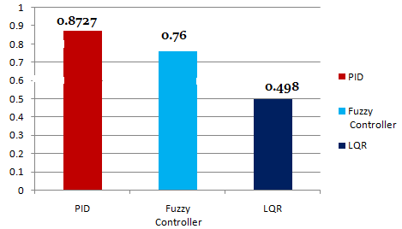
COMPARISON OF RISE TIME FOR DIFFERENT CONTROLLER

Slide 22
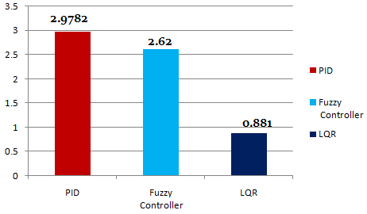
COMPARISON OF SETTLING TIME FOR DIFFERENT CONTROLLER

Slide 23
OPTIMIZED RESULT FOR SPEED CONTROL OF DC MOTOR

Slide 24
CONCLUSION
DC motor can be controlled either by software or directly by hardware.
Software controlling needs computers which are bulky and common man cannot afford for it, so hardware controls are in use. This Dissertation needs to develop the DC motor controller using Linear Quadratic Regulator (LQR) To make the motor operate.
Furthermore, the simulation results so obtained show that the LQR controller gives greatest value of percent overshoot and longer settling time. The result is a control that is guaranteed to be stable.
Linear quadratic regulator is the most effective controller because it regulates the error to zero and it doesn’t have percentage of overshoot and time settling. So it can stabilize the system quicker better than Fuzzy controller because it has,
1. Fast adaptation
2. Smoot operation
3. Reduce the effect of Non-linearity
4. Learning ability
5. Easily design

Slide 25
FUTURE SCOPE
The conventional FUZZY controller could be replaced with LQR controller which provides zero overshoot and better accuracy with stability.

Slide 26
PARAMETERS OF DC MOTOR
DC motor (Symbol) | Parameters of DC motor | Numerical Values
Lm | Motor Electric Inductance(H | 0.1215 H
Rm | Motor Electric Resistance(Ω | 11.2Ω
Kt | Torque Constant Kt | 1.28Nm/A
b | Viscous friction coefficient ,Bm | 0.002953Nms/rad
Jm | Rotor Inertia, Jm | 0.02215 kgm

Slide 27
REFERENCES
[1] Yasser Ali Almatheel, Ahmed Abdelrahman “Speed Control of DC Motor Using Fuzzy Logic Controller” IEEE,( International Conference on Communication, Control, Computing and Electronics Engineering (ICCCCEE), Khartoum, Sudan),2017.
[2] Mr. R. B. Nimbalkar, “A Review on Significance of PID Controller for Speed Control of DC Motor”International Journal on Recent and Innovation Trends in Computing and Communication Volume: 4 Issue: 5,April 2015.
[3] Mr. Raj Kumar Dwivedi and Devendra Dohare; PID Conventional Controller and LQR Optimal controller for Speed analysis of DC Motor: A Comparative Study, International Research Journal Of Engineering And Technology (IRJET) , VOL :2 , ISSUE :8 , NOV 2015.
[4] Farzan Rashidi, Mehran Rashidi, and Arash Hashemi-Hoseinit.,“Speed Regulation of DC Motors Using Intelligent Controllers” 0-7804-7739- X/04/$17.00 (3004) IEEE.
[5] AdityaPratap Singh, “Speed Control of DC Motor using PID Controller Based on Matlab” International Conference on Recent Trends in Applied Sciences with Engineering Applications, Vol.5, No.6, 2014 .
[5] Puneet Kumar and K. P. Singh, “Analysis on Separately Excited DC Motor Using Proportional Integral Derivative Controller”IJBSTR RESEARCH PAPER VOL 1 [ISSUE 7] JULY 2014.
[6] SaurabhDubey, Dr. S.K. Srivastava, “A PID Controlled Real Time Analysis of DCMotor”International Journal of Innovative Research in Computer and Communication Engineering,Vol. 1, Issue 8, October 2014
[7] Majed D. Youns,Abdulla I, , “Optimization Control of DC Motor with Linear Quadratic Regulator and Genetic Algorithm Approach” Tikrit Journal of Engineering Sciences/Vol.30/No.5/June 2014, (45-53).
[8] AnandMickky, PratibhaTiwari, “Analysis of Speed Control of Separately ExcitedDC Motor Using FOPID with LQR”International Journal Of Innovative Research In Electrical, Electronics, Instrumentation And Control Engineering ,Vol. 4, Issue 4, March 2015.
[9] C.Rajeswari,A.SivaSankar, “Obtaining step response with small settling time usingFuzzy Logic Controller for a seperately excited DC motor”2011 International Conference on Recent Advancements in Electrical, Electronics and Control Engineering
[10] ShashiBhushanKumar , Mohammed Hasmat Ali, AnshuSinha, “Design and Simulation of Speed Control of DC Motor by Fuzzy Logic Technique with Matlab/Simulink”International Journal of Scientific and Research Publications, Volume 5, Issue 7, July 2015

Slide 28
PUBLICATION RESEARCH PAPER
[1] Mr. Prasant Kumar And Prof. Devendra Dohare “Comparative Study On Speed Control Of DC Motor Using Various Controllers –A Survey” International Journal For Research & Development in Technology In Vol 7 Issue (3) Feb-17.
[2] Mr. Prasant Kumar and Prof. Devendra Dohare Published “Comparison of Performance Measures of Speed Control for a DC Motor Using Fuzzy logic Controller and Optimal LQR Controllers in International Journal of Science, Technology & Engineering (IJSTE), in Vol 4, Issue II ,May 2017

Slide 29
THANK YOU

