Slide 1
Term Project: Optimal Speed Control of DC Motor using Linear Quadratic Regulator
Student: Chung Quang Khanh - 20245360
Professor: Ahn Kyoung Kwan
Course: Linear System Control, 2025 Spring

Slide 2
Simulation - Goal
In this demo, we explore optimal control of a DC motor using the Linear Quadratic Regulator (LQR).

Slide 3
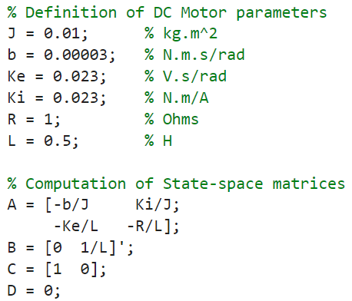
Simulation – DC motor parameters
MATLAB codes:
Symbol | Value and unit
J (Rotor inertia) | 1×10⁻² kg⋅m²
b (Viscous friction coefficient) | 3×10⁻⁵ N⋅m⋅s/rad
K_{e} (Back EMF constant) | 23×10⁻³ V⋅s/rad
K_{i} (Torque constant) | 23×10⁻³ N⋅m/A
R (Armature resistance) | 1 Ω
L (Armature inductance) | 0.5 H

Slide 4
Simulation – P controller
To highlight its advantages, we begin with a basic Proportional controller as baseline for comparison.

Slide 5
Simulation – LQR controller
Now, we implement the Linear Quadratic Regulator.
LQR computes an optimal state feedback gain by minimizing a cost function that balances state performance with control effort.

Slide 6
Simulation – LQR controller vs P controller
Overlaying both responses, the advantage of LQR becomes clear.
The LQR controller reacts more decisively, reaching the target quickly and precisely.

Slide 7
Q and R Tuning: Q and R Impact
We further explore LQR performance by adjusting the weighting matrices Q and R.
Each case tunes how aggressively the system corrects errors and how much control effort is used.

Slide 8
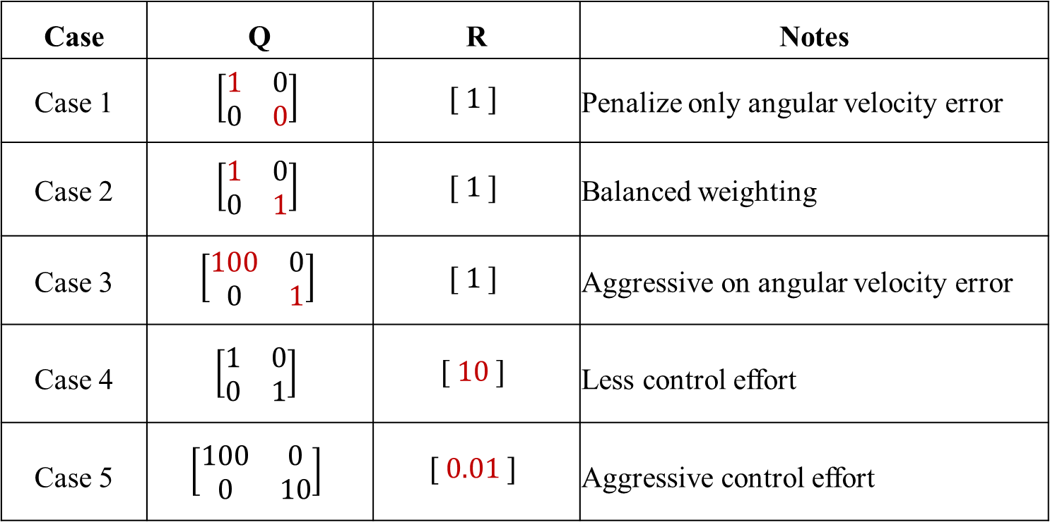
Q and R Tuning: Q and R Impact
State $x\left(t\right)=\left[\begin{matrix}\dot{θ} \\ i\end{matrix}\right]$ and $u\left(t\right)=V$
Case | Q | R | Notes
Case 1 | $$\left[\begin{matrix}1 & 0 \\ 0 & 0\end{matrix}\right]$$ | $$[ 1 ]$$ | Penalize only angular velocity error
Case 2 | $$\left[\begin{matrix}1 & 0 \\ 0 & 1\end{matrix}\right]$$ | $$[ 1 ]$$ | Balanced weighting
Case 3 | $$\left[\begin{matrix}100 & 0 \\ 0 & 1\end{matrix}\right]$$ | $$[ 1 ]$$ | Aggressive on angular velocity error
Case 4 | $$\left[\begin{matrix}1 & 0 \\ 0 & 1\end{matrix}\right]$$ | $$[ 10 ]$$ | Less control effort
Case 5 | $$\left[\begin{matrix}100 & 0 \\ 0 & 10\end{matrix}\right]$$ | $$[ 0.01 ]$$ | Aggressive control effort

Slide 9
Why Reference Tracking?
Although LQR provides excellent stability and fast response, it does not guarantee that the system will reach a specific target value on its own. This happens because standard LQR minimizes deviations from zero, not from a non-zero reference.
For example, if we command the motor to reach 1 rad/s, the basic LQR controller may settle slightly below that, resulting in a small steady-state error.
This is where reference tracking comes in.

Slide 10

LQR with reference tracking
To address this, we enhance the LQR controller to include reference tracking. By computing a special feedforward gain, we ensure the system output reaches the desired target exactly.
Modified LQR control law:
$u\left(t\right)=−Kx\left(t\right)+\tilde{K}r(t)$,
where $\tilde{K}$ is feedforward gain, and $r(t)$ is reference output
Computation of $\tilde{K}$:
$\tilde{K}=−{(C{(A−BK)}^{−1}B)}^{−1}$

Slide 11
LQR with reference tracking
This version of LQR eliminates steady-state error entirely, making it ideal for precise control tasks such as speed regulation or position control.

Slide 12
Summary of LQR
In summary, LQR offers substantial improvements over simple proportional control, with tunable performance and excellent tracking accuracy.
Thank you for watching!

