Slide 1
Term Project: Optimal Speed Control of DC Motor using Linear Quadratic Regulator
Student: Chung Quang Khanh - 20245360
Professor: Ahn Kyoung Kwan
Course: Linear System Control, 2024

Slide 2
Outline
Introduction
Linear Quadratic Regulator
DC motor model
Simulation results

Slide 3
Introduction
Goal: control the angular velocity of an armature-controlled DC motor using
Linear Quadratic Regulator
The result is then compared with that of PID and simple closed loop.

Slide 4
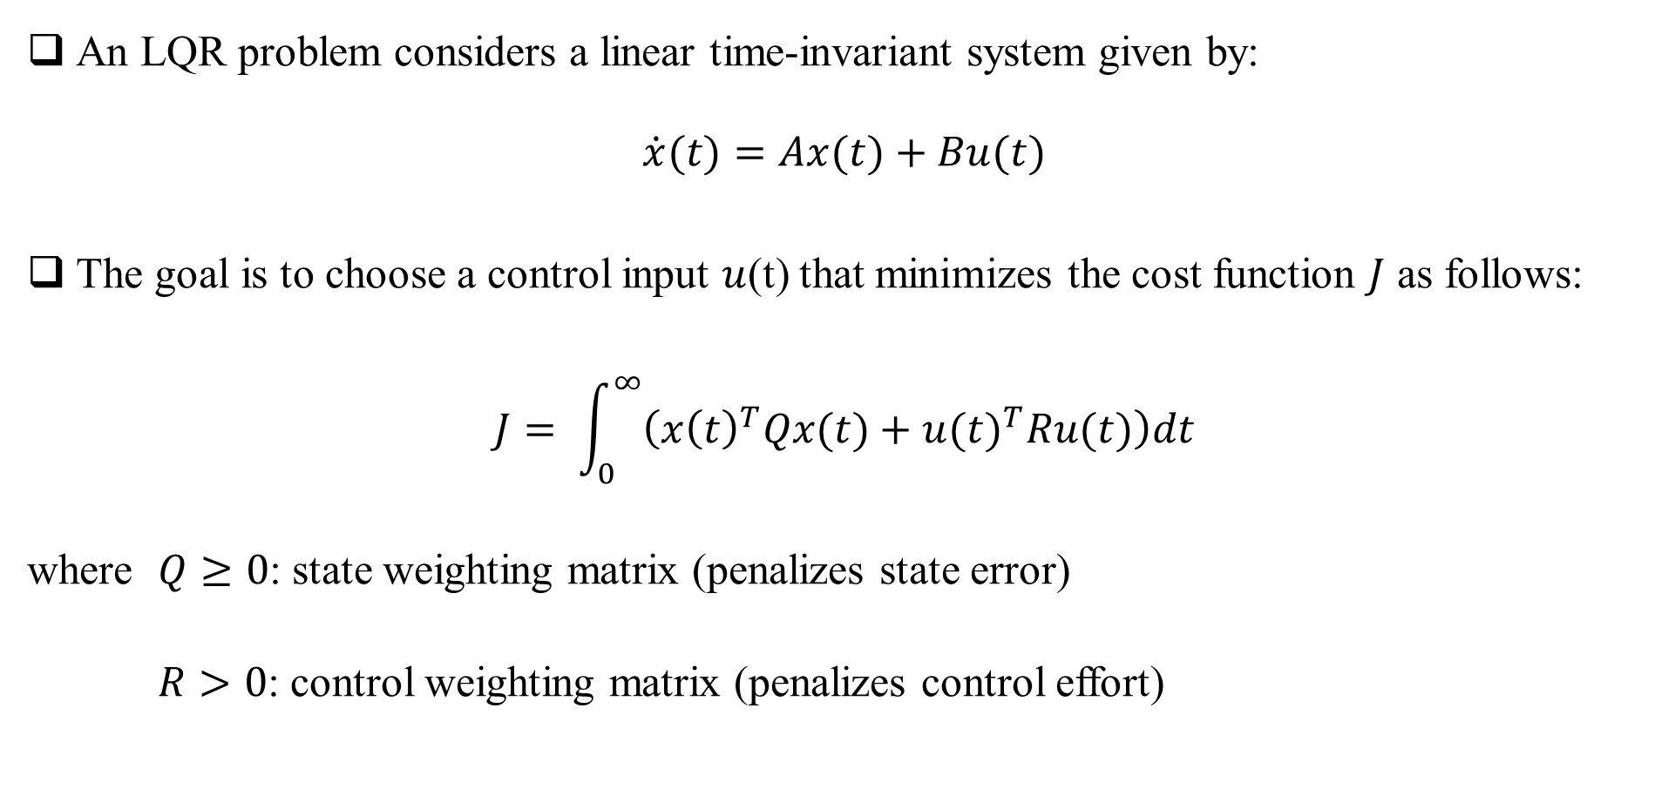
Linear Quadratic Regulator (LQR)
An LQR problem considers a linear time-invariant system given by:
$$\dot{x}(t)=Ax(t)+Bu(t)$$
The goal is to choose a control input $u$(t) that minimizes the cost function $J$ as follows:
$$J= \int_{0}^{∞}{\left({x\left(t\right)}^{T}Qx(t)+{u(t)}^{T}Ru(t)\right)dt}$$
where $Q≥0$: state weighting matrix (penalizes state error)
$R>0$: control weighting matrix (penalizes control effort)

Slide 5
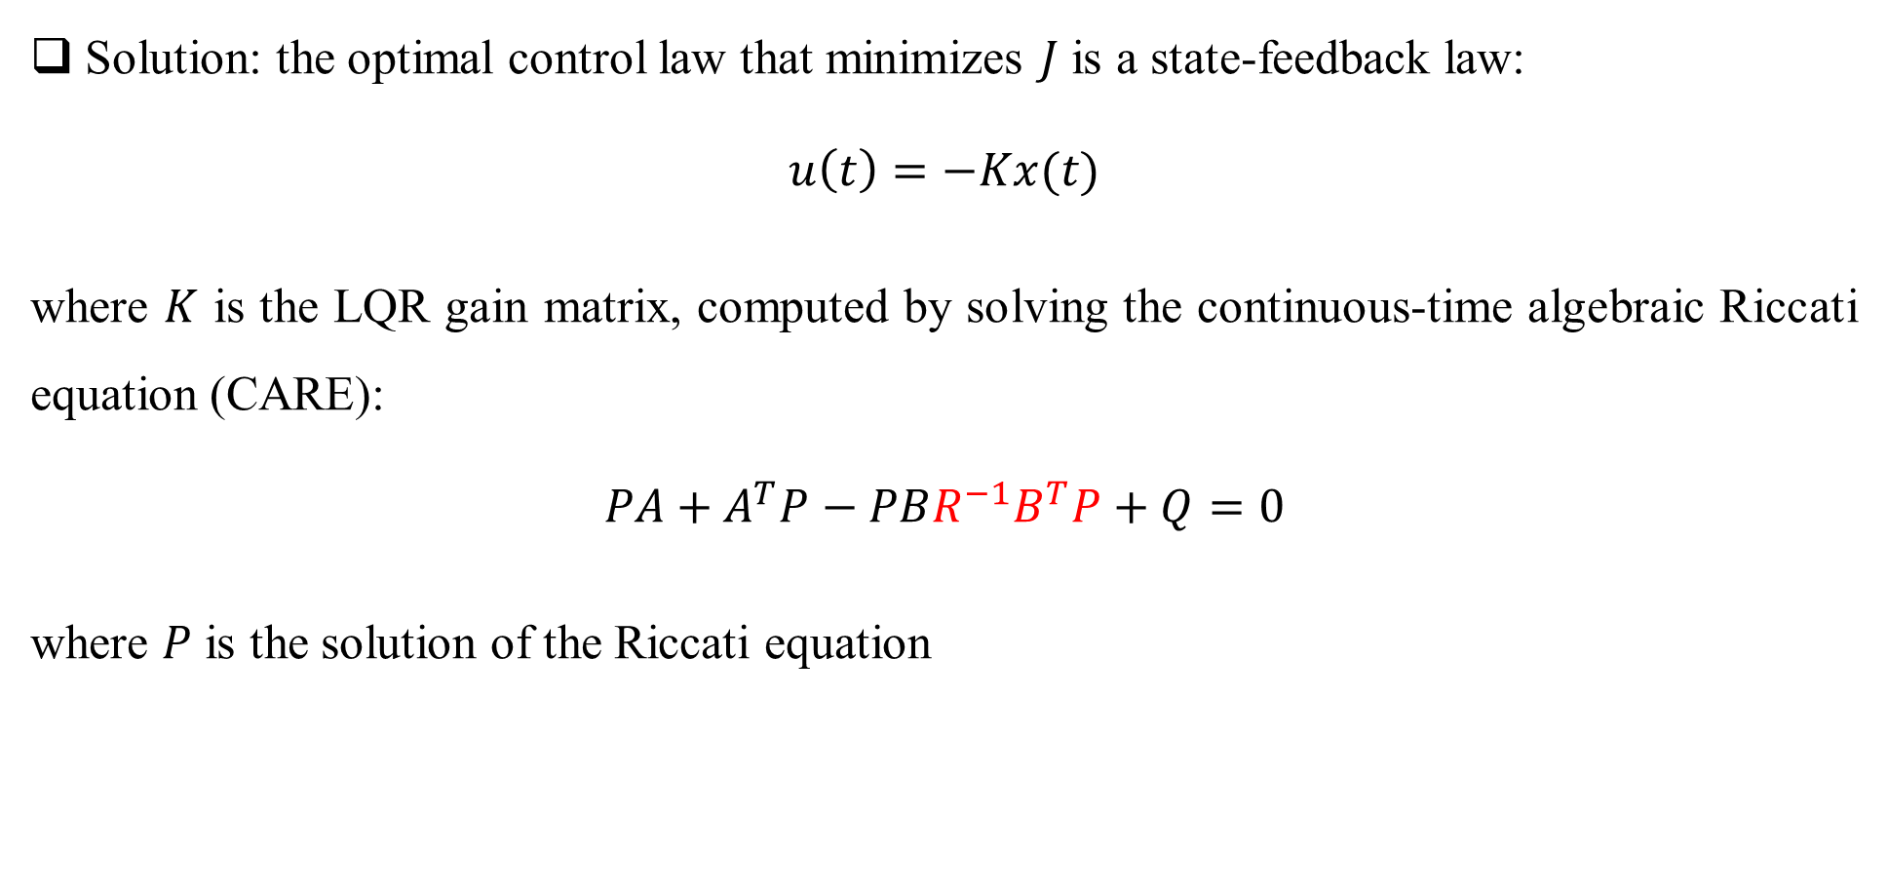

Linear Quadratic Regulator
Solution: the optimal control law that minimizes $J$ is a state-feedback law:
$$u\left(t\right)=−Kx(t)$$
where $K$ is the LQR gain matrix, computed by solving the continuous-time algebraic Riccati equation (CARE):
$$PA+A^{T}P−PBR^{−1}B^{T}P+Q=0$$
where $P$ is the solution of the Riccati equation
$$K$$

Slide 6
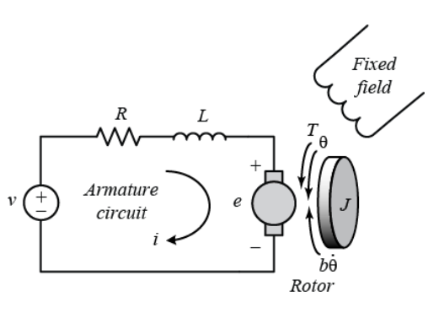

DC motor model
The armature circuit consist of a resistance R, an inductance L, and a voltage source V, which
represents the back emf e.
The motor torque $T$ is related to the armature current $i$, by a torque constant $K_{i}$:
$$T=K_{i}i$$
The back emf $e$ is relative to angular velocity of the shaft by a constant factor $K_{e}$:
$$e=K_{e}\dot{θ}$$
Fig. 1 DC motor model.

Slide 7

DC motor model
By applying the Newton’s law and Kirchhoff’s law, we have the following equations:
$J\ddot{θ}+b\dot{θ}=K_{i}i$ $L\frac{di}{dt}+Ri=V−K_{e}\dot{θ}$
Let $x\left(t\right)=\left[\begin{matrix}\dot{θ} \\ i\end{matrix}\right]$and $u\left(t\right)=V$, from the equations above, the state-space model is:
$$\dot{x}\left(t\right)=\left[\begin{matrix}−\frac{b}{J} & \frac{K_{i}}{J} \\ −\frac{K_{e}}{L} & −\frac{R}{L}\end{matrix}\right]x\left(t\right)+\left[\begin{matrix}0 \\ \frac{1}{L}\end{matrix}\right]u(t)$$
$$y=\left[\begin{matrix}1 & 0\end{matrix}\right]x\left(t\right)$$
A
B
C

Slide 8

DC motor model
Using the Laplace transform, the modeling equations can be expressed as follows:
$$s\left(Js+b\right)Θ\left(s\right)=K_{i}I\left(s\right)$$
$$\left(Ls+R\right)I\left(s\right)=V\left(s\right)−K_{e}sΘ\left(s\right)$$
Then, the open-loop transfer function of the motor is obtained by:
$$P\left(s\right)=\frac{\dot{Θ}(s)}{V(s)}=\frac{K_{i}}{\left(Js+b\right)\left(Ls+R\right)+K_{e}K_{i}}$$

