Slide 1
Term Project: Optimal Speed Control of DC Motor using Linear Quadratic Regulator
Student: Chung Quang Khanh - 20245360
Professor: Ahn Kyoung Kwan
Course: Linear System Control, 2025 Spring

Slide 2
Outline
Introduction
Linear Quadratic Regulator
DC motor model
Simulation

Slide 3
Introduction
Goal: control the angular velocity of an armature-controlled DC motor using
Linear Quadratic Regulator
The result is then compared with that obtained using a simple closed-loop
technique.

Slide 4
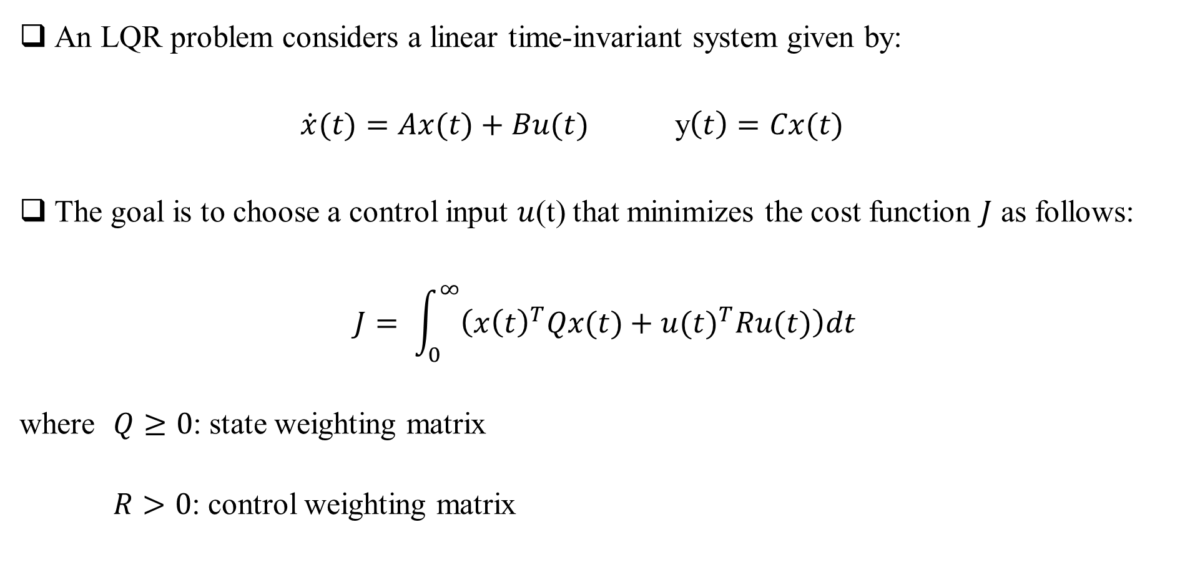
Linear Quadratic Regulator (LQR)
An LQR problem considers a linear time-invariant system given by:
$\dot{x}(t)=Ax(t)+Bu(t)$ y$\left(t\right)=Cx(t)$
The goal is to choose a control input $u$(t) that minimizes the cost function $J$ as follows:
$$J= \int_{0}^{∞}{\left({x\left(t\right)}^{T}Qx(t)+{u(t)}^{T}Ru(t)\right)dt}$$
where $Q≥0$: state weighting matrix
$R>0$: control weighting matrix

Slide 5
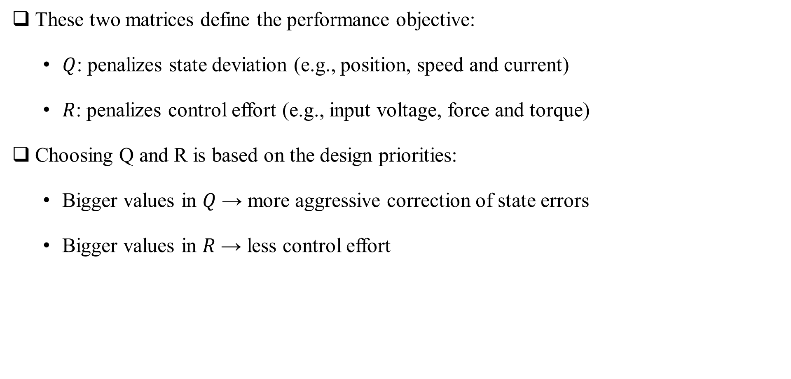
Determining Q and R
These two matrices define the performance objective:
$Q$: penalizes state deviation (e.g., position, speed and current)
$R$: penalizes control effort (e.g., input voltage, force and torque)
Choosing Q and R is based on the design priorities:
Bigger values in $Q$ → more aggressive correction of state errors
Bigger values in $R$ → less control effort

Slide 6

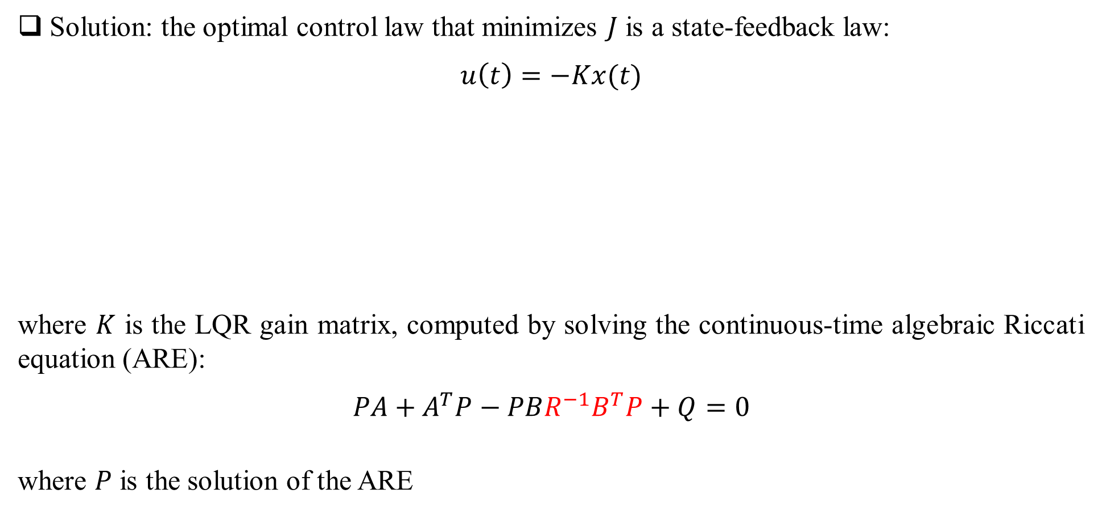





Linear Quadratic Regulator
Solution: the optimal control law that minimizes $J$ is a state-feedback law:
$$u\left(t\right)=−Kx(t)$$
where $K$ is the LQR gain matrix, computed by solving the continuous-time algebraic Riccati equation (ARE):
$$PA+A^{T}P−PBR^{−1}B^{T}P+Q=0$$
where $P$ is the solution of the ARE
$$x$$
$$\dot{x}=Ax+Bu$$
$$C$$
$$y$$
$$u=−Kx$$
$$K$$

Slide 7
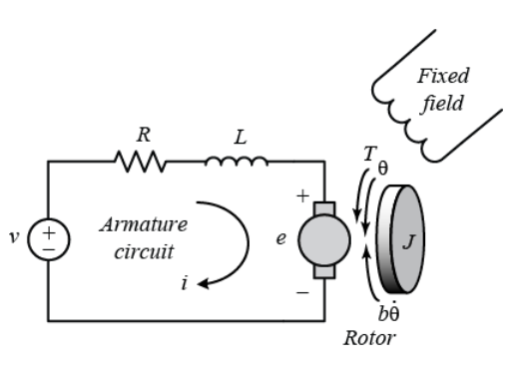

DC motor model
The armature circuit consist of a resistance R, an inductance L, and a voltage source V, which
represents the back emf e.
The motor torque $T$ is related to the armature current $i$, by a torque constant $K_{i}$:
$$T=K_{i}i$$
The back emf $e$ is relative to angular velocity of the shaft by a constant factor $K_{e}$:
$$e=K_{e}\dot{θ}$$
Fig. 1 DC motor model.

Slide 8

DC motor model – State space
By applying the Newton’s law and Kirchhoff’s law, we have the following equations:
$J\ddot{θ}+b\dot{θ}=K_{i}i$ $L\frac{di}{dt}+Ri=V−K_{e}\dot{θ}$
Let $x\left(t\right)=\left[\begin{matrix}\dot{θ} \\ i\end{matrix}\right]$and $u\left(t\right)=V$, from the equations above, the state-space model is:
$\dot{x}\left(t\right)=\left[\begin{matrix}−\frac{b}{J} & \frac{K_{i}}{J} \\ −\frac{K_{e}}{L} & −\frac{R}{L}\end{matrix}\right]x\left(t\right)+\left[\begin{matrix}0 \\ \frac{1}{L}\end{matrix}\right]u(t)$ $y=\left[\begin{matrix}1 & 0\end{matrix}\right]x\left(t\right)$
B
C
A

Slide 9

DC motor model – Transfer function
Using the Laplace transform, the modeling equations can be expressed as follows:
$$s\left(Js+b\right)Θ\left(s\right)=K_{i}I\left(s\right)$$
$$\left(Ls+R\right)I\left(s\right)=V\left(s\right)−K_{e}sΘ\left(s\right)$$
Then, the open-loop transfer function of the motor is obtained by:
$$G\left(s\right)=\frac{\dot{Θ}(s)}{V(s)}=\frac{K_{i}}{\left(Js+b\right)\left(Ls+R\right)+K_{e}K_{i}}$$

Slide 10












DC motor model
$$V(s)$$
$$+$$
$$\frac{1}{Ls+R}$$
$$i(s)$$
$$T(s)$$
$$\frac{1}{Js+b}$$
$$\dot{θ}(s)$$
$$ $$
$$K_{i}$$
$$−$$
$$e(s)$$
$$K_{e}$$
Fig. 2 DC motor system block diagram for speed control.

Slide 11
Simulation - Goal
Compare two control strategies – Proportional (P) and LQR – in regulating
the angular velocity of a DC motor.
Compare the impact of different Q and R matrices on LQR behavior.

Slide 12
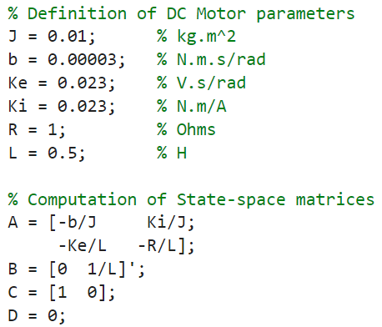
Simulation – DC motor parameters
MATLAB codes:
Symbol | Value and unit
J (Rotor inertia) | 1×10⁻² kg⋅m²
b (Viscous friction coefficient) | 3×10⁻⁵ N⋅m⋅s/rad
K_{e} (Back EMF constant) | 23×10⁻³ V⋅s/rad
K_{i} (Torque constant) | 23×10⁻³ N⋅m/A
R (Armature resistance) | 1 Ω
L (Armature inductance) | 0.5 H

Slide 13
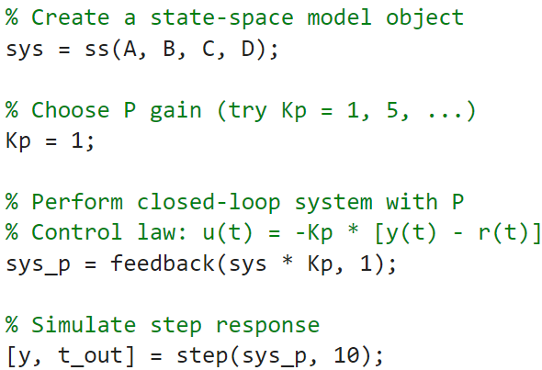
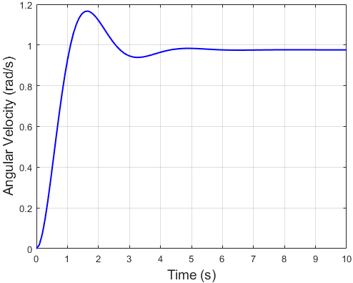
Simulation – P controller vs LQR controller
MATLAB codes:
Step response with Proportional controller

Slide 14
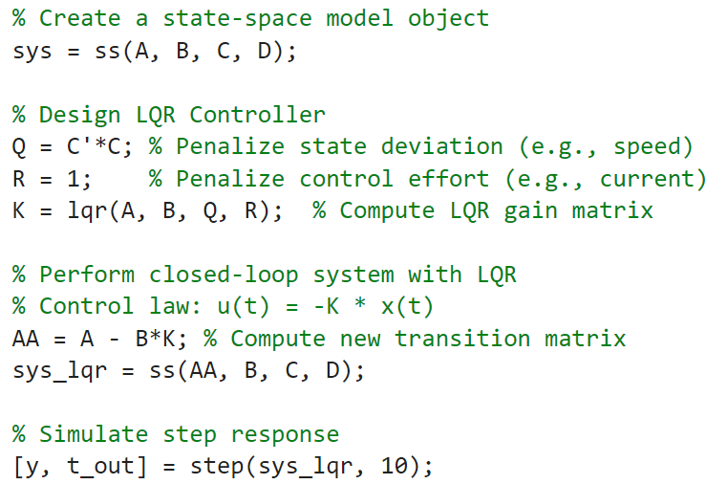
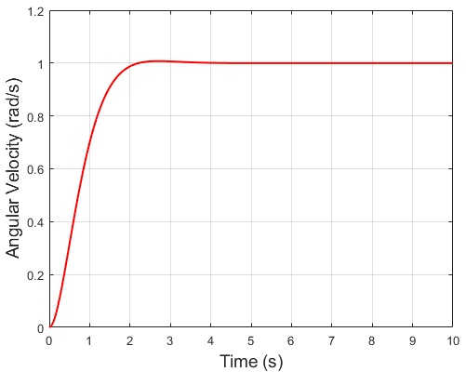
Simulation – P controller vs LQR controller
MATLAB codes:
Step response with LQR controller

Slide 15
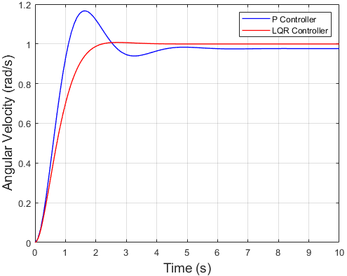
Simulation – P controller vs LQR controller
Step response comparison
Performance metrics comparison
Performance metrics | P controller | LQR controller
t_{s} | 3.8268 s | 1.9102 s
t_{p} | 1.6300 s | 2.7000 s
M_{p} | 19.53 % | 0.77 %

Slide 16
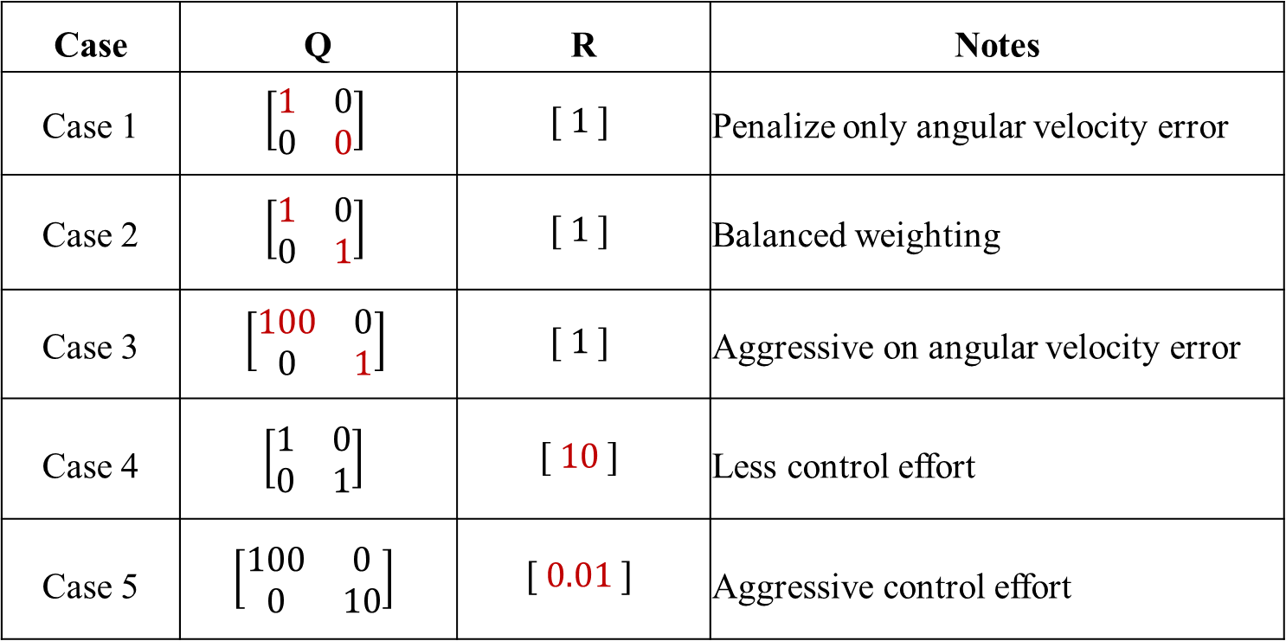
Simulation – Different Q and R in LQR controller
State $x\left(t\right)=\left[\begin{matrix}\dot{θ} \\ i\end{matrix}\right]$ and $u\left(t\right)=V$
Case | Q | R | Notes
Case 1 | $$\left[\begin{matrix}1 & 0 \\ 0 & 0\end{matrix}\right]$$ | $$[ 1 ]$$ | Penalize only angular velocity error
Case 2 | $$\left[\begin{matrix}1 & 0 \\ 0 & 1\end{matrix}\right]$$ | $$[ 1 ]$$ | Balanced weighting
Case 3 | $$\left[\begin{matrix}100 & 0 \\ 0 & 1\end{matrix}\right]$$ | $$[ 1 ]$$ | Aggressive on angular velocity error
Case 4 | $$\left[\begin{matrix}1 & 0 \\ 0 & 1\end{matrix}\right]$$ | $$[ 10 ]$$ | Less control effort
Case 5 | $$\left[\begin{matrix}100 & 0 \\ 0 & 10\end{matrix}\right]$$ | $$[ 0.01 ]$$ | Aggressive control effort

Slide 17
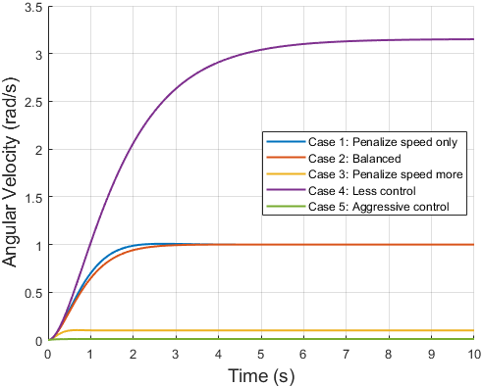

Simulation – Different Q and R in LQR controller
Step Responses for LQR Controllers with Various Q/R
LQR control law:
$$u\left(t\right)=−Kx\left(t\right)$$
So, the closed-loop system becomes:
$\dot{x}\left(t\right)=(A−BK)x(t)$
$x\left(t\right)→0$ as $t→∞$ (stable)
This yields to the result:
$y\left(t\right)=Cx\left(t\right)→0$ (non-tracking)
What if the goal is to track the desired output?
$y\left(t\right)→r(t)$

Slide 18
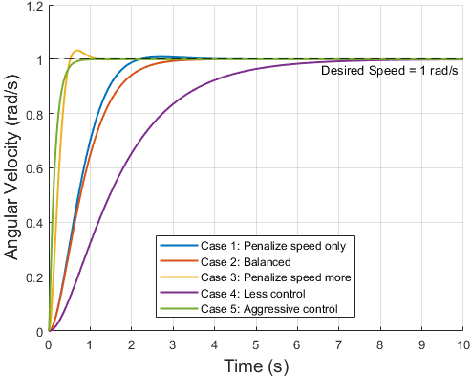

Simulation – LQR with reference tracking
Step Responses for LQR Tracking with Various Q/R
Modified LQR control law:
$u\left(t\right)=−Kx\left(t\right)+\tilde{K}r(t)$,
where $\tilde{K}$ is feedforward gain,
and $r(t)$ is reference output
Computation of $\tilde{K}$:
$\tilde{K}=−{(C{(A−BK)}^{−1}B)}^{−1}$

Slide 19




Appendices - Derivation of the ARE
Let V be a value function representing the minimum cost from state x onward:
From optimal control theory, the Hamilton-Jacobi-Bellman (HJB) equation says:
Derivation of dV/dt as follows:
Plugging this equation into HJB yields to:

Slide 20




Appendices - Derivation of the ARE
Minimize w.r.t. u
Take derivative of the expression with respect to u, and set to zero:
Plug this u back into the HJB equation and simplify to get:
Since this must hold for all x, the matrix itself must be zero.
Algebraic Riccati Equation:

