Slide 1
Term Project: Position and Velocity Estimation
Student: Khanh Q. Chung
Professor: SUH, YOUNG-SOO
Course: Estimation Theory, 2024

Slide 2

Project 1 – Updating the height zero
Measurement update $z=H x+v$
$\left[\begin{matrix}0_{3x1}−{\hat{v}}_{3x1}\end{matrix}\right]=\left[\begin{matrix}\begin{matrix}0_{3x3}\end{matrix} & \begin{matrix}0_{3x3}\end{matrix} & \begin{matrix}I_{3x3}\end{matrix}\end{matrix}\right] \left[\begin{matrix}{\hat{q}}_{e} \\ {\hat{r}}_{e} \\ {\hat{v}}_{e}\end{matrix}\right]$, where $R= \left[\begin{matrix}r_{vel} & 0 & 0 \\ 0 & r_{vel} & 0 \\ 0 & 0 & r_{vel}\end{matrix}\right]$
Modified
$\left[\begin{matrix}\begin{matrix}0 −{\hat{r}}_{z}\end{matrix} \\ \begin{matrix}\begin{matrix}0_{3x1}−{\hat{v}}_{3x1}\end{matrix}\end{matrix}\end{matrix}\right]$, $\left[\begin{matrix}0_{1x3} & 0 0 1 & 0_{1x3} \\ \begin{matrix}0_{3x3}\end{matrix} & \begin{matrix}0_{3x3}\end{matrix} & \begin{matrix}I_{3x3}\end{matrix}\end{matrix}\right]$ and $R= \left[\begin{matrix}r_{pos} & 0 & 0 & 0 \\ 0 & r_{vel} & 0 & 0 \\ 0 & 0 & r_{vel} & 0 \\ 0 & 0 & 0 & r_{vel}\end{matrix}\right]$

Slide 3
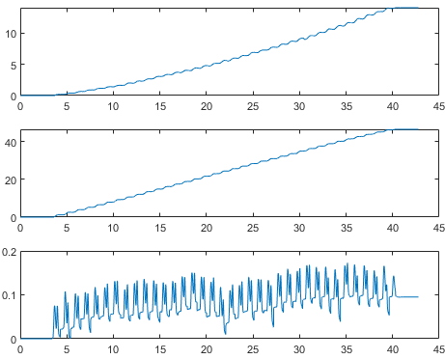
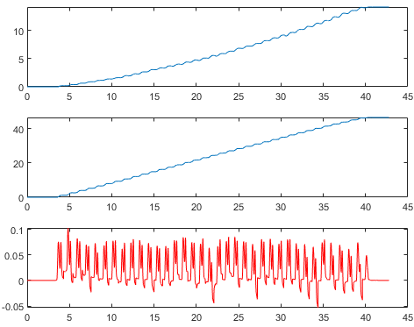


Project 1 – Results for longwalking1.mat
Original $\hat{r}$
Modified $\hat{r}$

Slide 4

Project 2 - Zero velocity detection
Goal: find the interval less than a threshold in a minimum length
Observation: the duration that a foot touches the ground is short
Solution:
Compute Euclidian norm of $y_{a}$ and $y_{g}$
For $y_{a}$, length = 4 and threshold = 30
For $y_{g}$, length = 4 and threshold = 8.5
Combine detection results of $y_{a}$ and $y_{g}$

Slide 5

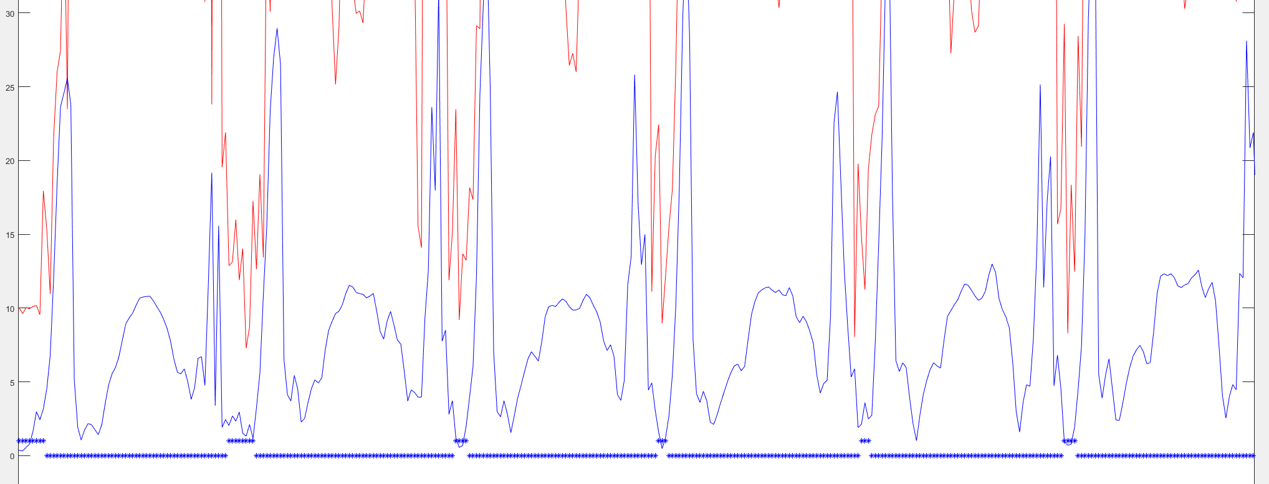
Project 2 – Results for running.mat

Slide 6
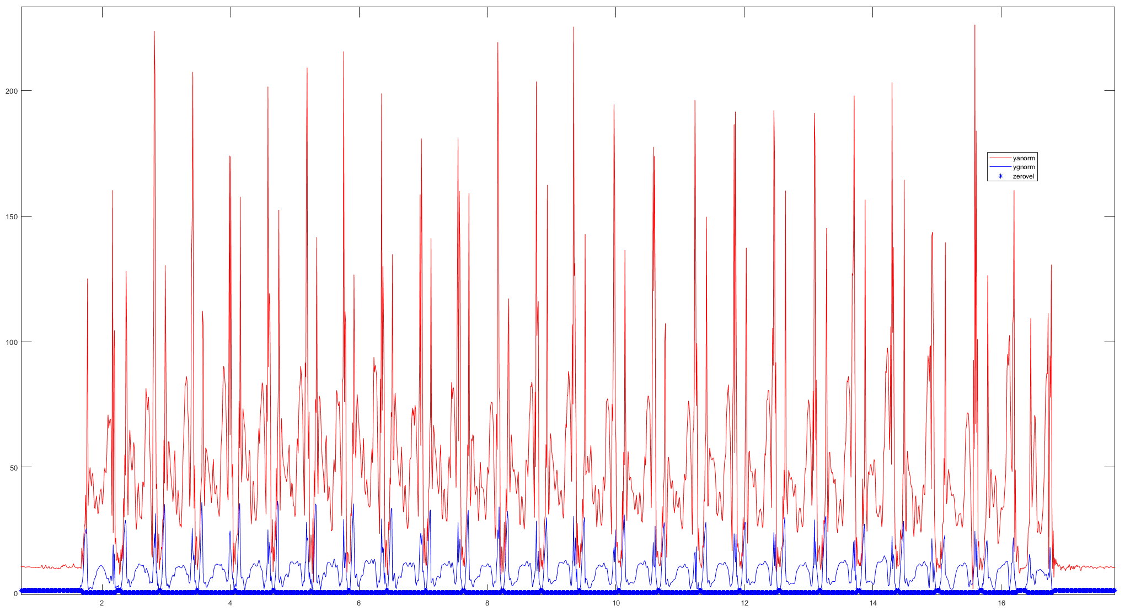
Project 2 – Results for running.mat

Slide 7
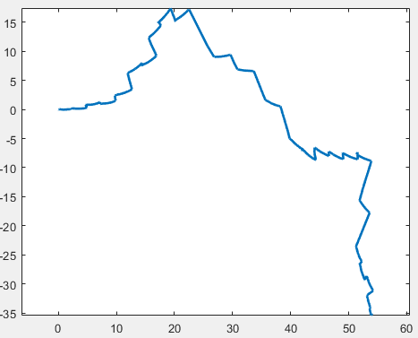
Project 2 - Results for running.mat
Total estimated running length is around 54.13 meters

Slide 8
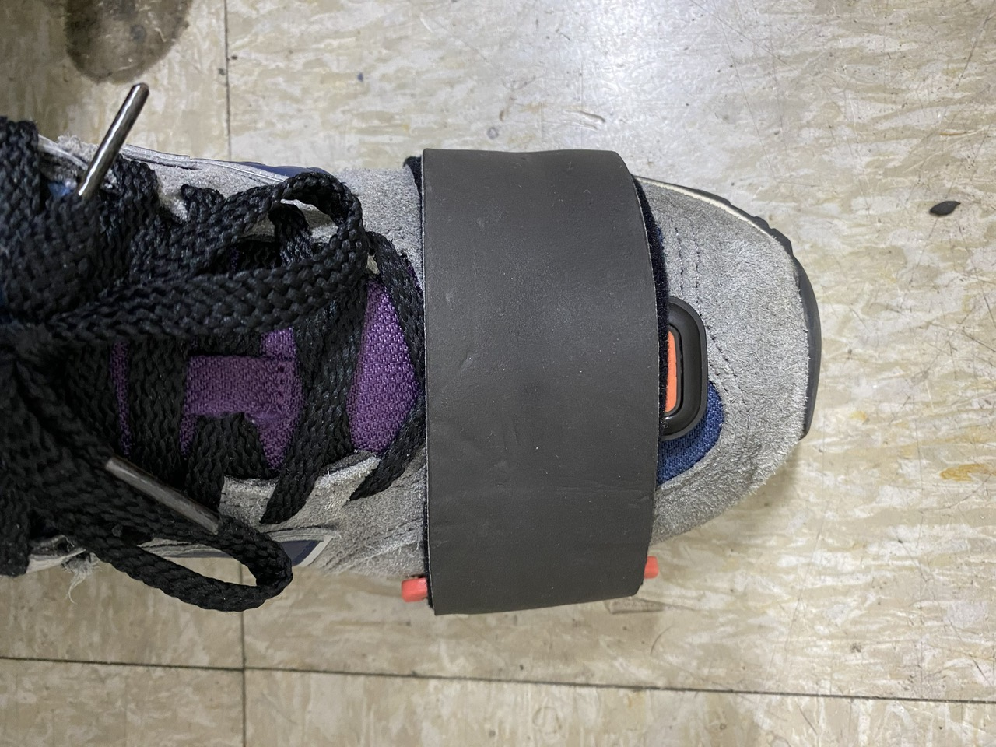
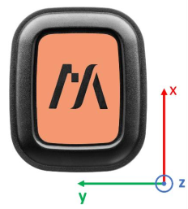
Project 3 – Walking distance estimation
Acceleration
Angular velocity
Magnetic field

Slide 9
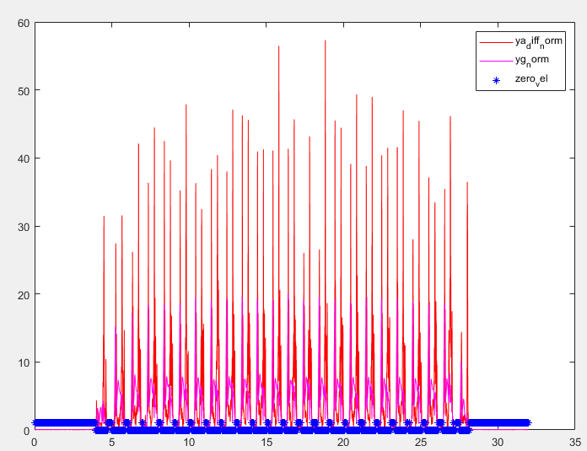
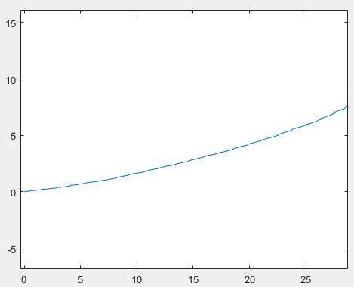
Project 3 – Experiments and Results
Walk straight about 30 meters in 2 times
Estimated distances:
1st time: ~ 29.12 meters
2nd time: ~ 29.03 meters

Slide 10
Project A+ – Walking upstairs estimation
612
Floor 6th
Floor 5/6
Floor 5th
Floor 4/5
437

Slide 11
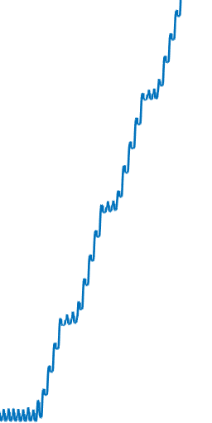
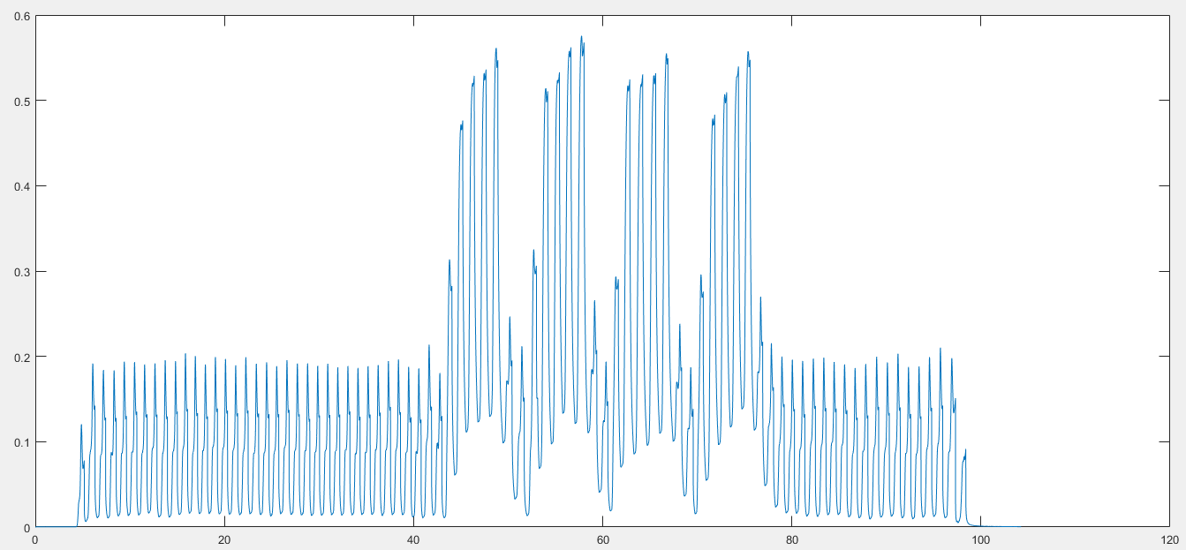


Project A+ – How to solve
Plotting ${\hat{r}}_{z}$
Floor 6th
Floor 5/6
Floor 5th
Floor 4/5
Solution:
if ${\hat{r}}_{z}$ < threshold, then:
make ${\hat{r}}_{z}$ zero
else
do not touch ${\hat{r}}_{z}$

Slide 12
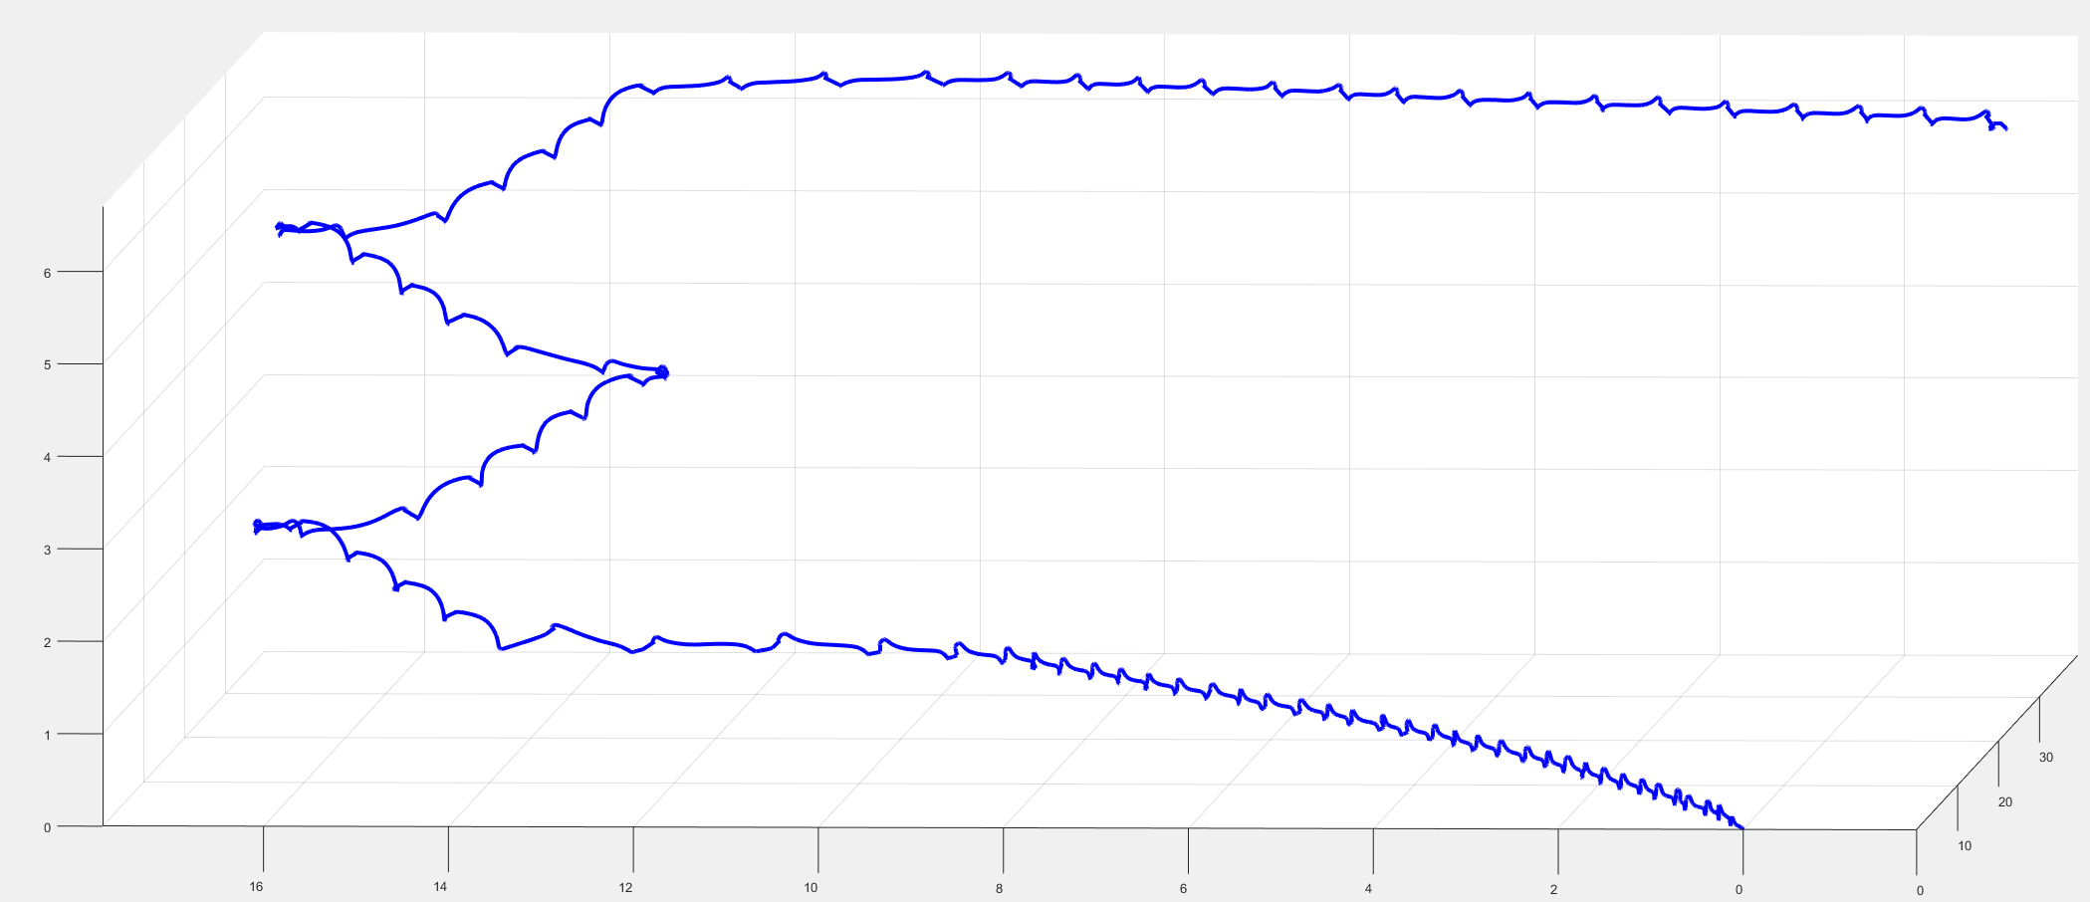
Project A+ –Results
612
Floor 5th
437

