Slide 1
Term Project: Position and Velocity Estimation
Student: Khanh Q. Chung
Professor: SUH, YOUNG-SOO
Course: Estimation Theory, 2024

Slide 2

Project 1 – Updating the height zero
Measurement update $z=H x+v$
$\left[\begin{matrix}0_{3x1}−{\hat{v}}_{3x1}\end{matrix}\right]=\left[\begin{matrix}\begin{matrix}0_{3x3}\end{matrix} & \begin{matrix}0_{3x3}\end{matrix} & \begin{matrix}I_{3x3}\end{matrix}\end{matrix}\right] \left[\begin{matrix}{\hat{q}}_{e} \\ {\hat{r}}_{e} \\ {\hat{v}}_{e}\end{matrix}\right]$, where $R= \left[\begin{matrix}r_{vel} & 0 & 0 \\ 0 & r_{vel} & 0 \\ 0 & 0 & r_{vel}\end{matrix}\right]$
Modified
$\left[\begin{matrix}\begin{matrix}0 −{\hat{r}}_{z}\end{matrix} \\ \begin{matrix}\begin{matrix}0_{3x1}−{\hat{v}}_{3x1}\end{matrix}\end{matrix}\end{matrix}\right]$, $\left[\begin{matrix}0_{1x3} & 0 0 1 & 0_{1x3} \\ \begin{matrix}0_{3x3}\end{matrix} & \begin{matrix}0_{3x3}\end{matrix} & \begin{matrix}I_{3x3}\end{matrix}\end{matrix}\right]$ and $R= \left[\begin{matrix}r_{pos} & 0 & 0 & 0 \\ 0 & r_{vel} & 0 & 0 \\ 0 & 0 & r_{vel} & 0 \\ 0 & 0 & 0 & r_{vel}\end{matrix}\right]$

Slide 3
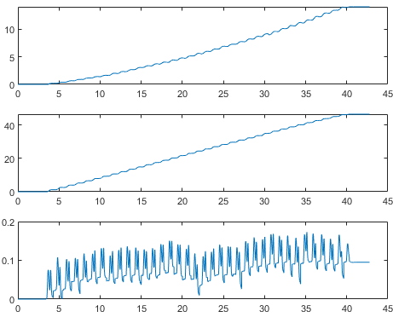
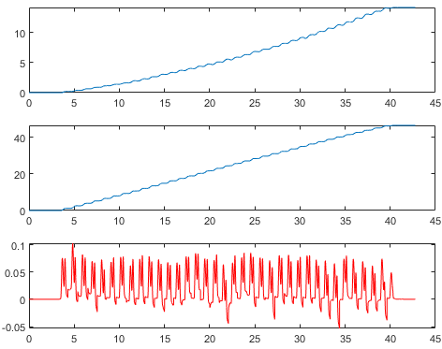


Project 1 – Results for longwalking1.mat
Original $\hat{r}$
Modified $\hat{r}$

Slide 4

Project 2 - Zero velocity detection
Goal: find the interval less than a threshold in a minimum length
Observation: the duration that a foot touches the ground is short
Solution:
Compute Euclidian norm of $y_{a}$ and $y_{g}$
For $y_{a}$, length = 4 and threshold = 30
For $y_{g}$, length = 4 and threshold = 8.5
Combine detection results of $y_{a}$ and $y_{g}$

Slide 5
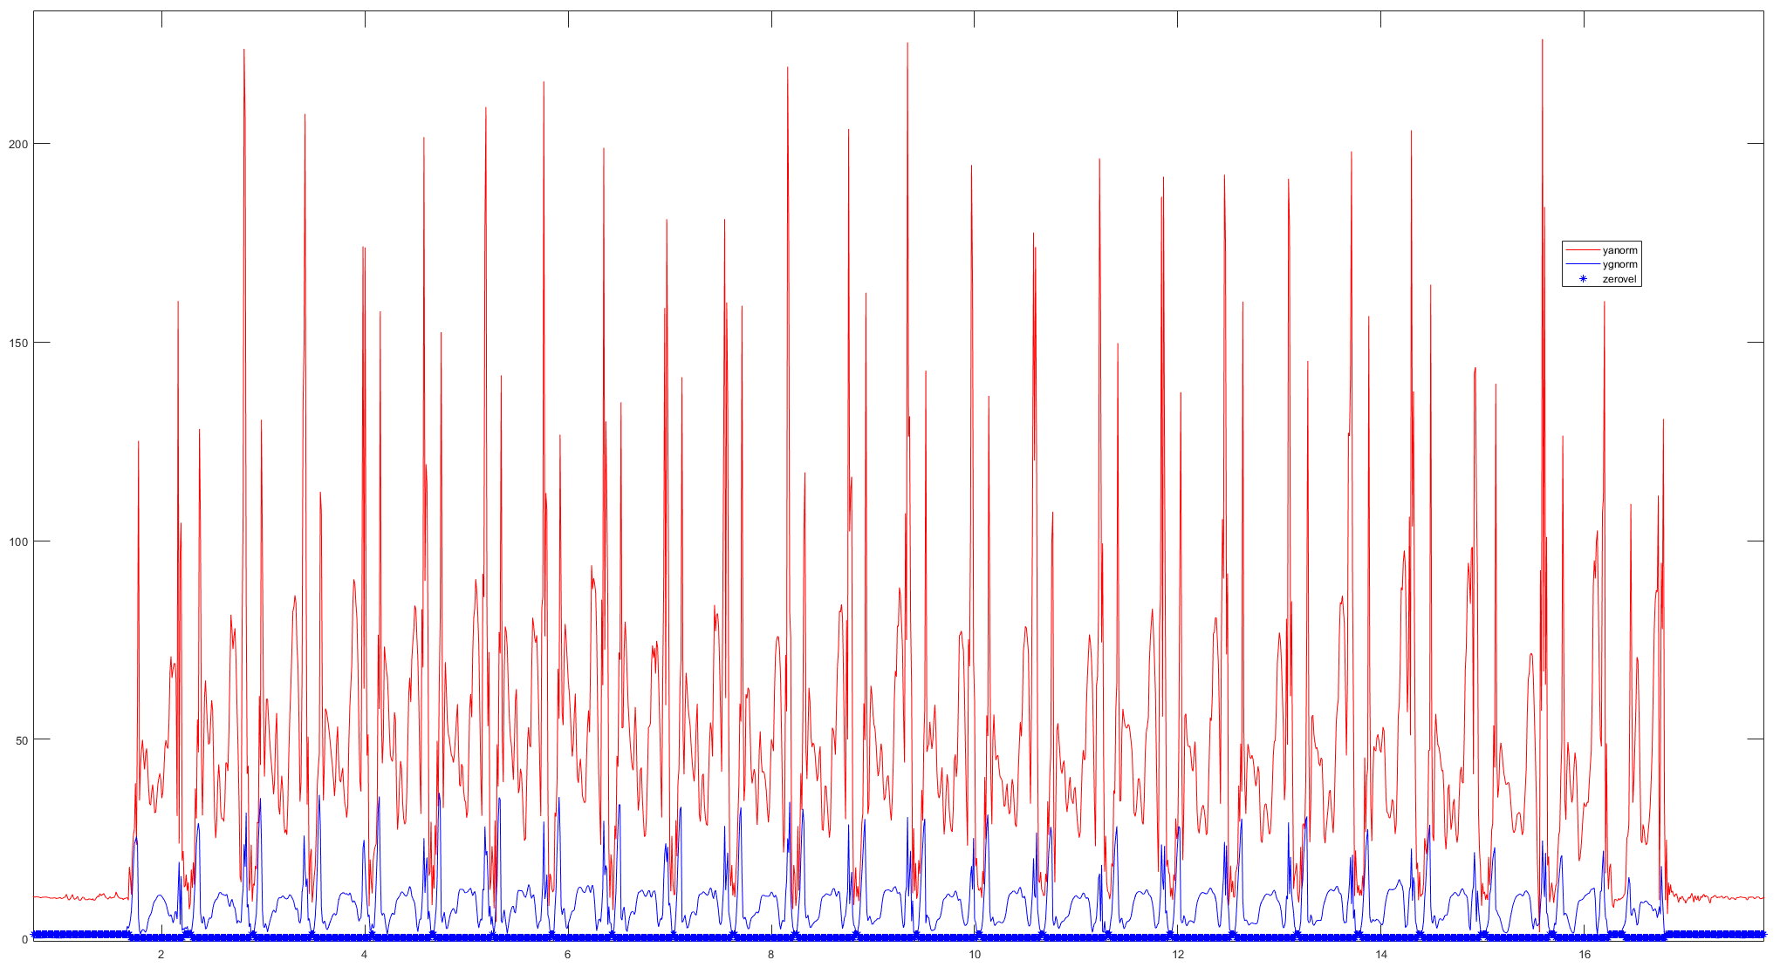
Project 2 – Results for running.mat

Slide 6
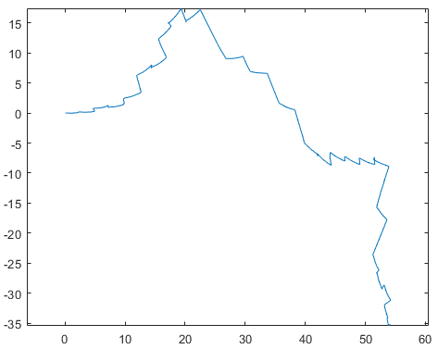
Project 2
Total estimated running length is around 53 meters

Slide 7
Project 3

Slide 8
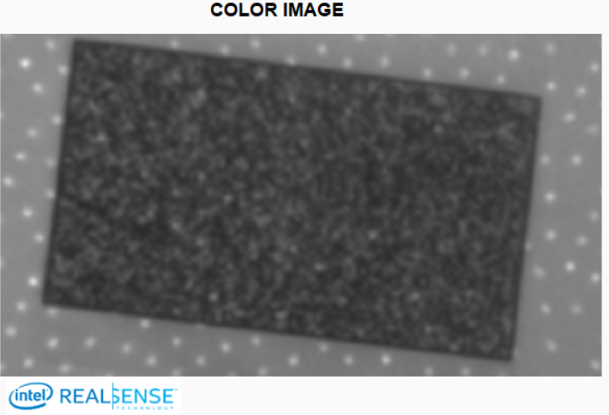
RMS Error or Spatial Noise
This metric measures the intrinsic variation in depth values across a region of
Interest (ROI) assuming a planar target.
To quantify this metric, the cameras can be
pointed at a flat target, and compute depth value at
every point in ROI, then compute standard deviation
Intel RealSense Depth Quality Tool provides this
metric
If the RMS error > 0.2 pixels over the central ROI
then recalibration may be needed
Field of View (FOV)
ROI

Slide 9
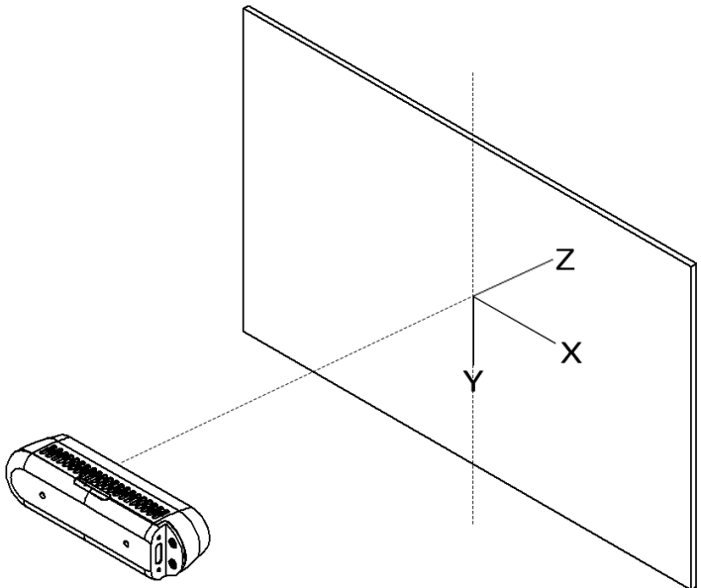
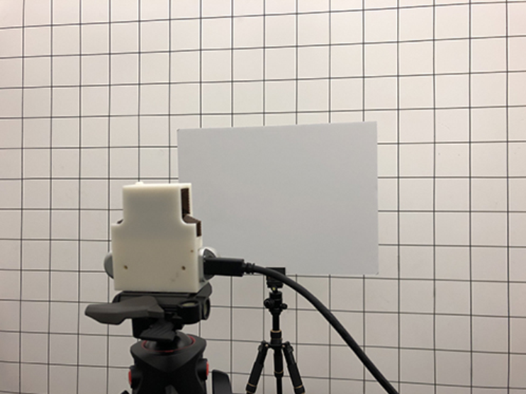
Modeling random noise along Z axis
Distance between camera and target varies: 0.4 m -> 2.1 m
Rotation angle about Y axis also varies: 0 degrees -> 75 degrees, at interval of 15 degrees
Record 100 times per each combination of distance and rotation angle

