Slide 1
Term Project: Position and Velocity Estimation
Student: Khanh Q. Chung
Professor: SUH, YOUNG-SOO
Course: Estimation Theory, 2024

Slide 2
Project 1

Slide 3
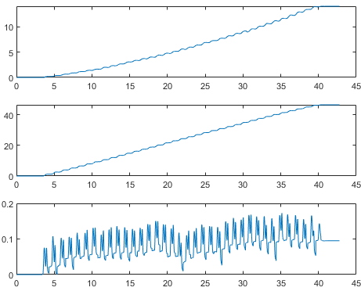
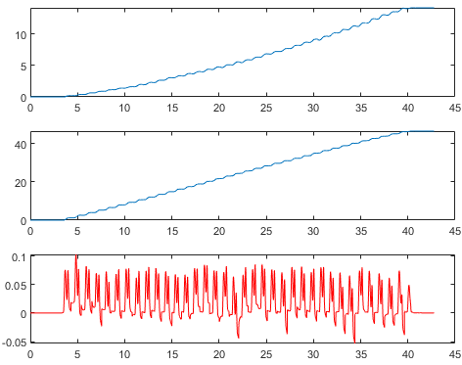


Project 1
Original $\hat{r}$
Modified $\hat{r}$

Slide 4
Project 2

Slide 5
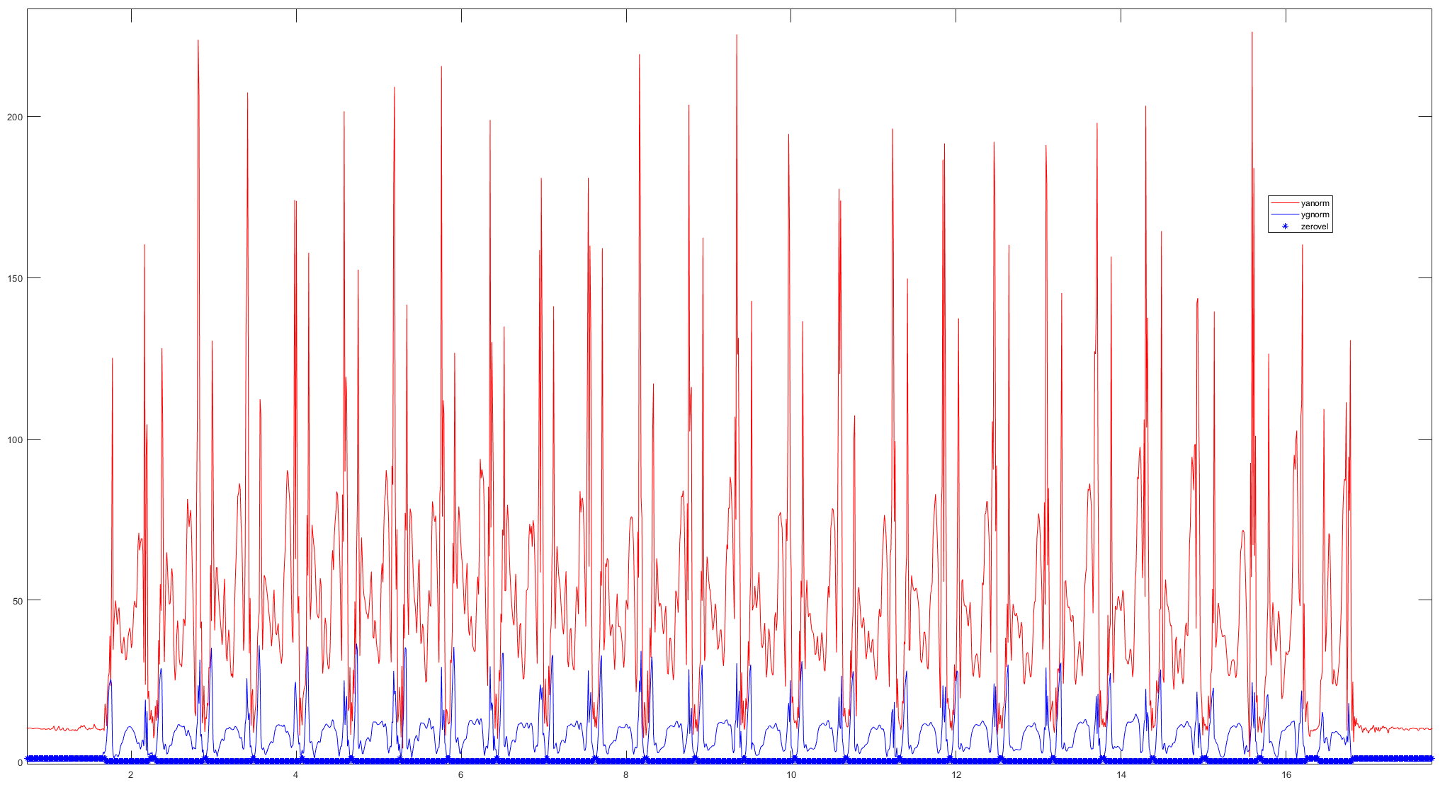
Project 2

Slide 6
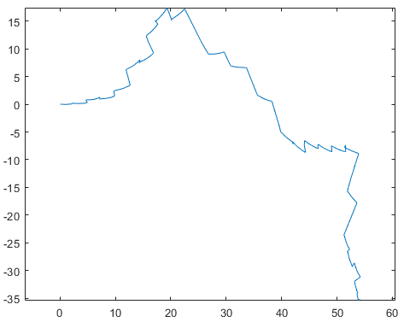
Project 2
Total estimated running length is around 54 meters

Slide 7
Project 3

Slide 8
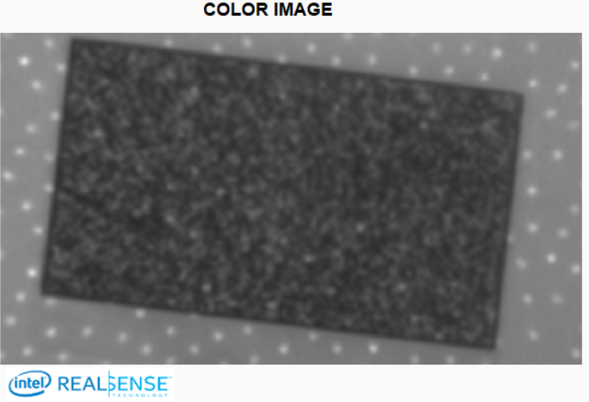
RMS Error or Spatial Noise
This metric measures the intrinsic variation in depth values across a region of
Interest (ROI) assuming a planar target.
To quantify this metric, the cameras can be
pointed at a flat target, and compute depth value at
every point in ROI, then compute standard deviation
Intel RealSense Depth Quality Tool provides this
metric
If the RMS error > 0.2 pixels over the central ROI
then recalibration may be needed
Field of View (FOV)
ROI

Slide 9
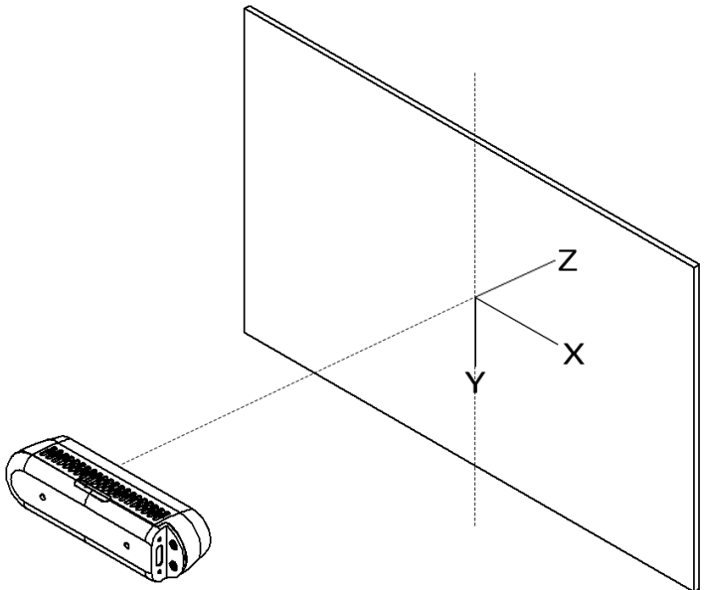
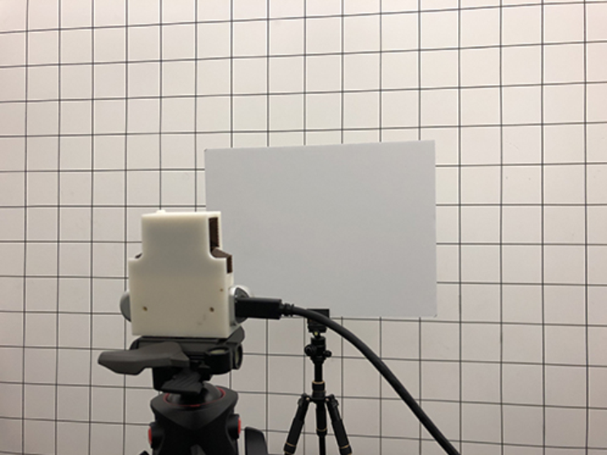
Modeling random noise along Z axis
Distance between camera and target varies: 0.4 m -> 2.1 m
Rotation angle about Y axis also varies: 0 degrees -> 75 degrees, at interval of 15 degrees
Record 100 times per each combination of distance and rotation angle

