Slide 1

Takehome - 250415
Calculate the determinant.
$$A=\left[\begin{matrix}4 & 0 & 1 \\ 2 & 3 & 2 \\ 1 & 0 & 4\end{matrix}\right]$$

Slide 2
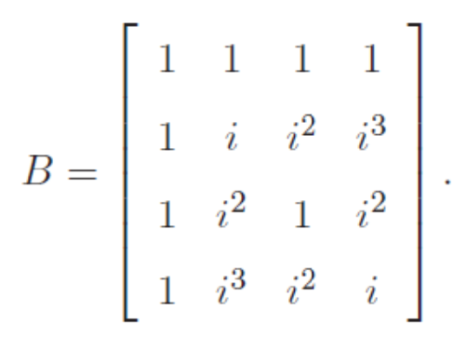

Takehome - 250415
Calculate the determinant ($i=\sqrt{−1}$).

