Slide 1
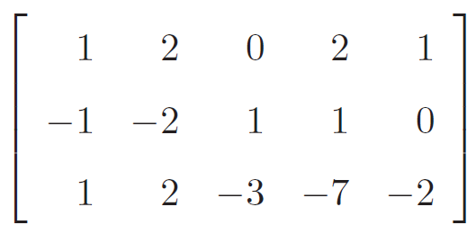
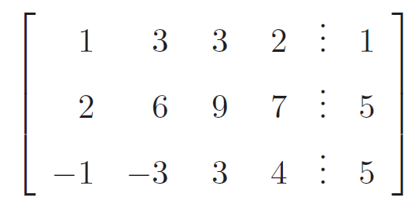
Takehome - 250311
Calculate the solution of the following system of linear equations by using the Gauss-Jordan method

