Slide 1
ERD- FILM CRITIC REVIEW ID- A00258770 NAME- REENU RATHI

Slide 2
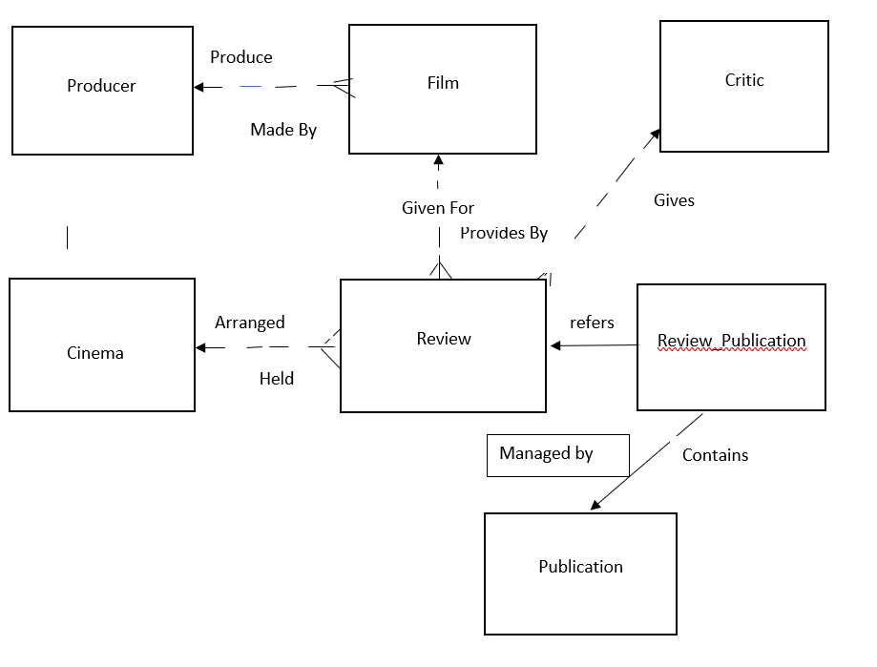
ERD- Film-Critic- Review

Slide 3
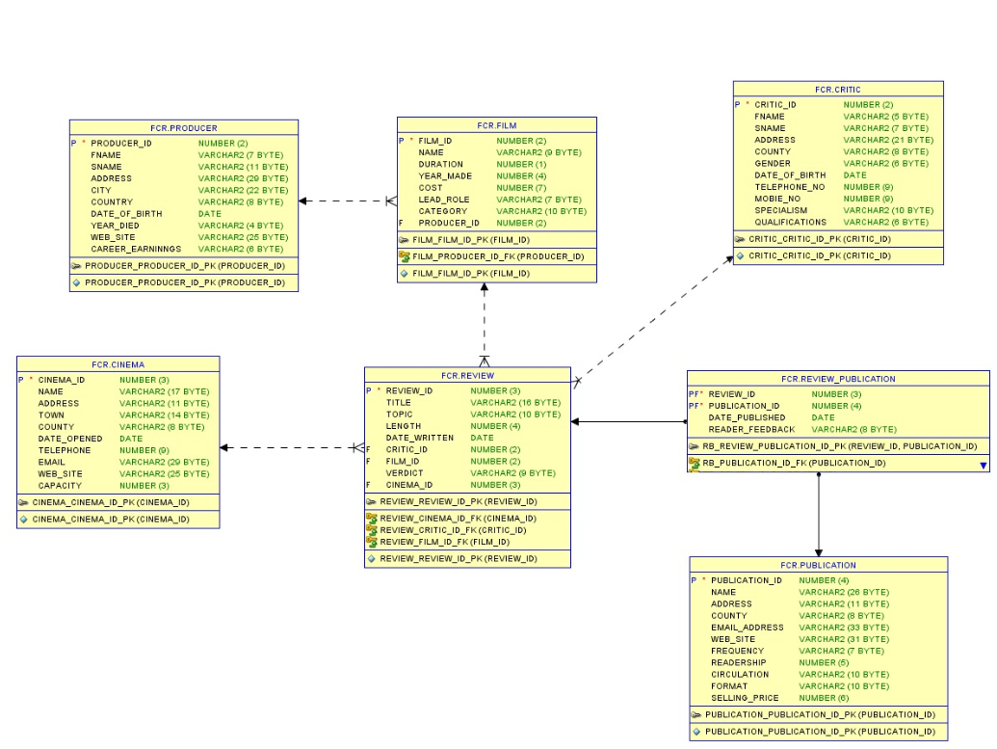
Extended ERD- Film- Critic- Review

