Slide 1

TNB Botathon 2017
Dec 14 & 15, 2017
Persistent Systems

Slide 2
Agenda
Overview of Watson Conversation
Chat bot Architecture
Chat bot – Required Criteria mapping
Chat Bot - Demo
Questions & Answers

Slide 3

Watson Conversation
Quickly build and deploy chatbots and virtual agents across a variety of channels, including mobile devices, messaging platforms, and even robots.
Developer friendly
Easy to begin, easy to use. Get faster time to value, and integrate across channels, networks and environments.
Enterprise grade
Conversation features a reliable infrastructure that scales with individual use cases.
Robust and secure
Own your data. IBM protects your privacy, allowing you to opt out of data sharing. Built on IBM Cloud and featuring reliable tooling with industry-leading security

Slide 4
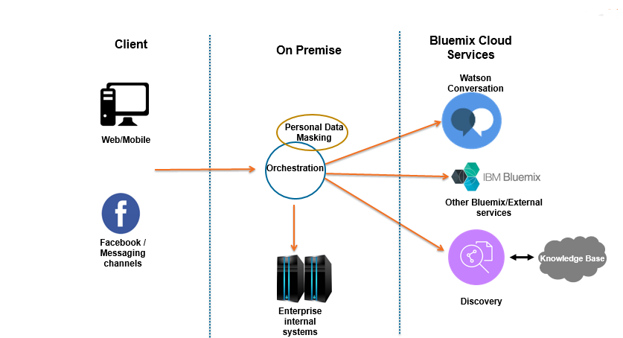
Reference High Level Architecture
Bluemix Cloud Services

Slide 5

Proposed Chat bot Solution mapping with required criteria
Criteria | Support | Comments
Infra Flexibility |  | Chat Services are in cloud, orchestration can be hosted on premise or cloud.
Local Support Availability |  | Support and Development teams are available locally.
Easiness of Integration and Support |  | Integration with internal systems Integration with other messaging channels Integration with other AI/Cognitive services. Facebook Integration Demo
AI Ability |  | Demo
Type of Language |  | Demo
Bot Training/Program |  | Demo

Slide 6
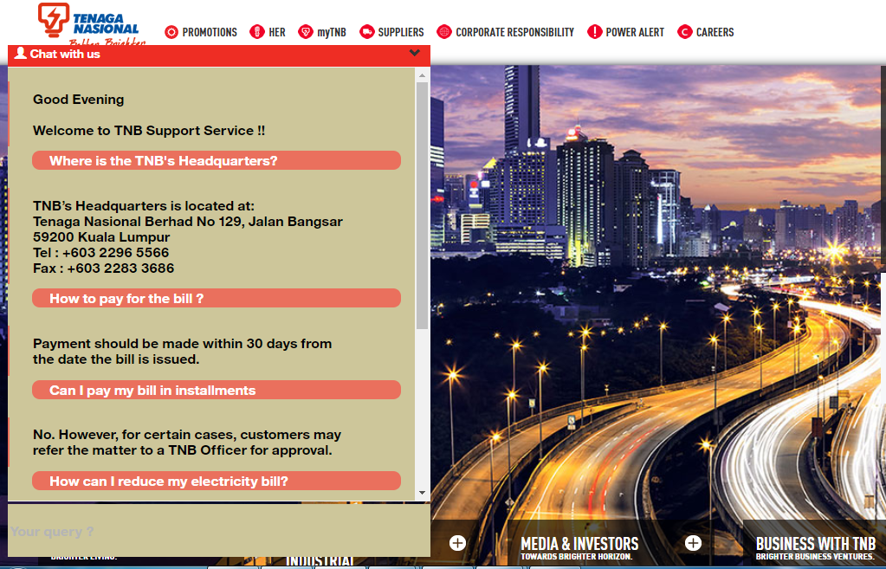
Demo
AI Ability (Natural language search)
Configured Question - Where can I get details on TNB Board and Management?
Variations getting addressed
share me tnb board management
share me tenaga national board management
Note: TNB acronym is configured and getting recognized.
Omni channel experience.
Web Interface
Where is the TNB's Headquarters?
How to pay for the bill ?
Can I pay my bill in installments
How can I reduce my electricity bill?
Facebook Messenger Integration
May I know about TNB's history?
Can we make partial payments on the bill?
Can I pay my bill in installments ?

Slide 7
Demo
Language Support
English
Bahasa Malaysia.
Back End systems integration
What is my billing balance ?
Ask for account number ? Enter 12345. (Bill data from DB will be displayed).

Slide 8
Demo
Bot Training
Trained:
Will I have to pay any additional charges ?
Untrained:
Do I need to pay any hidden charges ?

Slide 9
Q & A

Slide 10
Backup

Slide 11
Chat Bot Solution overview

Slide 12
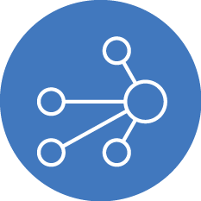





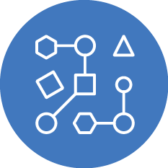
Chatbot Solution Overview
The Center of Customer Engagements
Automated first-contact resolution, deflected from higher cost channels
Create natural language interactions with your end-users, including Q&A and onboarding
Lessen burden for live agents, allowing them to focus on high revenue tasks
Create an omni-channel experience through the user’s channel of choice
Walk customers through business processes like application forms or resetting a password
Build once, deploy across multiple platforms

Slide 13



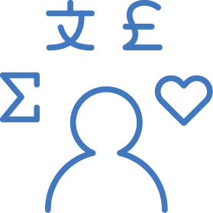
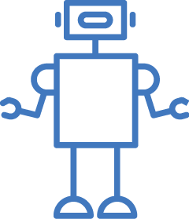
Use-cases for Conversational Agents
Customer Service Add a chatbot to your website that automatically responds to your customers’ most frequently asked question | Mobile Apps Allow your customers to control your mobile app using natural language virtual agents | Messaging Channels Build Twitter, Slack, Facebook Messenger, and other messaging platform chatbots that interact instantly with channel users | Internet-of-Things Power connected devices to understand language and respond to your users’ commands | Robots Power your robots with natural language understanding and conversational capabilities

Slide 14



























Watson Conversation Service
Watson’s APIs are ready-to-use micro-services that are building blocks of a cognitive solution.
Conversation Speech to Text Text to Speech | Retrieve and Rank Discovery Service Tone Analyzer | Natural Language Classifier Language Translator | Language Detection Tradeoff Analytics Personality Insights | Document Conversion Visual Recognition Natural Language Understanding
Conversation
Intent Extraction
Entity Extraction
Tone Analysis
Context Analysis
Knowledge Expansion
Natural Language Classifier
Tone Analyzer
Retrieve & Rank

Slide 15

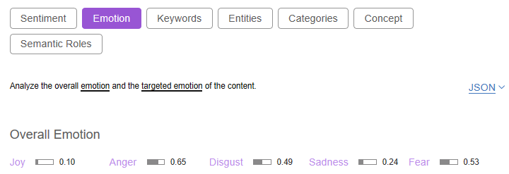
Natural Language Understanding
Understand emotions and communication style in text.
Uncover insights from structured and unstructured data
Analyze text to extract meta-data from content such as concepts, entities, keywords, categories, relations and semantic roles.
Understand sentiment and emotion
Returns both overall sentiment and emotion for a document, and targeted sentiment and emotion towards keywords in the text for deeper analysis.
I hate these new features on PHONE-A after the update.
The emojis in PHONE-A are stupid.
PHONE-A is a useless, stupid waste of money.
PHONE-A is the worst phone I've ever had - ever 😠.
PHONE-A another ripoff, lost all respect SHAME.
I'm worried my PHONE-A is going to overheat like my brother's did.
PHONE-A really let me down... my new phone won't even turn on.
https://natural-language-understanding-demo.mybluemix.net/

Slide 16
About Persistent

Slide 17





Persistent at a glance
9400+ employees
Global delivery centers 26 cities over 4 continents
Gold Partner for Scaled Agile Framework (SAFe)
350+ customers
5500+ product releases in the past 5 years
26+ years in business
Growth
Practice
Experience
Publically listed in India (BSE, NSE)
$429.01 M FY17 revenue
Recognized in Leadership Zone for Product Engineering Services – “Enterprise S/W” & “Consumer S/W”
Featured in Forbes India Magazine - “With an eye on the cloud, Persistent Systems continues to innovate”
Cited as a Leader among BPM Service Providers by The Forrester Wave™: BPM Service Providers, Q4 2016 Report
Recognized for strongest overall capabilities in Distributed Agile Delivery of Services by Ovum Decision Matrix: 2016-2017
India’s Coding Power House thrice in a row

Slide 18



Global Footprint
Delivery Center
Sales Office
Toronto
Leixlip
Rotterdam
Belfast
Frankfurt
Nashua
Quebec
Bellevue
Nagpur
Pune
Santa Clara
Hyderabad
Tokyo
London
Victoria
Kuala Lumpur
Grenoble
Charlotte
Rehovot
Singapore
Dublin
Goa
Colombo
Cuauhtémoc
Bangalore
Pretoria
Sydney
Over 9400 employees
Notes:
Global Footprint

Slide 19



360 Degrees IBM Partnership
IBM Watson Practice
APM Connectors
10+ Projects
20+ POCs & Pilots
80+ Engineers trained on Cognitive Computing
Partner in Year 2016
Integration
Prototype
14 years with IBM
2000+ practitioners
IP
Development
Watson, Hybrid Cloud & CE/CLM Products
2017 IBM APAC Analytics Business Partner Most Innovative Solution Award
Resell
Tech Takeover
Testing QA
2016 IBM Worldwide Watson Internet of Things Innovative Business Partner of the Year
Maintenance
CE/CELM
MDM
TNPM
ECM
Netezza
Professional Services
Security Cloud
Analytics Watson
Vendor in Year 2002

Slide 20
Thank You
Contact Us:
Goh Boon Yeow
Sales Director,
Phone: +6 (012) 379 9387
Email: gohby@persistent.com
Persistent Systems Malaysia Sdn. Bhd.
601, Uptown 1, Jalan SS 21/58
47400 Petaling Jaya, Selangor
www.persistent.com

