Slide 1
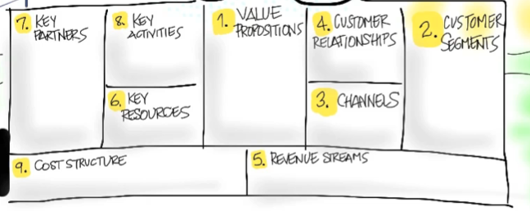
Customer Segments
Who Are They?
Why Would They Buy?

Slide 2
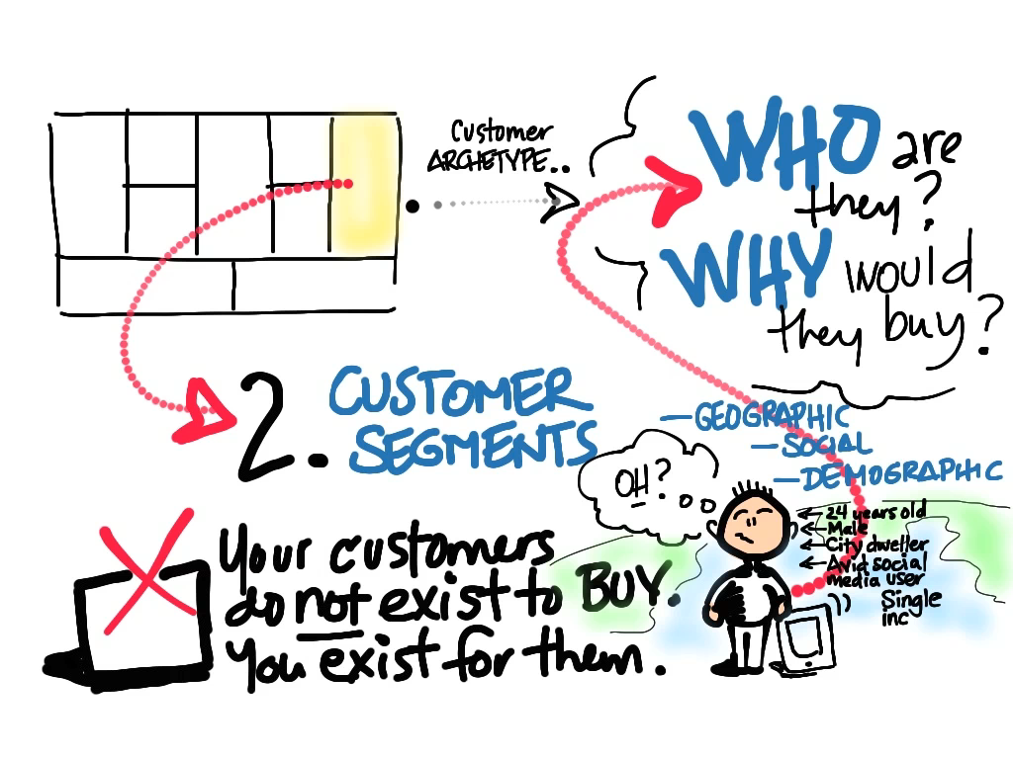
© 2012 Steve Blank

Slide 3
Product/Market
Fit

Slide 4
The Value Proposition
Gain Creators
MVP
Products & Services
Pain Killers

Slide 5
Pain = Customer Problem Gain = Customer Solution

Slide 6
The Customer Segment
Gains
Persona /Archetype
Jobs
Problem or Need
Pains
Market Type

Slide 7
Gain Creators
MVP
Gains
Products & Services
Persona /Archetype
Jobs
Problem or Need
Pain Killers
Pains
Product/Market
Fit

Slide 8
Jobs to Be Done Problems/Needs
What is the customer segment trying to get done?
Is it a problem or a need?

Slide 9
Customer Segments – Jobs/Needs
What functional or social jobs are getting done?
(e.g. perform or complete a specific task, solve a specific problem or trying to look good, gain power or status, ...)
What emotional jobs?
(e.g. esthetics, feel good, security, ...)
What basic needs are you helping your customer satisfy?
(e.g. entertainment, communication, ...)

Slide 10
Buyer/Co-Creator/Transferor
Are they buyers
(e.g. comparing offers, deciding, buying, taking delivery of a product or service, ...)
Are they co-creators
(e.g. co-designing with solution providers, contributing value to the solution, ...)
Are they transferors'
(how customers dispose of a product, transfer it to others, or resell, ...)

Slide 11
Customer Segment Jobs - Rank
Rank each job according to its significance to the customer.
Is it crucial or is it trivial?
For each job indicate the frequency at which it occurs.
Outline in which specific context a job is done, because that may impose constraints or limitations
(e.g. while driving, outside, ...)

Slide 12
Customer Pains
undesired costs and situations, risks, negative emotions

Slide 13
Customer Segments – Pains
What do your customers find too costly?
(e.g. takes a lot of time, costs too much, requires substantial efforts, ...)
How are current solutions underperforming?
(e.g. lack of features, performance, malfunctioning, ...)
What are the customers main difficulties and challenges?
(difficulties getting things done, resistance, ...)
What’s keeping your customer awake at night?
(e.g. big issues, concerns, worries, ...)

Slide 14
Customer Segments – Pains
What barriers are keeping customers from adopting?
(e.g. upfront investment costs, learning curve, resistance to change, ...)
What makes your customers feel bad?
(e.g. frustrations, annoyances, things that give them a headache, ...)
What risks do customers fear?
(e.g. financial, social, technical risks, or what could go awfully wrong, ...

Slide 15
Customer Gains
benefits the customer expects, desires or is surprised by. includes functional utility, social gains, positive emotions, and cost savings

Slide 16
Customer Segments – Gains
Which savings would make your customer happy?
(e.g. in terms of time, money and effort, ...)
What outcomes do they expect and what would go beyond their expectations?
(e.g. quality level, more of something, less of something, ...)
How do current solutions delight your customer?
(e.g. specific features, performance, quality, ...)
What would make your customer’s job or life easier?
(e.g. flatter learning curve, more services, lower cost of ownership, ...)

Slide 17
Customer Segments – Gains
What positive social consequences do they desire?
(e.g. makes them look good, increase in power, status, ...)
What are customers looking for?
(e.g. good design, guarantees, specific or more features, ...)
What do customers dream about?
(e.g. big achievements, big reliefs, ...)
How does your customer measure success and failure?
(e.g. performance, cost, ...)
What would increase the likelihood of adopting a solution?
(e.g. lower cost, less investments, lower risk, better quality, performance, design, ...)

Slide 18
Customer Persona/Archetype
Notes:
-

Slide 19
Define Customer Archetype/Persona
Who are they?
Position / title / age / gender / role
How do they buy?
Discretionary budget (name of budget and amount)
What matters to them?
What motivates them?
Who influences them?
What do they read/who do they listen to?
Draw a Day in the Life of the customer

Slide 20
Market Type
Notes:
-

Slide 21
Type of Market Changes Everything
Existing Market | Resegmented Market | New Market | Clone Market
Notes:
So why are we going to spend a valuable two hours talking about what type of market we are in?
What possible relevance can it have to how we set up our company and bring our product to market?
- Anyone?

Slide 22
Type of Market Changes Everything
Existing Market | Resegmented Market | New Market | Clone Market
Market
Market Size
Cost of Entry
Launch Type
Competitive Barriers
Positioning
Sales
Sales Model
Margins
Sales Cycle
Chasm Width
Customers
Needs
Adoption
Customers
Needs
Adoption
Finance
Ongoing Capital
Time to Profitability
Finance
Ongoing Capital
Time to Profitability
Notes:
Each “type of market” is radically different
Different ways to size the market opportunity
Different sales costs
Different demand creation costs
Different time to liquidity
Very different capital requirements
And as we’ll see market type choices radically effect the Customer Development process.

Slide 23
Definitions: Four Types of Markets
Existing Market | Resegmented Market | New Market | Clone Market
Existing Market
Faster/Better = High end
Resegmented Market
Niche = marketing/branding driven
Cheaper = low end
New Market
Cheaper/good enough can create a new class of product/customer
Innovative/never existed before
Clone Market
Local adaptation
Notes:
In looking at how companies succeed and fail, their success tends to be organized around groupings of customers and markets.
More importantly it is how these groupings of customers view their needs and how your new product satisfies those needs

Slide 24
Market Type
 | Existing | Resegmented | New | Clone
Customers | Known | Possibly Known | Unknown | Possibly Known
Customer Needs | Performance | Better fit | Transform-ational improvement | Local version
Competitors | Many | Many if wrong, few if right | None | None
Risk | Lack of branding, sales and distribution ecosystem | Market and product re-definition | Evangelism and education cycle | Misjudge local needs
Examples | Google | Southwest | Groupon | Baidu
Market Type determines:
Rate of customer adoption
Sales and Marketing strategies
Cash requirements

Slide 25
Market Type - Existing
Incumbents exist, customers can name the mkt
Customers want/need better performance
Usually technology driven
Positioning driven by product and how much value customers place on its features
Risks:
Incumbents will defend their turf
Network effects of incumbent
Continuing innovation

Slide 26
Market Type – Resegmenting Existing
Low cost provider (Southwest)
Unique niche via positioning (Whole Foods)
What factors can:
you eliminate that your industry has long competed on?
Be reduced well below the industry’s standard?
should be raised well above the industry’s standard?
be created that the industry has never offered? (blue ocean)

Slide 27
Market Type – New
Customers don’t exist today
How will they find out about you?
How will they become aware of their need?
How do you know the market size is compelling?
Which factors should be created that the industry has never offered? (blue ocean)

Slide 28
Market Type – Clone
Takes foreign business model and adapts it to local conditions
Language
Culture
Import restrictions
Local control/ownership
Need market large enough >100 million

Slide 29
Other Thoughts

Slide 30
Who’s the Customer?
User?
Influencer?
Recommender?
Decision Maker?
Economic Buyer?
Saboteur?
Archetypes for each?

