Slide 1
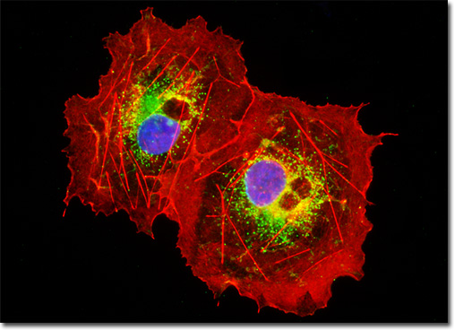
Blood Cell Image Segmentation
Sirui Cai
FALL 2016 EEE6512

Slide 2





Human Blood Cell
Human blood cells:
Basic unit of life
Circulatory system
Disease indicator: Leukemia, anemia, infection, malignancy, arthritis, etc.
Composition:
RBC
WBC
platelet
plasma
Notes:
RBC mature ones are non-nucleid, biconcave shape small cells that carries oxygen through hemoglobin.
WBC could be further separated into Neutrophils, Monocytes, Lymphocytes
Plasma contains mostly water, some protein or backteria

Slide 3
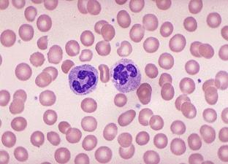
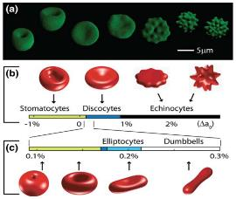
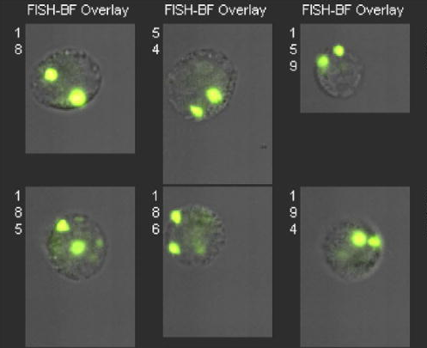
Blood Cell Images
Blood Smear Confocal Microscopy Flow Cytometry
http://library.med.utah.edu/WebPath/HEMEHTML/HEME001.html
Figure 1. Khairy, Khaled, JiJinn Foo, and Jonathon Howard. "Shapes of red blood cells: Comparison of 3D confocal images with the bilayer-couple model." Cellular and molecular bioengineering 1, no. 2-3 (2008): 173-181.
Figure 5. Basiji, David A. et al. “Cellular Image Analysis and Imaging by Flow Cytometry.” Clinics in laboratory medicine 27.3 (2007): 653–viii. PMC. Web. 14 Dec. 2016.
Notes:
Blood smear: manual, medium speed, relative good resolution, 2D image, 500 cells/sec for automated form
Confocal Microscopy: Time consuming, high resolution, 3D reconstruction
Flow Cytometry: high speed, typical 5000cells/sec, low resolution, hard to get fluorscence

Slide 4
Problem Statement
The segmentation of blood cells (WBC, RBC, platelets) and counting of blood cells includes image acquisition, pre-processing to enhance image quality and minimization of noise, and counting of different blood cells in a given image. Among those processes, the most challenging one is blood cell segmentation.

Slide 5
Segmentation Methods
Morphological Operations
Dilation, Erosion, Hole filing, closing, etc.
Granulometric method
Size, area, eccentricity, convex part area, etc.
Level threshold and wasteshed
Supervised methods
multilayer neural network, Marhov hidden tree
Supplementary methods
Histogram equalization and thresholding

Slide 6
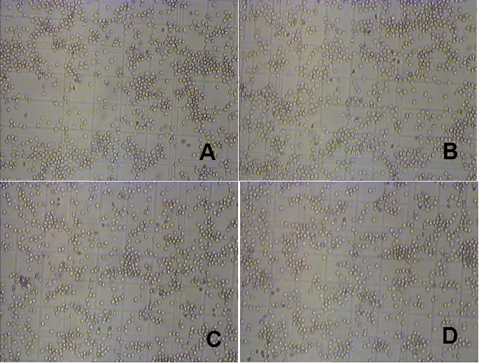
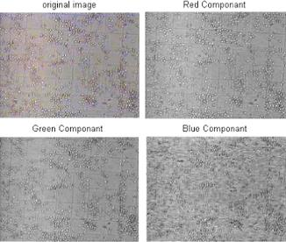
Dataset
38 Sets of Blood Smear Images
Sherif Abbas, Microscopic images dataset for automation of RBCs counting, Data in Brief, Volume 5, December 2015, Pages 35-40, ISSN 2352-3409, http://dx.doi.org/10.1016/j.dib.2015.08.006.
Figure 4. The 4 original images are selected randomly from the image sets. The exposure in those images is different where C and D look unevenly exposed.
Figure 5. Color components of the original image. The Green has the best contrast [9].

Slide 7
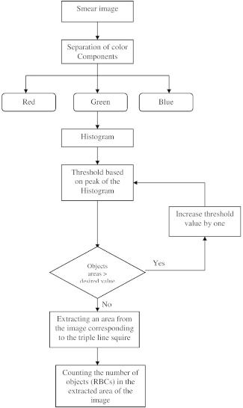
Implementation
Matlab 2016a
Code modified
Demo

Slide 8
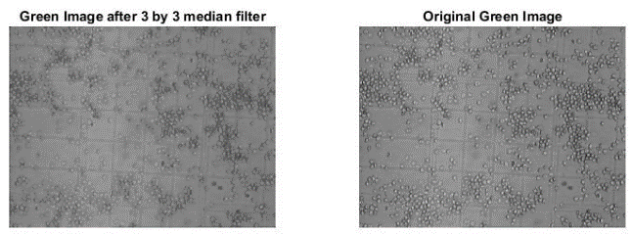
Filtering
Figure 6. Green image after mediam filter and original green image.

Slide 9
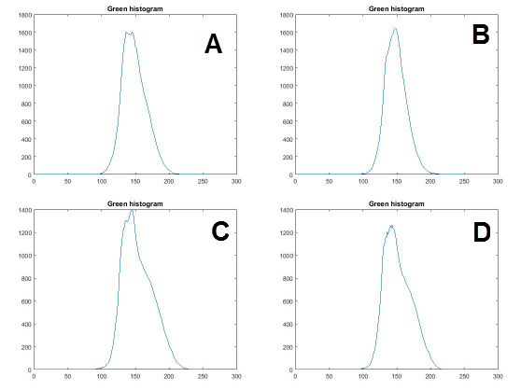
Histogram
Figure 7. Green Historgram from 4 selected images.

Slide 10
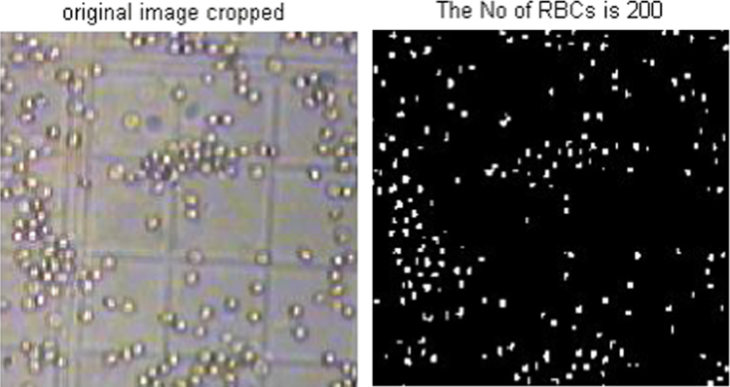
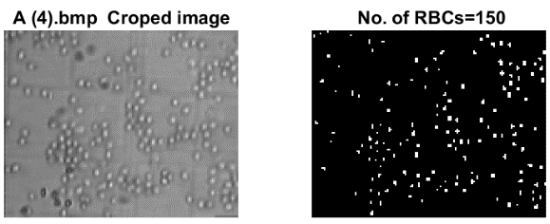
Result
Figure 9. Original cropped Image vs. Binary cropped image [9].
Figure 10. Original cropped Image vs. Binary cropped image, another set.

Slide 11
ReSults & Improvement
Manual Count | Automatic Count
174 | 179
168 | 150
168 | 176
157 | 150
182 | 167
Image preprocessing
Remove noise: Pepper n Salt, Gaussian Filter
De cluster
Watershed
Hole filling

