Slide 1
Python String

Slide 2
Agenda

Slide 3
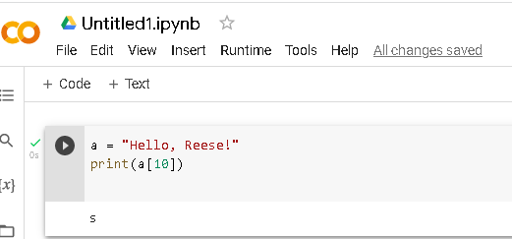

Slide 4
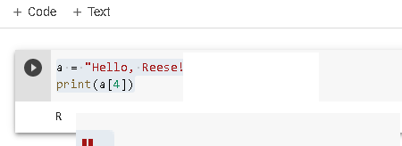

Slide 5

Looping String

Slide 6

String Length

