Slide 1
MY JOURNAL TO PYTHON
Name: 雷利斯
Teacher: My dear greate teacher

Slide 2
AGENDA
Python
Input and output: input() and print()
Data types: numerisc, strings, list , dict
Operators ON data type:
CONTROLS : IF- | IF –ELSIF |-F-ELSE
LOOP: FOR |WHILE | RANGE() | BREAK | CONTINUE
FUNCTION:
PARAMETERS(ARGUMETNS)
RECURSIVE FUNCTION
LAMBDA FUNCTION

Slide 3
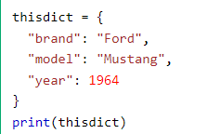
Data types: Dictionary
Dictionaries are used to store data values in key:value pairs.
A dictionary is a collection which is ordered*, changeable and do not allow duplicates.
As of Python version 3.7, dictionaries are ordered.
In Python 3.6 and earlier, dictionaries are unordered.
Dictionaries are written with curly brackets, and have keys and values:
Key
value

Slide 4
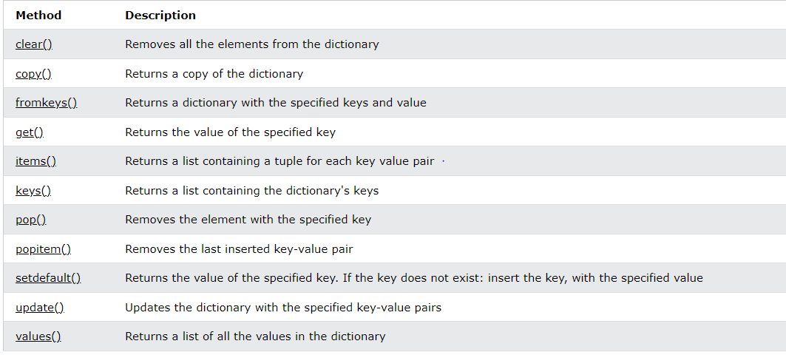
Python Dictionary Methods
Dictionary Methods
Python has a set of built-in methods that you can use on dictionaries.

Slide 5
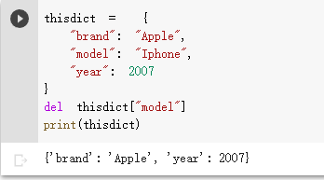
Python - Remove Dictionary Items
Removing Items
There are several methods to remove items from a dictionary:
Example

Slide 6
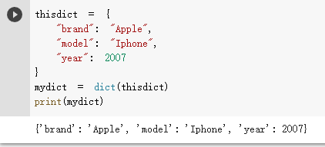
Python - Copy Dictionaries
Copy a Dictionary
You cannot copy a dictionary simply by typing dict2 = dict1, because: dict2 will only be a reference to dict1, and changes made in dict1 will automatically also be made in dict2.
There are ways to make a copy, one way is to use the built-in Dictionary method copy().
Example

Slide 7
Recursion
- Python also accepts function recursion, which means a defined function can call itself.
- Recursion is a common mathematical and programming concept. It means that a function calls itself. This has the benefit of meaning that you can loop through data to reach a result.
- The developer should be very careful with recursion as it can be quite easy to slip into writing a function which never terminates, or one that uses excess amounts of memory or processor power. However, when written correctly recursion can be a very efficient and mathematically-elegant approach to programming.
- In this example, tri_recursio() is a function that we have defined to call itself ("recurse"). We use the k variable as the data, which decrements ( -1) every time we recurse. The recursion ends when the condition is not greater than 0 (i.e. when it is 0).
- To a new developer it can take some time to work out how exactly this works, best way to find out is by testing and modifying it.

Slide 8
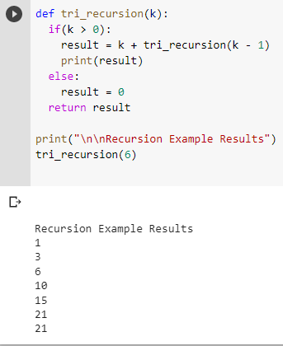
Example of Recursion

Slide 9
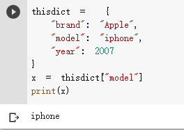
Python - Access Dictionary Items
Accessing Items
:
You can access the items of a dictionary by referring to its key name, inside square brackets:
Example

Slide 10
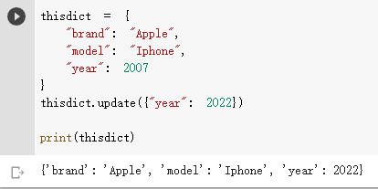
Python - Change Dictionary Items
Change Values
You can change the value of a specific item by referring to its key name:
Example

Slide 11
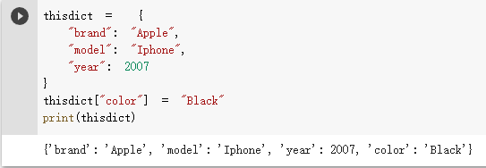
Python - Add Dictionary Items
Adding Items
Adding an item to the dictionary is done by using a new index key and assigning a value to it:
Example

Slide 12
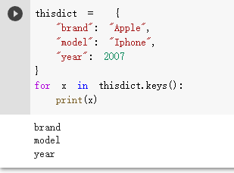
Python - Loop Dictionaries
Loop Through a Dictionary
You can loop through a dictionary by using a for loop
When looping through a dictionary, the return value are the keys of the dictionary, but there are methods to return the values as well.
Example

Slide 13
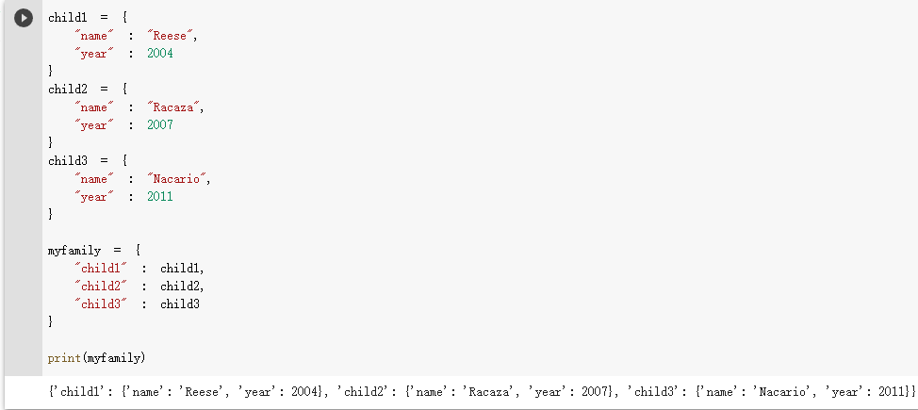
Python - Nested Dictionaries
Nested Dictionaries
A dictionary can contain dictionaries, this is called nested dictionaries.
Example

Slide 14
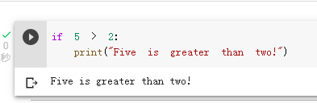
Python Syntax
Execute Python Syntax
As we learned in the previous page, Python syntax can be executed by writing directly in the Command Line:
Indentation refers to the spaces at the beginning of a code line.
Where in other programming languages the indentation in code is for readability only, the indentation in Python is very important.
Python uses indentation to indicate a block of code.
Example

Slide 15
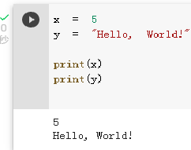
Python Variables
In Python, variables are created when you assign a value to it:
Example

Slide 16
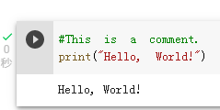
Comments
Python has commenting capability for the purpose of in-code documentation.
Comments start with a #, and Python will render the rest of the line as a comment:
Example
Comments in Python:

Slide 17
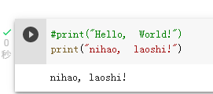
Python Comments
Comments can be used to explain Python code.
Comments can be used to make the code more readable.
Comments can be used to prevent execution when testing code.
Creating a Comment
Example

Slide 18
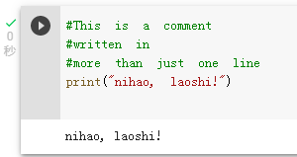
Multi Line Comments
Python does not really have a syntax for multi line comments.
To add a multiline comment you could insert a # for each line:
Example

Slide 19
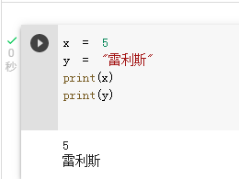
Python Variables
Creating Variables
Variables are containers for storing data values.
Python has no command for declaring a variable.
A variable is created the moment you first assign a value to it.
Example

Slide 20
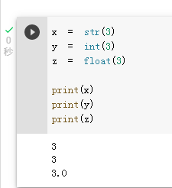
Casting
If you want to specify the data type of a variable, this can be done with casting.
Example

Slide 21
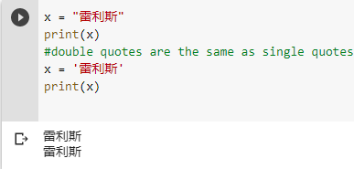
Single or Double Quotes
String variables can be declared either by using single or double quotes:
Example

Slide 22
Python - Variable Names
A variable can have a short name (like x and y) or a more descriptive name (age, carname, total_volume). Rules for Python variables
A variable name must start with a letter or the underscore character
A variable name cannot start with a number
A variable name can only contain alpha-numeric characters and underscores (A-z, 0-9, and _ )
Variable names are case-sensitive (age, Age and AGE are three different variables)

Slide 23
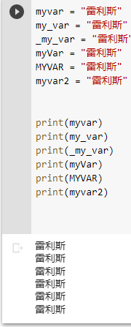
Example of Variable names
Example

Slide 24
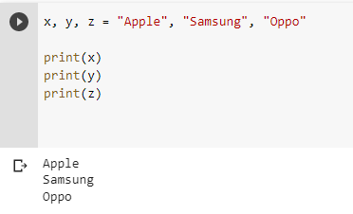
Python Variables - Assign Multiple Values
Many Values to Multiple Variables
Python allows you to assign values to multiple variables in one line:
Example

Slide 25
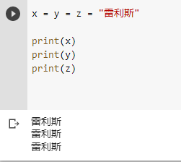
One Value to Multiple Variables
And you can assign the same value to multiple variables in one line:
Example

Slide 26
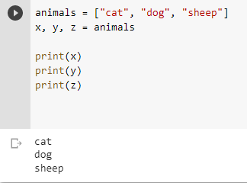
Unpack a Collection
If you have a collection of values in a list, tuple etc. Python allows you to extract the values into variables. This is called unpacking.
Example

Slide 27
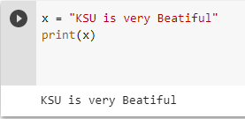
Python - Output Variables
Output Variables
The Python print() function is often used to output variables.
Example

Slide 28
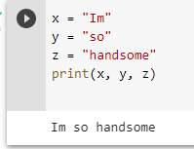
In the print() function, you output multiple variables, separated by a comma:
Example

Slide 29
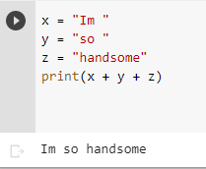
You can also use the + operator to output multiple variables:
Example

Slide 30
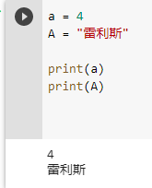
Case-Sensitive
Variable names are case-sensitive.
Example

Slide 31
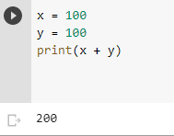
Notice the space character after "Python " and "is ", without them the result would be "Pythonisawesome".
For numbers, the + character works as a mathematical operator:
Example

Slide 32
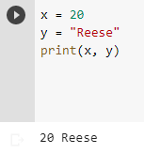
The best way to output multiple variables in the print() function is to separate them with commas, which even support different data types
Example

Slide 33
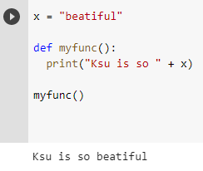
Python - Global Variables
Global Variables
Variables that are created outside of a function (as in all of the examples above) are known as global variables.
Global variables can be used by everyone, both inside of functions and outside.
Example

Slide 34
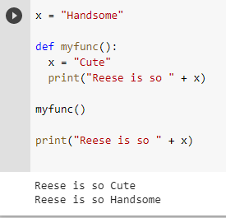
If you create a variable with the same name inside a function, this variable will be local, and can only be used inside the function. The global variable with the same name will remain as it was, global and with the original value.
Example

Slide 35
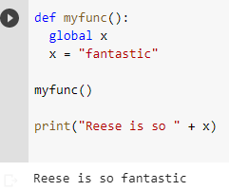
The global Keyword
Normally, when you create a variable inside a function, that variable is local, and can only be used inside that function.
To create a global variable inside a function, you can use the global keyword
Example

Slide 36
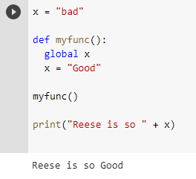
Also, use the global keyword if you want to change a global variable inside a function.
Example
-To change the value of a global variable inside a function, refer to the variable by using the global keyword:

Slide 37
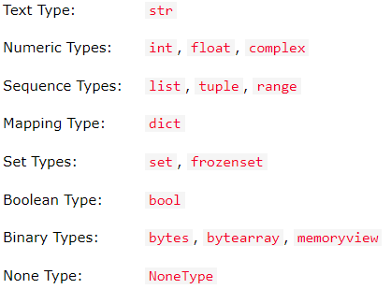
Python Data Types
Built-in Data Types
In programming, data type is an important concept.
Variables can store data of different types, and different types can do different things.
Python has the following data types built-in by default, in these categories:

Slide 38
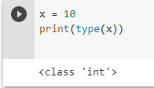
Getting the Data Type
You can get the data type of any object by using the type () function
Example

Slide 39
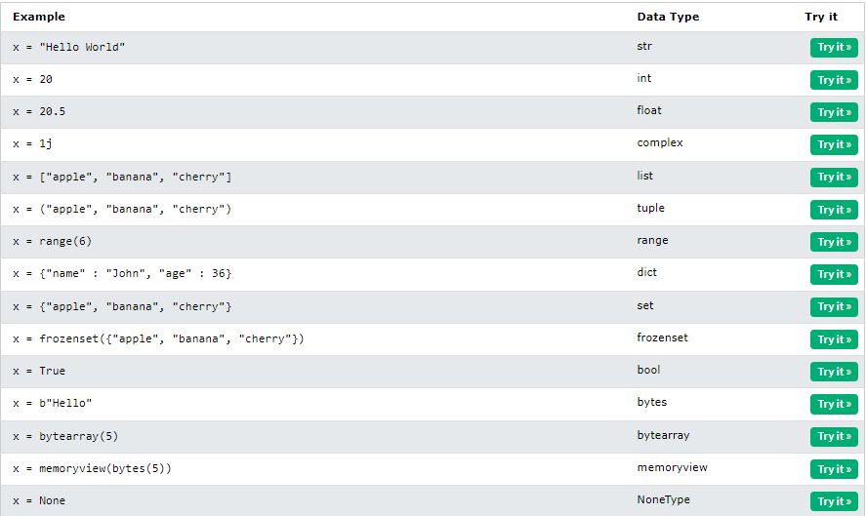
Setting the Data Type
In Python, the data type is set when you assign a value to a variable:

Slide 40
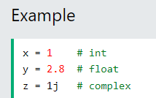
Python Numbers
There are three numeric types in Python:
Int
float
complex

Slide 41
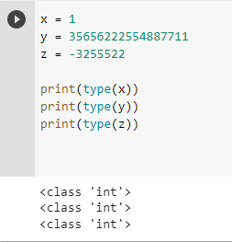
Int
Int, or integer, is a whole number, positive or negative, without decimals, of unlimited length.
Example
-Integers

Slide 42
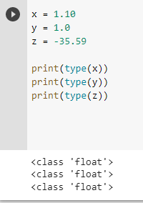
Float
Float, or "floating point number" is a number, positive or negative, containing one or more decimals.
Example

Slide 43
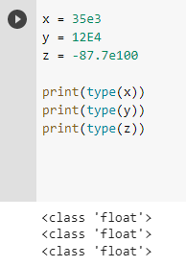
Float can also be scientific numbers with an "e" to indicate the power of 10.
Example

Slide 44
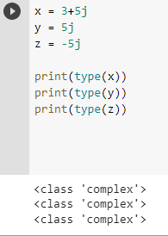
Complex
Complex numbers are written with a "j" as the imaginary part:
Example

Slide 45
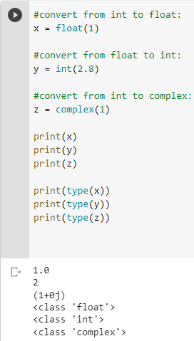
Type Conversion
You can convert from one type to another with the int(), float(), and complex() methods:
Example
Convert from one type to another:

Slide 46
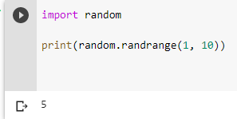
Random Number
Python does not have a random() function to make a random number, but Python has a built-in module called random that can be used to make random numbers:
Example

Slide 47
Python Casting
Specify a Variable Type
There may be times when you want to specify a type on to a variable. This can be done with casting. Python is an object-orientated language, and as such it uses classes to define data types, including its primitive types.
Casting in python is therefore done using constructor functions:
Int() - constructs an integer number from an integer literal, a float literal (by removing all decimals), or a string literal (providing the string represents a whole number)
Float() - constructs a float number from an integer literal, a float literal or a string literal (providing the string represents a float or an integer)
Str() - constructs a string from a wide variety of data types, including strings, integer literals and float literals

Slide 48
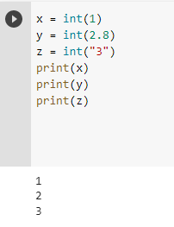
Example of Python Casting
Integers:

Slide 49
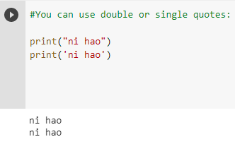
Python Strings
Strings in python are surrounded by either single quotation marks, or double quotation marks.
‘hello’ is the same as “hello” .
You can display a string literal with the print() function:
Example

Slide 50
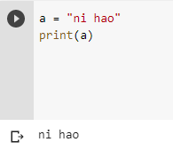
Assign String to a Variable
Assigning a string to a variable is done with the variable name followed by an equal sign and the string:
Example

Slide 51
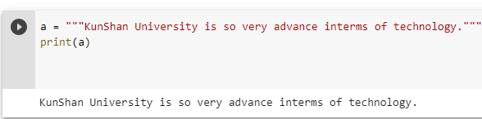
Multiline Strings
You can assign a multiline string to a variable by using three quotes:
Example

Slide 52
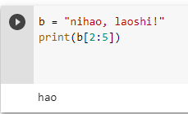
Python - Slicing Strings
Slicing
You can return a range of characters by using the slice syntax.
Specify the start index and the end index, separated by a colon, to return a part of the string.
Example
-Get the characters from position 2 to position 5 (not included):

Slide 53
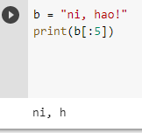
Slice From the Start
By leaving out the start index, the range will start at the first character:
Example
-Get the characters from the start to position 5 (not included):

Slide 54
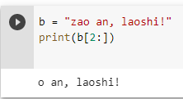
Slice To the End
By leaving out the end index, the range will go to the end:
Example
-Get the characters from position 2, and all the way to the end:

Slide 55
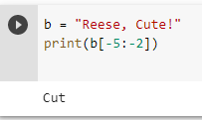
Negative Indexing
Use negative indexes to start the slice from the end of the string:
Example
- Get the characters:
- From: "o" in "World!" (position -5)
- To, but not included: "d" in "World!" (position -2):

Slide 56

Multiline Strings
You can assign a multiline string to a variable by using three quotes:
Example

Slide 57

Python - Modify Strings
Python has a set of built-in methods that you can use on strings.
Upper Case
Example
- The upper() method returns the string in upper case:

Slide 58

Lower Case
Example
- The lower() method returns the string in lower case:

Slide 59

Remove Whitespace
Whitespace is the space before and/or after the actual text, and very often you want to remove this space.
Example
- The strip() method removes any whitespace from the beginning or the end:

Slide 60

Python - String Concatenation
Note: All string methods return new values. They do not change the original string

Slide 61
Python Booleans
Booleans represent one of two values: True or False
Boolean Values
In programming you often need to know if an expression is True or False
You can evaluate any expression in Python, and get one of two answers, True or False
When you compare two values, the expression is evaluated and Python returns the Boolean answer:

Slide 62

Boolean Values Example

Slide 63

Evaluate Values and Variables
The bool () function allows you to evaluate any value, and give you True or False in return,
Example
- Evaluate a string and a number:

Slide 64

Python Operators
Operators are used to perform operations on variables and values.
In the example below, we use the + operator to add together two values:
Example

Slide 65

Python Arithmetic Operators
Arithmetic operators are used with numeric values to perform common mathematical operations:

Slide 66

Python - Join Lists
Join Two Lists
There are several ways to join, or concatenate, two or more lists in Python.
One of the easiest ways are by using the + operator.
Example

Slide 67

Python Tuples
mytuple =(“Math”, “Chinese”, “English”)
Tuple
Tuples are used to store multiple items in a single variable.
Tuple is one of 4 built-in data types in Python used to store collections of data, the other 3 are List, Set, and Dictionary, all with different qualities and usage.
A tuple is a collection which is ordered and unchangeable.
Tuples are written with round brackets.
Example
-Create a Tuple:

Slide 68
Tuple Items
- Tuple items are ordered, unchangeable, and allow duplicate values.
- tuple items are indexed, the first item has index [0] , the second item has index [1] etc.
Ordered
- When we say that tuples are ordered, it means that the items have a defined order, and that order will not change.
Unchangeable
- Tuples are unchangeable, meaning that we cannot change, add or remove items after the tuple has been created.
Allow Duplicates
- Since tuples are indexed, they can have items with the same value:

Slide 69

Python - Access Tuple Items
Access Tuple Items
You can access tuple items by referring to the index number, inside square brackets
Example
Print the second item in the tuple:

Slide 70

Negative Indexing
Negative indexing means start from the end.
-1 refers to the last item, -2 refers to the second last item etc.
Example
- Print the last item of the tuple:

Slide 71

Range of Indexes
You can specify a range of indexes by specifying where to start and where to end the range.
When specifying a range, the return value will be a new tuple with the specified items.
Example
- Return the third, fourth, and fifth item:

Slide 72
Python - Update Tuples
Tuples are unchangeable, meaning that you cannot change, add, or remove items once the tuple is created.
But there are some workarounds.
Change Tuple Values
Once a tuple is created, you cannot change its values. Tuples are unchangeable, or immutable as it also is called.
But there is a workaround. You can convert the tuple into a list, change the list, and convert the list back into a tuple.

Slide 73

Example of Python Change Tuple Values
Convert the tuple into a list to be able to change it:

Slide 74

Elif
The elif keyword is pythons way of saying "if the previous conditions were not true, then try this condition".
Example

Slide 75

Else
The else keyword catches anything which isn't caught by the preceding conditions.
Example

Slide 76

Short Hand If ... Else
If you have only one statement to execute, one for if, and one for else, you can put it all on the same line:
Example
- One line if else statement:

Slide 77

And
The and keyword is a logical operator, and is used to combine conditional statements:
Example
Test if a is greater than b, AND if c is greater than a :

Slide 78

Or
The or keyword is a logical operator, and is used to combine conditional statements:
Example
Test if a is greater than b, OR if a is the greater than c :

Slide 79

Nested If
You can have if statements inside if statements, this is called nested if statements.
Example

Slide 80

The pass Statement
if statements cannot be empty, but if you for some reason have an if statement with no content, put in the pass statement to avoid getting an error.
Example

Slide 81


Python While Loops
Python Loops
- Python has two primitive loop commands:
The while Loop
- With the while loop we can execute a set of statements as long as a condition is true.
Example
Print i as long as i is less than 6:

Slide 82

The break Statement
With the break statement we can stop the loop even if the while condition is true:
Example
- Exit the loop when i is 3:

Slide 83

Python For Loops
- A for loop is used for iterating over a sequence (that is either a list, a tuple, a dictionary, a set, or a string).
- This is less like the for keyword in other programming languages, and works more like an iterator method as found in other object-orientated programming languages.
- With the for loop we can execute a set of statements, once for each item in a list, tuple, set etc.
Example
Print each country in a country list:

Slide 84

Looping Through a String
Even strings are iterable objects, they contain a sequence of characters:
Example
Loop through the letters in the word "雷利斯":

Slide 85

The range() Function
To loop through a set of code a specified number of times, we can use the range() function,
The range() function returns a sequence of numbers, starting from 0 by default, and increments by 1 (by default), and ends at a specified number.
Example
- Using the range() function:

Slide 86

Else in For Loop
The else keyword in a for loop specifies a block of code to be executed when the loop is finished:
Example
- Print all numbers from 0 to 5, and print a message when the loop has ended:

Slide 87

Nested Loops
A nested loop is a loop inside a loop.
The "inner loop" will be executed one time for each iteration of the "outer loop":
Example
- Print each adjective for every Country:

Slide 88

The pass Statement
for loops cannot be empty, but if you for some reason have a for loop with no content, put in the p ass statement to avoid getting an error.
Example

Slide 89

Parameters or Arguments?
- The terms parameter and argument can be used for the same thing: information that are passed into a function.
Number of Arguments
- By default, a function must be called with the correct number of arguments. Meaning that if your function expects 2 arguments, you have to call the function with 2 arguments, not more, and not less.

Slide 90

Arbitrary Arguments, *args
If you do not know how many arguments that will be passed into your function, add a * before the parameter name in the function definition.
This way the function will receive a tuple of arguments, and can access the items accordingly:
Example
- If the number of arguments is unknown, add a * before the parameter name:

Slide 91

Keyword Arguments
You can also send arguments with the key = value syntax.
This way the order of the arguments does not matter.
Example

Slide 92

Arbitrary Keyword Arguments, **kwargs
If you do not know how many keyword arguments that will be passed into your function, add two asterisk: ** before the parameter name in the function definition.
This way the function will receive a dictionary of arguments, and can access the items accordingly:
Example
- If the number of keyword arguments is unknown, add a double ** before the parameter name:

Slide 93


Python Lambda
A lambda function is a small anonymous function.
A lambda function can take any number of arguments, but can only have one expression.
Syntax
- The expression is executed and the result is returned:
Example
Add 10 to argument a , and return the result:

Slide 94


Why Use Lambda Functions?
The power of lambda is better shown when you use them as an anonymous function inside another function.
Say you have a function definition that takes one argument, and that argument will be multiplied with an unknown number:
- Use that function definition to make a function that always doubles the number you send in:
Example

Slide 95

Another example of Lambda Functions
use the same function definition to make both functions, in the same program:
Example

Slide 96

What is an Array?
An array is a special variable, which can hold more than one value at a time.
If you have a list of items (a list of car names, for example), storing the cars in single variables could look like this:
- However, what if you want to loop through the cars and find a specific one? And what if you had not 3 country, but 300?
- The solution is an array!
- An array can hold many values under a single name, and you can access the values by referring to an index number.

Slide 97

The Length of an Array
Use the len() method to return the length of an array (the number of elements in an array).
Example
- Return the number of elements in the country() array:

Slide 98

Looping Array Elements
You can use the for in loop to loop through all the elements of an array.
Example
- Print each item in the country array:

Slide 99

Adding Array Elements
You can use the append() method to add an element to an array.
Example
- Add one more element to the country array:

Slide 100

Removing Array Elements
You can use the pop() method to remove an element from the array
Example
- Delete the second element of the country array :

