Slide 1
MY JOURNAL TO PYTHON
Name: 雷利斯
Teacher: My dear greate teacher

Slide 2
AGENDA
Python
Input and output: input() and print()
Data types: numerisc, strings, list , dict
Operators ON data type:

Slide 3
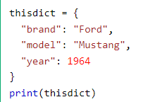
Data types: Dictionary
Dictionaries are used to store data values in key:value pairs.
A dictionary is a collection which is ordered*, changeable and do not allow duplicates.
As of Python version 3.7, dictionaries are ordered.
In Python 3.6 and earlier, dictionaries are unordered.
Dictionaries are written with curly brackets, and have keys and values:
Key
value

Slide 4
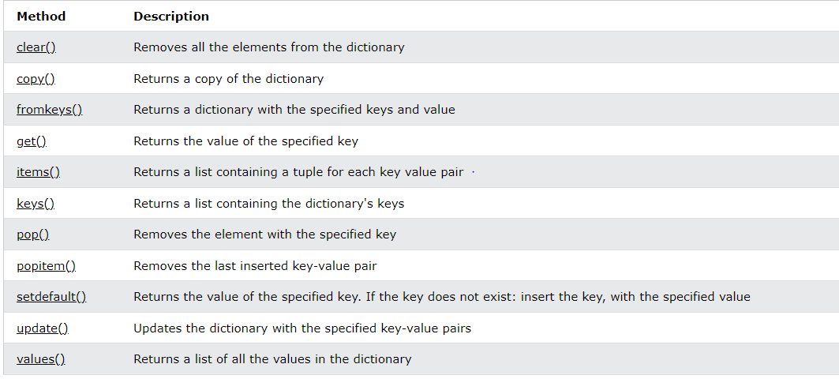
Python Dictionary Methods
Dictionary Methods
Python has a set of built-in methods that you can use on dictionaries.

Slide 5
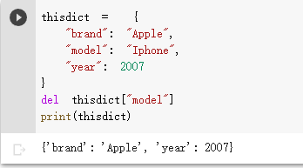
Python - Remove Dictionary Items
Removing Items
There are several methods to remove items from a dictionary:
Example

Slide 6
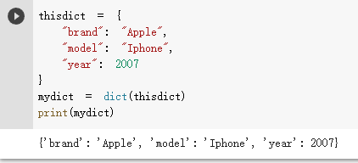
Python - Copy Dictionaries
Copy a Dictionary
You cannot copy a dictionary simply by typing dict2 = dict1, because: dict2 will only be a reference to dict1, and changes made in dict1 will automatically also be made in dict2.
There are ways to make a copy, one way is to use the built-in Dictionary method copy().
Example

Slide 7
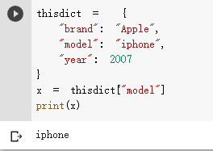
Python - Access Dictionary Items
Accessing Items
:
You can access the items of a dictionary by referring to its key name, inside square brackets:
Example

Slide 8
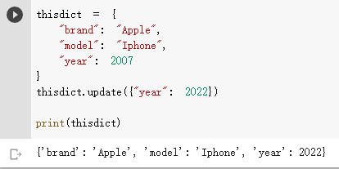
Python - Change Dictionary Items
Change Values
You can change the value of a specific item by referring to its key name:
Example

Slide 9
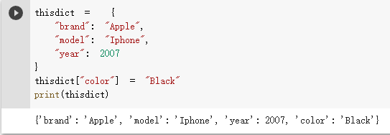
Python - Add Dictionary Items
Adding Items
Adding an item to the dictionary is done by using a new index key and assigning a value to it:
Example

Slide 10
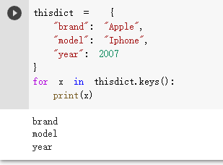
Python - Loop Dictionaries
Loop Through a Dictionary
You can loop through a dictionary by using a for loop
When looping through a dictionary, the return value are the keys of the dictionary, but there are methods to return the values as well.
Example

Slide 11
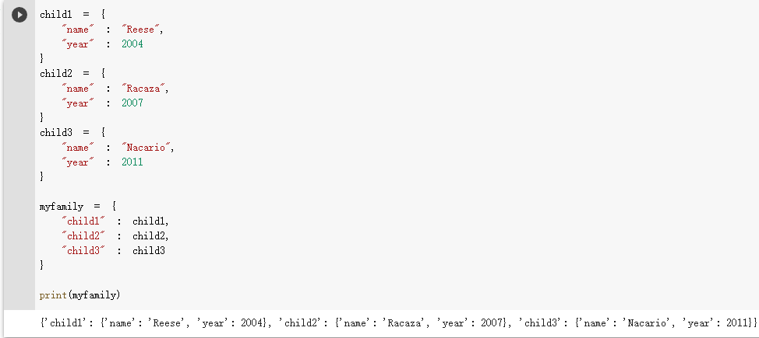
Python - Nested Dictionaries
Nested Dictionaries
A dictionary can contain dictionaries, this is called nested dictionaries.
Example

