Slide 1

CSCI 476: Computer Security
Review
Reese Pearsall
Fall 2022
https://www.cs.montana.edu/pearsall/classes/fall2022/476/main.html

Slide 2

Announcement
Project due TONIGHT @ 11:59 PM
Lab 10 Due Sunday December 11th
Fill out the course evaluation!

Slide 3
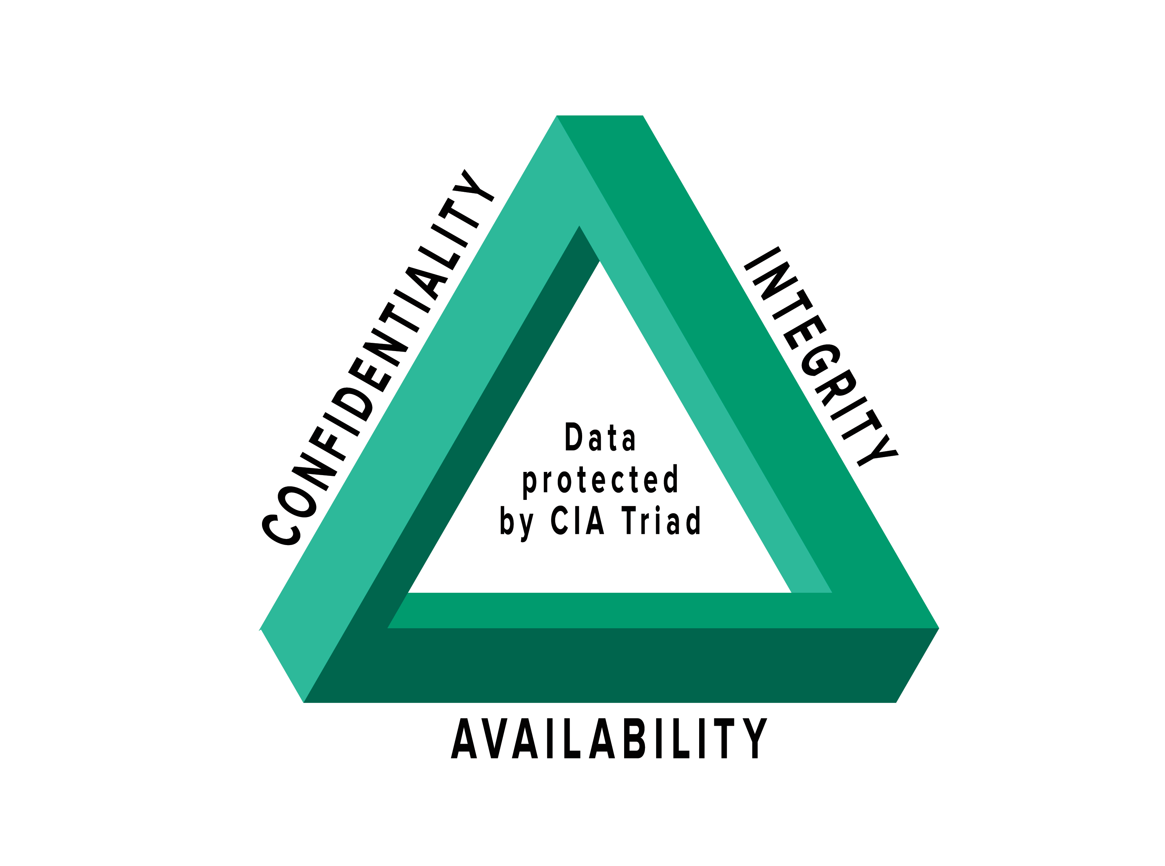
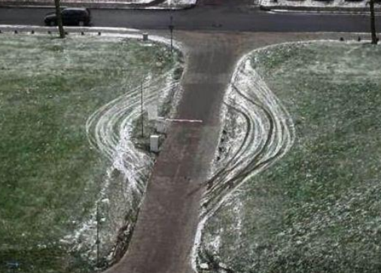

Takeaways
Trust- Trust as little as possible. We never know for sure how a user will interact with software
Intended Design- Users may interact with out system in ways that we did not think of.
Separation- There should always be a clear separation of code and data (user input)
Privilege- Privilege is a very powerful mechanism. We should never give more privilege than needed
Usability- Security and software should be useable. Too much security will push people away
Layering- Security should be happening at multiple layers
(Firewall → Input Sanitization → Authentication → Antivirus Scanner)
Use your security knowledge to do good things!

Slide 4
Final Exam Logistics + Format
Tuesday December 13th 2:00 – 3:50 PM
You are allowed to use one 8.5 x 11 Note sheet
(both sides, written or typed)
No Laptops
Final Exam is worth 15% of your grade
There won’t be a curve unless one is needed
The exam will consist of short answer questions about lecture material.
For each attack, you should be comfortable with:
What is the attack is
The attack methodology
The vulnerability/weakness that is being exploited (this might be a specific detail, or a general weakness)
You won’t need to write any code or OS commands, but you might need to look at small snippets of code (python/PHP or C)
List of topics/content + sample exam questions can be found on the study guide (on the website)

Slide 5
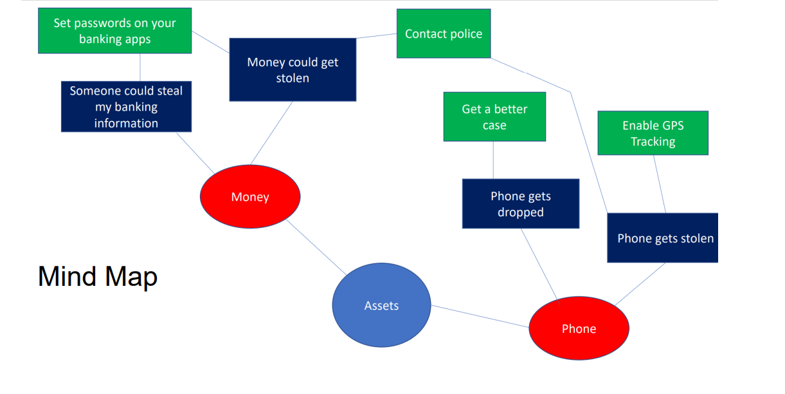
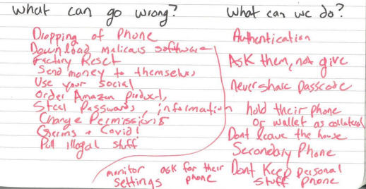
Threat Modeling
Threat modeling is a structured approach to assessing risk and defenses
What are you building?
What are the assets?
What can go wrong?
What should you do about those things that can go wrong?
Did you do a decent job of analysis?

Slide 6

SET-UID Programs
A SET-UID Program allows a user to run a program with the program owner’s privilege
User runs a program w/ temporarily elevated privileges
Every process has two User IDs
Real UID (RUID)– Identifies the owner of the process
Effective UID (EUID)– Identifies current privilege of the process
If a program owner == root,
The program runs with root privileges
Methods of Attack
Unsafe Function Calls (system() vs exec() )
Overwriting important ENV variables (PATH)
Overwriting important linking ENV variables (LD PRELOAD)

Slide 7
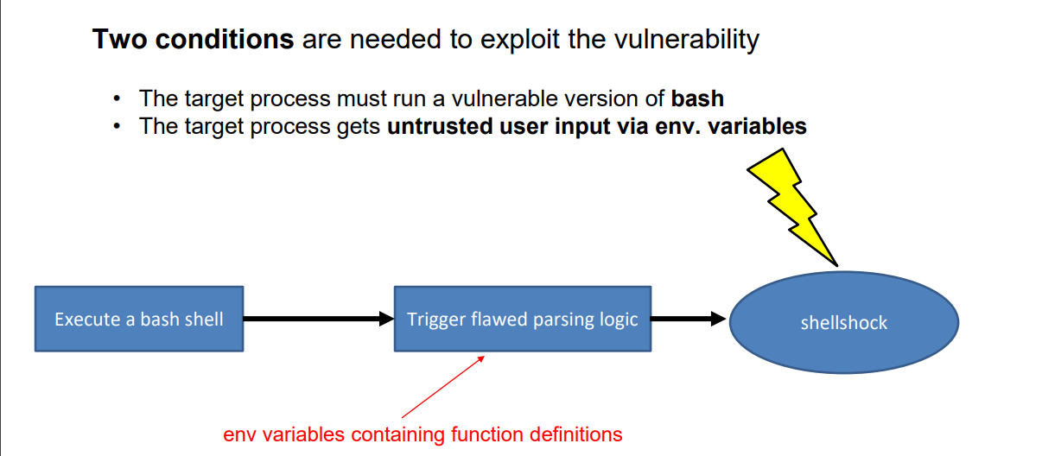
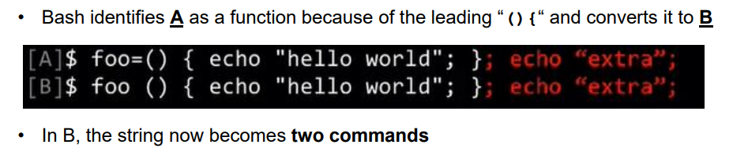
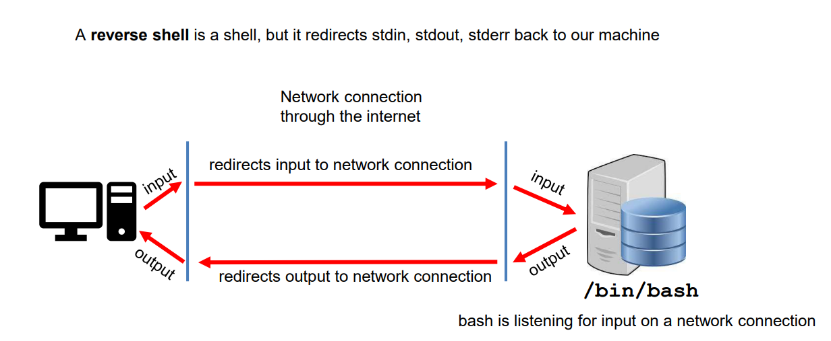
Shellshock Attack
Due to parsing logic in a vulnerable version of bash, we can export an environment variable that bash will interpret as a shell function
Example Payload
You should know what a reverse shell is, and why we need one

Slide 8
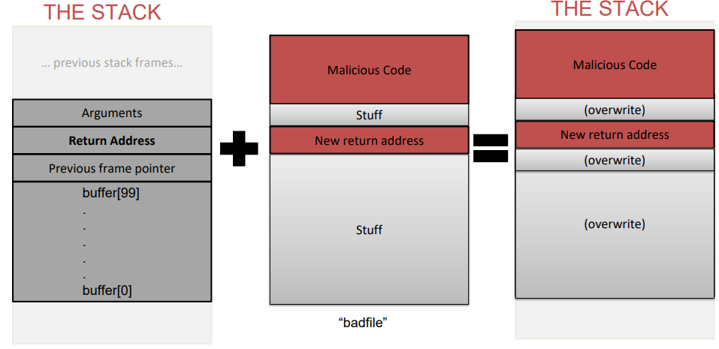
Buffer Overflow
When a program unsafely writes data to the stack via some buffer, we can overflow the buffer with our data
If we are smart, we can overwrite the return address and have the code jump to our malicious function
Countermeasures:
Secure Shell (/bin/dash)
ASLR
Stack Guard
Non-Executble Stack
To find the important locations in our stack, we used $ebp and $esp
The malicious code that we injected was shellcode
How did we bypass these countermeasures?
We filled overwrote everything else with NOPs

Slide 9
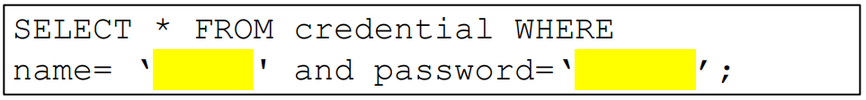
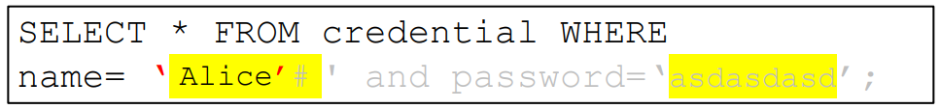

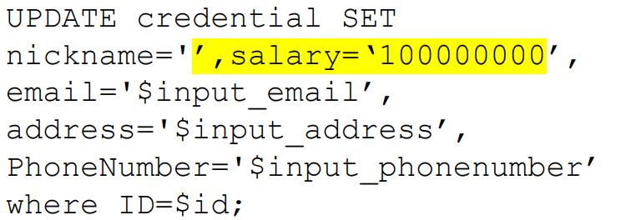
SQL Injection
It is common for user input to be inserted into a back-end SQL query. If an application is not careful about sanitizing user input, a user could supply an input that could be interpreted as SQL code and will interfere with the query
Username = Alice’#
Password = asdasdasd
Countermeasure: SQL Prepare() statements

Slide 10
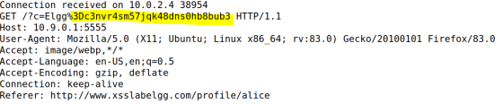
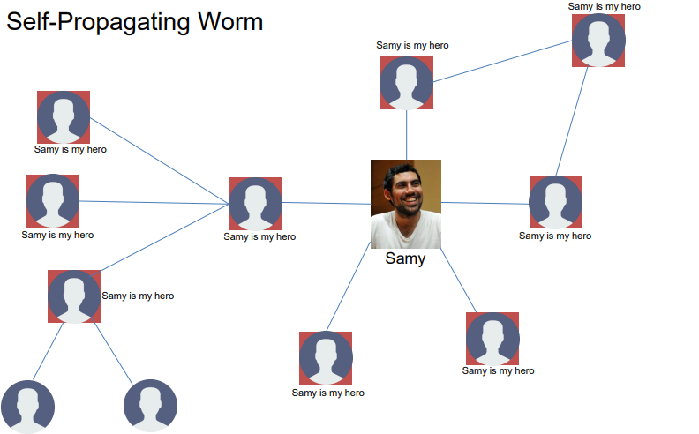

XSS Attack
Goal: Get someone else’s browser to execute our own JavaScript code
Vulnerability: Unsafe user input handling, and unsafe web communication policies
netcat server
Countermeasures:
Filtering
Encoding
CSP, CORS

Slide 11
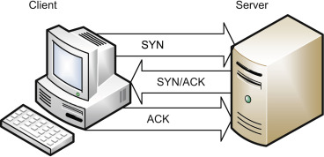
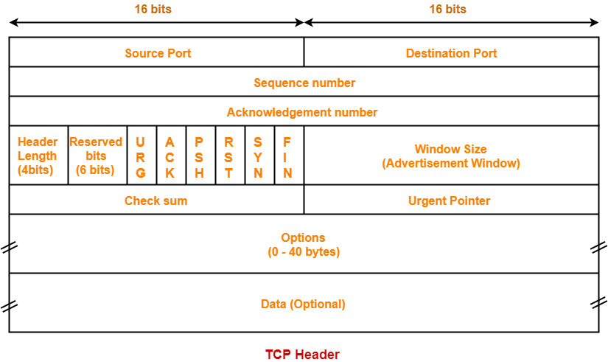


TCP Attacks
TCP Flooding- spoof a bunch of packets with bogus source IP addresses with the SYN flag. The server thinks these are legitimate requests and allocates computational resources for the request. We flood a server with these until the server can no longer accept new requests (and essentially denying service)
TCP Reset- Break an existing TCP connection by spoofing a TCP RST packet that looks like it came from one of the people in the existing TCP connection.
TCP Hijack- Hijack an existing TCP connection to get a TCP server to execute arbitrary commands. Spoofed a packet with the correct information so that the server thinks it came from the client

Slide 12
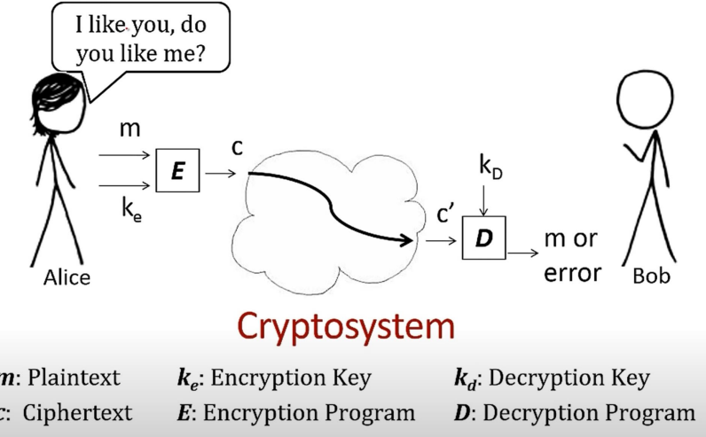

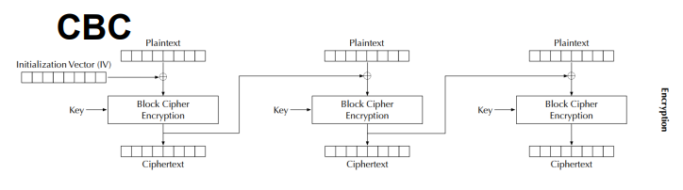
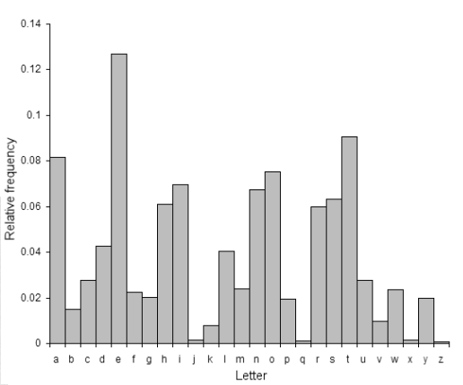
Symmetric Cryptography / Secret Key Encryption
Block Cipher (AES)
→ Split messages into fixed sized blocks, encrypt each block separately
Hello there world
01101000 01100101 01101100 01101100 01101111 00100000 01110100 01101000 01100101 01110010 01100101 00100000 01110111 01101111 01110010 01101100 01100100 00001010
Padding gets applied if the plaintext is not a multiple of the block size
Block 1
Block 2 Block 3
Frequency Analysis
(as a way to crack substitutions ciphers)
Ciphertext
An initialization vector (IV) is an arbitrary number that can be used with a secret key for data encryption
Modes of encryption: ECB, CBC, CFG, CTR, CFB

Slide 13
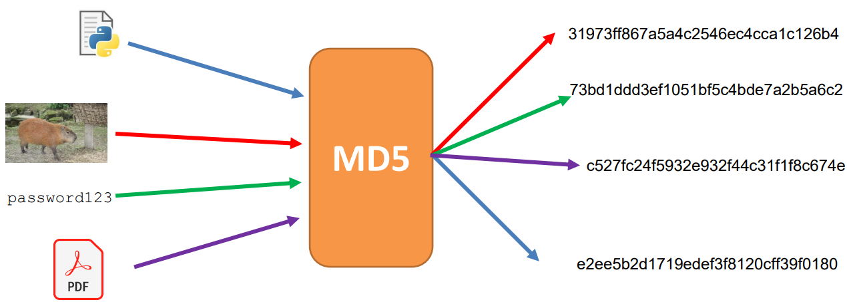
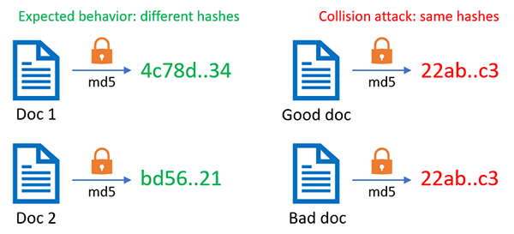
Hashing
Properties of Cryptographic Hash Function:
Given a hash, it should be difficult to reverse it
Given a message and it’s hash, it should be difficult to find another message that has the same hash
In general, difficult to calculate two values that have the same hash
Hash Collisions occur when two inputs map to the same hash, which can have some scary consequences
Applications of Hashing:
Message Integrity
Password Storing
Fairness and Commitment
Birthday Paradox

Slide 14
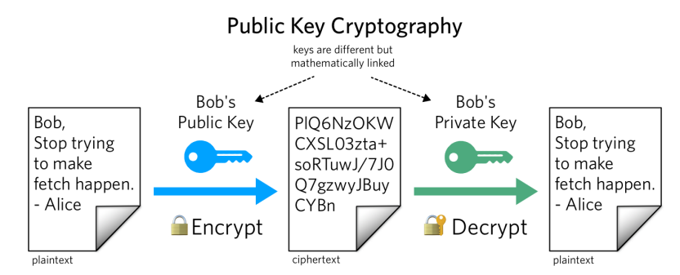
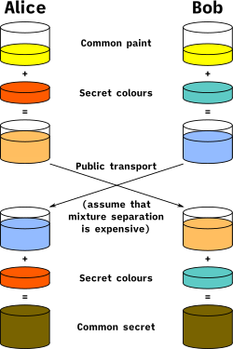
Asymmetric Cryptography / Public Key Encryption
Public Key vs Private Key (Mathematically linked)
Public key used to encrypt; Private key used to decrypt
Alice knows the prime products that generated her key, so it’s very easy for her to factorize
Eve does not know the products, and it is computationally infeasible for her to calculate the integer factorization of very large number
Diffie Helman Technique is used to transport a secret over an unsecure channel
RSA can not encrypt stuff that is larger than its key size,
So we typically will encrypt the key for a symmetric encryption algorithm (AES)
Private Keys are also used for digital signatures, which can be used to authenticate a message

Slide 15
Secret Last Question
On the last question, I will ask you to reflect on some of the things that we have discussed
in CSCI 476
If you attempt it, and give a thoughtful answer, you will get full points ☺

Slide 16
Any Questions?

Slide 17
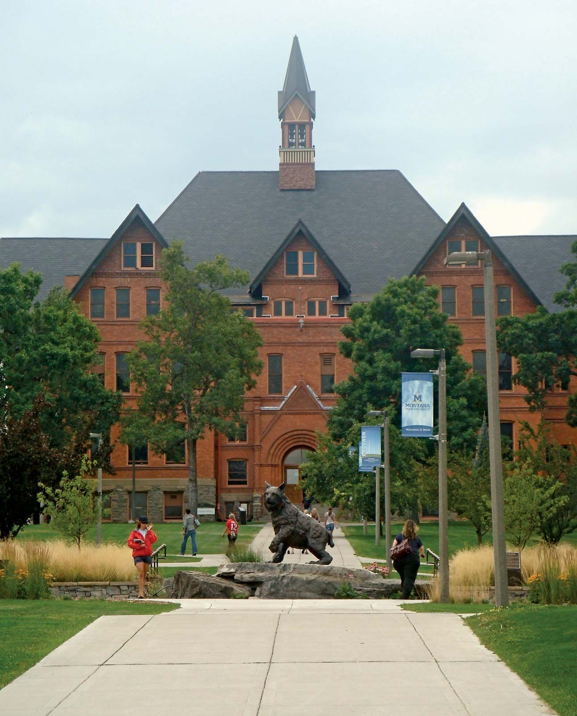

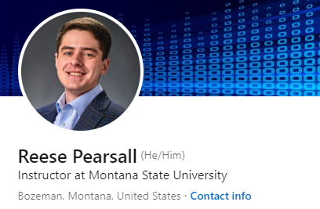

Thank You!
This class has been a blast to teach. Thank you for your patience, flexibility, and kindness ☺
There were a lot of long nights, and I know things were not perfect, but I am happy with how things went
I hope you enjoyed this class, and I hope the stuff you learned will be helpful in your career
If you are interested in security, check out HackerCats (hackercats.club@gmail.com)
I will be teaching 476 and 132 next semester
Connect with me on LinkedIn! If you find a job in cybersecurity, please keep in touch!
Congrats to those that are graduating next weekend! I hope you find a job that you love!
If I can be of assistance to you for anything in the future, please let me know!

