Slide 1

CSCI 132: Basic Data Structures and Algorithms
ArrayLists
Reese Pearsall & Iliana Castillon
Fall 2024
https://www.cs.montana.edu/pearsall/classes/fall2024/132/main.html
*All images are stolen from the internet

Slide 2

Announcements
Lab 4 due tomorrow at 11:59 PM
Program 1 due on Sunday @ 11:59 PM

Slide 3
Array Limitations
Cons
Can’t change the length
Can only store one data type
What can we do about this?
int[] myArray = {1, 2, 3};
System.out.println(Arrays.toString(myArray));
int[] newArray = new int[myArray.length + 1];
for(int i = 0; i < myArray.length; i++) {
newArray[i] = myArray[i];
}
// Create a new array that is one spot bigger
// Fill new array with contents of old array
int new_value = 4;
newArray[myArray.length] = new_value;
myArray = newArray;
// add new value to array
// Update reference variable

Slide 4
Array Limitations
Cons
Can’t change the length
Can only store one data type
What can we do about this?
int[] myArray = {1, 2, 3};
System.out.println(Arrays.toString(myArray));
int[] newArray = new int[myArray.length + 1];
for(int i = 0; i < myArray.length; i++) {
newArray[i] = myArray[i];
}
// Create a new array that is one spot bigger
// Fill new array with contents of old array
This process can be expensive
int new_value = 4;
newArray[myArray.length] = new_value;
myArray = newArray;
// add new value to array
// Update reference variable

Slide 5
Array Limitations
Cons
Can’t change the length
Can only store one data type
int[] myArray = {1, 2, 3};
System.out.println(Arrays.toString(myArray));
Solution
Create new array, copy everything over
int[] newArray = new int[myArray.length + 1];
for(int i = 0; i < myArray.length; i++) {
newArray[i] = myArray[i];
}
(this can be expensive ☹ )
int new_value = 4;
newArray[myArray.length] = new_value;
myArray = newArray;
Solution
Store an object, use two separate arrays, use a different data structure

Slide 6
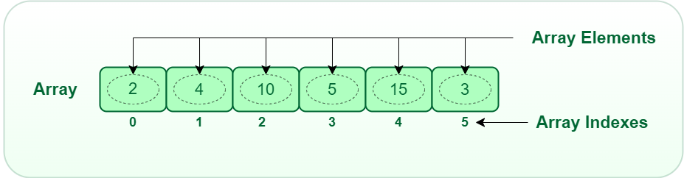
An ArrayList is a data structure that can hold multiple, similar values (just like an array), BUT
Dynamic, can easily resize
Can easily add new elements and remove elements
Like a Python list ☺
Somebody took arrays, and made them better
Still have indices
Still can only store one data type

Slide 7
Java ArrayLists
We first need to remember to import it ☺
import java.util.ArrayList;
Creating a new ArrayList
ArrayList<String> mylist = new ArrayList<String>();
We must specify what datatype the ArrayList will hold
We never have to specify the size, because we can now easily grow/shrink our ArrayList!
Reference Variable

Slide 8
Java ArrayLists
We first need to remember to import it ☺
import java.util.ArrayList;
Creating a new ArrayList
ArrayList<String> mylist = new ArrayList<String>();
We can add stuff to the ArrayList using the .add() method (built in method!)
mylist.add("Jack");

Slide 9


Java ArrayLists
We first need to remember to import it ☺
import java.util.ArrayList;
Creating a new ArrayList
ArrayList<String> mylist = new ArrayList<String>();
We can add stuff to the ArrayList using the .add() method (built in method!)
mylist.add("Jack");
Under the hood, it is
Creating a new array
Copy old contents
Add new element at the end
Updating reference variable
int[] myArray = {1, 2, 3};
System.out.println(Arrays.toString(myArray));
int[] newArray = new int[myArray.length + 1];
for(int i = 0; i < myArray.length; i++) {
newArray[i] = myArray[i];
}
int new_value = 4;
newArray[myArray.length] = new_value;
myArray = newArray;

Slide 10
Java ArrayLists
We first need to remember to import it ☺
import java.util.ArrayList;
Creating a new ArrayList
ArrayList<String> mylist = new ArrayList<String>();
We can add stuff to the ArrayList using the .add() method (built in method!)
mylist.add("Jack");
To access elements in the array, we use the .get() method (we cannot use the square bracket index [ ] )
System.out.println(mylist.get(2));
// this will print the String at index 2

Slide 11
Java ArrayLists
We first need to remember to import it ☺
import java.util.ArrayList;
Creating a new ArrayList
ArrayList<String> mylist = new ArrayList<String>();
We can add stuff to the ArrayList using the .add() method (built in method!)
mylist.add("Jack");
To access elements in the array, we use the .get() method (we cannot use the square bracket index [ ] )
System.out.println(mylist.get(2));
// this will print the String at index 2
We can remove stuff by index, or by searching for a specific element
mylist.remove("Eli");
mylist.remove(0);

Slide 12
Java ArrayLists
import java.util.ArrayList;
public class ArrayListDemo {
public static void main(String[] args) {
ArrayList<String> mylist = new ArrayList<String>();
mylist.add("Jack");
mylist.add("Tory");
mylist.add("Sam");
mylist.add("Eli");
System.out.println(mylist);
System.out.println(mylist.get(2));
mylist.remove("Eli");
mylist.remove(0);
System.out.println(mylist);
System.out.println(mylist.isEmpty());
}
}

Slide 13
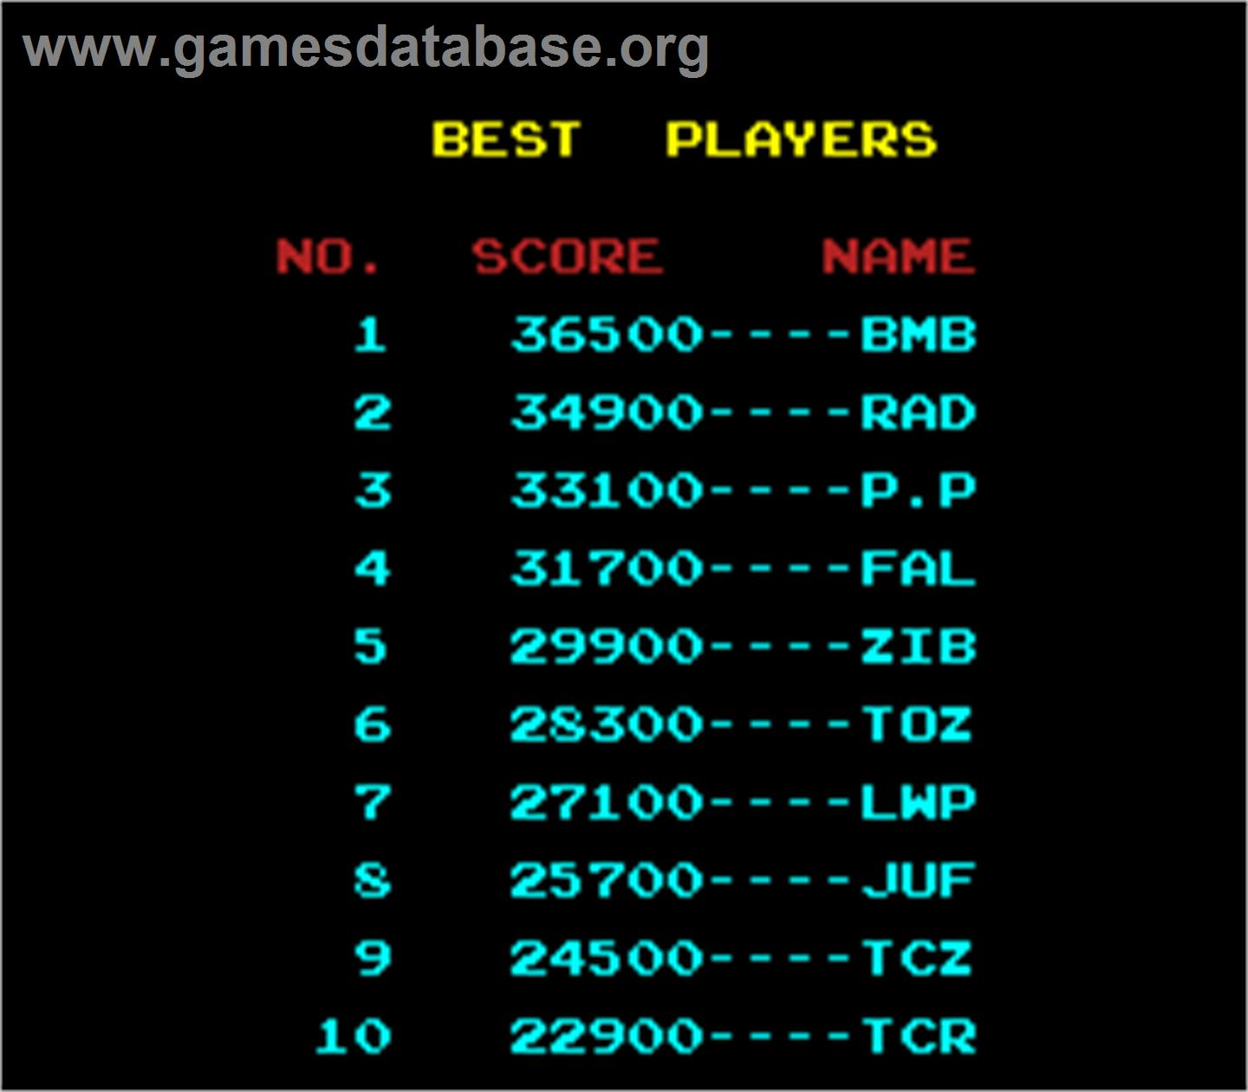
Java ArrayLists Example
Let’s write a program that will keep track of high scores on an arcade machine
Each entry will have the player name (String), and their score (Int)
The program should allow for
Adding a new high score
Removing a score
Print out scoreboard
Print out top N scores
Search for score by name
And we must use an ArrayList to hold all this information!

