Slide 1

CSCI 466: Networks
Application Layer
(More DNS, SMTP)
Reese Pearsall
Fall 2024
https://www.cs.montana.edu/pearsall/classes/fall2024/466/main.html
*All images are stolen from the internet

Slide 2
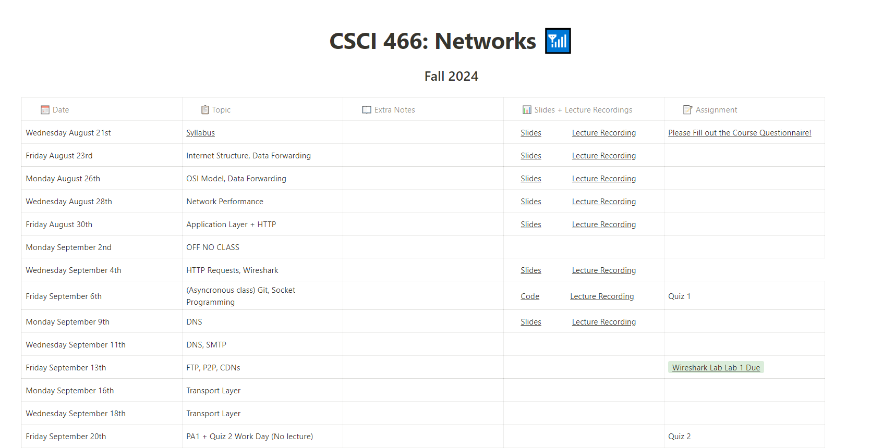

Course Website is back after DNS was updated☺

Slide 3
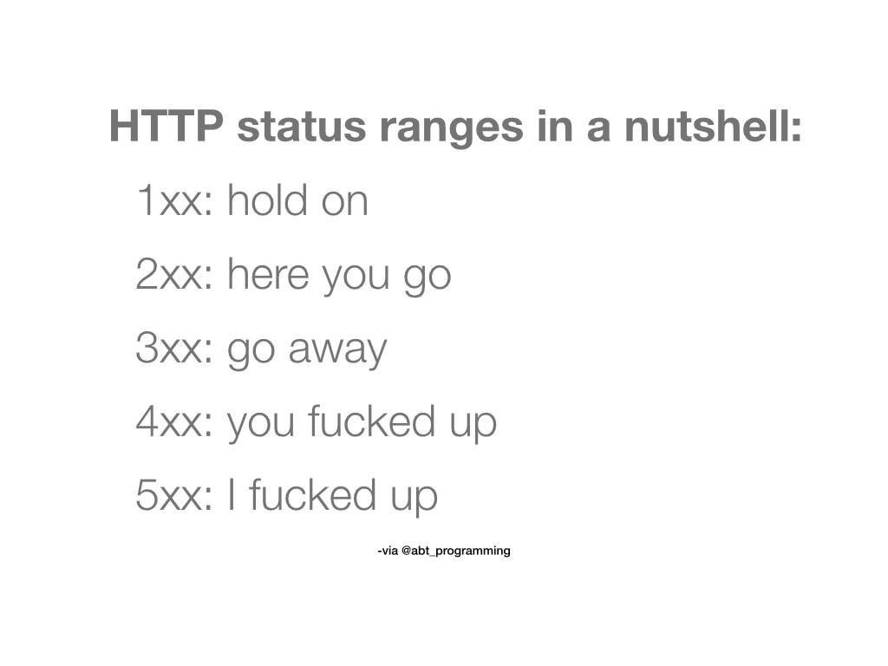
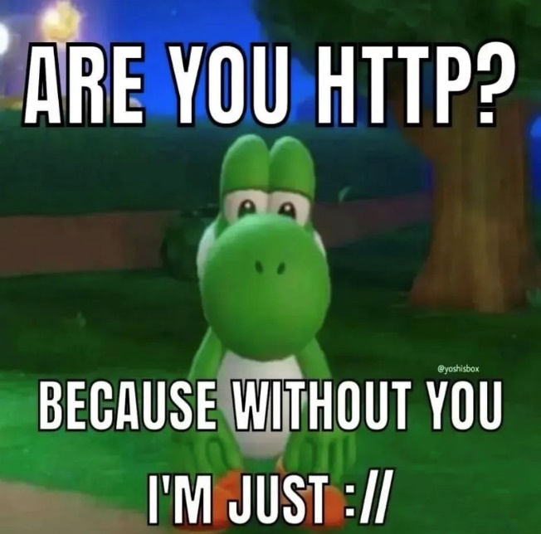
Announcements
Wireshark Lab 1 due on Friday @ 11:59 PM
Cybersecurity Capture the Flag (CTF) club meets on Fridays
Open to anyone
We will be competing in an online CTF event next weekend
https://learn2ctf.org/

Slide 4
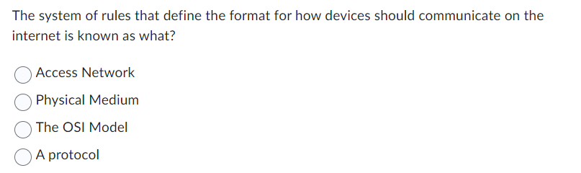
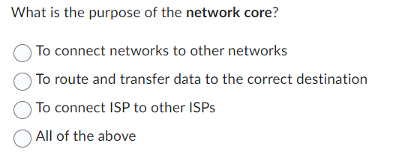

Slide 5
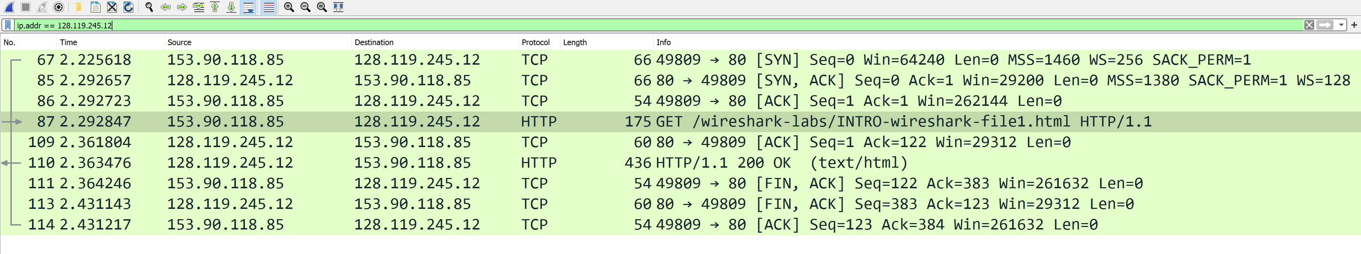
Finding the TCP Handshake in Wireshark

Slide 6

Application Layer
OSI Model
Presentation Layer
*
Application Layer
Session Layer
*
Messages from Network Applications
Transport Layer
Network Layer
Physical Layer
Data Link Layer
Bits being transmitted over a copper wire
Physical Layer
*In the textbook, they condense it to a 5-layer model, but 7 layers is what is most used

Slide 7


DNS
Humans browse the web using hostnames
(They need English)
Computers understand numbers
(They need IP addresses)
DNS
153.90.127.197
Domain Name System (DNS) is a database of mappings between hostnames and IP addresses

Slide 8
Protocols so far
HTTP
DNS
TCP
UDP

Slide 9






DNS Architecture
DNS is a distributed, hierarchical database (no DNS server has all the records!)
Hierarchy consists of different types of DNS servers:
root DNS server
Authoritative DNS servers- Organization’s own DNS with up-to-date records
.com TLD DNS server
.edu TLD DNS server
Top-level domain (TLD) servers- responsible for keeping IP addresses for authoritative DNS servers for each top-level domain (.com, .edu, .jp, etc)
facebook.com DNS
amazon.com DNS
montana.edu DNS
harvard.edu DNS
Root DNS servers- responsible for maintaining IP addresses for TLD servers

Slide 10



DNS Architecture
DNS is a distributed, hierarchical database (no DNS server has all the records!)
root DNS server
Hostname | IP Address
marketplace.facebook.com | 192.23.54.221
gaming.facebook.com | 192.23.54.219
facebook.com | 192.23.54.222
friends.facebook.com | 192.23.54.216
… | …
.com TLD DNS server
.edu TLD DNS server
facebook.com DNS
amazon.com DNS
montana.edu DNS
harvard.edu DNS
Authoritative DNS Server

Slide 11

DNS Architecture
DNS is a distributed, hierarchical database (no DNS server has all the records!)
root DNS server
Hostname | IP Address
google.com Auth. DNS | 77.87.124.3
facebook.com Auth. DNS | 192.23.54.22
amazon.com Auth DNS | 10.172.44.92
ebay.com Auth DNS | 192.7.66.111
… | …
.com TLD DNS server
.edu TLD DNS server
TLD DNS servers hold records for authoritative DNS server for a particular domain
facebook.com DNS
amazon.com DNS
montana.edu DNS
harvard.edu DNS

Slide 12

DNS Architecture
DNS is a distributed, hierarchical database (no DNS server has all the records!)
root DNS server
Hostname | IP Address
.com TLD DNS server | 21.220.198.29
.org TLD DNS server | 68.198.64.235
.edu TLD DNS server | 103.109.123.65
.gov TLD DNS server | 39.61.129.155
… | …
.com TLD DNS server
.edu TLD DNS server
The root DNS server holds records for TLD DNS servers for all top-level domains
facebook.com DNS
amazon.com DNS
montana.edu DNS
harvard.edu DNS

Slide 13
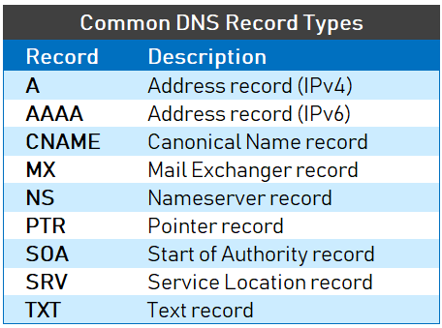

DNS Architecture
DNS is a distributed, hierarchical database (no DNS server has all the records!)
root DNS server
Hostname | IP Address
.com TLD DNS server | 21.220.198.29
.org TLD DNS server | 68.198.64.235
.edu TLD DNS server | 103.109.123.65
.gov TLD DNS server | 39.61.129.155
… | …
.com TLD DNS server
.edu TLD DNS server
The root DNS server holds records for TLD DNS servers for all top-level domains
facebook.com DNS
amazon.com DNS
montana.edu DNS
harvard.edu DNS

Slide 14
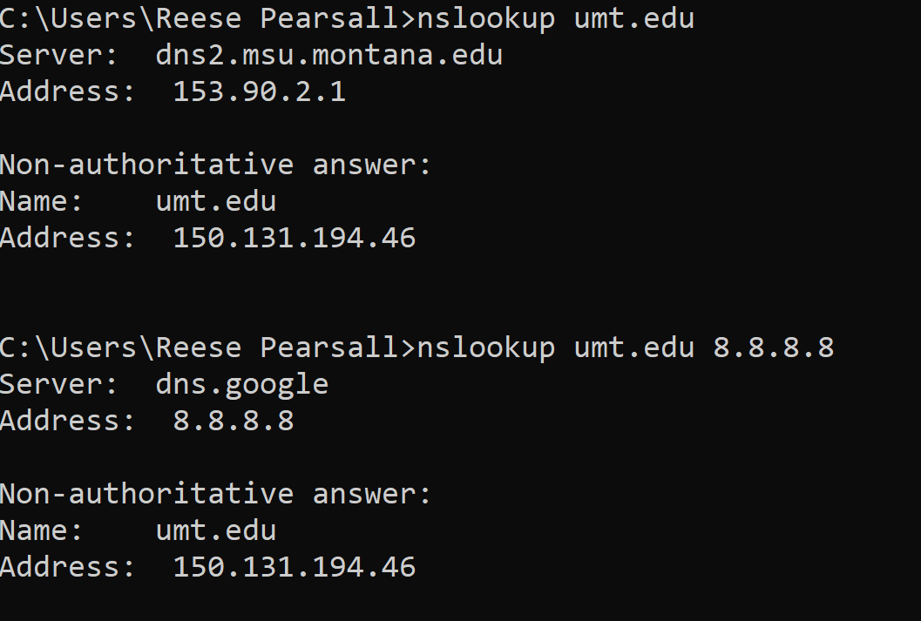
Local DNS Server
DNS Traffic in Wireshark
Now forcing to use 8.8.8.8

Slide 15
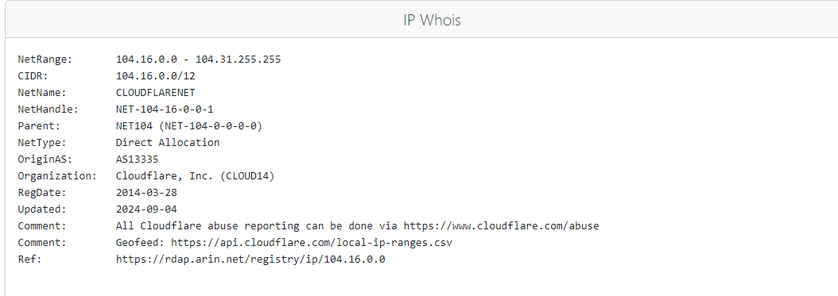

Slide 16

Cloudflare is a company that provides a variety of network and security services for companies
Content Delivery Networks (CDN)
Large network of edge servers that store dynamic and static content
DNS Management
Cloudflare will handle DNS resolutions for hostnames, websites, and nameservers
Web Security Management
DDoS Protection, Firewalls, Encryption + Certificates
4. Cloud Computing
“Cloudflare Workers” can be deployed on Cloudflare’s edge network
5. And much much more…

Slide 17
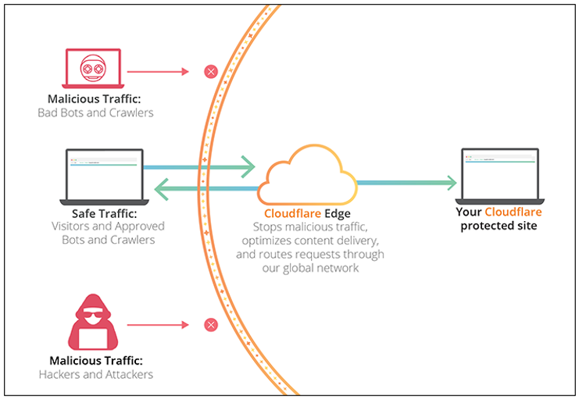
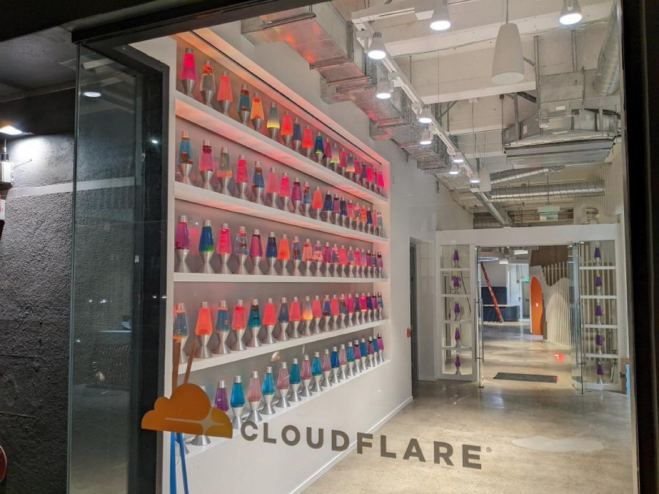

Slide 18
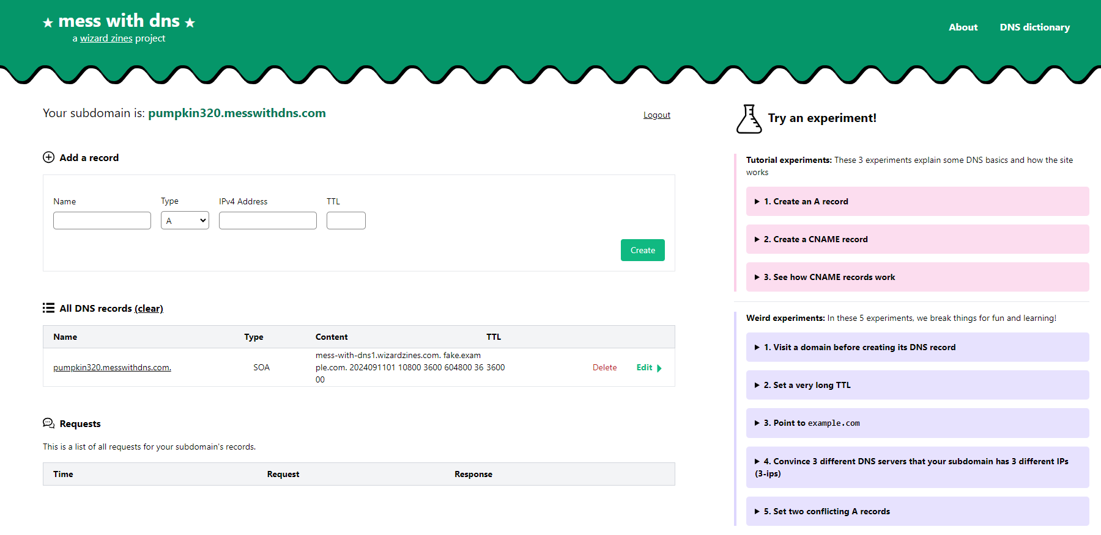
Mess with DNS
An interesting DNS “sandbox” that allows you to create a mock DNS server with your own records

Slide 19
SMTP
Simple Mail Transfer Protocol (SMTP) is the protocol used for sending e-mails from one server to another

Slide 20

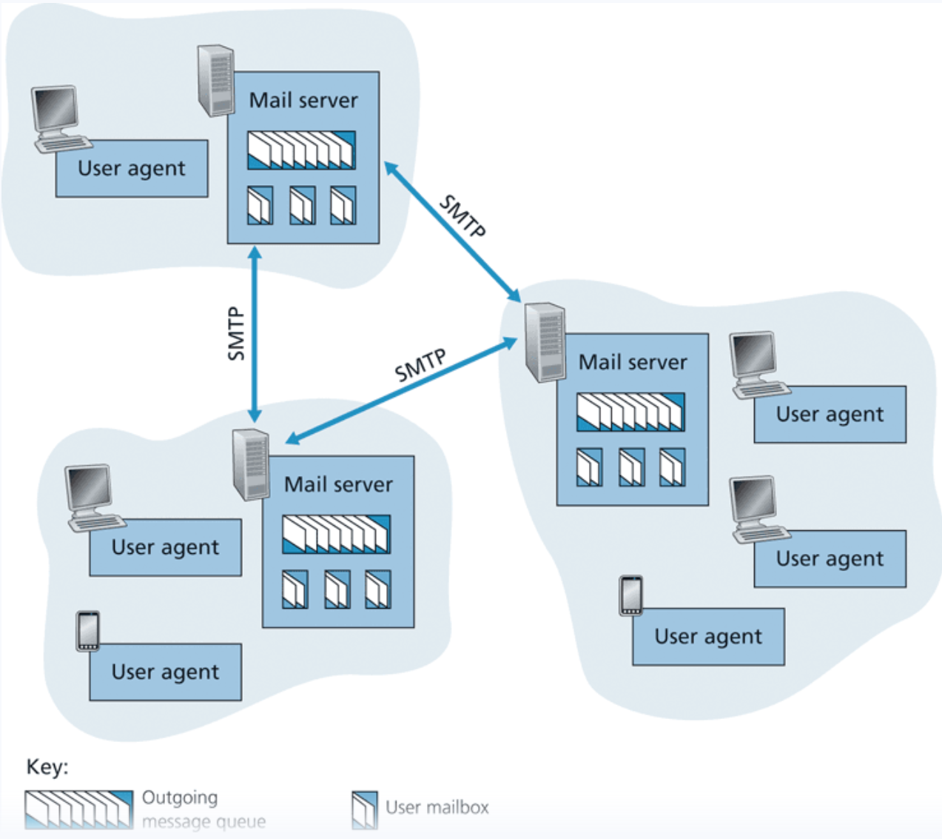


SMTP
Simple Mail Transfer Protocol (SMTP) is the protocol used for sending e-mails from one server to another

Slide 21
SMTP
Simple Mail Transfer Protocol (SMTP) is the protocol used for sending e-mails from one server to another
Each recipient has a mailbox location in one of the mail servers

Slide 22
SMTP
Simple Mail Transfer Protocol (SMTP) is the protocol used for sending e-mails from one server to another
Each recipient has a mailbox location in one of the mail servers
Messages are put in an outgoing message queue when they are sent
SMTP uses TCP to ensure reliable data transfer of emails

Slide 23



SMTP
Simple Mail Transfer Protocol (SMTP) is the protocol used for sending e-mails from one server to another

Slide 24
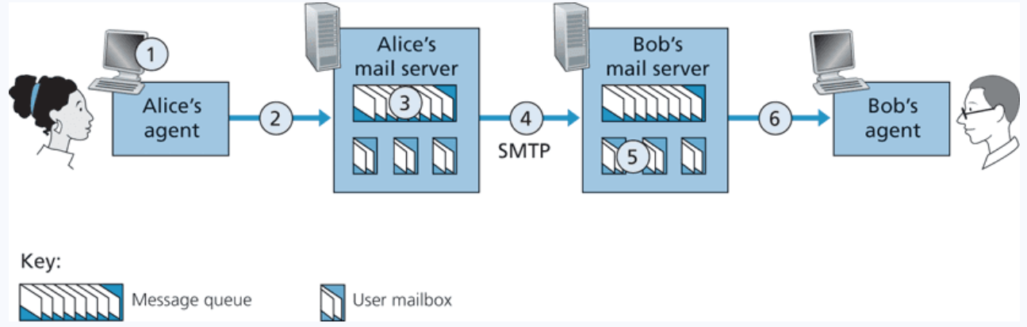
SMTP
1. Alice invokes her user agent for e-mail, provides Bob’s e-mail address (for example, bob@someschool.edu), composes a message, and instructs the user agent to send the message.

Slide 25
SMTP
1. Alice invokes her user agent for e-mail, provides Bob’s e-mail address (for example, bob@someschool.edu), composes a message, and instructs the user agent to send the message.
2. Alice’s user agent sends the message to her mail server, where it is placed in a message queue.

Slide 26
SMTP
1. Alice invokes her user agent for e-mail, provides Bob’s e-mail address (for example, bob@someschool.edu), composes a message, and instructs the user agent to send the message.
2. Alice’s user agent sends the message to her mail server, where it is placed in a message queue.
3. The client side of SMTP, running on Alice’s mail server, sees the message in the message queue. It opens a TCP connection to an SMTP server, running on Bob’s mail server.

Slide 27
SMTP
1. Alice invokes her user agent for e-mail, provides Bob’s e-mail address (for example, bob@someschool.edu), composes a message, and instructs the user agent to send the message.
2. Alice’s user agent sends the message to her mail server, where it is placed in a message queue.
3. The client side of SMTP, running on Alice’s mail server, sees the message in the message queue. It opens a TCP connection to an SMTP server, running on Bob’s mail server.
4. After some initial SMTP handshaking, the SMTP client sends Alice’s message into the TCP connection.

Slide 28
SMTP
1. Alice invokes her user agent for e-mail, provides Bob’s e-mail address (for example, bob@someschool.edu), composes a message, and instructs the user agent to send the message.
2. Alice’s user agent sends the message to her mail server, where it is placed in a message queue.
3. The client side of SMTP, running on Alice’s mail server, sees the message in the message queue. It opens a TCP connection to an SMTP server, running on Bob’s mail server.
4. After some initial SMTP handshaking, the SMTP client sends Alice’s message into the TCP connection.
5. At Bob’s mail server, the server side of SMTP receives the message. Bob’s mail server then places the message in Bob’s mailbox.

Slide 29
SMTP
1. Alice invokes her user agent for e-mail, provides Bob’s e-mail address (for example, bob@someschool.edu), composes a message, and instructs the user agent to send the message.
2. Alice’s user agent sends the message to her mail server, where it is placed in a message queue.
3. The client side of SMTP, running on Alice’s mail server, sees the message in the message queue. It opens a TCP connection to an SMTP server, running on Bob’s mail server.
4. After some initial SMTP handshaking, the SMTP client sends Alice’s message into the TCP connection.
5. At Bob’s mail server, the server side of SMTP receives the message. Bob’s mail server then places the message in Bob’s mailbox.
6. Bob invokes his user agent to read the message at his convenience.

Slide 30
SMTP
Simple Mail Transfer Protocol (SMTP) is the protocol used for sending e-mails from one server to another
This is not a protocol for retrieving emails
STMP uses TCP for the end-to-end delivery (DIRECT)
(PORT 25)

Slide 31
SMTP
POP3 (post office protocol) or IMAP (internet message access protocol) are used to retrieve emails from mail servers.

Slide 32
SMTP
POP3 (post office protocol) or IMAP (internet message access protocol) are used to retrieve emails from mail servers.
POP3 deletes the email of the web server, IMAP maintains a copy to synchronize across multiple devices

Slide 33
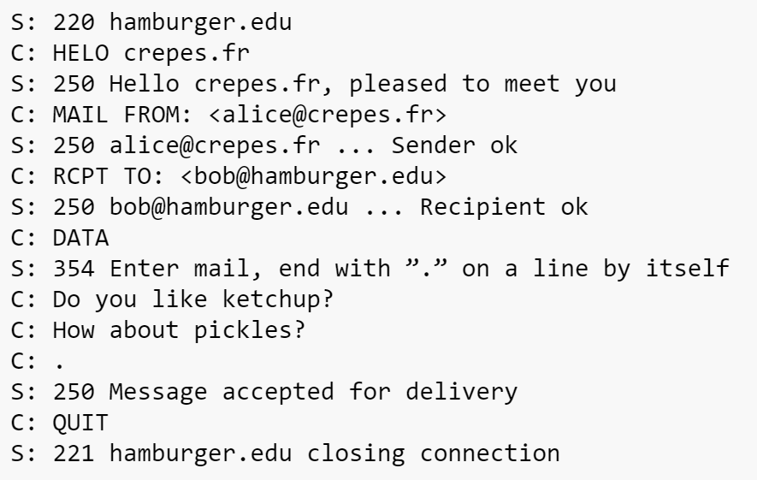






SMTP
SMTP Handshake + Message exchange format
(Very verbose)

Slide 34
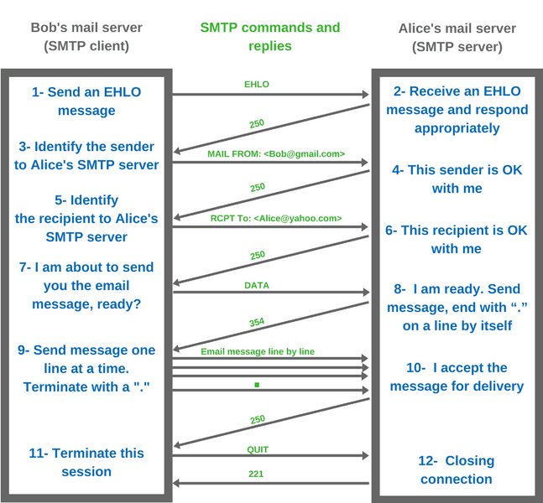

Slide 35
SMTP
Simple Mail Transfer Protocol (SMTP) is the protocol used for sending e-mails from one server to another asynchronously
Ports 25 is reserved for SMTP traffic (and also port 587 & 465)

Slide 36
SMTP Traffic in Wireshark

