Slide 1

CSCI 466: Networks
FTP, Peer 2 Peer Networks (P2P), Content Distribution Networks (CDN)
Reese Pearsall
Fall 2024
https://www.cs.montana.edu/pearsall/classes/fall2024/466/main.html
*All images are stolen from the internet

Slide 2
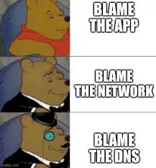
Announcements
Wireshark Lab 1 due tonight at 11:59 PM
Everyone needs to submit something to D2L, even if you work with partners
i hope you have a good weekend

Slide 3

FTP
File Transfer Protocol (FTP)- protocol used for transferring files from server to client
FTP procedure:
FTP client contacts FTP server at port 21, using TCP
Client authorized over control connection
Client browses remote directory, sends commands over control connection
When server receives file transfer command, server opens 2nd TCP data connection (for file) to client
After transferring one file, server closes data connection
TCP control connection,
server port 21
FTP
client
TCP data connection,
server port 20
FTP
server
FTP communicates over two connections
Port 21 for control information
Port 20 for data
Differences from HTTP
Control communication “out-of-band”
Server maintains per client state: authentication, current directory
Why use a separate control connection?

Slide 4
WinSCP

Slide 5





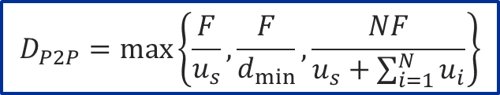
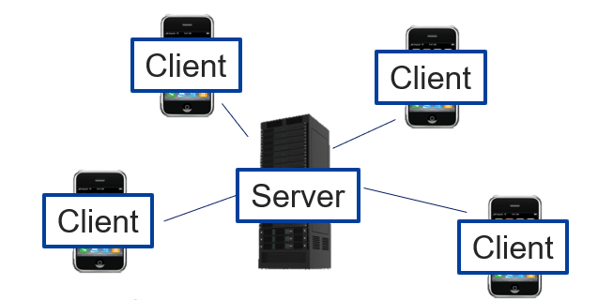
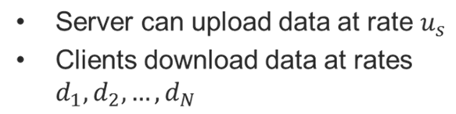
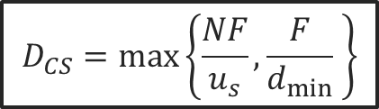
P2P Networks
No always-on server
Arbitrary end systems directly communicate
Peers are intermittently connected and change IP addresses
Time to distribute a file of size F to N clients
Client-Server Architecture
Time to distribute a file of size F to N clients

Slide 6
P2P Networks
Client-Server Architecture
New peers bring increasing capacity!
New peers are both a client and a server. There will not be a negative impact on current peers
Existing clients have to share resources with new users
P2P architectures are self-scaling

Slide 7
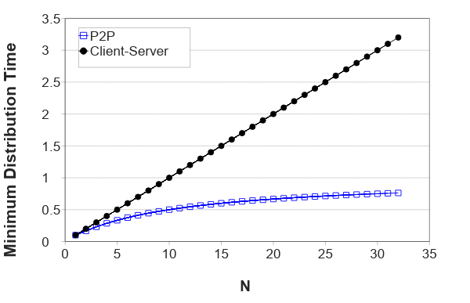
P2P Networks
Client server distribution time grows with the number of clients
P2P distribution time approaches 1 hour as number of clients grows

Slide 8
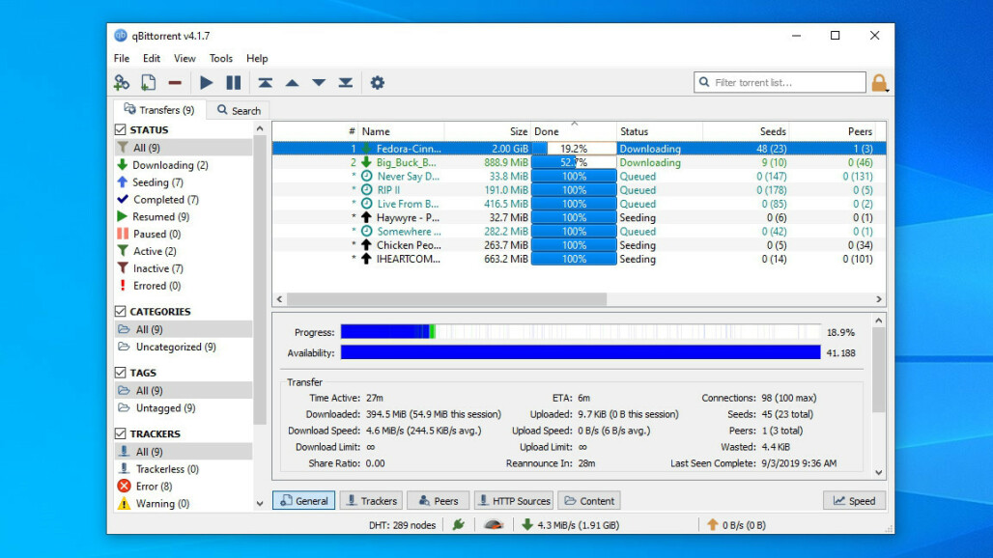
P2P file distribution: BitTorrent
Service for sharing files over the internet in a decentralized fashion
(BitTorrent, uTorrent, qBittorrent are all popular torrent clients)

Slide 9


User 1

Slide 10
A Tracker is made, typically located at the person who created the torrent
User 1
Tracker
Chunk1: 10.1.2.3
Chunk2: 10.1.2.3
Chunk3: 10.1.2.3
Chunk4: 10.1.2.3
…
ChunkN: 10.1.2.3
10.1.2.3

Slide 11
A Tracker is made, typically located at the person who created the torrent
User 1
Tracker
Chunk1: 10.1.2.3
Chunk2: 10.1.2.3
Chunk3: 10.1.2.3
Chunk4: 10.1.2.3
…
ChunkN: 10.1.2.3
10.1.2.3
User 2
User 2 wants the file, so they download a TorrentFile which allows them to contact the Tracker and join the P2P
10.1.2.4

Slide 12
A Tracker is made, typically located at the person who created the torrent
User 1
Tracker
Chunk1: 10.1.2.3
Chunk2: 10.1.2.4
Chunk3: 10.1.2.4
Chunk4: 10.1.2.3
…
ChunkN: 10.1.2.3
10.1.2.3
User 2
10.1.2.4

Slide 13
A Tracker is made, typically located at the person who created the torrent
User 1
Tracker
Chunk1: 10.1.2.3
Chunk2: 10.1.2.4
Chunk3: 10.1.2.4
Chunk4: 10.1.2.3
…
ChunkN: 10.1.2.3
10.1.2.3
User 2
User 3
10.1.2.4
10.1.2.5

Slide 14
A Tracker is made, typically located at the person who created the torrent
User 1
Tracker
Chunk1: 10.1.2.5
Chunk2: 10.1.2.4
Chunk3: 10.1.2.4
Chunk4: 10.1.2.3
…
ChunkN: 10.1.2.3
10.1.2.3
User 2
User 3
User 3
10.1.2.4
10.1.2.5
10.1.2.6

Slide 15
A Tracker is made, typically located at the person who created the torrent
User 1
Tracker
Chunk1: 10.1.2.5
Chunk2: 10.1.2.4
Chunk3: 10.1.2.4
Chunk4: 10.1.2.3
…
ChunkN: 10.1.2.3
10.1.2.3
User 2
User 3
User 3
10.1.2.4
As more users join the network, it grows the capability of the networks and chunks are more scattered
10.1.2.5
10.1.2.6

Slide 16
P2P file distribution: BitTorrent
Files are divided into chunks
Peers in torrent send/receive file chunks
tracker: tracks peers
participating in torrent
torrent: group of peers exchanging chunks of a file
Alice arrives …
… obtains list
of peers from tracker
… and begins exchanging
file chunks with peers in torrent

Slide 17
P2P file distribution: BitTorrent
Files are divided into chunks
Peers in torrent send/receive file chunks
tracker: tracks peers
participating in torrent
torrent: group of peers exchanging chunks of a file
peer joining torrent:
has no chunks, but will accumulate them over time from other peers
registers with tracker to get list of peers, connects to subset of peers (“neighbors”)
Alice arrives …
… obtains list
of peers from tracker
… and begins exchanging
file chunks with peers in torrent

Slide 18
P2P file distribution: BitTorrent
Files are divided into chunks
Peers in torrent send/receive file chunks
tracker: tracks peers
participating in torrent
torrent: group of peers exchanging chunks of a file
while downloading, peer uploads chunks to other peers
peer may change peers with whom it exchanges chunks
churn: peers may come and go
once peer has entire file, it may (selfishly) leave or (altruistically) remain in torrent
Alice arrives …
… obtains list
of peers from tracker
… and begins exchanging
file chunks with peers in torrent

Slide 19
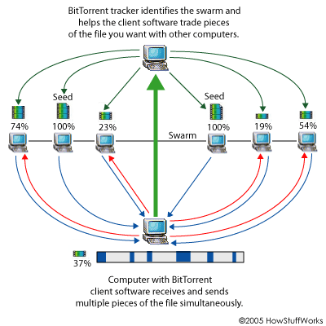
P2P file distribution: BitTorrent
Collaborative download

Slide 20
P2P file distribution: BitTorrent
Collaborative download
Which chunks to download?
Rarest first
Try to equalize the number of copies of each chunk in the system

Slide 21
P2P file distribution: BitTorrent
Collaborative download
From which peers to download?
Allow download to N peers with highest upload rates
Allows peers with similar upload rates to find each other

Slide 22
P2P file distribution: BitTorrent
requesting chunks:
at any given time, different peers have different subsets of file chunks
periodically, Alice asks each peer for list of chunks that they have
Alice requests missing chunks from peers, rarest first

Slide 23


P2P file distribution: BitTorrent
sending chunks: tit-for-tat
Alice sends chunks to those four peers currently sending her chunks at highest rate
other peers are choked by Alice (do not receive chunks from her)
re-evaluate top 4 every10 secs
every 30 secs: randomly select another peer, starts sending chunks
“optimistically unchoke” this peer
newly chosen peer may join top 4
BitTorrent is referred to as an unstructured P2P
higher upload rate: find better trading partners, get file faster !
Security Concerns?
IP Address
Malware

Slide 24




CDNs
video traffic: major consumer of Internet bandwidth
Netflix, YouTube: 37%, 16% of downstream residential ISP traffic
~1B YouTube users, ~75M Netflix users
challenge: scale - how to reach ~1B users?
single mega-video server won’t work (why?)
challenge: heterogeneity
different users have different capabilities (e.g., wired versus mobile; bandwidth rich versus bandwidth poor)
solution: distributed, application-level infrastructure

Slide 25

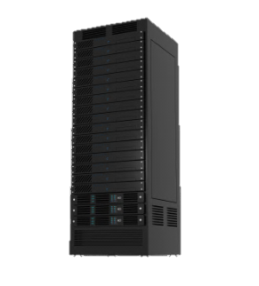
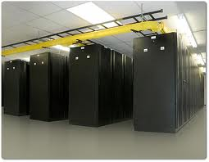
CDNs
Caching
Save previously delivered data
Subsequent requests served from cache on the browser, or in the access network
Applications
Reduce response time for client request
Reduce ISP traffic costs
Content distribution networks
Distributed caches
Web objects addressed to CDN server
CDN server fetches from content provider on first access
GET index.htm
GET
Client
OK
Cache
Server
Conditional GET
Cache: specify date of cached copy in HTTP request If-modified-since: <date>
Server: response contains no object if cached copy is up-to-date: HTTP/1.0 304 Not Modified

Slide 26


CDNs
Challenge:
How to stream content to millions of users?
Option 1:
Single mega-datacenter
Pros: Simple
Cons:
Single point of failure
Point of network congestion
Long path to distant clients
Multiple copies of video sent over outgoing link

Slide 27
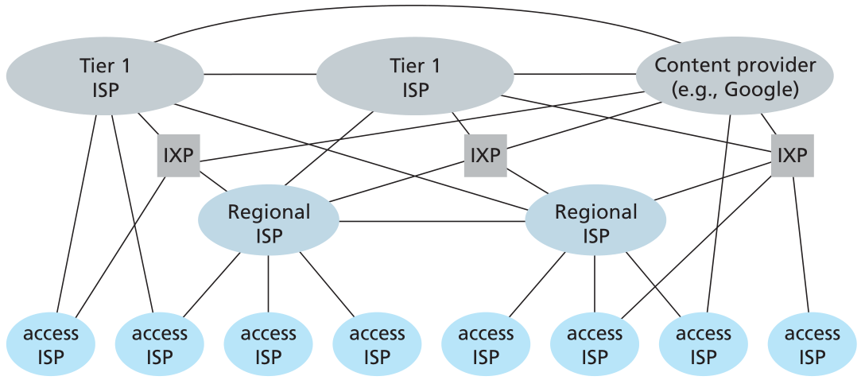

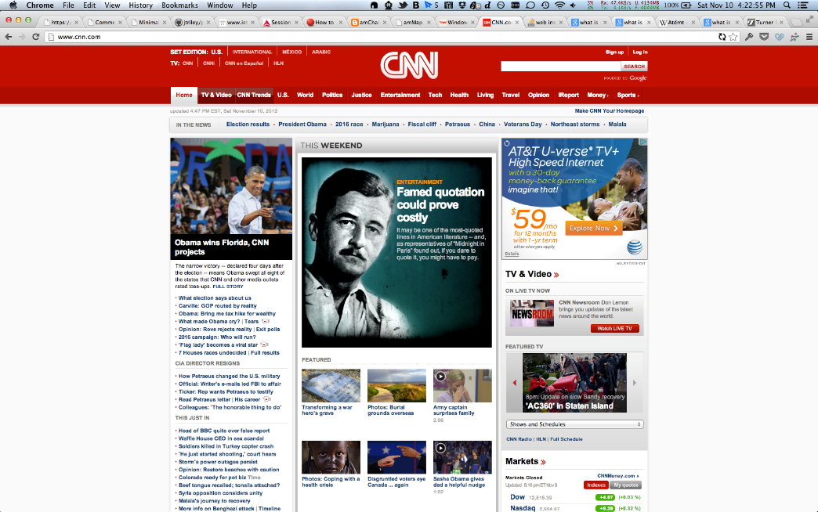




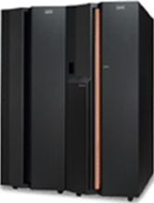




CDNs
Option 2:
Store/serve multiple copies of videos at multiple geographically distributed sites
A content delivery network (CDN) refers to a geographically distributed group of cache servers which work together to provide fast delivery of Internet content.
(not a web host)
34 DNS lookups
204 HTTP requests
520 KB of data downloaded
Origin server
56% of domains resolve to a CDN
LDNS

Slide 28

CDNs
https://cdn.discordapp.com/attachments/1017630358621143110/1017849417216294972/unknown.png

Slide 29
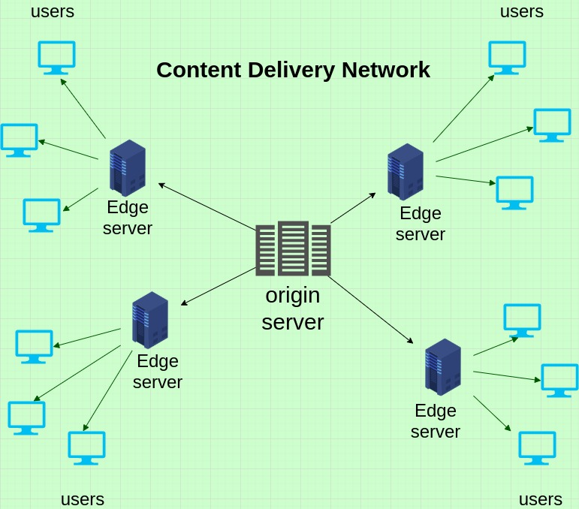
CDNs
Challenge: how does CDN DNS select “good” CDN node to stream to client
Pick CDN node geographically closest to client’s local DNS
Pick CDN node with shortest delay (or min # hops) to client (CDN nodes periodically ping access ISPs, reporting results to CDN DNS)
?
?
?
?

Slide 30
CDNs
In HTTP steaming, video is stored at an HTTP server and retrieved with a GET request
Frames are sent to a client buffered and played back after a certain threshold
All clients receiving the same encoding of the video despite widely different bandwidth

Slide 31
CDNs
In HTTP steaming, video is stored at an HTTP server and retrieved with a GET request
Frames are sent to a client buffered and played back after a certain threshold
All clients receiving the same encoding of the video despite widely different bandwidth
Dynamic Adaptive Streaming over HTTP (DASH)- video is encoded into several different versions
Different encoding rate, different quality, etc
Clients dynamically request chunks of video segments every few seconds via GET requests
Is the current bandwidth good? → Retrieve good quality
Is the current bandwidth bad? → Retrieve ok quality

Slide 32
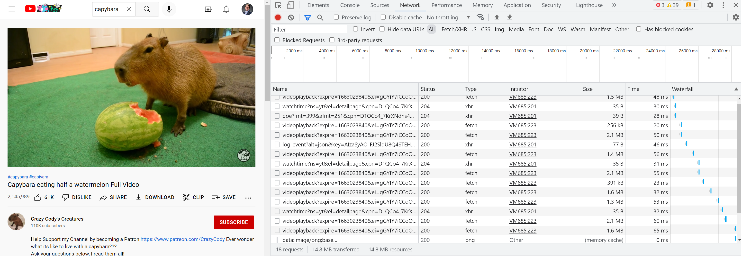





CDNs
When streaming, you are consistently issuing GET requests

Slide 33
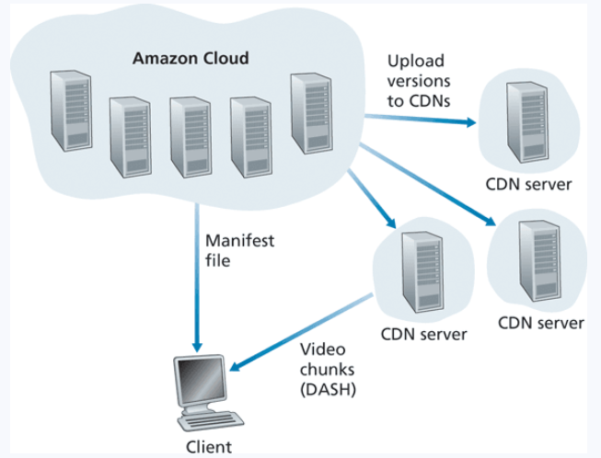

CDNs
Studio maser versions are uploaded to a private Amazon cloud

Slide 34

CDNs
Studio maser versions are uploaded to a private Amazon cloud
Videos are processed into many different formats, allowing for DASH

Slide 35


CDNs
Studio maser versions are uploaded to a private Amazon cloud
Videos are processed into many different formats, allowing for DASH
Versions are uploaded to Netflix’s CDNs

