Slide 1

CSCI 466: Networks
Transport Layer (Multiplexing, Error Checking)
Reese Pearsall
Fall 2024
https://www.cs.montana.edu/pearsall/classes/fall2024/466/main.html
*All images are stolen from the internet

Slide 2
Announcements
PA1 Due Sunday @ 11:59 PM
Files must be pushed to a PA1 folder on your GitHub Repo
Video demo is required
Submit your repo link to D2L when finished
Adding time.sleep() after your .send calls can resolve timing issues
Quiz on Friday

Slide 3
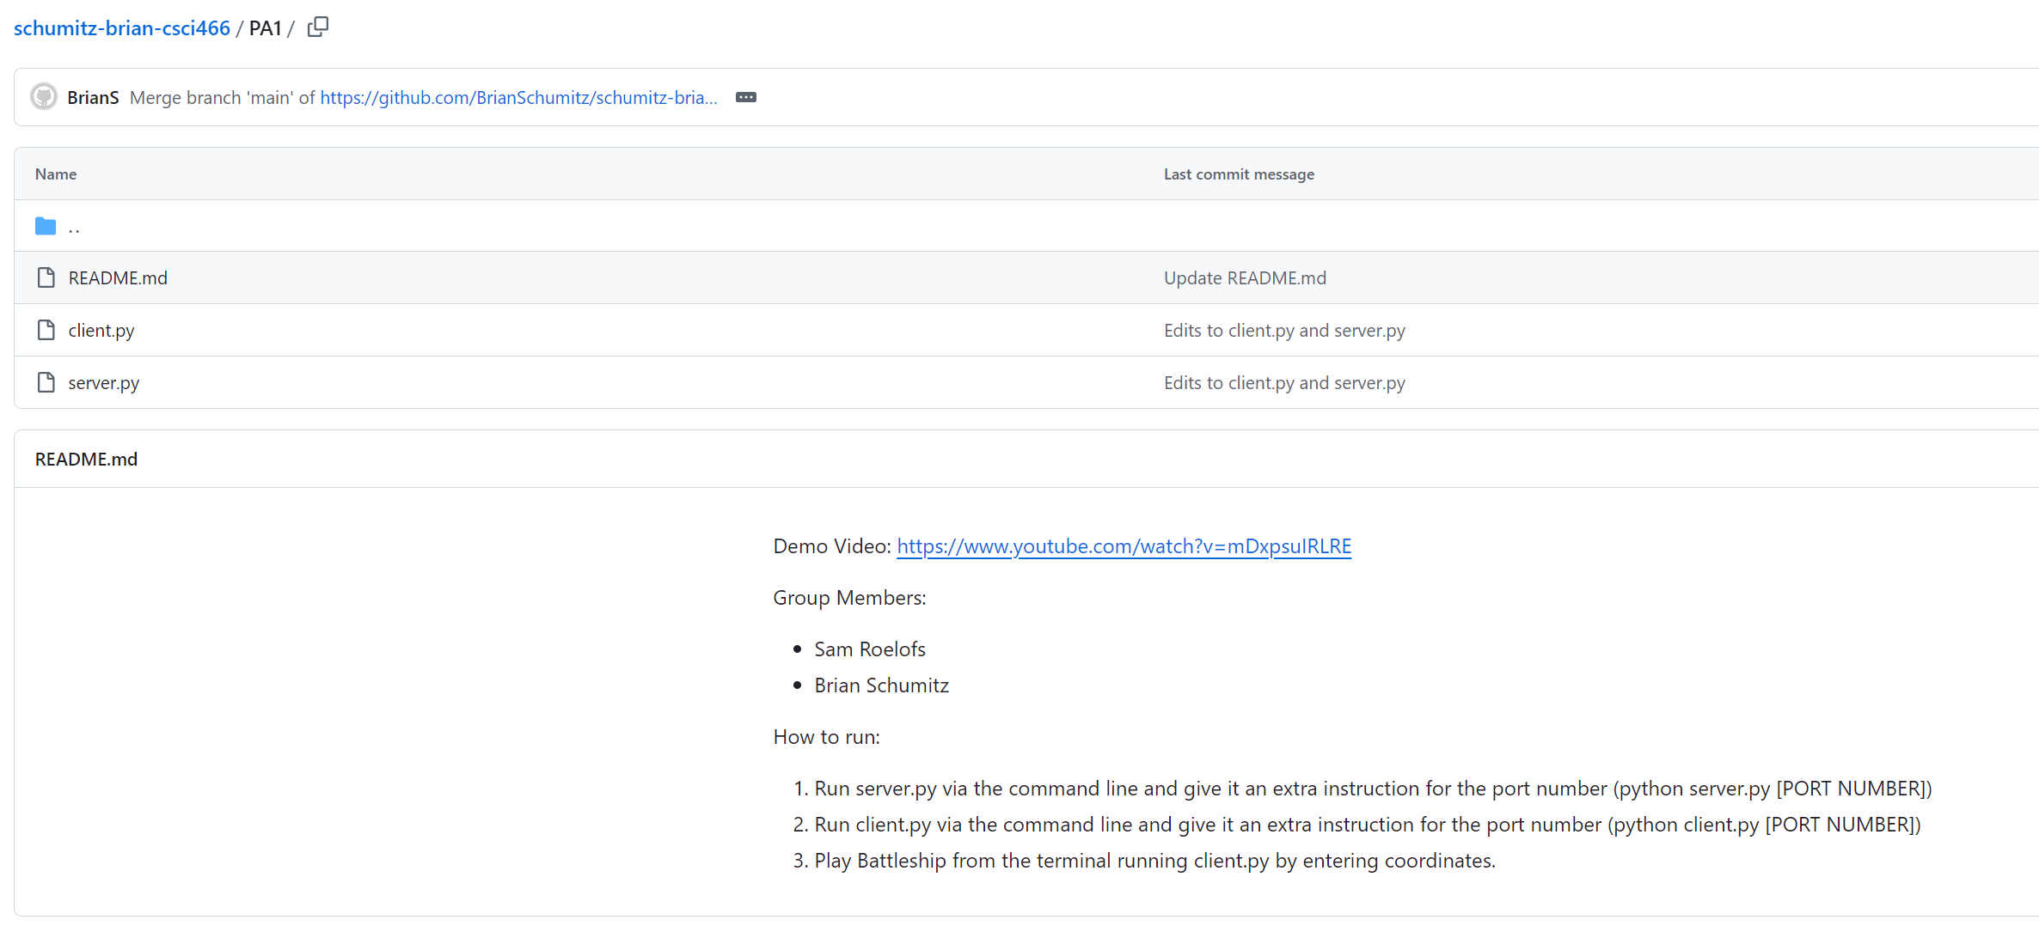
Put a README in head of your folders. Provide the video demo link, group members, and instructions for how to run

Slide 4
UDP Sockets

Slide 5

Application Layer
OSI Model
Presentation Layer
*
Application Layer
Session Layer
*
Messages from Network Applications
Transport Layer
Network Layer
Physical Layer
Data Link Layer
Bits being transmitted over a copper wire
Physical Layer
*In the textbook, they condense it to a 5-layer model, but 7 layers is what is most used

Slide 6

Transport Layer
Provides logical end-to-end communication between application processes
(Network layer handles delivery between hosts)
Transport Layer Services
Important Services
Flow Control
Reliability
Segmentation
Error Checking
Addressing
Flow Control
Reliability
Error Checking
Addressing
Segmentation

Slide 7
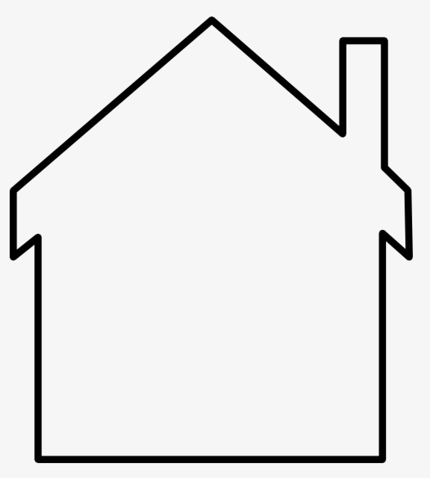



Transport Layer

Slide 8


Transport Layer
Bill
Ann

Slide 9
Transport Layer
Bill
Ann
Bill and Ann are responsible for collecting their siblings mail…

Slide 10


Transport Layer
Bill
Ann
Bill and Ann are responsible for collecting their siblings mail…
And delivering it to the postal service worker

Slide 11
Transport Layer
Bill
Ann
Bill and Ann are responsible for collecting their siblings mail…
And delivering it to the postal service worker

Slide 12
Transport Layer
When new mail arrives, Bill and Ann receive it from the postman and distribute it to the correct cousin
Bill
Ann
Bill and Ann are responsible for collecting their siblings mail…
And delivering it to the postal service worker

Slide 13
Transport Layer
Letters in envelopes = Application messages
Bill
Ann

Slide 14
Transport Layer
Letters in envelopes = Application messages
Cousins = Processes
Bill
Ann

Slide 15
Transport Layer
Letters in envelopes = Application messages
Cousins = Processes
Houses = Hosts/End systems
Bill
Ann

Slide 16
Transport Layer
Letters in envelopes = Application messages
Cousins = Processes
Houses = Hosts/End systems
Ann and Bill = Transport Layer Protocol
Bill
Ann

Slide 17
Transport Layer
Letters in envelopes = Application messages
Cousins = Processes
Houses = Hosts/End systems
Ann and Bill = Transport Layer Protocol
Postal Service = Network Layer/Network core
Bill
Ann

Slide 18
Transport Layer
Letters in envelopes = Application messages
Cousins = Processes
Houses = Hosts/End systems
Ann and Bill = Transport Layer Protocol
Postal Service = Network Layer/Network core
Bill
Ann
From the perspective of the cousins, Bill and Ann are the postal service

Slide 19
Transport Layer
Letters in envelopes = Application messages
Cousins = Processes
Houses = Hosts/End systems
Ann and Bill = Transport Layer Protocol
Postal Service = Network Layer/Network core
Bill
Ann
From the perspective of the cousins, Bill and Ann are the postal service
What if Bill and Ann are sick?

Slide 20
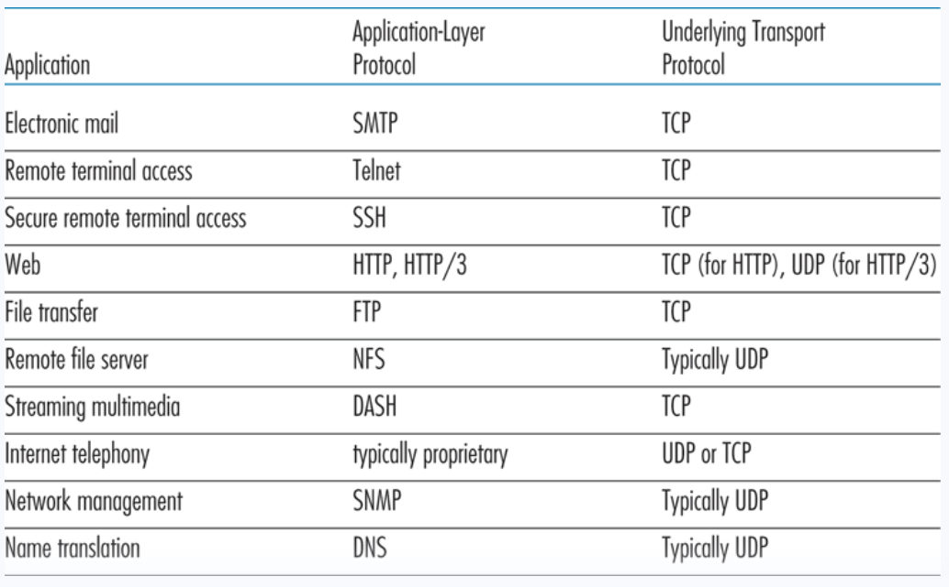
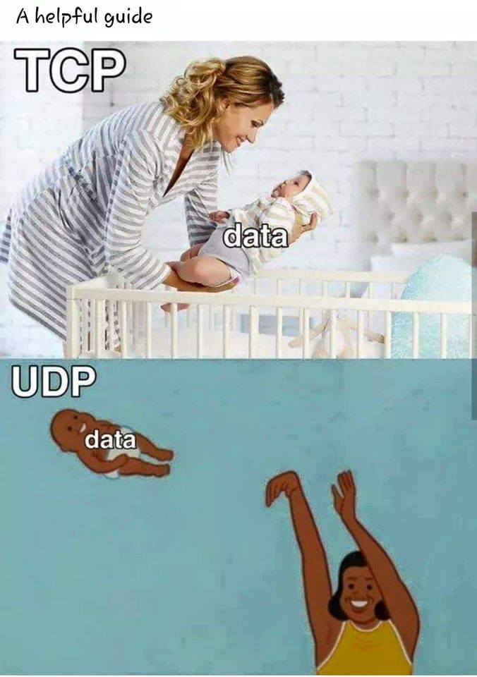
Transport Layer
TCP – Reliable, Connection-oriented transport layer protocol
UDP – Unreliable, connectionless transport layer protocol

Slide 21
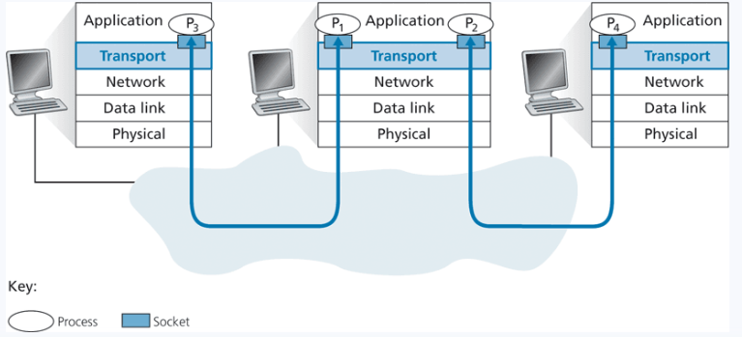
Transport Layer
TCP – Reliable, Connection-oriented transport layer protocol
UDP – Unreliable, connectionless transport layer protocol
Transport layer delivers to sockets

Slide 22
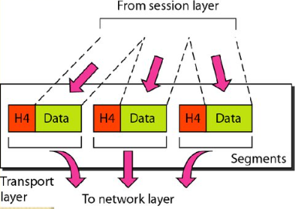
Transport Layer
TCP – Reliable, Connection-oriented transport layer protocol
UDP – Unreliable, connectionless transport layer protocl
Transport layer delivers to sockets
Messages from the Application Layer/Session Layer are split into smaller chunks called segments, and passed into the network layer

Slide 23
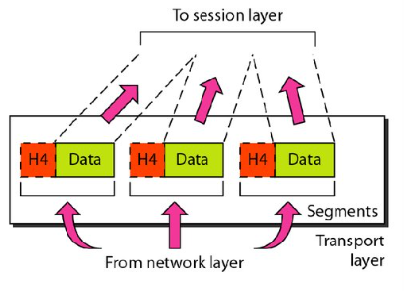
Transport Layer
TCP – Reliable, Connection-oriented transport layer protocol
UDP – Unreliable, connectionless transport layer protocl
Transport layer delivers to sockets
Messages from the network layer arrive as segments. Transport layer must reassemble to send it to the correct process

Slide 24
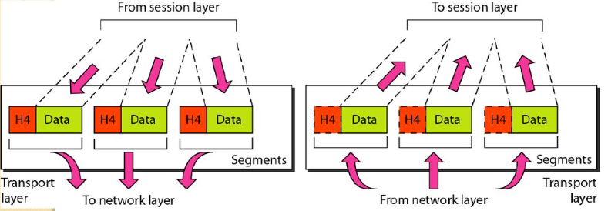
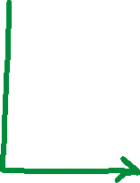
Transport Layer
TCP – Reliable, Connection-oriented transport layer protocol
UDP – Unreliable, connectionless transport layer protocol
Multiplexing is the process of gathering chunks from sockets, encapsulating chunks with header information, and passing the segment into the network layer
Socket
Segment
data
data
header
data
header
data
header
data
data

Slide 25
Transport Layer
TCP – Reliable, Connection-oriented transport layer protocol
UDP – Unreliable, connectionless transport layer protocl
Demultiplexing is the receiving segments from the transport layer and delivering the segment to the correct socket.
Socket
Socket
Socket
header
data
header
data
header
data

Slide 26

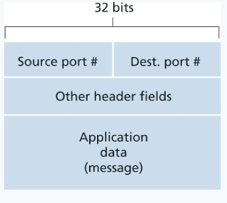
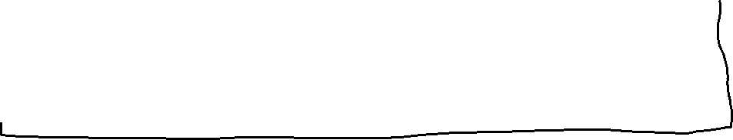
Transport Layer
TCP – Reliable, Connection-oriented transport layer protocol
UDP – Unreliable, connectionless transport layer protocl
Socket
Socket
Socket
Socket
Port 80
Port 8000
Port 9254
Port 11234
Socket
A port is a 16-bit number that is an entrance/exit point of a machine
header
data
An active port is associated with a specific process or service
Network Layer

Slide 27
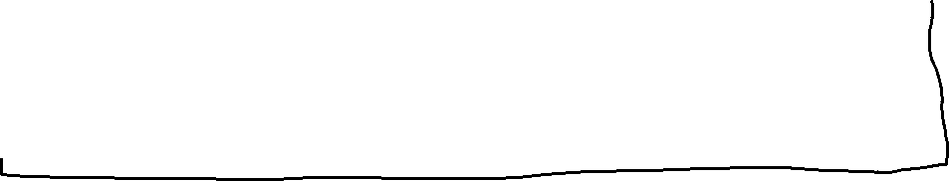
Transport Layer
TCP – Reliable, Connection-oriented transport layer protocol
UDP – Unreliable, connectionless transport layer protocl
Socket
Socket
https://en.wikipedia.org/wiki/List_of_TCP_and_UDP_port_numbers
Socket
Socket
A port is a 16-bit number that is an entrance/exit point of a machine
Socket
Socket
header
data
An active port is associated with a specific process or service
Network Layer

Slide 28
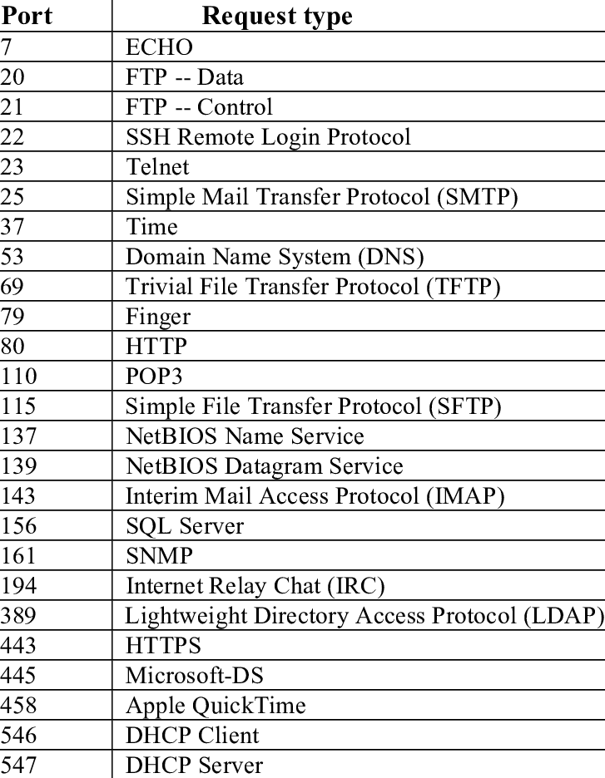
Ones you should probably remember
HTTP: 80
HTTPS: 443
DNS: 53
SSH: 22
FTP: 20/21
SMTP: 25
You can request to register a service under a specific port number through the Internet Assigned Numbers Authority (IANA)

Slide 29
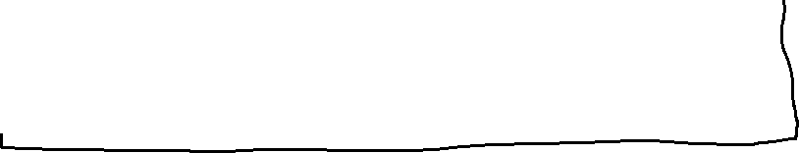
Transport Layer
TCP – Reliable, Connection-oriented transport layer protocol
UDP – Unreliable, connectionless transport layer protocol
Socket
Socket
Socket
Socket
Port 80
Port 8000
Port 9254
Port 11234
Socket
(Demultiplexing)
TCP/UDP
Segment
header
data
header
data
Network Layer

Slide 30
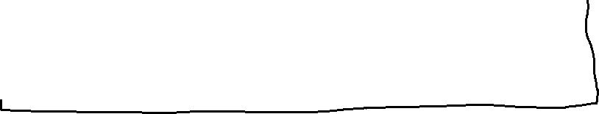
Transport Layer
TCP – Reliable, Connection-oriented transport layer protocol
UDP – Unreliable, connectionless transport layer protocol
Socket
Socket
Socket
Socket
Port 80
Port 8000
Port 9254
Port 11234
Socket
(Demultiplexing)
Source Port: 112233
DST port:
9254
TCP/UDP
Segment
header
data
header
data
Network Layer

Slide 31


Transport Layer
TCP – Reliable, Connection-oriented transport layer protocol
UDP – Unreliable, connectionless transport layer protocol
Socket
Socket
Socket
Socket
Port 80
Port 8000
Port 9254
Port 11234
Socket
(Demultiplexing)
Source Port: 112233
DST port:
9254
TCP/UDP
Segment
header
data
header
data
Network Layer

Slide 32
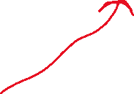
Transport Layer
TCP – Reliable, Connection-oriented transport layer protocol
UDP – Unreliable, connectionless transport layer protocl
Socket
Socket
Socket
Socket
Port 80
Port 8000
Port 9254
Port 11234
Socket
TCP/UDP
Segment
header
data
header
data
Network Layer

Slide 33



Transport Layer
TCP – Reliable, Connection-oriented transport layer protocol
UDP – Unreliable, connectionless transport layer protocl
Socket
Socket
Socket
Socket
Port 80
Port 8000
Port 9254
Port 11234
Socket
A port is a 16-bit number that is an entrance/exit point of a machine
header
data
An active port is associated with a specific process or service
When developing a new application, we need to assigned the application a port number (greater than 1024)
Network Layer

Slide 34
Transport Layer
TCP – Reliable, Connection-oriented transport layer protocol
UDP – Unreliable, connectionless transport layer protocl
Socket
Socket
Socket
Socket
Port 80
Port 8000
Port 9254
Port 11234
Socket
A port is a 16-bit number that is an entrance/exit point of a machine
header
data
An active port is associated with a specific process or service
Why does UDP need a source port # ?
Network Layer

Slide 35

Transport Layer
Multiplexing is the process of gathering chunks from sockets, encapsulating chunks with header information, and passing the segment into the network layer
Demultiplexing is the receiving segments from the transport layer and delivering the segment to the correct socket.
Socket
Segment
data
data
header
data
header
data
header
data
data

Slide 36
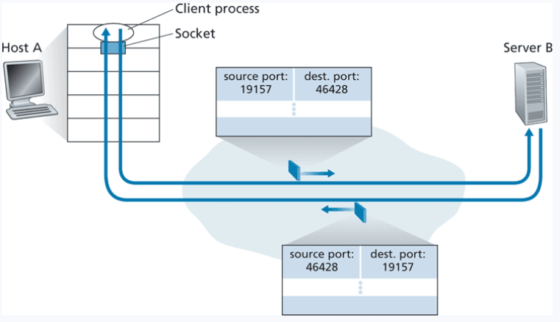
Transport Layer

Slide 37
Transport Layer
UDP sockets are identified by a two-tuple
(destination IP address, destination port number)

Slide 38
Transport Layer
TCP sockets are identified by a four-tuple
A host will demultiplex segments using all of these values
(source IP address, source port number, destination IP address, destination port number)

Slide 39


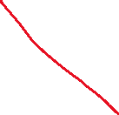
Transport Layer
80
12345
Socket
Socket
80.60.122.3
192.77.123.4
Name | Value
Src IP | 192.77.123.4
Src Port | 12345
Dst IP | 80.60.122.3
Dst Port | 80

Slide 40
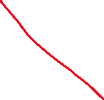
Transport Layer
80
12345
Socket
Socket
80.60.122.3
Socket
192.77.123.4
9999
Name | Value
Src IP | 192.77.123.4
Src Port | 12345
Dst IP | 80.60.122.3
Dst Port | 80

Slide 41


Transport Layer
80
12345
Socket
Socket
80.60.122.3
Socket
192.77.123.4
Name | Value
Src IP | 80.60.122.3
Src Port | 80
Dst IP | 192.77.123.4
Dst Port | 12345
Name | Value
Src IP | 192.77.123.4
Src Port | 12345
Dst IP | 80.60.122.3
Dst Port | 80
New socket, but isn’t binded to a specific port like the listening socket

Slide 42


Transport Layer
80
12345
Socket
Socket
80.60.122.3
Socket
192.77.123.4
12345
Socket
Name | Value
Src IP | 80.60.122.3
Src Port | 80
Dst IP | 192.77.123.4
Dst Port | 12345
99.88.77.6
Name | Value
Src IP | 99.88.77.6
Src Port | 12345
Dst IP | 80.60.122.3
Dst Port | 80
New socket, but isn’t binded to a specific port like the listening socket

Slide 43
Transport Layer
80
12345
Socket
Socket
80.60.122.3
Socket
192.77.123.4
12345
Socket
Socket
99.88.77.6
Name | Value
Src IP | 80.60.122.3
Src Port | 80
Dst IP | 99.88.77.6
Dst Port | 12345
Name | Value
Src IP | 99.88.77.6
Src Port | 12345
Dst IP | 80.60.122.3
Dst Port | 80
New socket, but isn’t binded to a specific port like the listening socket

Slide 44
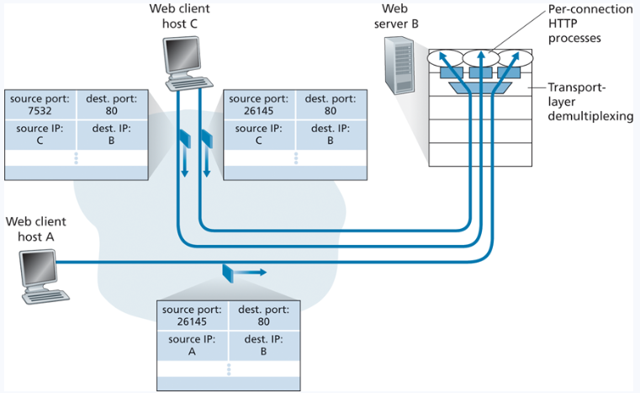
Transport Layer
Now that we are using four values, we can support simultaneous connections

Slide 45





Transport Layer
Now that we are using four values, we can support simultaneous connections
All three of these packets have the same dest port and dest ip

Slide 46









Transport Layer
Now that we are using four values, we can support simultaneous connections
All three of these packets have the same dest port and dest ip
We can multiplex/demultiplex using the TCP sockets source information

Slide 47
Port Scanning with nmap

Slide 48

Transport Layer
16 bits
16 bits
Source Port #
Dest. Port #
Our application layer message (HTTP request, DNS Query, FTP data) gets split into chunks, and each chunk is encapsulated in a transport layer header
Headers
Length
Checksum
Segment
…
…
Data
(Application Layer Data)

Slide 49
Transport Layer
16 bits
16 bits
Source Port #
Dest. Port #
Our application layer message (HTTP request, DNS Query, FTP data) gets split into chunks, and each chunk is encapsulated in a transport layer header
Headers
Length
Checksum
Segment
…
…
Source port and Dest Port are attached to our packet
Data
(Application Layer Data)

Slide 50
Transport Layer
16 bits
16 bits
Source Port #
Dest. Port #
Our application layer message (HTTP request, DNS Query, FTP data) gets split into chunks, and each chunk is encapsulated in a transport layer header
Headers
Length
Checksum
Segment
…
…
Source port and Dest Port are attached to our packet
Data
(Application Layer Data)
What is the checksum?

Slide 51
Transport Layer
16 bits
16 bits
Source Port #
Dest. Port #
Headers
Length
Checksum
Important Services
Flow Control
Reliability
Segmentation
Error Checking
Addressing
Segment
…
…
Data
(Application Layer Data)

Slide 52
Transport Layer
Transport layer provides a checksum that is used to determine whether bits within the segment have been altered/corrupted
Checksum
Data

Slide 53
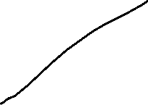
Transport Layer
Transport layer provides a checksum that is used to determine whether bits within the segment have been altered/corrupted
Checksum
Data
0110011001100000
0101010101010101
1000111100001100

Slide 54
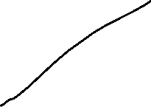
Transport Layer
Transport layer provides a checksum that is used to determine whether bits within the segment have been altered/corrupted
Checksum
Data
0110011001100000
0101010101010101
1000111100001100
Checksum is used a bit-level operation to see if any data has been corrutped

Slide 55
Transport Layer
Checksum
Split up data into 16-bit “words”
0110011001100000
0101010101010101
1000111100001100
0110011001100000
0101010101010101
1000111100001100
Checksum is used a bit-level operation to see if any data has been corrutped

Slide 56
Transport Layer
Checksum
Split up data into 16-bit “words”
Sum up all words
0110011001100000
0101010101010101
1000111100001100
0110011001100000
0101010101010101
1011101110110101
Checksum is used a bit-level operation to see if any data has been corrutped

Slide 57
Transport Layer
Checksum
Split up data into 16-bit “words”
Sum up all words
0110011001100000
0101010101010101
1000111100001100
0110011001100000
0101010101010101
1011101110110101
1000111100001100
Checksum is used a bit-level operation to see if any data has been corrutped

Slide 58
Transport Layer
Checksum
Split up data into 16-bit “words”
Sum up all words
0110011001100000
0101010101010101
1000111100001100
0110011001100000
0101010101010101
1011101110110101
1000111100001100
0100101011000010
Checksum is used a bit-level operation to see if any data has been corrutped

Slide 59
Transport Layer
Split up data into 16-bit “words”
Sum up all words
Compute the ones compliment
Checksum
0110011001100000
0101010101010101
1000111100001100
0110011001100000
0101010101010101
1011101110110101
1000111100001100
0100101011000010
Checksum is used a bit-level operation to see if any data has been corrutped

Slide 60
Transport Layer
Split up data into 16-bit “words”
Sum up all words
Compute the ones compliment
Checksum
0110011001100000
0101010101010101
1000111100001100
0110011001100000
0101010101010101
1011101110110101
1000111100001100
0100101011000010
1011010100111101
This is our checksum value!

Slide 61
Transport Layer
Split up data into 16-bit “words”
Sum up all words
Compute the ones compliment
1011010100111101
0110011001100000
0101010101010101
1000111100001100
0110011001100000
0101010101010101
1011101110110101
1000111100001100
0100101011000010
1011010100111101
This is our checksum value!

Slide 62
Transport Layer
Source Port #
Dest. Port #
Length
1011010100111101
…
…
Send to receiver
0110011001100000
0101010101010101
1000111100001100

Slide 63
Transport Layer
When the receiver gets the segment, it will compute the sum of all four 16-bit words (including the checksum)
Source Port #
Dest. Port #
Length
1011010100111101
…
…
Send to receiver
0110011001100000
0101010101010101
1000111100001100

Slide 64
Transport Layer
When the receiver gets the segment, it will compute the sum of all four 16-bit words (including the checksum)
Source Port #
Dest. Port #
0110011001100000
0101010101010101
1011101110110101
1000111100001100
0100101011000010
1011010100111101
Length
1011010100111101
…
…
Send to receiver
0110011001100000
0101010101010101
1000111100001100

Slide 65
Transport Layer
When the receiver gets the segment, it will compute the sum of all four 16-bit words (including the checksum)
Source Port #
Dest. Port #
0110011001100000
0101010101010101
1011101110110101
1000111100001100
0100101011000010
1011010100111101
1111111111111111
Length
1011010100111101
…
…
Send to receiver
0110011001100000
0101010101010101
1000111100001100

Slide 66

Transport Layer
When the receiver gets the segment, it will compute the sum of all four 16-bit words (including the checksum)
Source Port #
Dest. Port #
0110011001100000
0101010101010101
1011101110110101
1000111100001100
0100101011000010
1011010100111101
1111111111111111
Length
1011010100111101
…
…
Send to receiver
0110011001100000
0101010101010101
1000111100001100

Slide 67

Transport Layer
When the receiver gets the segment, it will compute the sum of all four 16-bit words (including the checksum)
Source Port #
Dest. Port #
0110011001100000
0101010101010101
1011101110110101
1000111100001100
0100101011000010
1011010100111101
1111111111111111
Length
1011010100111101
…
…
Send to receiver
0110011001100000
0101010101010101
1000111100001100
If the result of this operation is not all 1s, then data must have been corrupted in the segment

Slide 68
Transport Layer
When the receiver gets the segment, it will compute the sum of all four 16-bit words (including the checksum)
Source Port #
Dest. Port #
0110011001100000
0101010101010101
1011101110110101
1000111100001100
0100101011000010
1011010100111101
1111110111111111
Length
1011010100111101
…
…
Send to receiver
0110011001100000
0101010101010101
1000111100001100
If the result of this operation is not all 1s, then data must have been corrupted in the segment

Slide 69
Transport Layer
When the receiver gets the segment, it will compute the sum of all four 16-bit words (including the checksum)
Source Port #
Dest. Port #
0110011001100000
0101010101010101
1011101110110101
1000111100001100
0100101011000010
1011010100111101
1111110111111111
Length
1011010100111101
…
…
Send to receiver
0110011001100000
0101010101010101
1000111100001100
The receiver will do that for each packet, if the checksum is invalid, it may ask for a retransmission

Slide 70
Transport Layer
When the receiver gets the segment, it will compute the sum of all four 16-bit words (including the checksum)
Source Port #
Dest. Port #
0110011001100000
0101010101010101
1011101110110101
1000111100001100
0100101011000010
1011010100111101
1111110111111111
Length
1011010100111101
…
…
Send to receiver
0110011001100000
0101010101010101
1000111100001100
The receiver will do that for each packet, if the checksum is invalid, it may ask for a retransmission

Slide 71
Transport Layer
Why do error checking here?
16 bits
16 bits
Protocols at other layers (link layer) can also do error checking
Source Port #
Dest. Port #
Length
Checksum
…
…
Data

Slide 72
Transport Layer
Why do error checking here?
16 bits
16 bits
Protocols at other layers (link layer) can also do error checking
Source Port #
Dest. Port #
However, there is no guarantee that our packet of information will use these protocols
Length
Checksum
…
…
Data

Slide 73
Transport Layer
Why do error checking here?
16 bits
16 bits
Protocols at other layers (link layer) can also do error checking
Source Port #
Dest. Port #
However, there is no guarantee that our packet of information will use these protocols
Length
Checksum
End-to-end principle states that since certain functionality such as error detection, must be implemented on an end-end bases
…
…
Data
Functionality places at the lower levels may be redundant or of little value when compared to the cost of providing them at a higher level

Slide 74


Transport Layer
Important Services
Flow Control
Reliability
Segmentation
Error Checking
Addressing

Slide 75
Transport Layer
Sending Process
Receiving Process
Socket
Socket

Slide 76
Transport Layer
Sending Process
Receiving Process
Socket
Socket
Unreliable Channel

Slide 77
Transport Layer
Sending Process
Receiving Process
Socket
Socket
Things that may happen
Corruption
Loss of packets
Duplicate Delivery
Unreliable Channel

Slide 78
Transport Layer
Sending Process
Receiving Process
Socket
Socket
Reliable Data Transfer Protocol
Reliable Data Transfer Protocol
Things that may happen
Corruption
Loss of packets
Duplicate Delivery
Unreliable Channel

Slide 79
Transport Layer
Sending Process
Receiving Process
Application Layer
Socket
Socket
Reliable Data Transfer Protocol
Reliable Data Transfer Protocol
Transport Layer
Unreliable Channel
Network Layer

