Slide 1

CSCI 466: Networks
Reliable Data Transfer (RDT)
Reese Pearsall
Fall 2024
https://www.cs.montana.edu/pearsall/classes/fall2024/466/main.html
*All images are stolen from the internet

Slide 2
Announcements
NO CLASS ON FRIDAY
PA1 Due Sunday
Quiz 2 on Friday
DNS
SMTP
FTP
P2P
CDNs/Caches
Transport Layer
Reliable Data Transfer
Opens at 8AM, closes at 11:59 PM

Slide 3
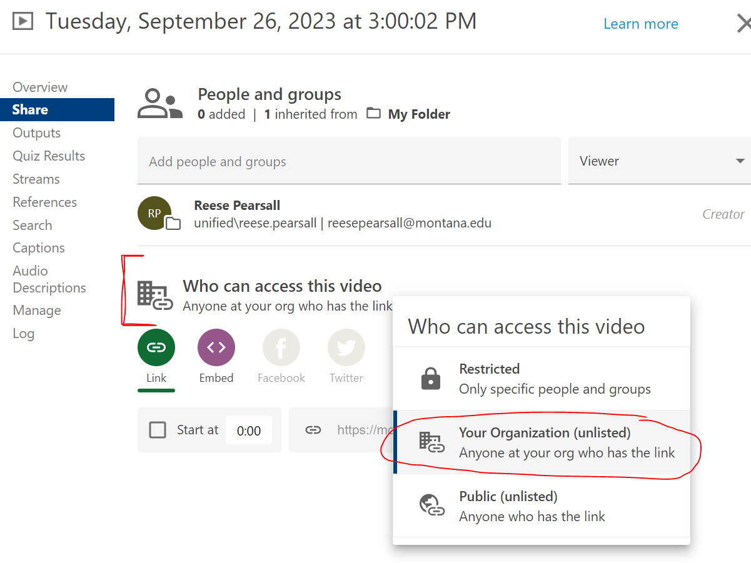
Announcements
PA1 Due tonight
Quiz 3 on Friday
DNS
SMTP
DTP
P2P
Transport Layer Intro
Reliable Data Transfer

Slide 4

Application Layer
OSI Model
Presentation Layer
*
Application Layer
Session Layer
*
Messages from Network Applications
Transport Layer
Network Layer
Physical Layer
Data Link Layer
Bits being transmitted over some medium
Physical Layer
*In the textbook, they condense it to a 5-layer model, but 7 layers is what is most used

Slide 5
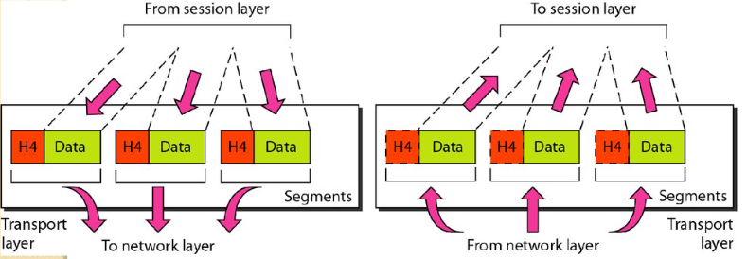
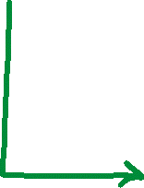
Transport Layer
Multiplexing is the process of gathering chunks from sockets, encapsulating chunks with header information, and passing the segment into the network layer
Demultiplexing is the receiving segments from the transport layer and delivering the segment to the correct socket.
Socket
Segment
data
data
header
data
header
data
header
data
data

Slide 6
Transport Layer
16 bits
16 bits
Source Port #
Dest. Port #
Transport Layer provides a checksum that is used to determine whether bits within a segment have been altered
Length
Checksum
Data
(HTTP Request, DNS, FTP, etc)

Slide 7
Transport Layer
Sending Process
Receiving Process
Application Layer
Socket
Socket
Reliable Data Transfer Protocol
Reliable Data Transfer Protocol
Transport Layer
Things that may happen
Corruption
Loss of packets
Duplicate Delivery
Network Layer
Unreliable Channel

Slide 8
Transport Layer
Sending Process
Receiving Process
Application Layer
Socket
Socket
Reliable Data Transfer Protocol
Reliable Data Transfer Protocol
Transport Layer
Things that may happen
Corruption
Loss of packets
Duplicate Delivery
Network Layer
Unreliable Channel

Slide 9
Transport Layer
Sending Process
Receiving Process
Application Layer
Socket
rdt_send()
deliver()
Socket
Reliable Data Transfer Protocol
Reliable Data Transfer Protocol
Transport Layer
udt_send()
rdt_rcv()
Things that may happen
Corruption
Loss of packets
Duplicate Delivery
Network Layer
Unreliable Channel

Slide 10
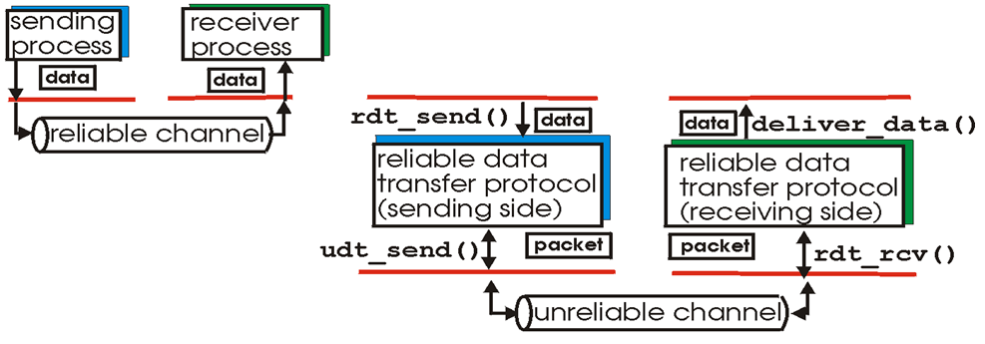
Transport Layer
Reliable Data Transfer
Application
Transport
Network
Characteristics of unreliable channel will determine complexity of reliable data transfer protocol (rdt)
Things to consider:
Corruption
Loss of packets
Duplicate delivery
What are some ways in which the network channel can be unreliable?

Slide 11

Transport Layer
Reliable Data Transfer

Slide 12
Transport Layer
Reliable Data Transfer
Bruce Lee FSM
Event causing state transition
Wait for ball
in_court(ball) == True
send_it(ball)
Actions taken on state transition

Slide 13

Transport Layer
Reliable Data Transfer 1.0
RDT 1.0
Assumptions:
Unidirectional long data flows
Perfectly reliable channel
No bit errors
No packet loss
No packet reordering

Slide 14
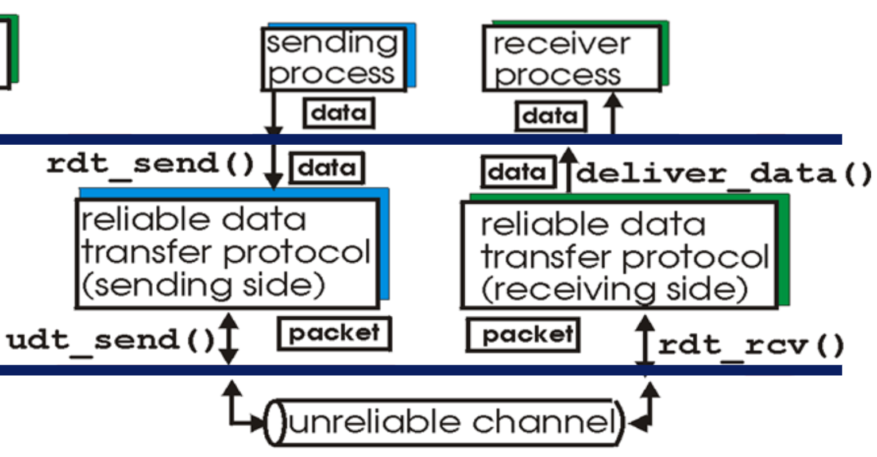
Transport Layer
Reliable Data Transfer 1.0
RDT 1.0
Assumptions:
Unidirectional long data flows
Perfectly reliable channel
No bit errors
No packet loss
No packet reordering

Slide 15
Transport Layer
Reliable Data Transfer 1.0
Sender
RDT 1.0
Assumptions:
Unidirectional long data flows
Perfectly reliable channel
No bit errors
No packet loss
No packet reordering
Wait for call from above

Slide 16
Transport Layer
Reliable Data Transfer 1.0
Sender
RDT 1.0
Assumptions:
Unidirectional long data flows
Perfectly reliable channel
No bit errors
No packet loss
No packet reordering
rdt_send(data)
Wait for call from above

Slide 17
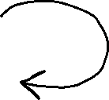
Transport Layer
Reliable Data Transfer 1.0
Sender
RDT 1.0
Assumptions:
Unidirectional long data flows
Perfectly reliable channel
No bit errors
No packet loss
No packet reordering
rdt_send(data)
Wait for call from above
packet = make_pkt(data)
udt_send(packet)

Slide 18
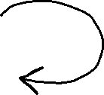
Transport Layer
Reliable Data Transfer 1.0
Sender
RDT 1.0
Assumptions:
Unidirectional long data flows
Perfectly reliable channel
No bit errors
No packet loss
No packet reordering
rdt_send(data)
Wait for call from above
packet = make_pkt(data)
udt_send(packet)
Receiver
Wait for call from Network

Slide 19
Transport Layer
Reliable Data Transfer 1.0
Sender
RDT 1.0
Assumptions:
Unidirectional long data flows
Perfectly reliable channel
No bit errors
No packet loss
No packet reordering
rdt_send(data)
Wait for call from above
packet = make_pkt(data)
udt_send(packet)
Receiver
Wait for call from Network
rdt_rcv(data)

Slide 20

Transport Layer
Reliable Data Transfer 1.0
Sender
RDT 1.0
Assumptions:
Unidirectional long data flows
Perfectly reliable channel
No bit errors
No packet loss
No packet reordering
rdt_send(data)
Wait for call from above
packet = make_pkt(data)
udt_send(packet)
Receiver
Wait for call from Network
rdt_rcv(data)
data = extract(packet)
deliver_data(data)

Slide 21

Transport Layer
Reliable Data Transfer 2.0
RDT 2.0
Potential for bit errors
How can we detect errors?
1110
???
0010
Reliable Channel
Unreliable Channel
Reliable Channel

Slide 22
Transport Layer
Reliable Data Transfer 2.0
RDT 2.0
Potential for bit errors
How can we detect errors?
-Checksum
1110
???
0010
Reliable Channel
Unreliable Channel
Reliable Channel

Slide 23
Transport Layer
Reliable Data Transfer 2.0
RDT 2.0
Potential for bit errors
How can we detect errors?
-Checksum
What is a good way to handle and prevent errors?
1110
???
0010
Reliable Channel
Unreliable Channel
Reliable Channel

Slide 24
Transport Layer
Reliable Data Transfer 2.0
RDT 2.0
Potential for bit errors
How can we detect errors?
-Checksum
What is a good way to handle and prevent errors?
- Acknowledged packet, Ask for retransmit if needed
1110
???
0010
Reliable Channel
Unreliable Channel
Reliable Channel

Slide 25

Transport Layer
Reliable Data Transfer 2.0
RDT 2.0
How can we detect errors?
-Checksum
What is a good way to handle and prevent errors?
- Acknowledged packet, Ask for retransmit if needed
Potential for bit errors
Stop-and-wait: sender sends one packet, then waits for receiver response
Sender
rdt_send(data)
sndpkt = make_pkt(data, checksum)
udt_send(sndpkt)
Wait for call from appl

Slide 26

Transport Layer
Reliable Data Transfer 2.0
RDT 2.0
How can we detect errors?
-Checksum
What is a good way to handle and prevent errors?
- Acknowledged packet, Ask for retransmit if needed
Potential for bit errors
Stop-and-wait: sender sends one packet, then waits for receiver response
Sender
rdt_send(data)
sndpkt = make_pkt(data, checksum)
udt_send(sndpkt)
Wait for call from appl
Wait for ACK or NAK

Slide 27
Transport Layer
Reliable Data Transfer 2.0
Sender
rdt_send(data)
sndpkt = make_pkt(data, checksum)
udt_send(sndpkt)
Wait for call from appl
Wait for ACK or NAK
Receiver

Slide 28
Transport Layer
Reliable Data Transfer 2.0
Sender
rdt_send(data)
sndpkt = make_pkt(data, checksum)
udt_send(sndpkt)
Wait for call from appl
Wait for ACK or NAK
Wait for call from below
Receiver

Slide 29

Transport Layer
Reliable Data Transfer 2.0
Sender
rdt_send(data)
sndpkt = make_pkt(data, checksum)
udt_send(sndpkt)
Wait for call from appl
Wait for ACK or NAK
rdt_rcv(rcvpkt) && corrupt(rcvpkt)
udt_send(NAK)
Wait for call from below
Receiver

Slide 30


Transport Layer
Reliable Data Transfer 2.0
Sender
rdt_send(data)
sndpkt = make_pkt(data, checksum)
udt_send(sndpkt)
Wait for call from appl
Wait for ACK or NAK
rdt_rcv(rcvpkt) && corrupt(rcvpkt)
udt_send(NAK)
Wait for call from below
Receiver
rdt_rcv(rcvpkt) && !corrupt(rcvpkt)
data = extract(packet)
deliver_data(data)
udt_send(ACK)

Slide 31

Transport Layer
Reliable Data Transfer 2.0
Sender
rdt_send(data)
sndpkt = make_pkt(data, checksum)
udt_send(sndpkt)
Wait for call from appl
Wait for ACK or NAK
Receiver
rdt_rcv(rcvpkt) && corrupt(rcvpkt)
udt_send(NAK)
Wait for call from below
rdt_rcv(rcvpkt) && !corrupt(rcvpkt)
data = extract(packet)
deliver_data(data)
udt_send(ACK)

Slide 32
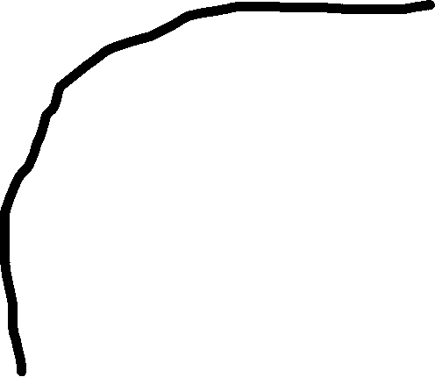

Transport Layer
Reliable Data Transfer 2.0
Sender
rdt_send(data)
sndpkt = make_pkt(data, checksum)
udt_send(sndpkt)
rdt_rcv(rcvpkt) &&
isNAK(rcvpkt)
udt_send(sndpkt)
Wait for call from appl
Wait for ACK or NAK
Receiver
rdt_rcv(rcvpkt) && corrupt(rcvpkt)
udt_send(NAK)
Wait for call from below
rdt_rcv(rcvpkt) && !corrupt(rcvpkt)
data = extract(packet)
deliver_data(data)
udt_send(ACK)

Slide 33

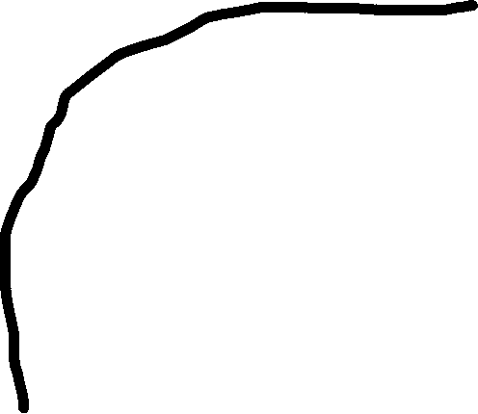

Transport Layer
Reliable Data Transfer 2.0
Sender
rdt_send(data)
sndpkt = make_pkt(data, checksum)
udt_send(sndpkt)
rdt_rcv(rcvpkt) &&
isNAK(rcvpkt)
udt_send(sndpkt)
Wait for call from appl
Wait for ACK or NAK
Receiver
rdt_rcv(rcvpkt) && isACK(rcvpkt)
rdt_rcv(rcvpkt) && corrupt(rcvpkt)
Λ
udt_send(NAK)
Wait for call from below
rdt_rcv(rcvpkt) && !corrupt(rcvpkt)
Λ = do no action, follow arrow to next state
data = extract(packet)
deliver_data(data)
udt_send(ACK)

Slide 34

Transport Layer
Reliable Data Transfer 2.0
What happens if ACK/NAK Corrupted?
Duplicate delivery, or no retransmission
Solution?
Retransmit if CORRUPT packet received
How to deal we duplicate Packets?
→ ???
Sender
rdt_send(data)
sndpkt = make_pkt(data, checksum)
udt_send(sndpkt)
rdt_rcv(rcvpkt) &&
isNAK(rcvpkt)
udt_send(sndpkt)
Wait for call from appl
Wait for ACK or NAK
Receiver
rdt_rcv(rcvpkt) && isACK(rcvpkt)
rdt_rcv(rcvpkt) && corrupt(rcvpkt)
Λ
udt_send(NAK)
Wait for call from below
rdt_rcv(rcvpkt) && !corrupt(rcvpkt)
Λ = do no action, follow arrow to next state
data = extract(packet)
deliver_data(data)
udt_send(ACK)

Slide 35
Transport Layer
Reliable Data Transfer 2.0
What happens if ACK/NAK Corrupted?
Duplicate delivery, or no retransmission
Solution?
Retransmit if CORRUPT packet received
How to deal we duplicate Packets?
→ Sequence Numbers
Sender
rdt_send(data)
sndpkt = make_pkt(data, checksum)
udt_send(sndpkt)
rdt_rcv(rcvpkt) &&
isNAK(rcvpkt)
udt_send(sndpkt)
Wait for call from appl
Wait for ACK or NAK
Receiver
rdt_rcv(rcvpkt) && isACK(rcvpkt)
rdt_rcv(rcvpkt) && corrupt(rcvpkt)
Λ
udt_send(NAK)
Wait for call from below
rdt_rcv(rcvpkt) && !corrupt(rcvpkt)
Λ = do no action, follow arrow to next state
data = extract(packet)
deliver_data(data)
udt_send(ACK)

Slide 36
Transport Layer
Reliable Data Transfer 2.1
Potential for bit errors and garbled ACKs
Sender
(We only need to use 0 or 1 for the sequence number)
Wait for call 0 from above

Slide 37

Transport Layer
Reliable Data Transfer 2.1
Potential for bit errors and garbled ACKs
Sender
rdt_send(data)
sndpkt = make_pkt(0, data, checksum)
udt_send(sndpkt)
(We only need to use 0 or 1 for the sequence number)
Wait for call 0 from above
Wait for ACK or NAK 0

Slide 38


Transport Layer
Reliable Data Transfer 2.1
Potential for bit errors and garbled ACKs
Sender
rdt_send(data)
sndpkt = make_pkt(0, data, checksum)
udt_send(sndpkt)
(We only need to use 0 or 1 for the sequence number)
rdt_rcv(rcvpacket) &&
( corrupt(rcvpkt) || isNAK(rcvpkt)
udt_send(sndpkt)
Wait for call 0 from above
Wait for ACK or NAK 0

Slide 39


Transport Layer
Reliable Data Transfer 2.1
Potential for bit errors and garbled ACKs
Sender
rdt_send(data)
sndpkt = make_pkt(0, data, checksum)
udt_send(sndpkt)
(We only need to use 0 or 1 for the sequence number)
rdt_rcv(rcvpacket) &&
( corrupt(rcvpkt) || isNAK(rcvpkt)
udt_send(sndpkt)
Wait for call 0 from above
Wait for ACK or NAK 0
rdt_rcv(rcvpacket) &&
notcorrupt(rcvpkt) &&
isAck(rcvpkt)
Λ
Wait for call 1 from above

Slide 40


Transport Layer
Reliable Data Transfer 2.1
Potential for bit errors and garbled ACKs
Sender
rdt_send(data)
sndpkt = make_pkt(0, data, checksum)
udt_send(sndpkt)
(We only need to use 0 or 1 for the sequence number)
rdt_rcv(rcvpacket) &&
( corrupt(rcvpkt) || isNAK(rcvpkt)
udt_send(sndpkt)
Wait for call 0 from above
Wait for ACK or NAK 0
rdt_rcv(rcvpacket) &&
notcorrupt(rcvpkt) &&
isAck(rcvpkt)
Λ
Wait for ACK or NAK 1
Wait for call 1 from above
rdt_send(data)
sndpkt = make_pkt(1, data, checksum)
udt_send(sndpkt)

Slide 41


Transport Layer
rdt_rcv(rcvpacket) &&
( corrupt(rcvpkt) || isNAK(rcvpkt)
udt_send(sndpkt)
Sender
rdt_send(data)
sndpkt = make_pkt(0, data, checksum)
udt_send(sndpkt)
Wait for call 0 from above
Wait for ACK or NAK 0
rdt_rcv(rcvpacket) &&
notcorrupt(rcvpkt) &&
isAck(rcvpkt)
Λ
rdt_rcv(rcvpacket) &&
( corrupt(rcvpkt) || isNAK(rcvpkt)
udt_send(sndpkt)
Wait for ACK or NAK 1
Wait for call 1 from above
rdt_send(data)
sndpkt = make_pkt(1, data, checksum)
udt_send(sndpkt)

Slide 42


Transport Layer
rdt_rcv(rcvpacket) &&
( corrupt(rcvpkt) || isNAK(rcvpkt)
udt_send(sndpkt)
Sender
rdt_send(data)
sndpkt = make_pkt(0, data, checksum)
udt_send(sndpkt)
Wait for call 0 from above
Wait for ACK or NAK 0
rdt_rcv(rcvpacket) &&
notcorrupt(rcvpkt) &&
isAck(rcvpkt)
Λ
rdt_rcv(rcvpacket) &&
notcorrupt(rcvpkt) &&
isAck(rcvpkt)
Λ
rdt_rcv(rcvpacket) &&
( corrupt(rcvpkt) || isNAK(rcvpkt)
udt_send(sndpkt)
Wait for ACK or NAK 1
Wait for call 1 from above
rdt_send(data)
sndpkt = make_pkt(1, data, checksum)
udt_send(sndpkt)

Slide 43
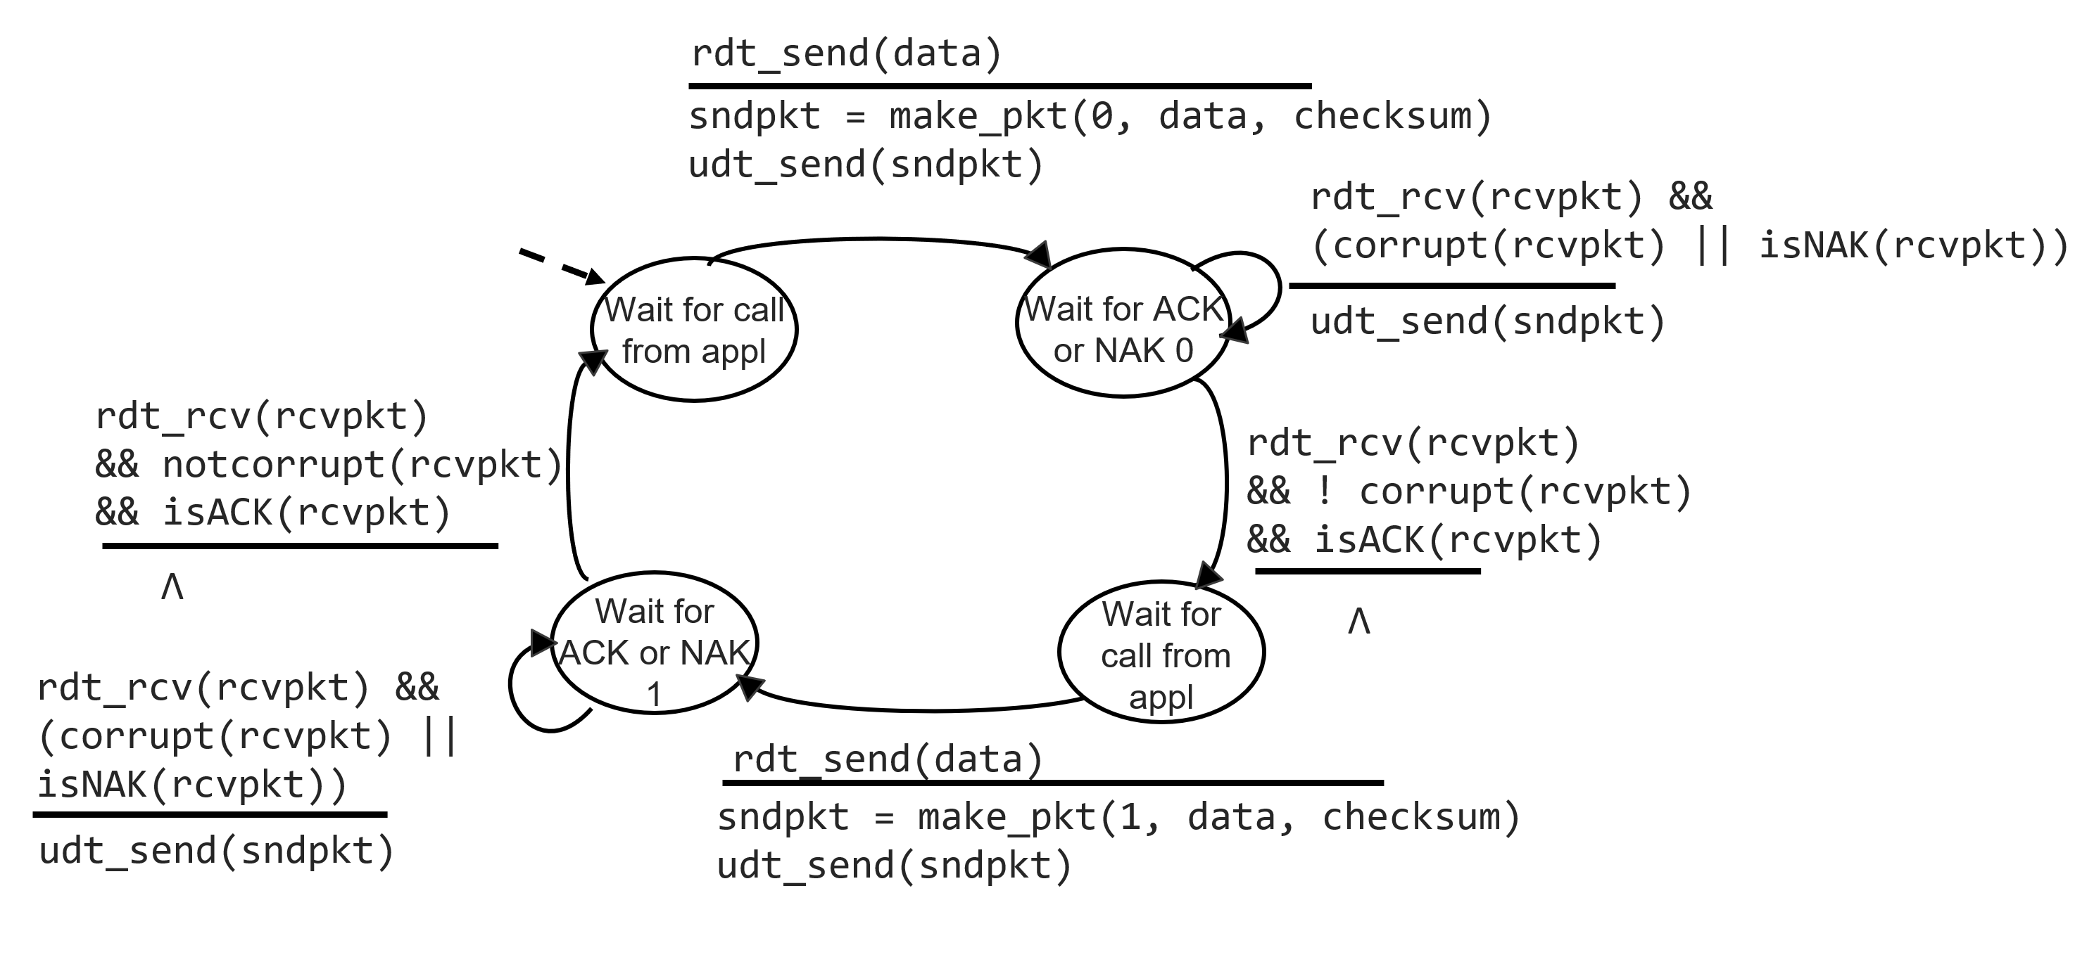
Transport Layer
Reliable Data Transfer 2.1
RDT 2.1
Stop-and-wait: sender sends one packet, then waits for receiver response
Potential for bit errors and garbled ACKs
(We only need 0 or 1 for the sequence #)

Slide 44
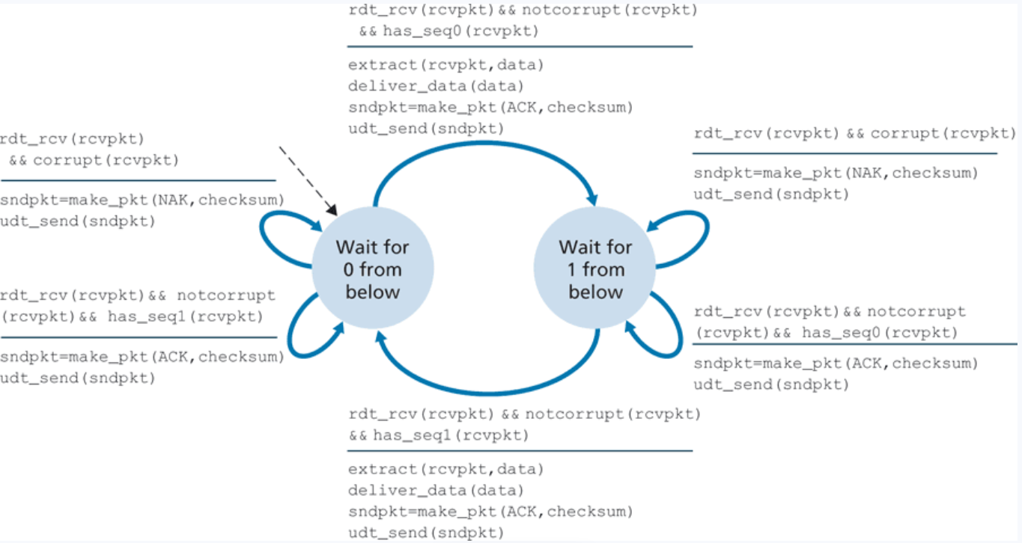
Transport Layer
Reliable Data Transfer 2.1
Receiver

Slide 45
Transport Layer
Reliable Data Transfer 2.1
Receiver

Slide 46
Transport Layer
Reliable Data Transfer 2.1
Receiver

Slide 47
Transport Layer
Reliable Data Transfer 2.1
Receiver

Slide 48
Transport Layer
Reliable Data Transfer 2.1
Receiver

Slide 49
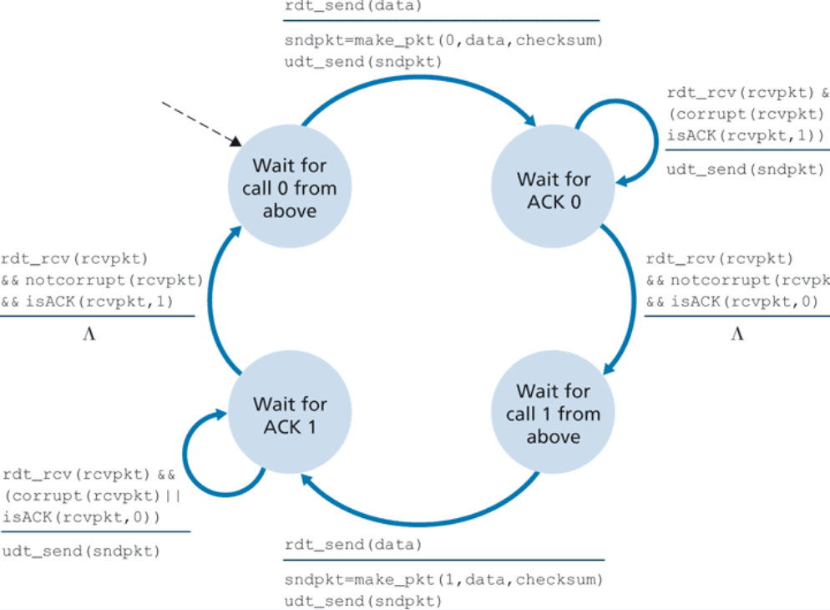




Transport Layer
Reliable Data Transfer 2.2
Sender
Instead of NAKs, we provide the sequence number of the packet for our ACK (ACK1, ACK0)
Duplicate ACK at sender results in same action as NAK: retransmit current pkt

Slide 50
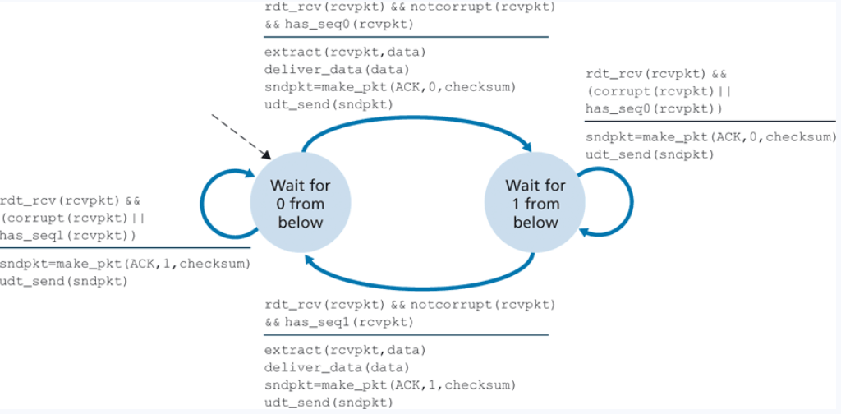




Transport Layer
Reliable Data Transfer 2.2
Receiver

Slide 51

Transport Layer
A quick meatball break…

Slide 52
Transport Layer
Reliable Data Transfer 3.0
Potential for:
bit errors
garbled ACKs
Lost/dropped packets
We will still need checksums, Seq #’s, ACKS, but we need more
What if an ACK gets dropped? Sender is stuck waiting forever

Slide 53
Transport Layer
Reliable Data Transfer 3.0
Potential for:
bit errors
garbled ACKs
Lost/dropped packets
We will still need checksums, Seq #’s, ACKS, but we need more
What if an ACK gets dropped? Sender is stuck waiting forever
Solution?

Slide 54
Transport Layer
Reliable Data Transfer 3.0
Potential for:
bit errors
garbled ACKs
Lost/dropped packets
We will still need checksums, Seq #’s, ACKS, but we need more
What if an ACK gets dropped? Sender is stuck waiting forever
A timer
Retransmit if ACK received in X amount of time
What if the ACK is just taking a really long time to arrive?

Slide 55
Transport Layer
Reliable Data Transfer 3.0
Potential for:
bit errors
garbled ACKs
Lost/dropped packets
We will still need checksums, Seq #’s, ACKS, but we need more
What if an ACK gets dropped? Sender is stuck waiting forever
A timer
Retransmit if ACK received in X amount of time
What if the ACK is just taking a really long time to arrive? This will be duplicate data, but we have a Seq # to handle that

Slide 56
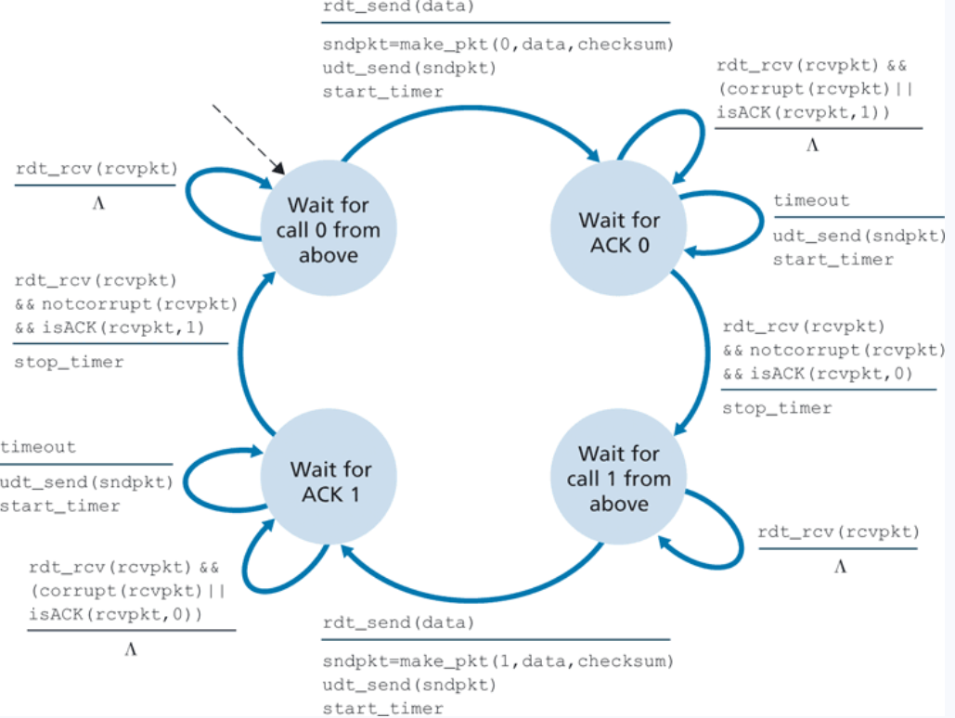

Transport Layer
Reliable Data Transfer 3.0
(Packets can get dropped or lost)
Sender

Slide 57

Transport Layer
Reliable Data Transfer 3.0
(Packets can get dropped or lost)
Sender

Slide 58


Transport Layer
Reliable Data Transfer 3.0
(Packets can get dropped or lost)
Sender

Slide 59


Transport Layer
Reliable Data Transfer 3.0
(Packets can get dropped or lost)
Sender

Slide 60


Transport Layer
Reliable Data Transfer 3.0
(Packets can get dropped or lost)
Sender

Slide 61


Transport Layer
Reliable Data Transfer 3.0
(Packets can get dropped or lost)
Sender

Slide 62

Transport Layer
Reliable Data Transfer 3.0
(Packets can get dropped or lost)
Sender
Receiver will be same as 2.2

Slide 63
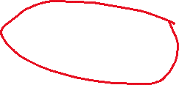

Transport Layer
Reliable Data Transfer 3.0
(Packets can get dropped or lost)
Sender
If we are waiting to send packet, but we receive a packet for some reason, this packet must be a duplicate packet, so do nothing

Slide 64
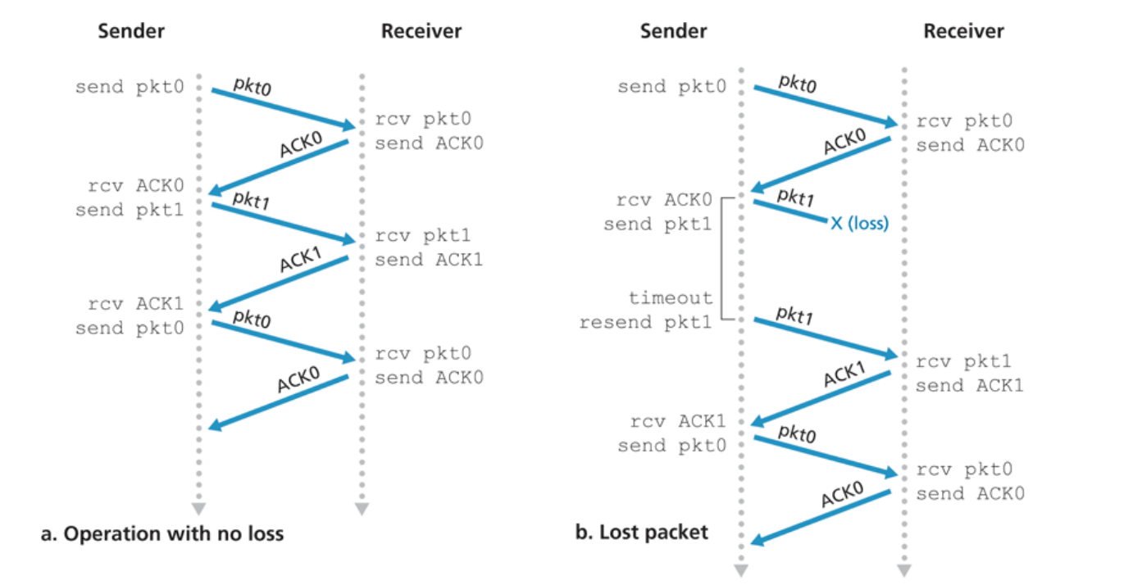
Transport Layer
Reliable Data Transfer 3.0
(Packets can get dropped or lost)

Slide 65
Transport Layer
Reliable Data Transfer 3.0
(Packets can get dropped or lost)

Slide 66
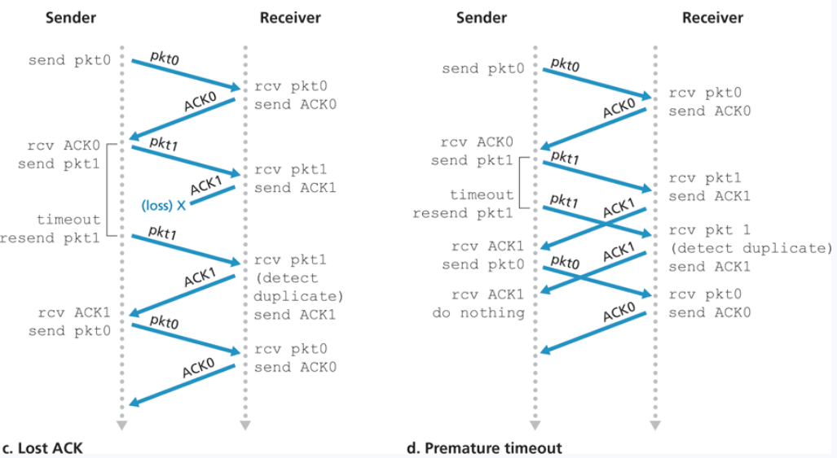
Transport Layer
Reliable Data Transfer 3.0
(Packets can get dropped or lost)

Slide 67
Transport Layer
Reliable Data Transfer 3.0
(Packets can get dropped or lost)

