Slide 1

CSCI 466: Networks
TCP Flow Control, Timeout, Congestion Control
Reese Pearsall
Fall 2024
https://www.cs.montana.edu/pearsall/classes/fall2024/466/main.html
*All images are stolen from the internet

Slide 2
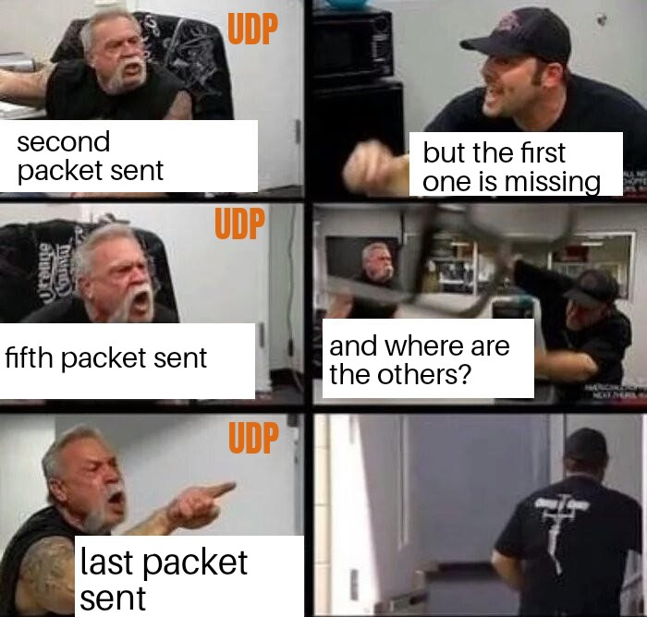
Announcements
Wireshark Lab due on Wednesday
Have a good weekend

Slide 3
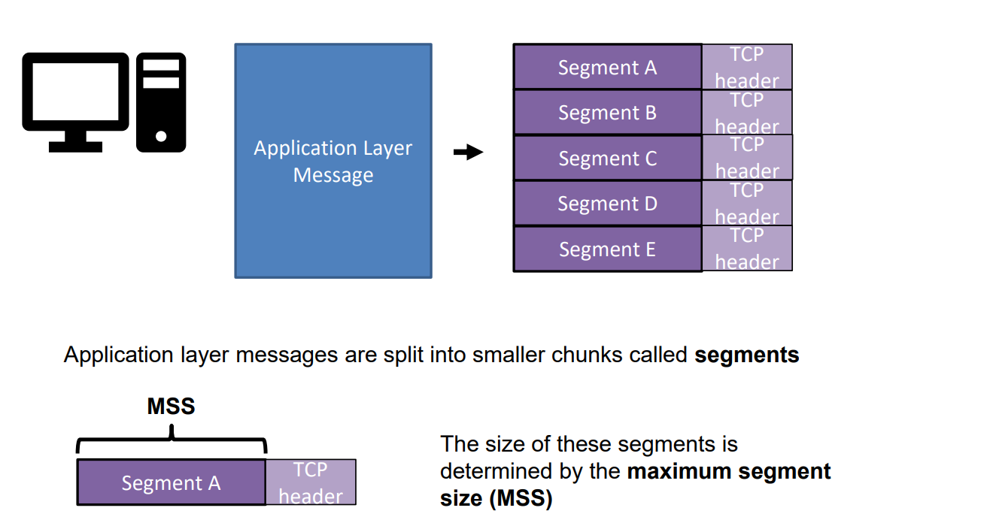
TCP Flow Control

Slide 4
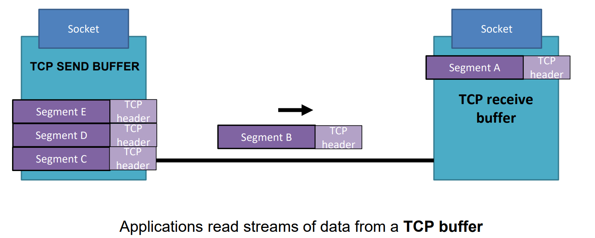
TCP Flow Control

Slide 5
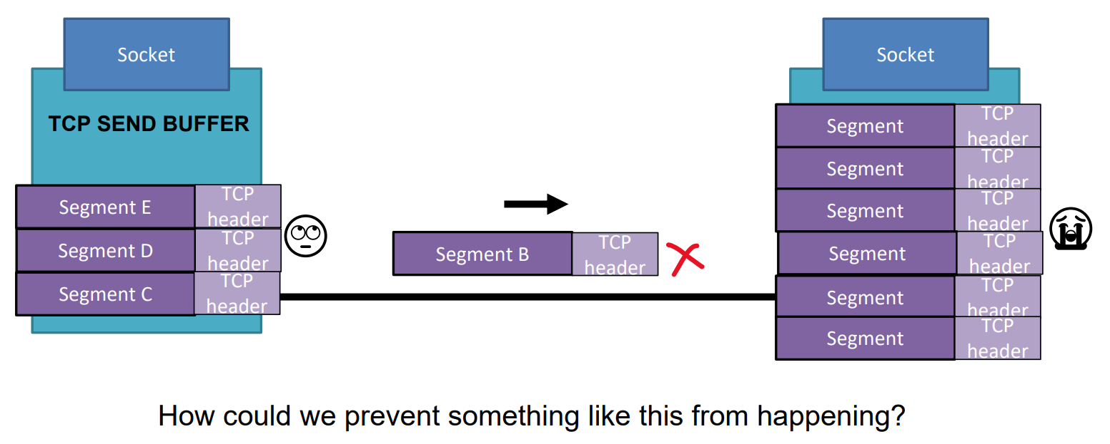
TCP Flow Control

Slide 6
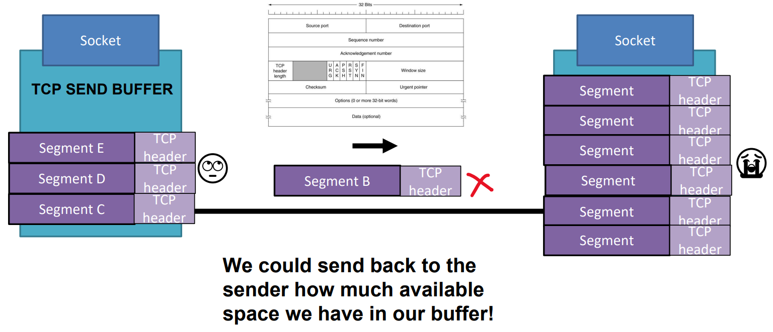
TCP Flow Control

Slide 7
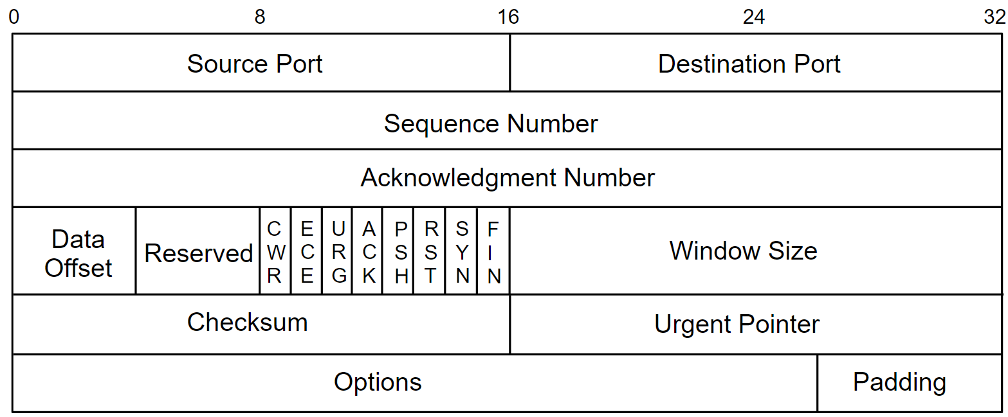

TCP Flow Control

Slide 8
TCP Flow Control
TCP receiver “advertises” free buffer space in rwnd field in TCP header
RcvBuffer size set via socket options (typical default is 4096 bytes)
many operating systems auto-adjust RcvBuffer
sender limits amount of unACKed (“in-flight”) data to received rwnd
guarantees receive buffer will not overflow
to application process
RcvBuffer
buffered data
rwnd
free buffer space
TCP segment payloads
TCP receiver-side buffering

Slide 9
TCP Flow Control
Wireshark ?

Slide 10
TCP Flow Control
https://media.pearsoncmg.com/aw/ecs_kurose_compnetwork_7/cw/content/interactiveanimations/flow-control/index.html

Slide 11
TCP Timer
What is a good way to determine when to timeout? (aka the length of timer)
1. Too short: premature timeout, unnecessary retransmissions
2. Too long: slow reaction to segment loss
The TCP timeout value should around the same time it take to ….

Slide 12
TCP Timer
What is a good way to determine when to timeout? (aka the length of timer)
1. Too short: premature timeout, unnecessary retransmissions
2. Too long: slow reaction to segment loss
The TCP timeout value should around the same time it take to receive an acknowledgement on a sent packet (on average)
Let’s consider setting it to be a dynamic value!

Slide 13
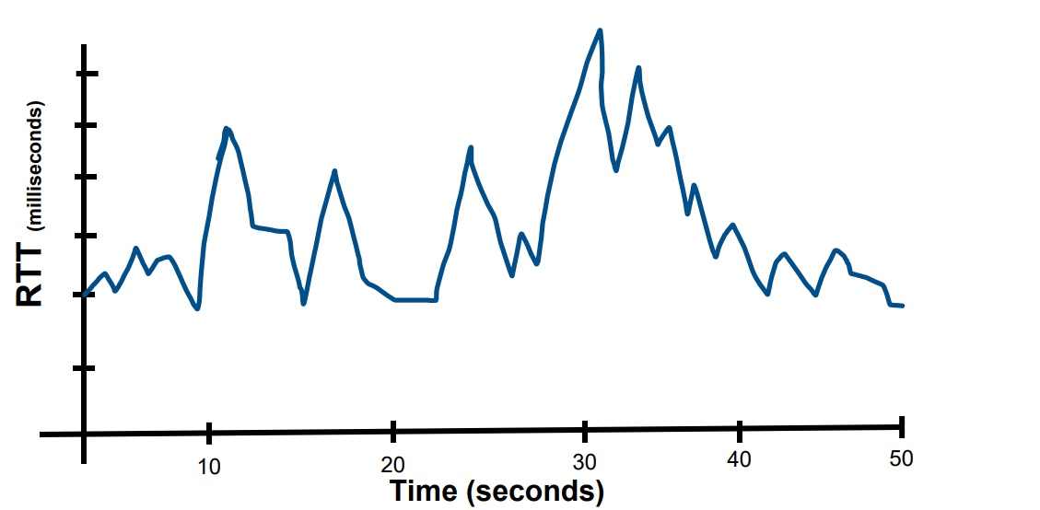
TCP Timeout

Slide 14
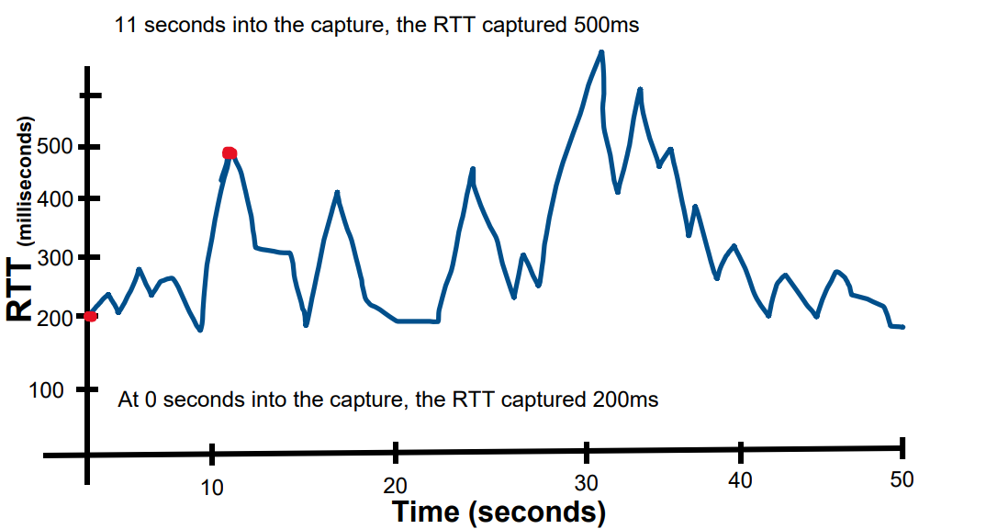
TCP Timeout

Slide 15
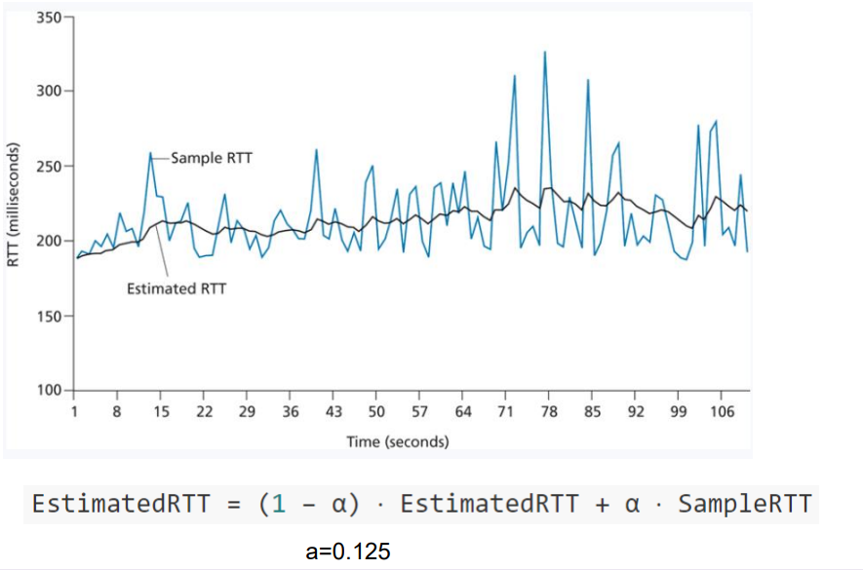
TCP Timeout

Slide 16
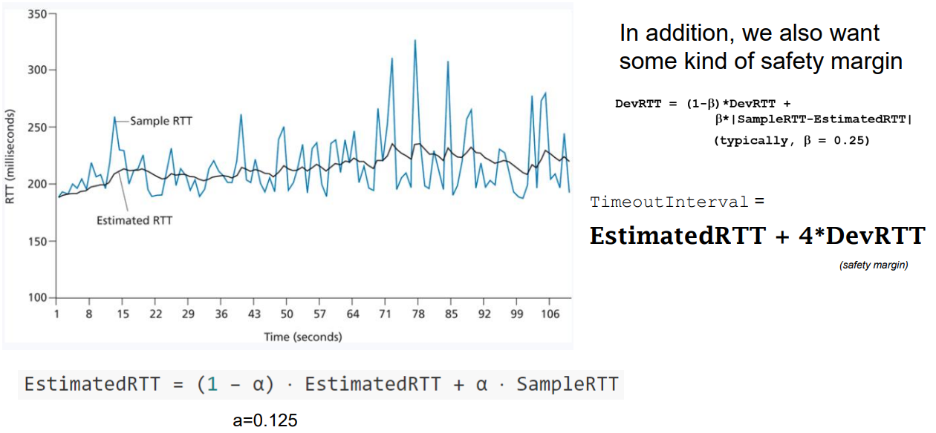
TCP Timeout

Slide 17
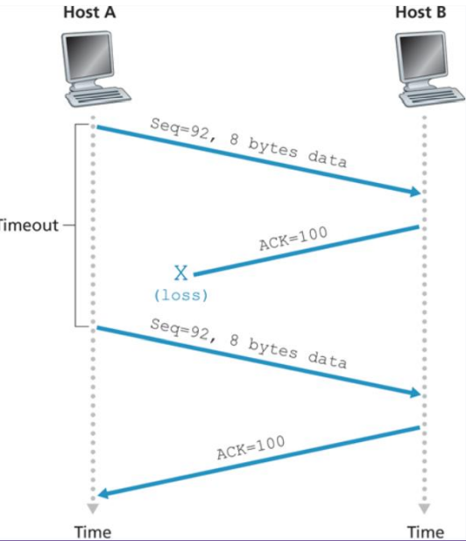
TCP Timeout
TCP retransmits on ACK loss

Slide 18
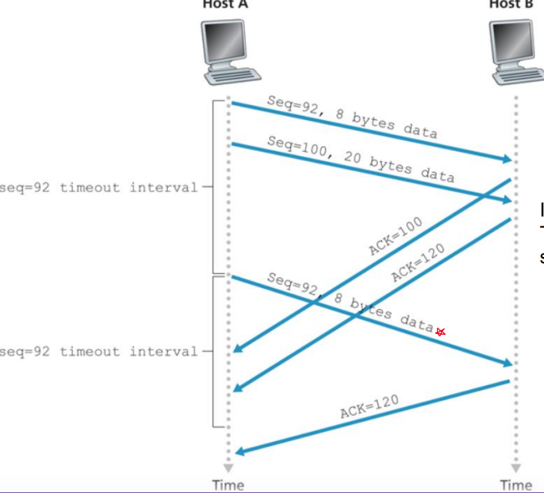
TCP Timeout
If multiple ACKS are lost/late, TCP only resends the first segment in the sequence

Slide 19
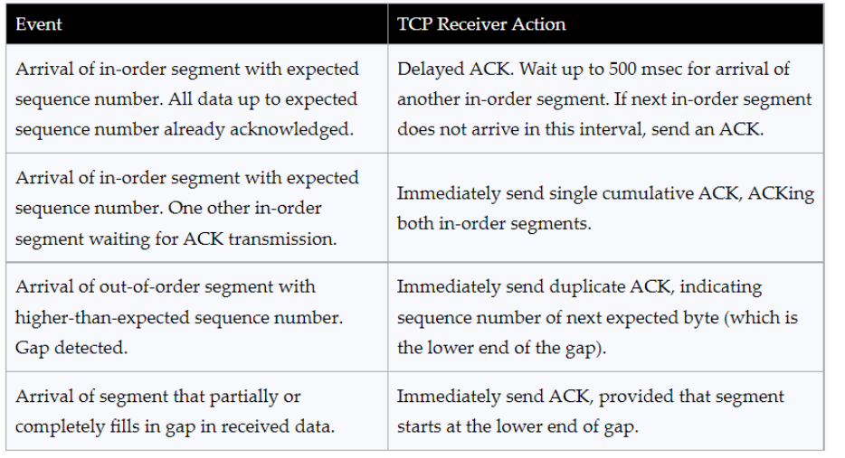
TCP Timeout
Actions for specific TCP events are described well in TCP documentation

Slide 20


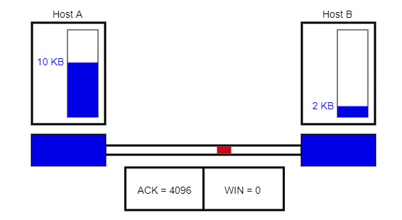


TCP Congestion Control
We also want to make sure we don’t congest the work!
???
Issues:
If the network is congested, we want to slow down our sending rate
If the network is not congested, we should try to send more stuff
TCP sends back amount of available buffer space in the receiver
This helps make sure we don’t overwhelm the receiver

Slide 21
TCP Congestion Control
We also want to make sure we don’t congest the work!
???
Issues:
If the network is congested, we want to slow down our sending rate
If the network is not congested, we should try to send more stuff
TCP sends back amount of available buffer space in the receiver
This helps make sure we don’t overwhelm the receiver
From the sender perspective, how could we measure how congested the network is?

Slide 22
TCP Congestion Control
We also want to make sure we don’t congest the work!
???
Issues:
If the network is congested, we want to slow down our sending rate
If the network is not congested, we should try to send more stuff
TCP sends back amount of available buffer space in the receiver
This helps make sure we don’t overwhelm the receiver
Some ways we could measure how congested the network is
-See how many dropped packets we are getting
-Amount of duplicate ACKs received
-Amount of UnAcked packets

Slide 23
TCP Congestion Control
We also want to make sure we don’t congest the work!
TCP sender also has a congestion window (cwnd), which controls the amount of unAck’d that can be sent out
???
TCP is self-clocking
(It uses acknowledgements to trigger, or clock, its increase in congestion window size)
The amount of unacknowledged data at a sender may not exceed the minimum of the congestion window and receiving window

Slide 24
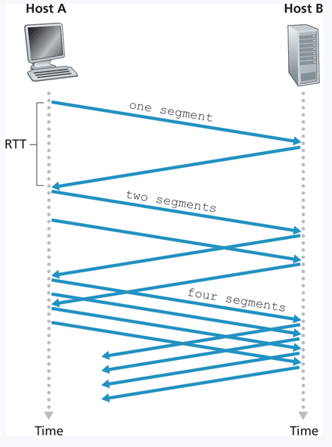
TCP Congestion Control Algorithm
TCP Algorithm to prevent network congestion
Slow Start
Congestion Avoidance
Fast recovery
Start sending slow, but exponentially grows up to a threshold

Slide 25
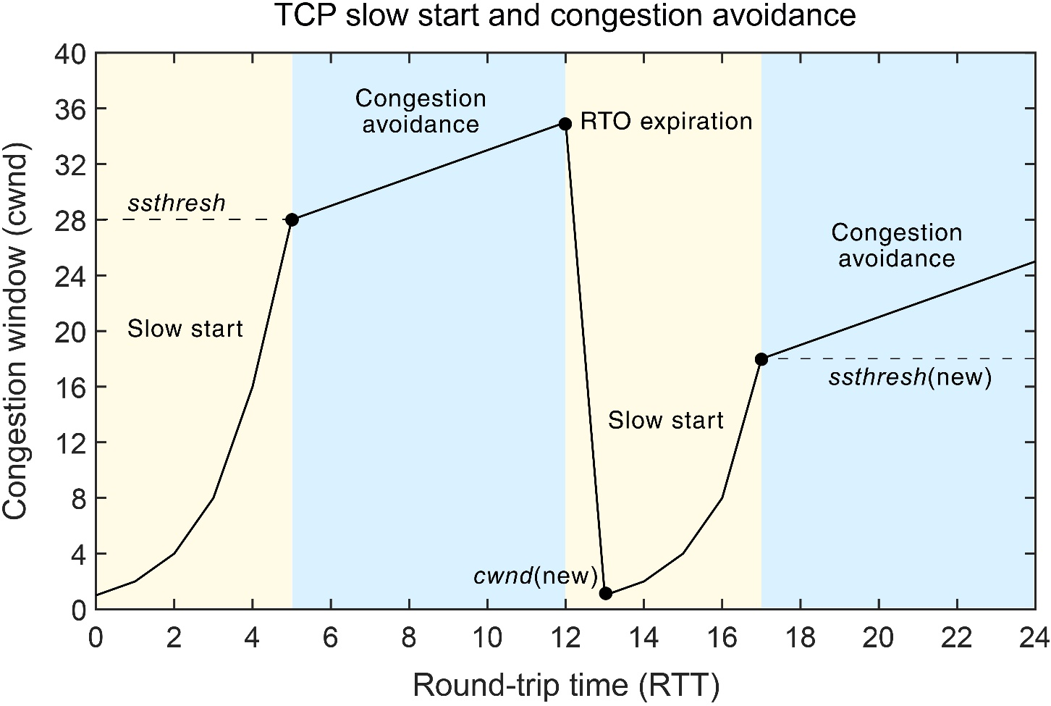
TCP Congestion Control Algorithm
TCP Algorithm to prevent network congestion
Slow Start
Congestion Avoidance
Fast recovery
Linearly increase congestion window for each ACK received
When a loss event occurs, significantly decrease congestion window and slow down transmission rate, and enter fast recovery

Slide 26
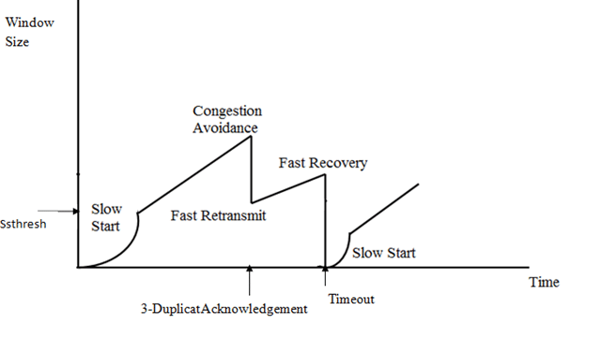
TCP Congestion Control Algorithm
TCP Algorithm to prevent network congestion
Slow Start
Congestion Avoidance
Fast recovery
Upon knowledge of packet loss, throttle the TCP connection and start off slow again

Slide 27
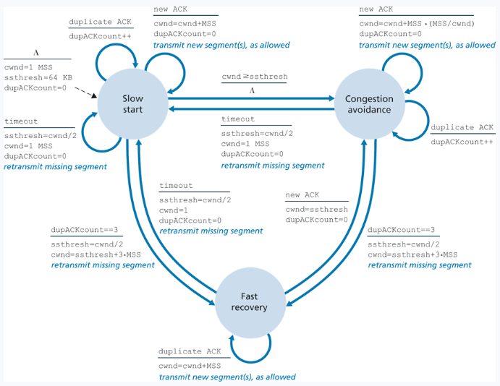

Slide 28
TCP Congestion Control Algorithm
Animation time!
https://media.pearsoncmg.com/aw/ecs_kurose_compnetwork_7/cw/content/interactiveanimations/tcp-congestion/index.html
TCP Algorithm to prevent network congestion
Slow Start
Congestion Avoidance
Fast recovery
Upon knowledge of packet loss, throttle the TCP connection and start off slow again

Slide 29
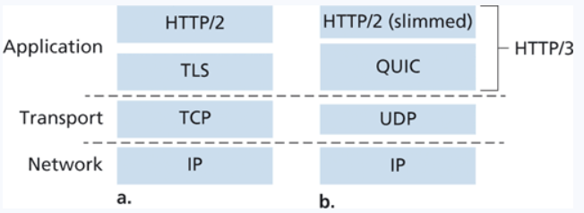
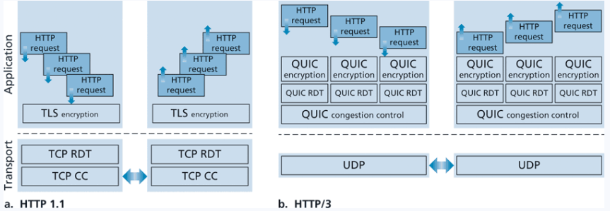
Current transport layer implementation
Transport layer protocols and congestion control is still a heavily researched area!

Slide 30
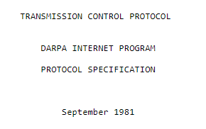
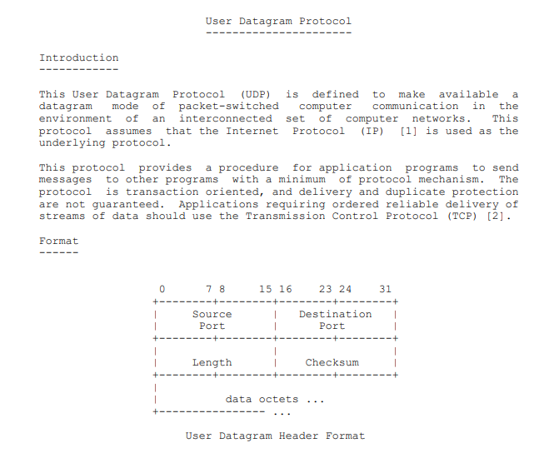
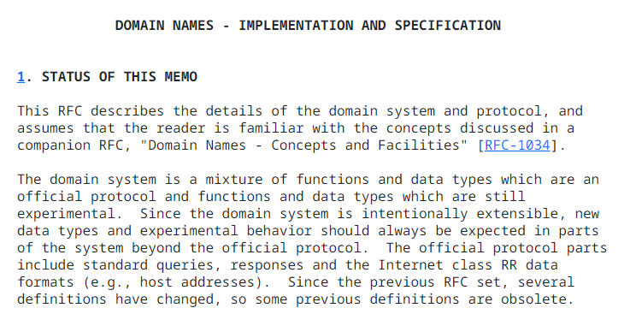
Transport Layer
RFCs
RFCs (Request for Comments) documents and describes the details and standards of how internet protocols (such as HTTP, TCP, UDP) should work
UDP- RFC 768
DNS- RFC 1035
TCP- RFC 793

Slide 31
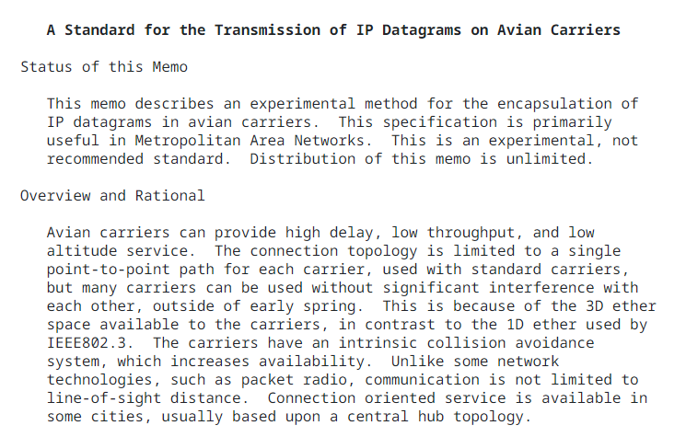

Transport Layer
RFCs

Slide 32
FIN

